Slide 1
Cycle Hire Regression Analysis
Richard Quelch, Chrissie Matthews, Dawn Newman

Slide 2
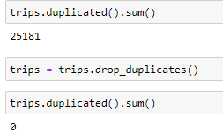
Data prep and cleaning
After importing the trips, stations and weather data we removed duplicates such as duplicate trips, removed unnecessary and corelated columns
We formatted some of the dataframes from tasks D1 to D5
This brought extra data into the model:
- Number of owners per zipcode, the number
- Income data per zipcode
- Number of schools near to each station
- Number of parks near to each station
- Number of venues near to each station

Slide 3
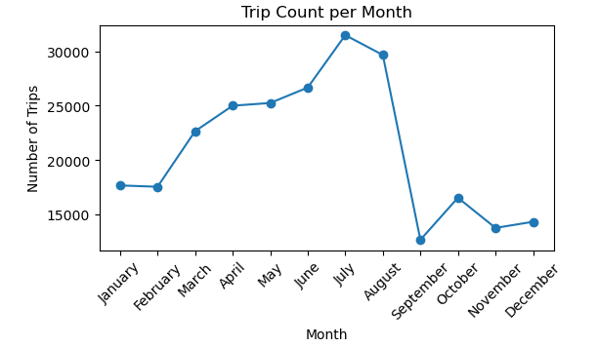
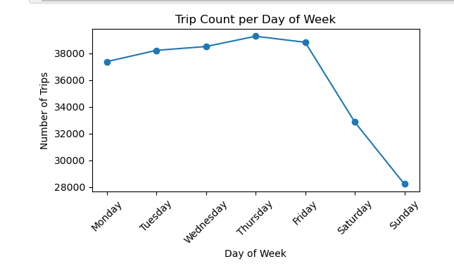
Trip count per month is higher in summer
We also plot for month_year which showed lower numbers in 2016, so we chose to create a feature for month_year for our model
Weekdays have much lower demand for bikes suggesting that a lot of cycle hire demand comes from commuters

Slide 4
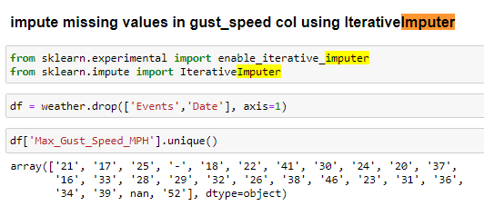

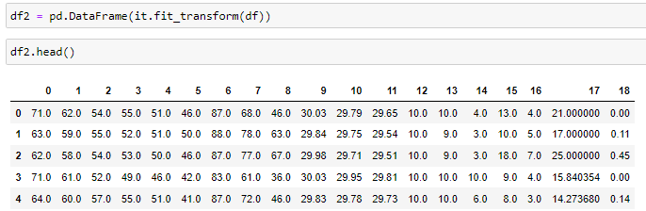
Imputing missing values
Gust speed column was missing in 185 out of 689 rows in the weather dataframe
We used IterativeImputer - this imputes missing values based off the relationships/collinearity between each column
(For weather events column we imputed ‘Clear’ for any days that had no event)

Slide 5
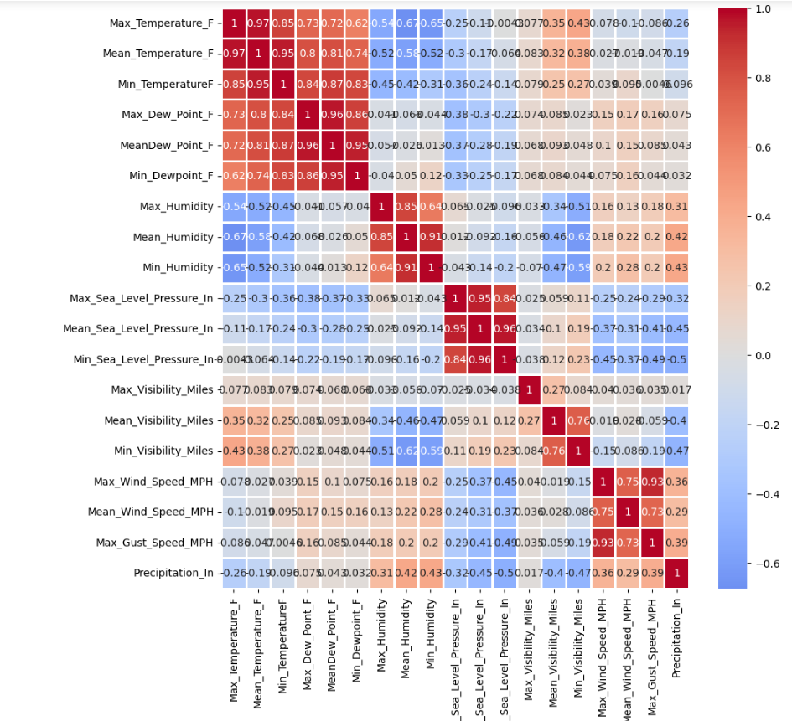
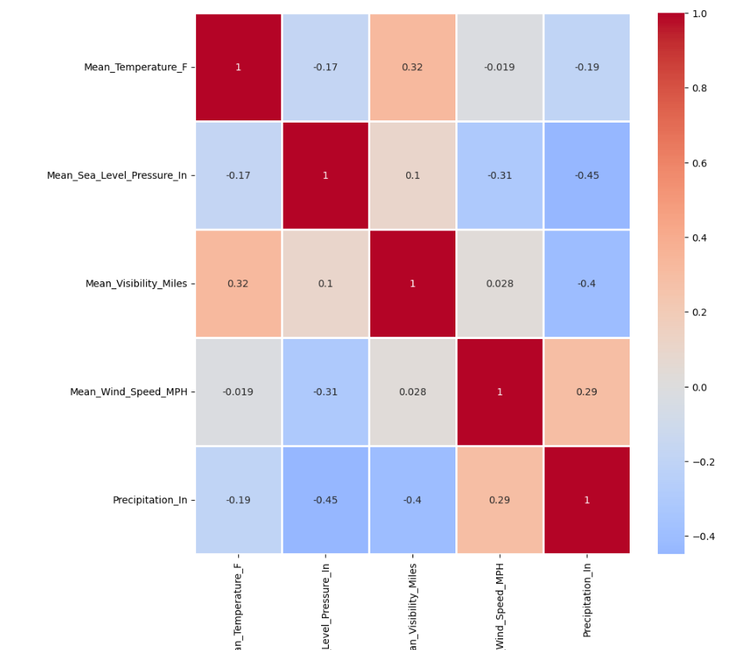
Weather correlation
Weather data had a lot of multi collinearity so we removed a lot of the columns

Slide 6
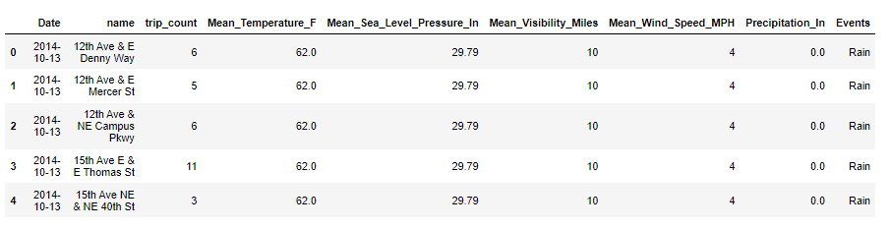
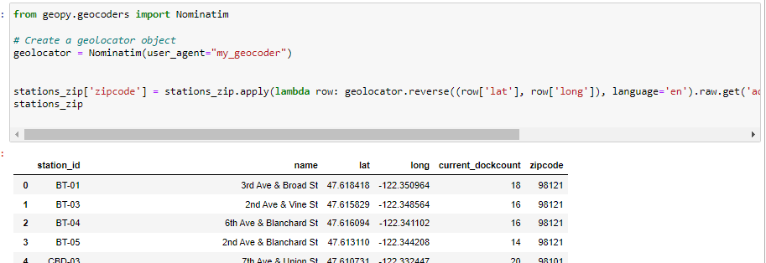
Merging dataframes
We used grouped-by to count the number of trips per station per day
And then merged with the weather dataframe
Geopy was used to get the zipcode for each station
We used this to merge dataframes for schools, parks and venues near to each station

Slide 7
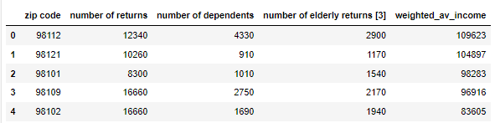
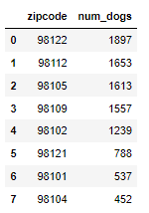
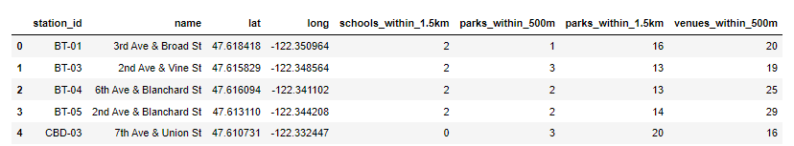
Merging dataframes
We merged income data for each zipcode
We merged dog owners per zip code data
We merged data on the number of schools, parks and venues within the locality of each station

Slide 8
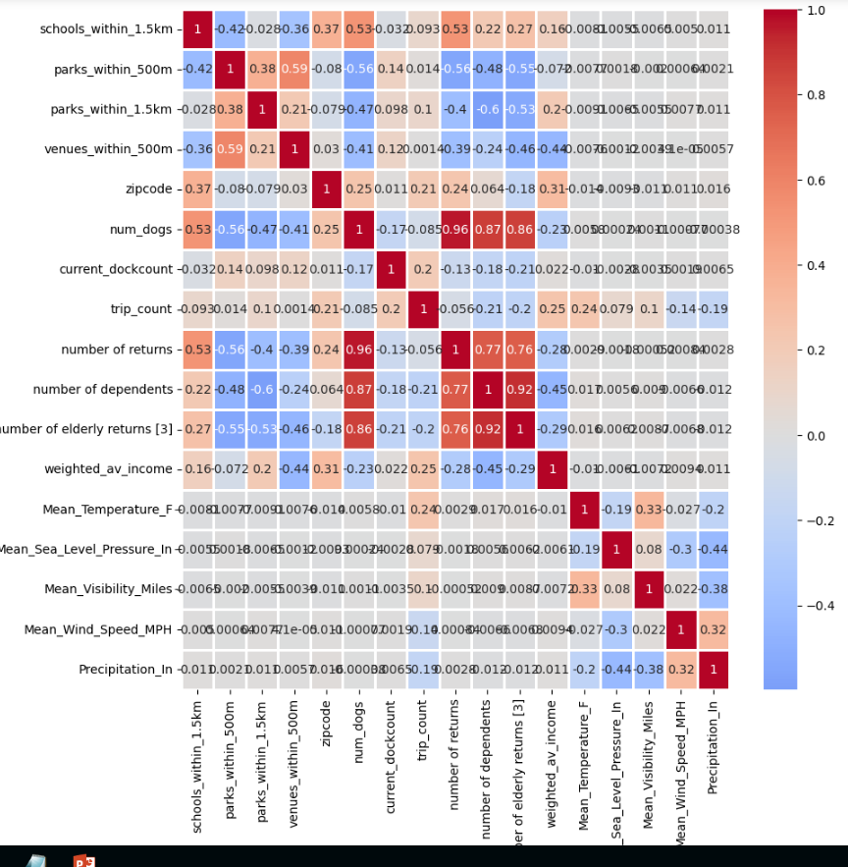
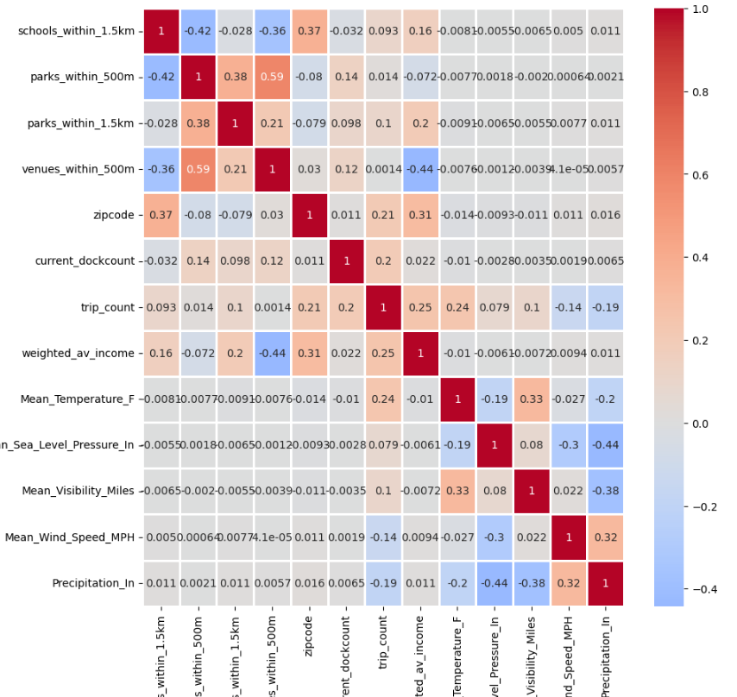
After merging the dataframes, we removed highly correlated columns
We encoded the categorical variables using One-Hot encoding. This left us with 111 columns of numerical data.

Slide 9
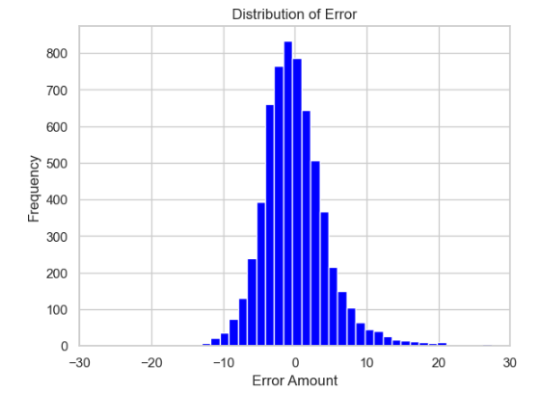

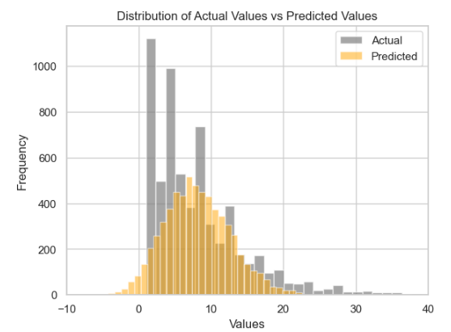
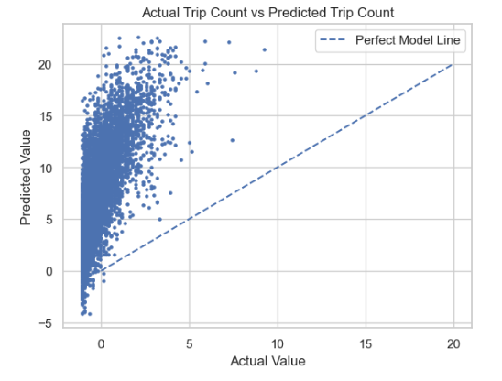
Linear Regression Model
We scaled the data using z-scores because Linear Regression assumes the data is normalised
We split the data in a 20 – 80 split
Our target variable was trip counts

Slide 10
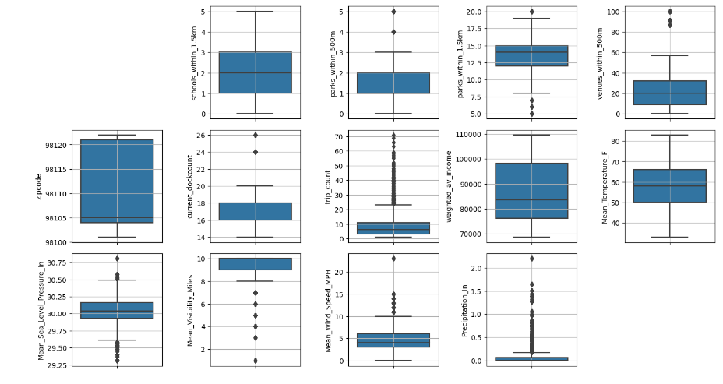
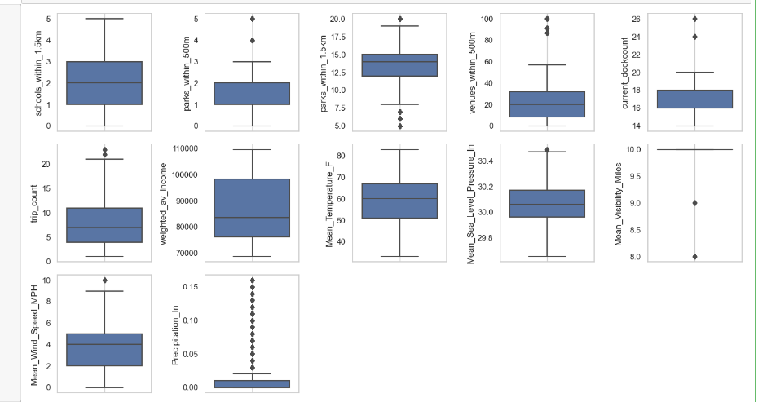
Outliers
We ran the model again but removed outliers using IQR method
Box plots without outliers
Box plots with outliers

Slide 11
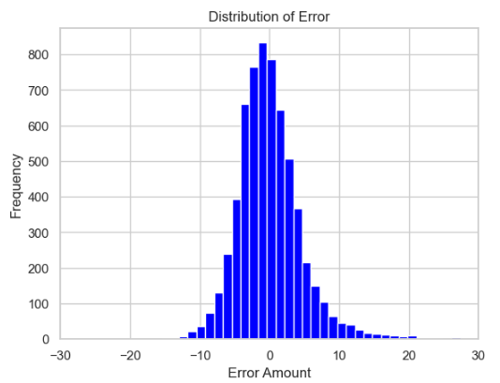

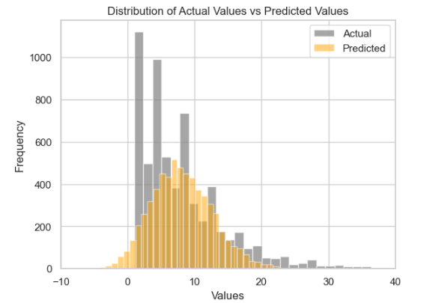
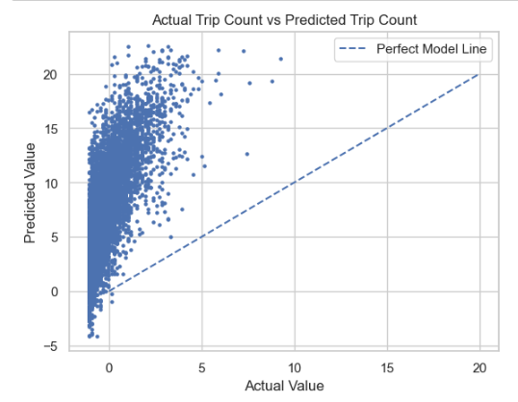
Linear Regression run 2 - results

Slide 12

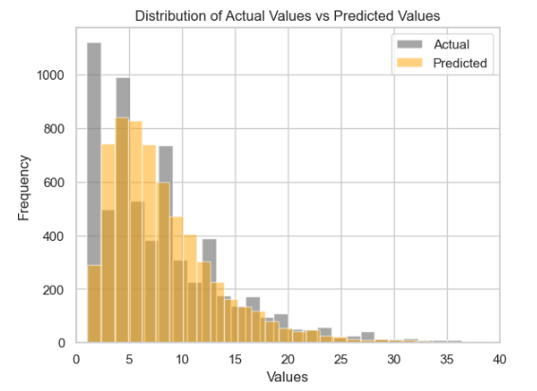
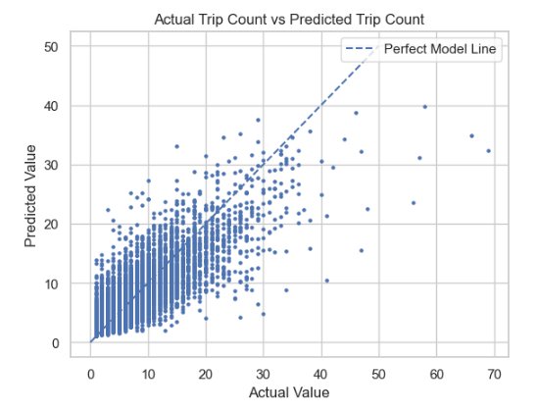
Random Forest model - results
We did not remove outliers as testing showed this reduced the R^2 value a lot

Slide 13
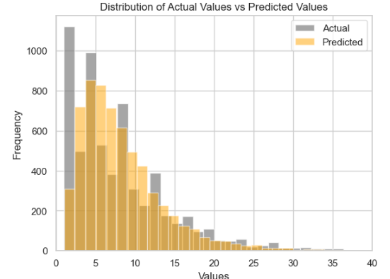
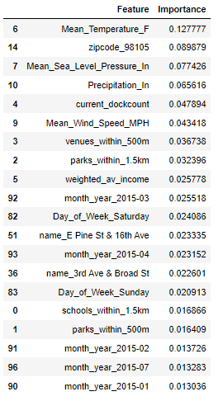

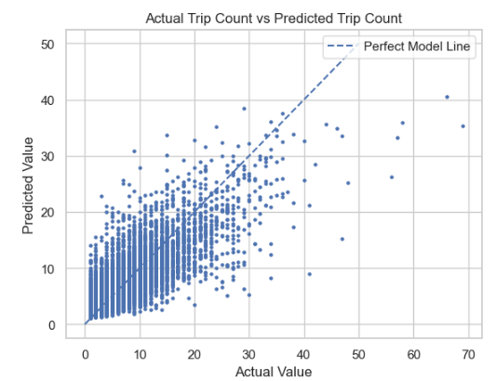
Feature selection of Random Forest model
We used Sklearn ModelSelect to filter out features with importance less than 0.1
The results were worse

Slide 14
Improvements
Insights
Temperature and precipitation feature have high predictive value
Carry out Grid Search Cross Validation on the Random Forest – we did not have the processing power for this
Event schedules at each venue would indicate when people were travelling nearby
Perhaps have dummy variables for each day in the dataset rather than for month_year and day of the week
The zip code of the station, average income and number of venues, parks and schools also had high predictive value
The number of bike docks in the station also played a part in the number of trips
The time of the year were also important suggesting people take other forms of transport when it likely to be rainy or cold
Day of the week also features highly, suggesting a lot of commuters use bikes during the week

