Slide 1
Archipelago
A project for ufology information infrastructure

Slide 2
Agenda
Problem Statement
The Needs
Vision
Concepts
Design
  Architecture
  Integration
Deployment
Development plan

Slide 3
The Problem
Ufological data are :
  Not reusable
    No standard way to
      describe data (sighting, investigation, etc.)
      To link data
  Not shareable
    Results can really be reviewed
    Multiple databases and formats
    Differences in data amounts and contents
    Every new project is a new incompatible database
      This can’t be avoided

Slide 4
Ufology information today
No link (orphan, unexploitable data)
Web link without ufological semantics and info
Custom processing 1
Book
Another future database
Custom processing 2

Slide 5
The Need
To embrace existing and new databases instead of trying to replace them
To provide a system that motivates sharing

Slide 6
Archipelago vision
Processes at global level
Enable cooperation, sharing and link semantics
Metadata level
(data about data)
Leverages existing data
Data level (existing database record, text, image, video, PDF…)

Slide 7
Vision benefits
View all the data
  non only yours
Process all the data
  Search/filtering, classifying, statistics
  Build and share your own processes
Processes are long lived
  They depend on the metamodel
    Not the concrete databases anymore
Results can be shared
Old databases can migrate, not just die

Slide 8
The Need : Traps About Data
Selecting data
  Researchers’ job
    Understanding a unknown phenomenon requires all the data
Interpreting data
  Researchers’ job
    the tool only helps (customizable processing)
Hiding data
  User’s preferences
    But data origin (sources, authors) is critical for metadata
Centralizing data
  Anti-trust accusations
  People don’t build using a single hammer

Slide 9
The Need : Traps About People
Selecting people
  Witnesses are not to be selected
  We need both amateur and scientists
Build a software that impose too much constraints
  Ease of use is critical for a de facto standard
    For witnesses
    For contributors
  Don’t impose data
  Don’t impose processes

Slide 10
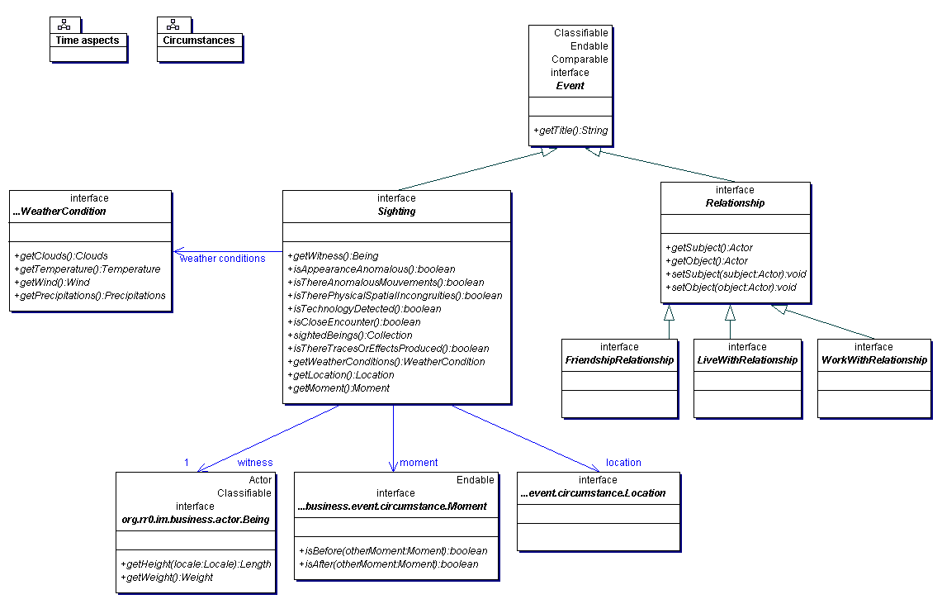
Analysis : model
A modeling of manipulated ufological concepts

Slide 11
Analysis : processes
Functions applicable to modeled data
  Can take multiple arguments
  Can result in many values
  Can be composed
levelland:Case
HynekClassificationFunction
CE2:HynekClassification
all:Case
MultiCriteriaSearchFunction
exeter:Case
1965:Year
valensole:Case
SearchByHynekFunction
all:Case
HynekClassificationFunction
MultiCriteriaSearchFunction
1965:Year

Slide 12
Architecture
Archipelago implementation
Datastore
Model
Processes
Archipelago platform
Query
Statistic
primitives
Graphical
primitives
Etc.
UUDF
Other
Archipelago
platform

Slide 13
Integration architecture
Active : server provider
Archipelago
server
UUDF
Existing
database
Server 1
Database 1
adapter
Existing
database
Server 2
HTTP query
Database 2
adapter
Passive : data provider
Each integration model can either push or pull information

Slide 14
Provider integration levels
Passive : Data provider
  Virtually everbody : nothing to do, existing data is just referenced by Archipelago
Active : Server provider
  Implements Archipelago APIs over an existing UFO data server

Slide 15
UUDF
Unified Ufological Data Format
  The interchange data format
  The format legacy databases map to
UFO4ALLDB
Case:
Ufo4alldb.caseNumber: 0024
Ufoo.caseNo: CE2001
Ufo4alldb.location : Exeter
Date : November 11, 1957, 23 h 00
Classification : Close Encounter of the 2nd Kind
Last updates:
Ufo4alldb: 19/03/2004
Ufoo: 20/03/2004
<uudf xmlns="http://ufoathome.org/uudf/1.0" source="UFO4ALLDB" date="19/03/2004">
<field name="case" type="uudf.Case">
<field name="caseNumber" type="Integer">0024</field>
<field name="location" type="String">Exeter</field>
<field name="date" type="ufo4all.DateTime">195711022300</field>
<field name="classification" type="uudf.HynekClassification">CE3</field>
</field>
</uudf>
0024
Levelland
195711022300
CE2
<uudf xmlns="http://ufoathome.org/uudf/1.0" source="UFOODB" date="20/03/2004">
<field name="case" type="uudf.Case">
<field name="caseNo" type="Integer">CE2001</field>
<field name="location" type="String">Exeter</field>
<field name="date" type="ufoo.Date">195711022300</field>
<field name="credibility" type="Integer">4</field>
</field>
</uudf>
CE2001
Levelland
1957,Nov 02
5
UUDF
UFOODB

Slide 16
Integration
Why integrate ?
  To benefit from Archipelago services
    Data from others
    Processes (statistics, feeding, search…) at a global level
    Work referencement, accessibility, visibility
  To make people benefit from your services
    MyStatistics, MyCredibilityIndex(case)
Offline databases
  Can be a standalone Archipelago
  Can be imported manually
  Can connect when then want

Slide 17
Deployment
The Archipelago platform can run on any host
  Any hardware (PC, Mac)
  Any OS (Windows, Linux, MacOS)
Any deployment
  Does not mandate data centralization
    Actually most is from legacy database that doesn’t move
  Allow replication
    For performance, data safety
  Client-Server, Distributed, Standalone, Peer-to-peer

Slide 18
Client-Server deployment
Archipelago web portal
Web/data server
Web client
Rich client

Slide 19
Distributed deployment
Archipelago web portal 1
Archipelago web portal 2
Server 1
Server 2
Client 1
Data exchange
through Unified Ufological Data Format (UUDF)
Client 2
Client 3

Slide 20
Standalone deployment
Archipelago personal
User 1

Slide 21
Peer to peer deployment
Archipelago personal
Archipelago personal
User 1
User 2

Slide 22
Archipelago RI
Reference Implementation
  Proof Of Concept (POC)
  Demonstrator
  « Default » implementation
    Feed by UFO@home applet
    Multi-criteria queries
    View filters
    Classifications (Hynek, etc.)
    Evaluation processes (Ballester-Guasp)
    Statistics

Slide 23
Technological choices
Java
  Platform-independent, from mainframes to PDAs
  Suited to the web (lightweight, applets, security)
  Successful in many big projects
  Good candidates : JDO
XML
  Neutral, flexible data format
  Good candidates : xQuark
Internet HTTP
  Travels everywhere (firewalls)
  Any web client

Slide 24
Develoment plan
Iterative
  State of art
  Specifications
  RI Development
  Generalization

Slide 25
Keys to success
State of art
Leverage legacies
Big players support
Skilled people
  In ufology
  In computer science
Best services
  Best querying service, statistical tools, etc.
Unprecedented services
  Visual reporting/replay
  UUDF
Ease of use
Flexibility
  Deployment
  Model
  Internationalization
Open source

Slide 26
Thank you
http://ufoathome.org/archipelago

