Slide 1
Visual Reporting Applet
Reporting UFO sightings visually, from anywhere

Slide 2
Contents
Goals
Principles
Example
Anti-goals
Technical features
Future enhancements
References

Slide 3
Goals
Objectivate
  A (animated) sketch is better than dozens of subjective words
Standardize
  Process to gather sighting reports (best practices)
  Allow processing (statistics, interpretations…)
  Allow exchanges (between databases, between researchers)

Slide 4
Principles
Display of sighting sky
  Depending on the location (town -> latitude + longitude)
  Depending on sighting date+time
  Depending on orientation (NSEW -> azimuth)
  Depending on sighting angle (altitude)
Drawing(s) of the UFO(s) on the sky
  Shape(s)
  Color(s)
  Movement

Slide 5
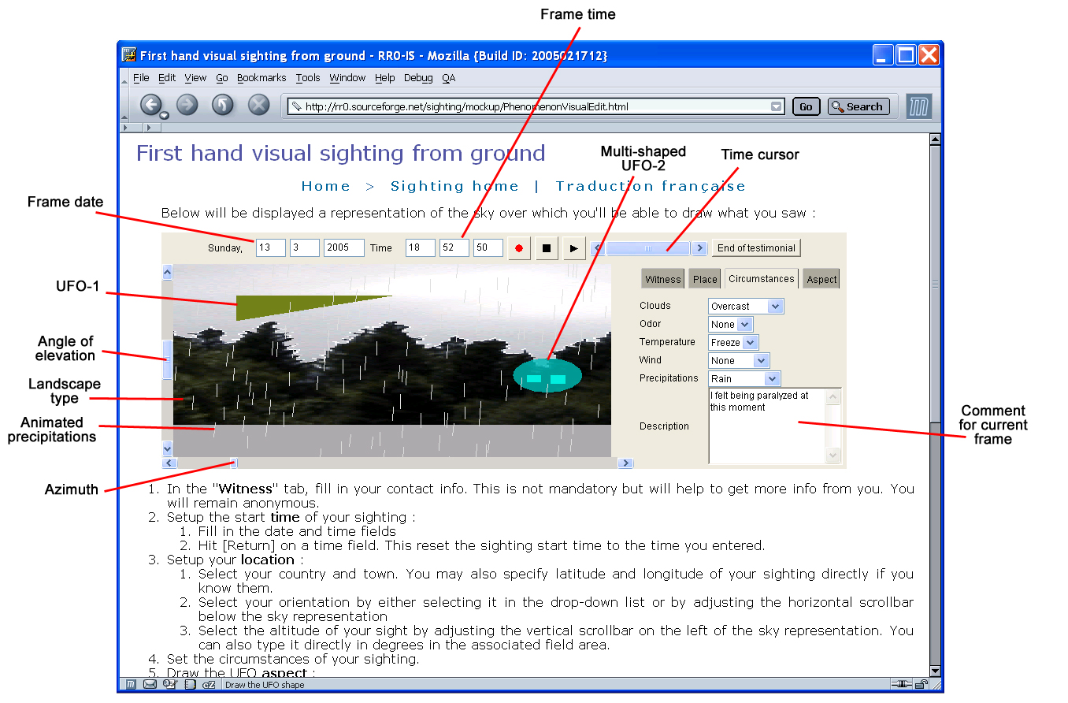
Example

Slide 6
Anti-goals
Neither replace
  An investigation
    Only collects data at a first level
      No comparison with a face-to-face interview
    Helps to evaluate the need for an investigation
  A textual testimonial
    Words contain information too
      About the observer him/herself, his/her perception
      Consistency check between visual and textual descriptions
      Meaningfulness terms, number of words, etc.

Slide 7
Technical features
« Open Source » project
  The source code is visible, usable, modifiable by everyone
  Collaborative work
Written in Java
  Executable everywhere (Windows, Unix, personal assistants, mobiles…)
  Including on the Web
  Professionnal platform and langage, broadly available (in corporations, etc.)
Multi-language support
  English, french, spanish, italian, others…

Slide 8
Future enhancements
Ground
  Environment display (buildings, etc.)
  User-provided photographs
Sky
  Artificial satellites
  Magnitudes/places (town, nature…)
UFO
  Texture
  Luminosity (halos, blinking…)
Report types
  From the sky (plane…), from a car (windows), etc.
  CE3 (visual description of sighted occupants)

Slide 9
References
The project hosted on SourceForge
  http://ufoathome.org
Mockup
  http://ufoathome.org/Mockup
  Visual sighting report from ground
    http://ufoathome.org/sighting/mockup/PhenomenonVisualEdit.html

