Slide 1
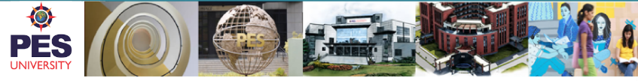


InternKit
Department Name: Computer Science & Engineering
Subject Code: UE17CS353
Subject Name: Web Technologies II
Team Members:
Vishnu S Murali : PES1201701624
Rishi Ravikumar : PES1201700754
Aniket Kaulavkar : PES1201700095

Slide 2

Project Description
The web portal is intelligent to convey students the probability of acceptance to a particular internship he or she as posted with respect to the skills the student has and the projects he or she built.
InternKit
The online portal provides the employees to post any internship offers they want to post and students can apply to the listed internships that are posted.
Opportunities to connect to employees of different companies for internships according to the skills the students have

Slide 3






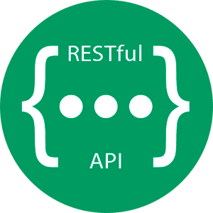



Education Infographic
Technologies Used:
Front-end
1 out of 3
React JS
React framework
For running dynamically rendered components of the UI
40%
30%
30%
Title:
An online platform to connect employers and students for internships.
InternKit
React JS
Flask on python
Siamese LSTM with Word Cloud
30%
Flask app on python
Back-end
Back-end
Flask app with jwt enabled and sqlite3 used as database to store the data.
Serving the apis via flask app for different functionalites that the website offers. It uses REST architecture and periodic refresh techniques to connect to the frontend
30%
Probability acceptance to an internship
Intelligent Component
Siamese LSTM integrating it with word cloud features for text similarity check
Frontend
Backend
Intelligent Component

Slide 4
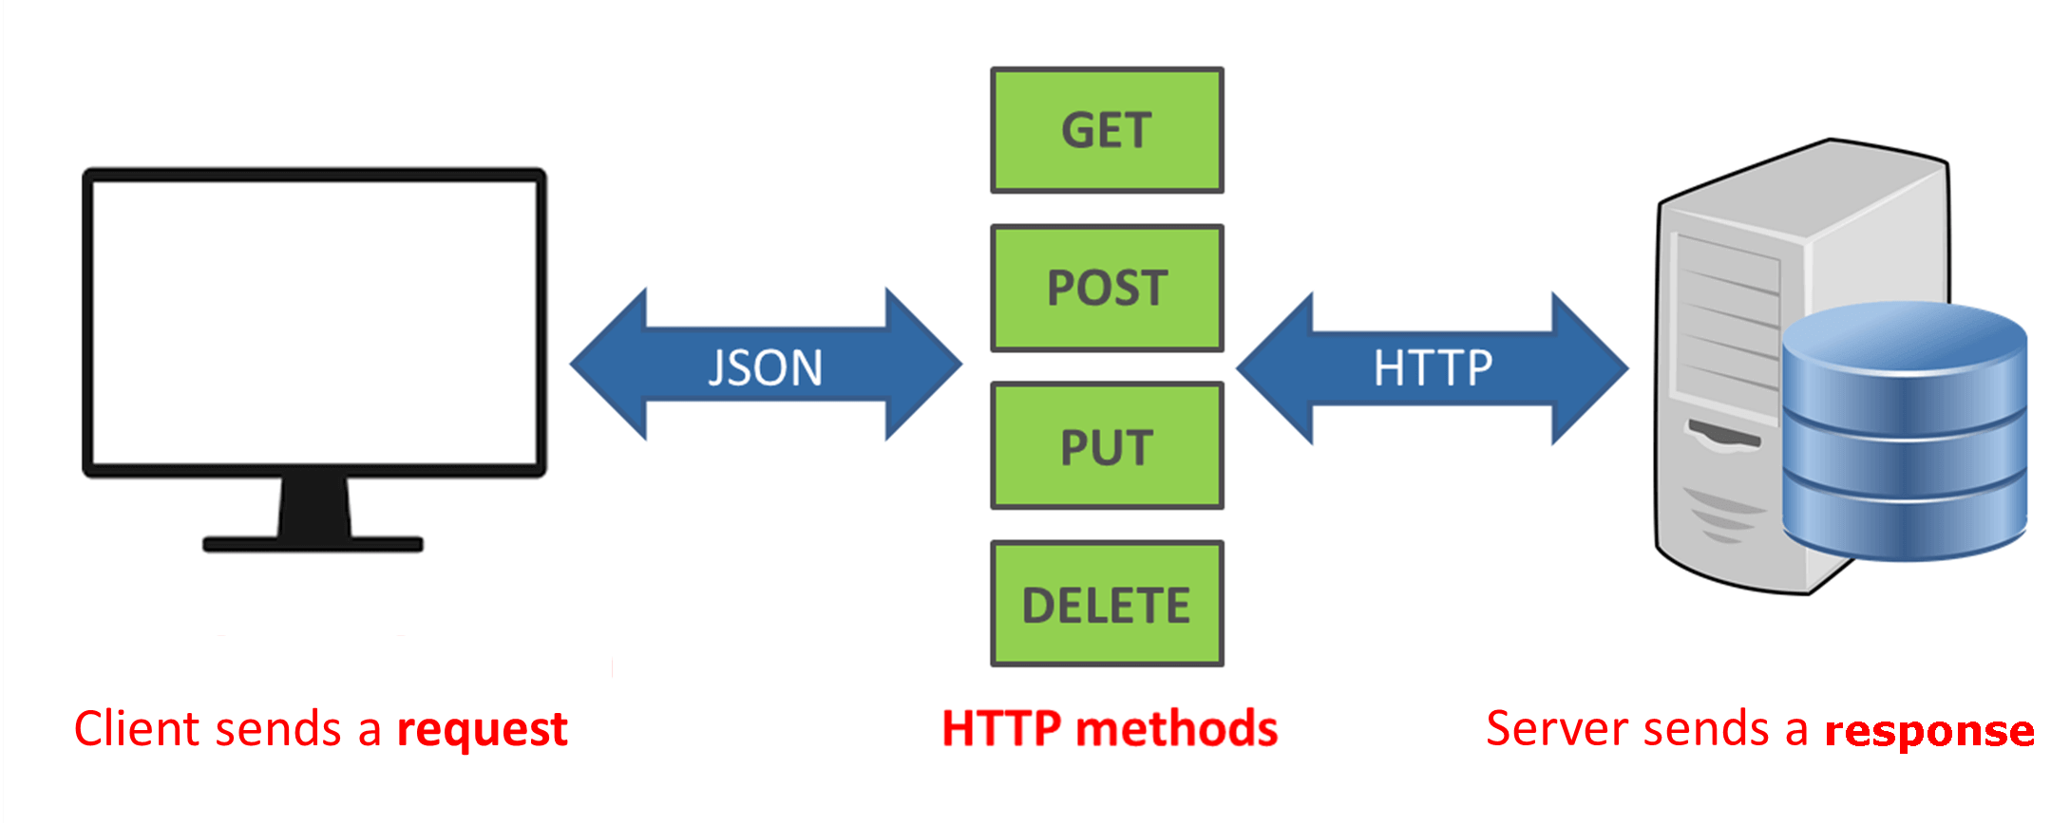
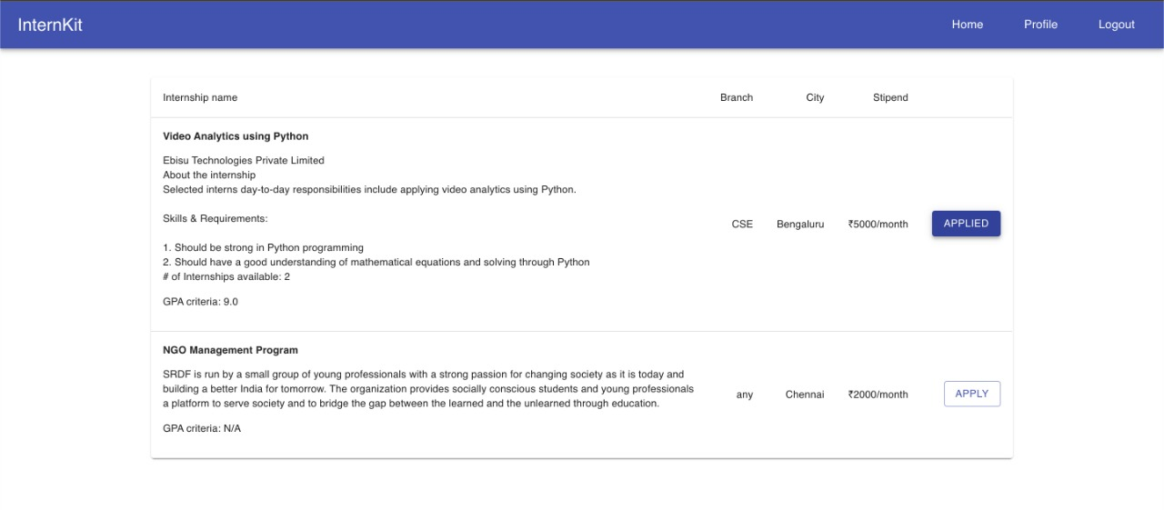
InternKit
Techniques Implemented
Get all details of students, employees, internships and probability acceptance[GET]
REST API Architecture
Login, add and edit details, and password of the students and employees[POST]
Sign Up, Add internships and apply for Internships[PUT]
Delete user accounts, internships or internship applications
[DELETE]
Periodic Refresh
Periodically refreshing the list of internships posted by the employees on the students page

Slide 5
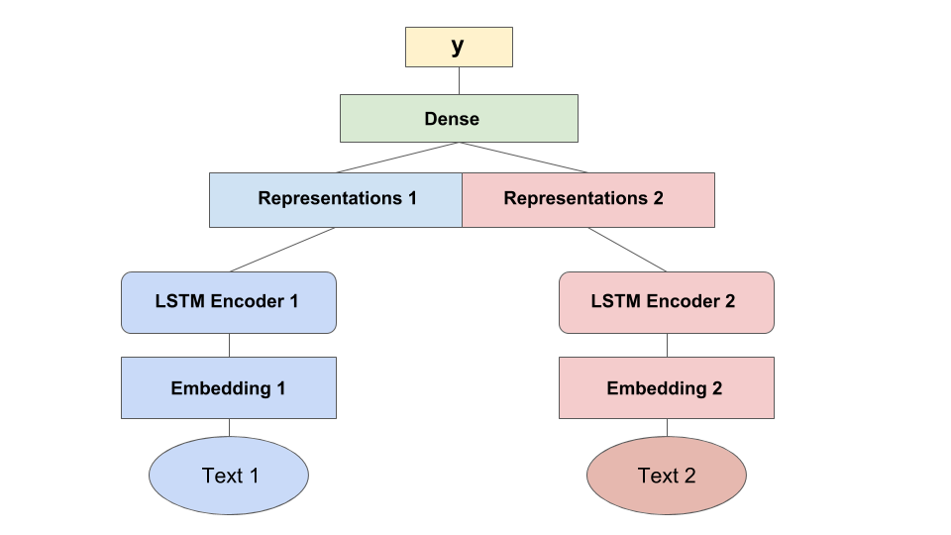
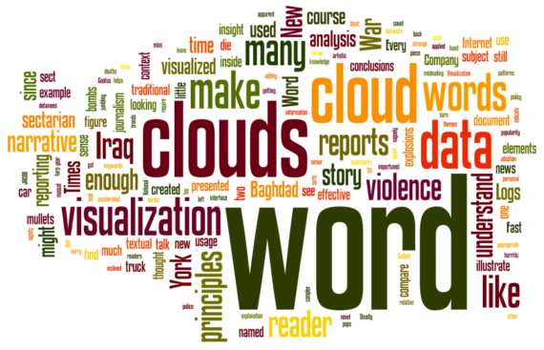
Intelligent Functionality
Model is applied to assess semantic similarity between sentences. Text similarity of the skills, and project description of students with company requirements set for the internship is found
Siamese LSTM for text similarity
Word Cloud
Frequencies of the words in the project description, and skills of students is compared with the company requirements set for internship and used as weightage of the skills
Probability Acceptance of Internship

Slide 6


