Slide 1

Covid-19

Slide 2




Covid-19: signs of success!
Diana Crowe, Eline Keutgens and Inkeri Virkki

Slide 3
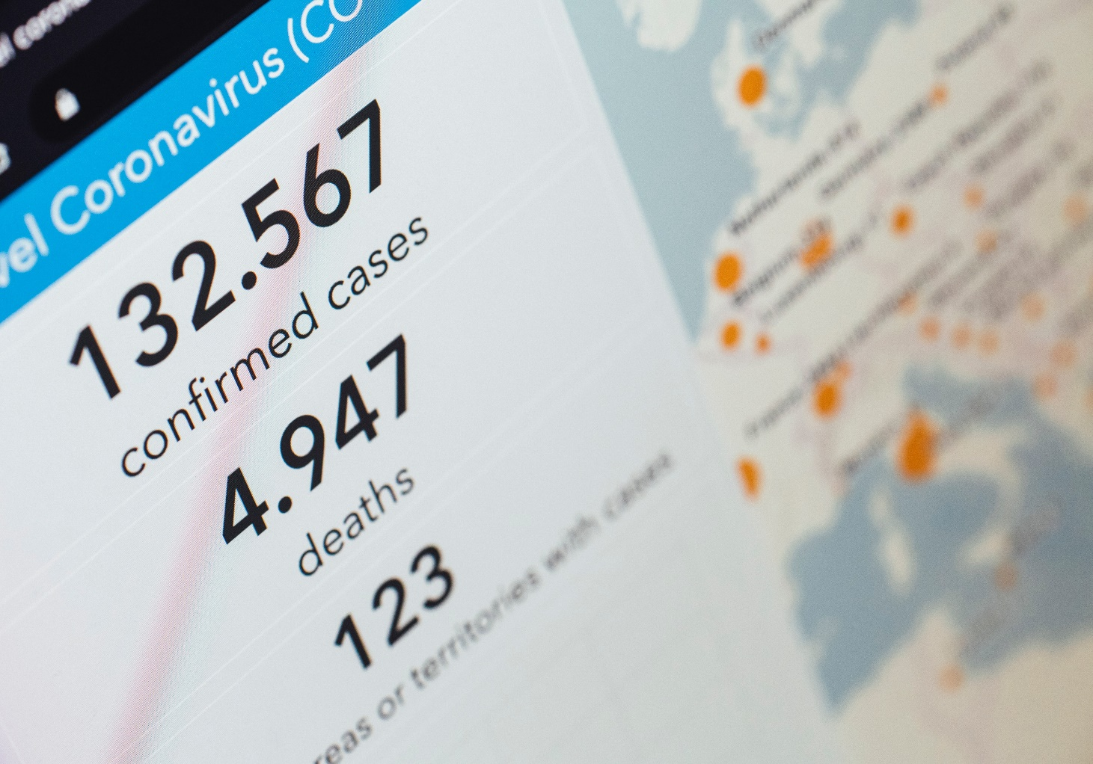
First:
Look into country-specific Covid data
Look into demographic data
Then:
Try to predict if a country is likely to do good or bad in a possible new outbreak

Slide 4

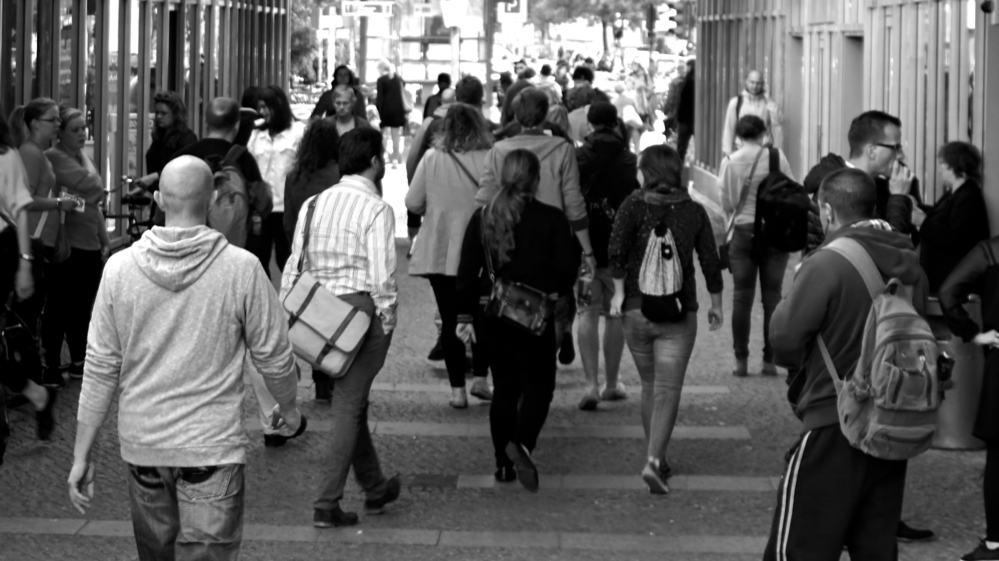
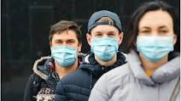


Slide 5
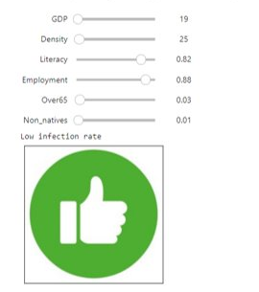
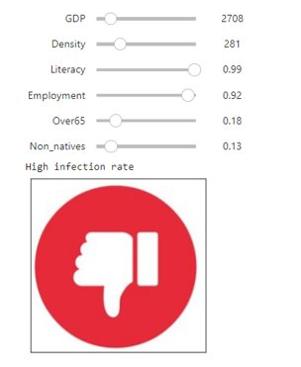
Application:
Zambia
The United Kingdom

Slide 6
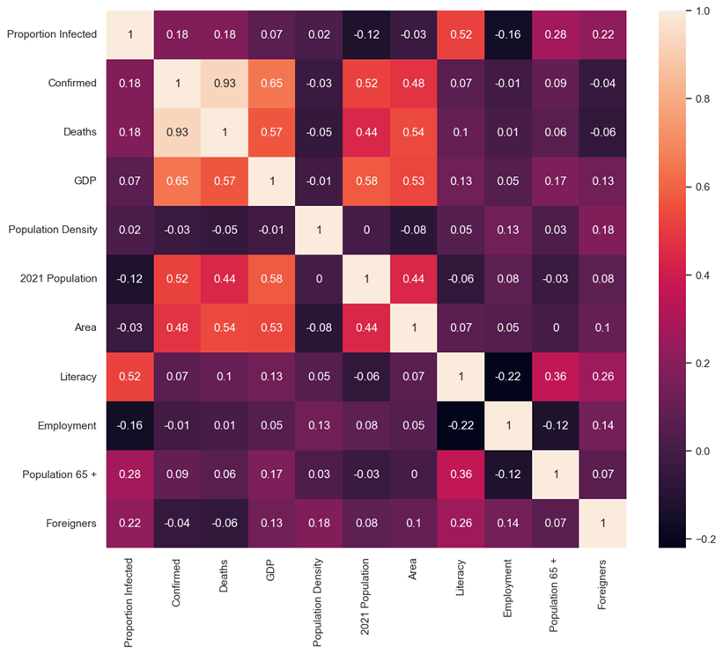



Slide 7
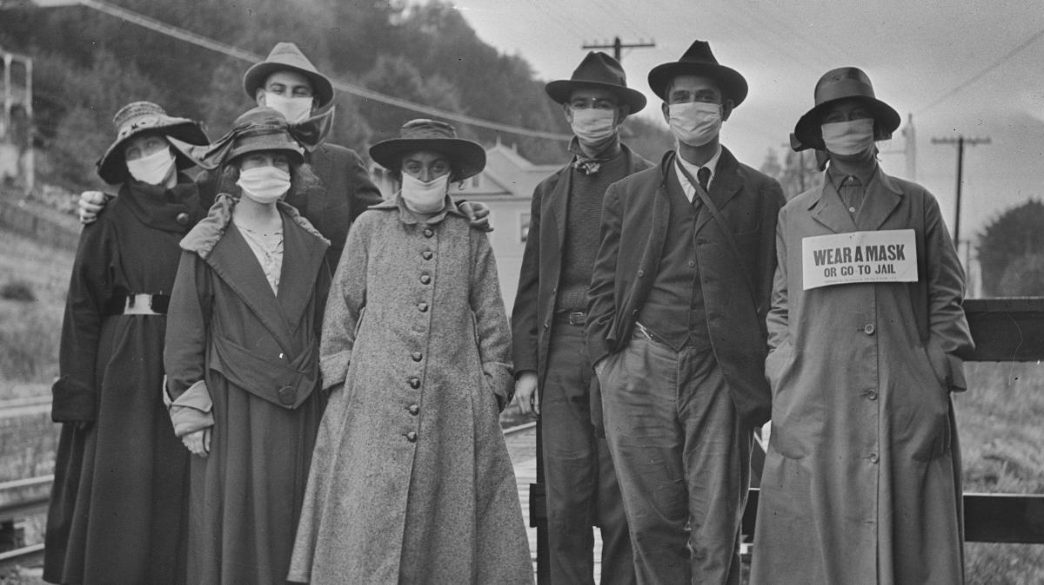
Learn from History lest we repeat it…

