Slide 1

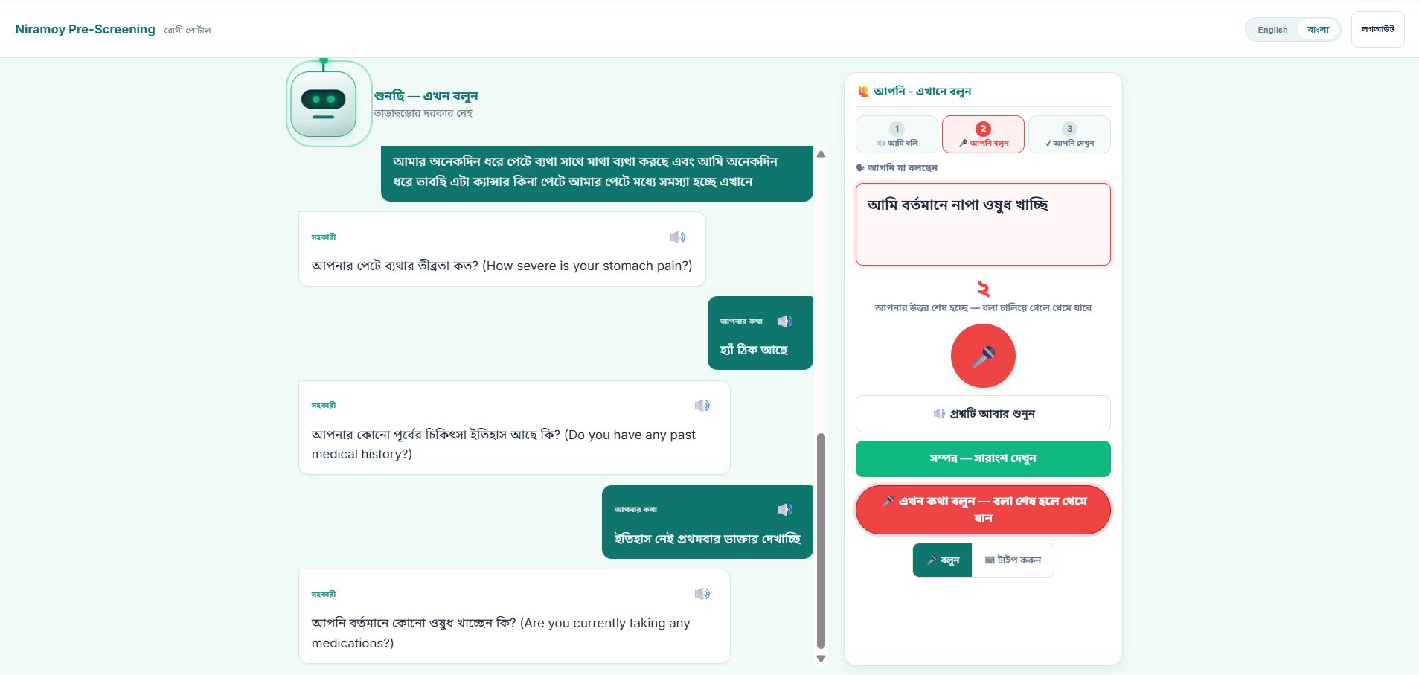
NORTH SOUTH UNIVERSITY · DEPT. OF ELECTRICAL & COMPUTER ENGINEERING · CSE499 CAPSTONE
A Voice-Based AI Framework for Medical Pre-Screening of Bangla & Regional Bangladeshi Speech
“Niramoy” — intelligent symptom capture · risk assessment · clinical documentation · EHR integration
What it is: A patient speaks their symptoms in Bangla / Banglish / dialect before the visit; the system turns that speech into a structured, risk-scored, explainable pre-screening report.
The problem: Consultations are short; elderly & low-literacy patients struggle with typing-first, English-first tools, and key details get missed.
Who it’s for: Patients, triage medics and doctors — one shared record across three portals.
The value: The doctor walks in already knowing the story. It assists — it never diagnoses.
Patient portal — live voice conversation in Bangla.
3 portals
15-module pipeline
16-model ASR study
FHIR + PDF export
Rafiur Rahman Mashrafi (2221971042) · M. G. Rabbi Hossen (2222516042) · Israt Zaman Srity (2211084042) | Advisor: Dr. Mohammad Ashrafuzzaman Khan (AzK), Associate Professor

Slide 2
Analysis of the Design — why it works this way
1
›
2
›
3
›
4
›
5
›
6
Speak
Understand
Capture
Assess
Document
Review
The patient’s exact words are preserved end-to-end; the doctor makes every clinical decision.
!
The insight that shaped it
Four rules the system always obeys
Even the best open-source Bangla ASR mishears ~47% of words on real dialect speech — a single-pass transcript can’t be trusted clinically.
So the system is a stateful, conversational pre-screener that verifies and fills gaps, preserves the raw words, and keeps a human in the loop — instead of trusting one transcript.
One shared record (the visit); a local safety rule overrides the AI; AI providers are swappable by config.
1
Never edit the patient’s raw words — stored once, untouched.
2
Never diagnose — assist only; the doctor decides.
3
Surface red flags — a local rule forces “Critical”; AI failure defaults to Medium, never Low.
4
Synthetic / consented data only.

Slide 3
Usability · Manufacturability · Sustainability
UX
Usability
Build
Manufacturability
Life
Sustainability
how people actually use it
practical to build, deploy & maintain
stays useful & maintainable
Voice-first — the patient just talks
Bilingual English / বাংলা; questions spoken + shown
Every answer is read back to catch mistakes
Large touch targets; typing always available
Designed for elderly & low-literacy users
CPU-only — no GPU required
Free & open-source tools throughout
Single-file SQLite → one-line swap to Postgres
One requirements.txt; Windows & Linux
A small clinic could realistically install it
Modular — one small service per module
Versioned database migrations
~1,196 automated tests guard every rule
Multi-provider AI failover for uptime
Standards-based FHIR — portable, not a silo
Inclusive by design.
Deployable on a shoestring.
Built to last and evolve.
“Manufacturability” for a software system = how practically it can be built, deployed and maintained on real clinic hardware.

Slide 4
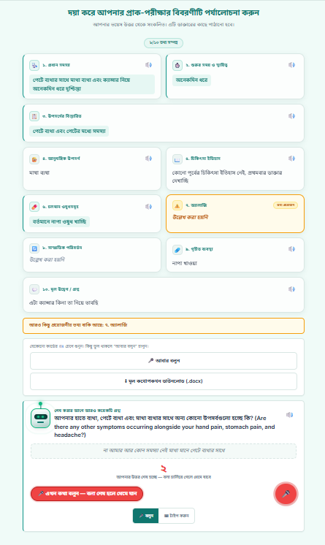
Implementation — Patient Side (Voice-First Kiosk)
The patient’s journey
1
Log in with a phone number + one-time code (OTP)
2
The assistant asks — spoken aloud & shown; the mic opens itself
3
The patient speaks; the answer is read back (“You said…”) to catch mishearings
Voice conversation — spoken follow-up questions, answered by voice in Bangla.
4
Targeted follow-up questions fill the gaps
5
Review the 10-field summary → Confirm & Submit
Review screen — the 10 captured fields, confirmed before submit.
Bilingual EN / বাংলা
Typing fallback (same backend path)
Raw words preserved

Slide 5
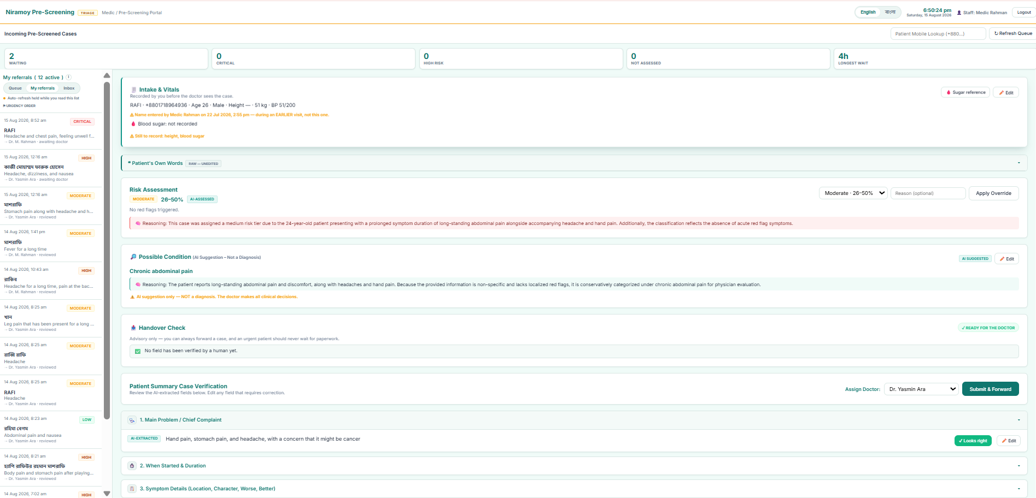
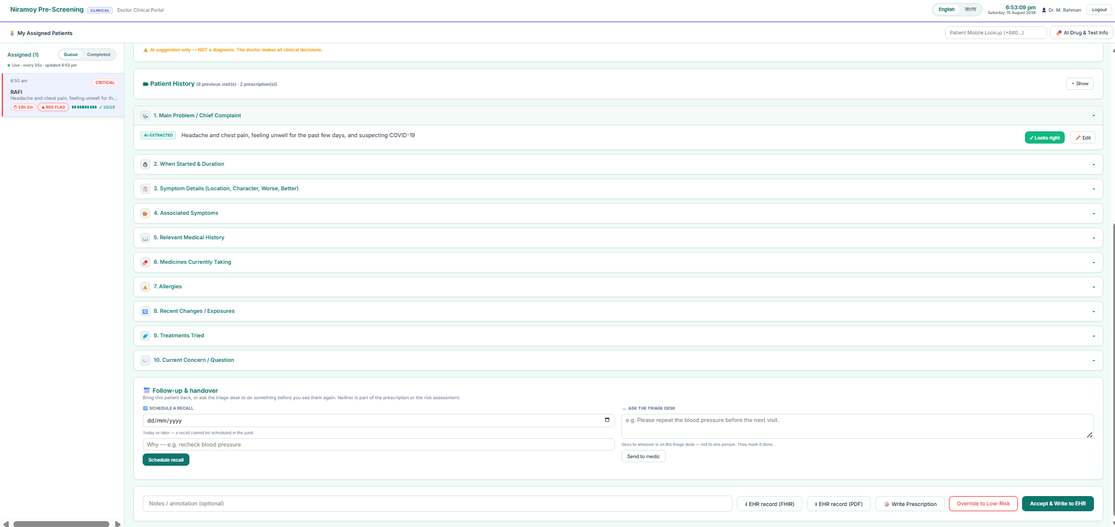
Implementation — Backend, Staff & Doctor
Doctor portal — safety first (risk, red flags, explanation), history, prescribe, export FHIR / PDF.
Medic portal — verify AI fields against the patient’s raw words, record vitals, forward.
How speech becomes structured information · FastAPI + SQLite (18 tables, one “visit” record)
correction
→
extraction (10 fields)
→
summary
→
gap analysis
follow-up loop
→
risk + red-flag
→
explanation
→
structured report
Data trail: speech → raw utterance (immutable) → 10-field profile → risk + explanation → report → doctor review → FHIR / PDF
The doctor types the diagnosis; the AI never fills it and it is excluded from the exported record.

Slide 6
Development Process
Research track — measure first, then design
1
›
2
›
3
›
4
›
5
Collect audio
4.7 h · multi-dialect
Baseline ASR
12 models benchmarked
Bigger models
>1B params tested
Dialect fine-tuning
planned (CSE499B)
Chatbot study
pending
Phases 4–5 are planned / upcoming — shown honestly, not claimed as done.
Build track — small services, test-guarded, iterative
Challenges → how we solved them
Spec service
→
Build
→
Test each rule
→
Review
→
Iterate
ASR is unreliable
→ verify-and-fill conversational design
~1,196 automated tests
Every safety rule is pinned by a test, so a change that breaks a rule fails the suite.
Decisions recorded as Architecture Decision Records (ADRs).
Free-tier AI limits
→ multi-key / multi-provider failover
Bangla PDF shaping
→ fpdf2 + HarfBuzz (correct conjuncts)

Slide 7
Environmental Considerations & Sustainability
Software-only Nothing to manufacture — it runs on the clinic PCs & tablets you already have.
!
Scope, honestly
Low compute CPU-only, no GPU farm; free & open-source tools throughout.
We don’t claim measured carbon savings.
Cloud speech & AI still use energy today. The real efficiency path is the local, on-device models we’ve designed toward — that’s future work, stated as such.
The durable “green” win is process: less paper, less re-entry, and records that don’t have to be rebuilt later.
Paperless intake Structured digital records replace paper forms and manual re-copying.
Long-lived records Standards-based FHIR outlives the app; modular, maintainable code.
Path to greener ops On-device STT / TTS is on the roadmap to cut cloud calls.
Real, defensible sustainability claims only — no unsupported environmental numbers.

Slide 8
Tools & Technologies Used
Only what is actually in the final build.
Backend
Speech / Voice
AI / LLM
Python
FastAPI
Uvicorn
Web Speech API (bn-BD) — STT
Gemini Flash / Flash-Lite
Groq
edge-tts
espeak — TTS
Cerebras / OpenRouter
multi-key failover
Clinical Data & Export
Frontend
Testing / Infra
SQLite
SQLAlchemy
Alembic
HTML
CSS
JavaScript
pytest (~1,196 tests)
HL7 FHIR R4
fpdf2 + HarfBuzz
3 portals
Google Colab
python-docx
All free / open-source · CPU-only · one codebase on Windows & Linux.

Slide 9
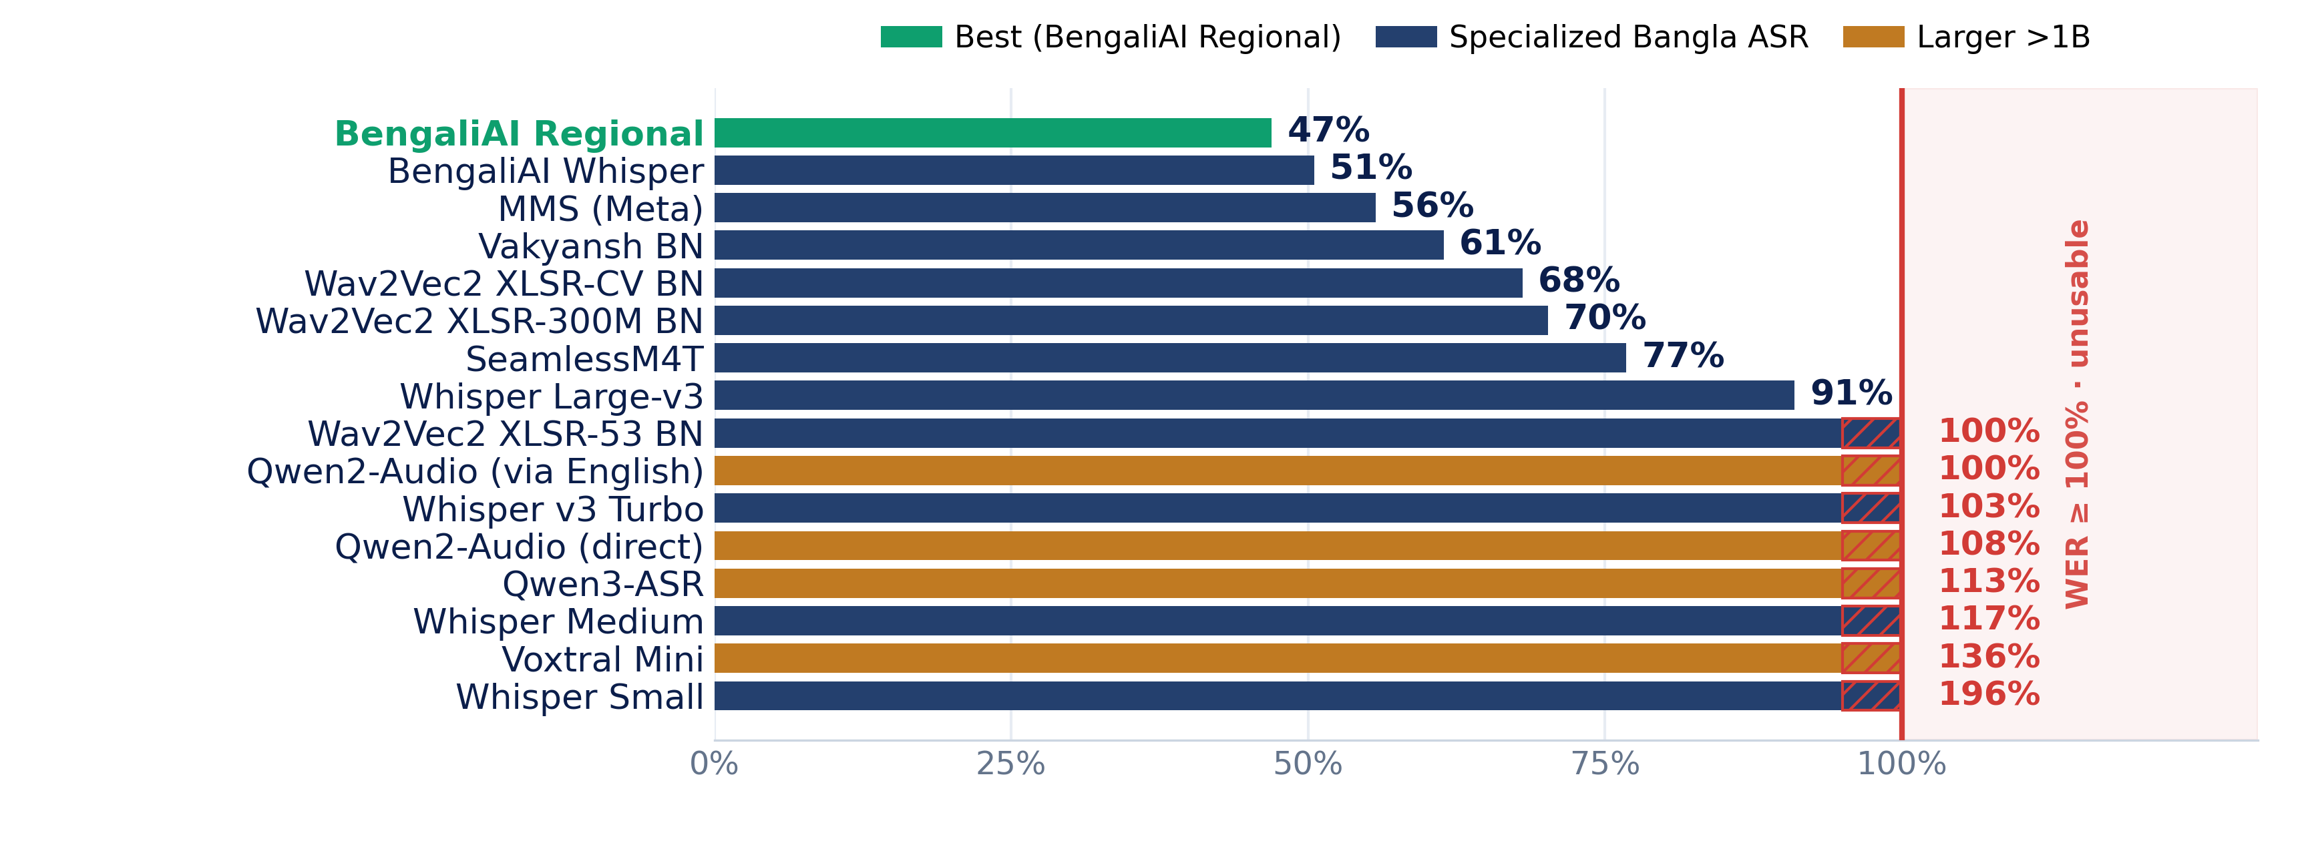
Results — Bangla Dialect ASR Benchmark
16
models tested
47%
best WER (BengaliAI Regional)
8
unusable (WER ≥ 100%)
What it means
Best open model still misses ~47% of words on dialect medical speech.
Bigger >1B models did not help — several hallucinate past 100% WER.
Exact dialect accuracy ≈ zero → this shaped the verify-and-fill design.
Offline research benchmark of candidate open models — not the live browser STT the prototype uses.

Slide 10
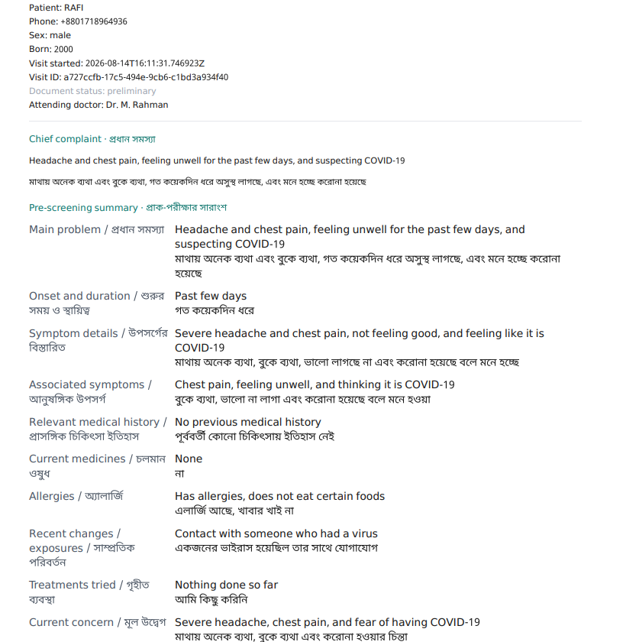
Results, Impact & What’s Next
What we achieved
Real-world impact
What’s next
Working end-to-end prototype across 3 portals
~1,196 automated tests passing (safety rules pinned)
Bilingual record → HL7 FHIR R4 + PDF + DOCX
Live-mic run judged “very accurate”, ~2 s (informal)
Includes elderly, low-literacy & dialect speakers
Faster, more complete intake before the consult
Interoperable, standards-based output
Danger signs surfaced — never falsely reassured
Local on-device STT (faster-whisper)
LoRA dialect fine-tuning
Real authentication & encryption
Feedback-driven retraining; Postgres + clinic pilot
Honest limits: cloud STT today · auth/encryption prototype-stage · extraction accuracy not yet formally measured · synthetic data.
A patient speaks Bangla; a doctor gets an explainable, standards-based record — exact words preserved, no machine diagnosis.
Rafiur Rahman Mashrafi (2221971042) M. G. Rabbi Hossen (2222516042) Israt Zaman Srity (2211084042) | Advisor: Dr. Mohammad Ashrafuzzaman Khan (AzK), Associate Professor

