Slide 1
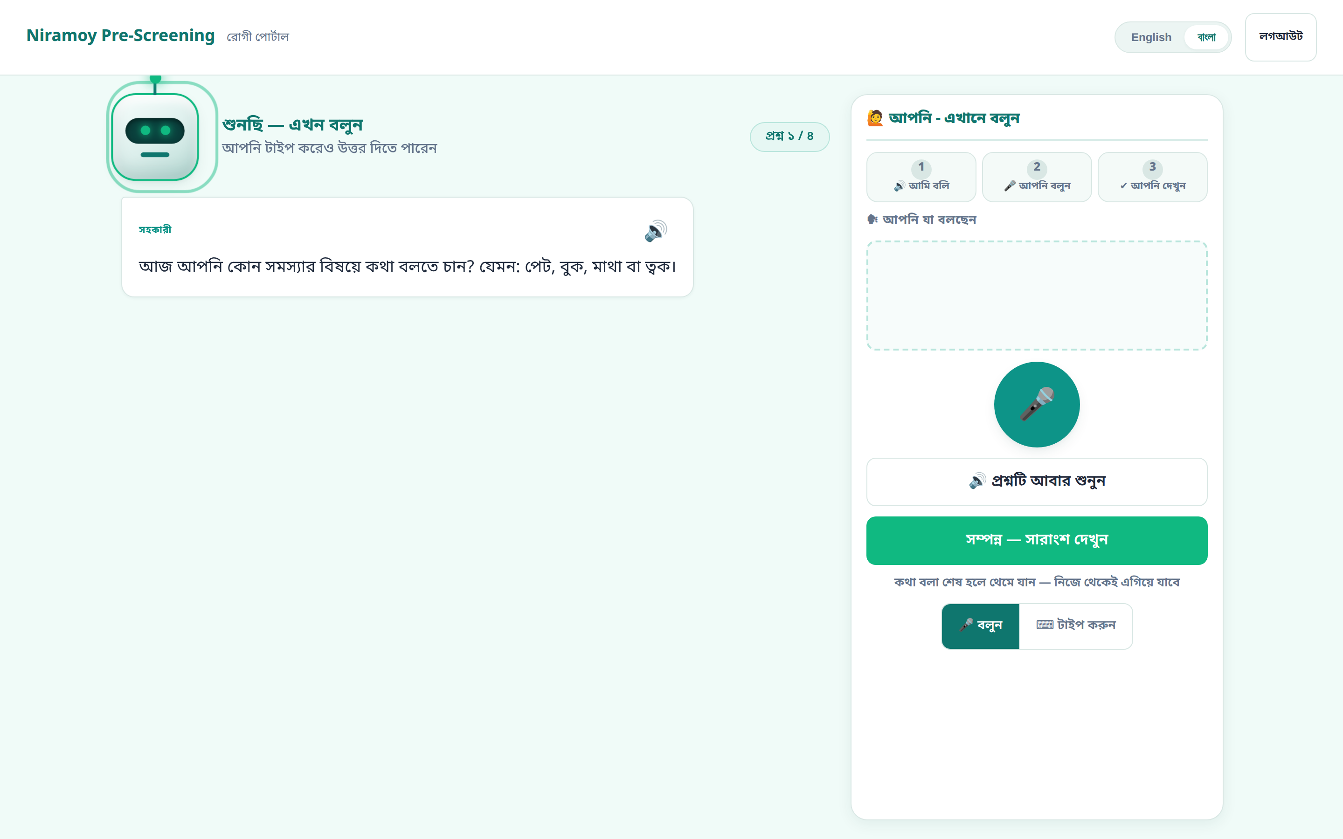
VOICE-FIRST CLINICAL AI · BANGLADESH
Niramoy
Voice-First Medical Pre-Screening for Bangla, Banglish & Regional Speech
Patients speak naturally, in their own language, before they see the doctor — and the doctor gets a clear, structured, safety-checked summary.
Designed, built & engineered by [Your Name]
Capstone engineering project · presented as a technical project overview
The patient portal — hands-free, in Bangla
Notes:
Open confidently. This is Niramoy — a voice-first pre-screening system I designed and built for Bangladeshi clinics. The one line: patients speak naturally before the visit, and the doctor gets structure. I own this system end to end; today I'll show what it does, the engineering decisions I made, and where it goes next.

Slide 2
THE PROBLEM
A real problem in Bangladeshi clinics
🕒
Overloaded clinics, very short visits
“
Doctors see huge patient volumes. History-taking gets compressed into a couple of minutes, so details are missed before the exam even starts.
Before the doctor even says hello, the clock is already running — and the most important information is what the patient can't quite put into words.
🗣
Patients can't give a structured history
Elderly, low-literacy, and anxious patients struggle to organise symptoms, duration, and history the way a form expects.
🌐
Bangla, Banglish & regional dialects
Most digital tools assume typing or English. Real patients mix Bangla and English and speak in regional dialects — so they get left out.
Niramoy · Voice-First Pre-Screening
02
Notes:
Frame the problem from the clinic's reality: volume, two-minute consults, and patients who can't self-structure a history — across Bangla, Banglish and dialects. Existing tools assume typing or English, which excludes exactly the people who need help most.

Slide 3
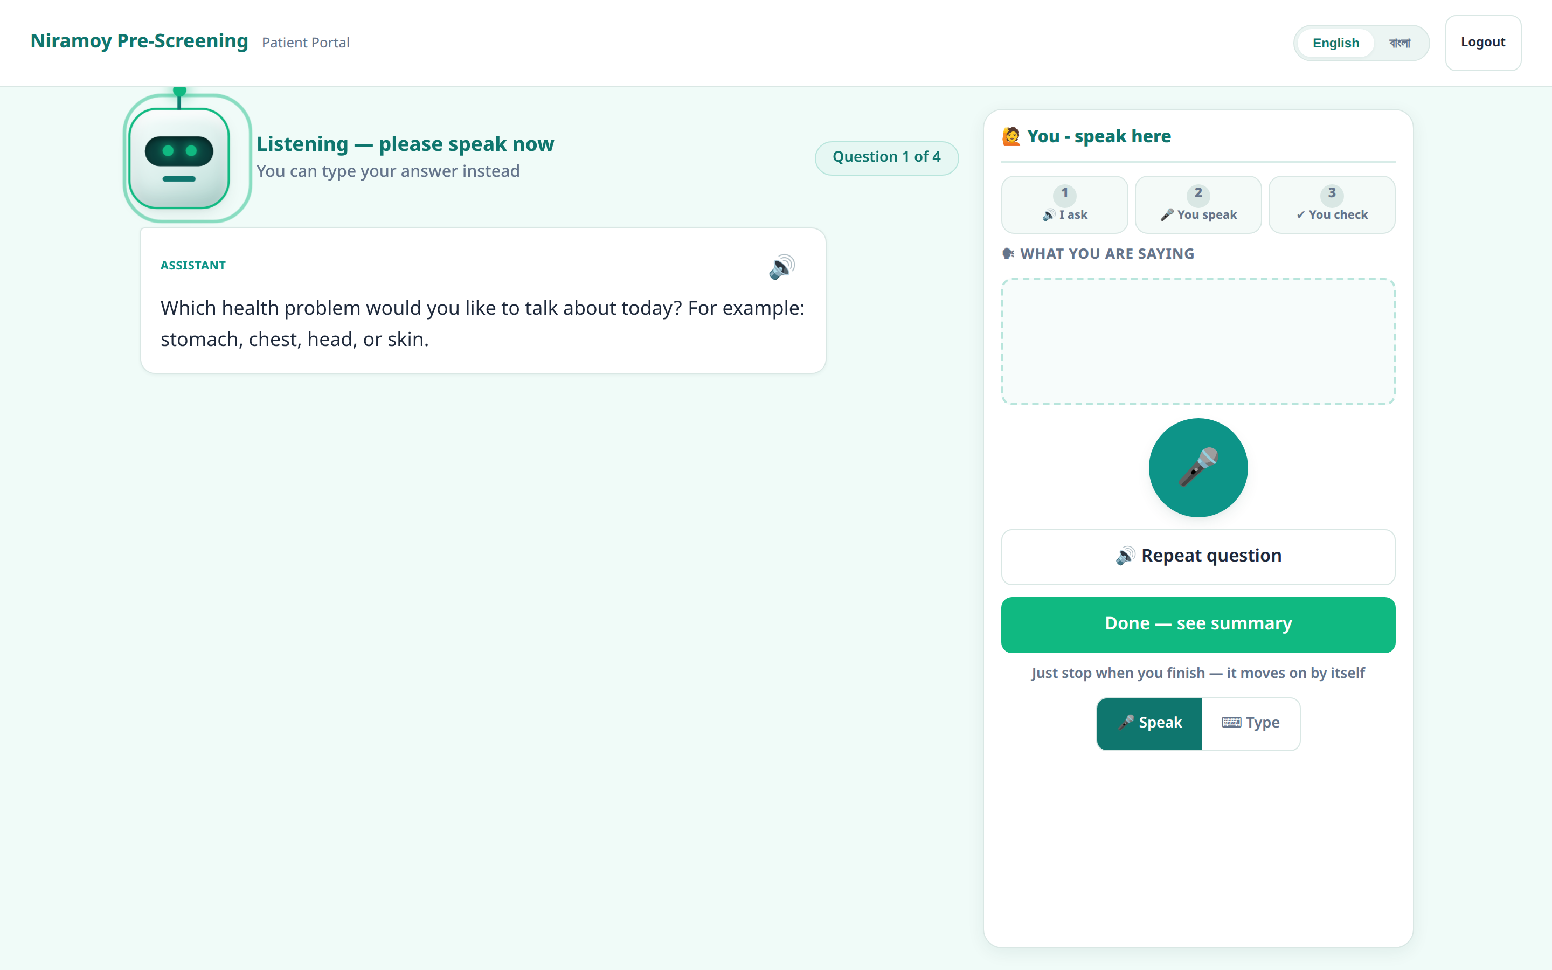
THE CORE IDEA
Let people just speak
Niramoy is voice-first and hands-free. The patient talks in their own language; the system listens, asks what's missing, and turns it into structure — before the doctor walks in.
🎤
Voice is the default — not an add-on
The mic opens itself and guides the patient. Speaking is the primary path.
⌨
Typing is always one tap away
A noisy room, a failed mic, or a personal preference never blocks a patient.
🌐
Built for how Bangladesh actually speaks
Bangla, Banglish and regional dialects — spoken, not typed in English.
Real screen · the assistant asks, the patient speaks, it moves on by itself
Niramoy · Voice-First Pre-Screening
03
Notes:
This is the thesis of the product. Voice-first, hands-free, in the patient's own language. Typing is always available, but voice leads. Point at the real screen: the assistant asks, the mic is open, and the patient just talks.

Slide 4
WHAT I BUILT
One system, three roles
A single FastAPI backend and database serve three role-specific web portals that share one design system.
🎤
🩺
🧑‍⚕️
PATIENT
TRIAGE
CLINICAL
Patient Voice Portal
Medic Triage Desk
Doctor Clinical Portal
Voice-first intake in Bangla / Banglish. Phone + OTP, spoken answers, on-screen text, typing fallback.
An urgency-ordered queue. Verify the AI's extracted fields against the patient's own words; record vitals.
Risk, red flags and the AI's reasoning first. Review, then write a prescription and an EHR record.
Also served: a landing directory and a legacy transcript demo — same backend.
Niramoy · Voice-First Pre-Screening
04
Notes:
I built three portals for three real people, not one app pretending to serve everyone. Patient portal is voice-first. Medic verifies and triages. Doctor decides and prescribes. One backend, one database, one design system — the colours even signal the role: amber triage, indigo clinical.

Slide 5
HOW IT WORKS
From spoken words to a doctor-ready summary
🎤
🔒
🧠
❓
⚠
📄
Patient speaks
Raw transcript
Clean + extract
Follow-up loop
Risk + red flags + XAI
Report → doctor → EHR
Bangla / Banglish, hands-free
stored unchanged — forever
→ 10 structured fields
asks only what's missing
tier + plain-language reason
review, prescribe, export
The rule the whole system is built on: the patient's exact words are captured once and never changed. Cleaning, correction and AI interpretation all happen in separate, later stages — so the record of what was actually said is always preserved.
Niramoy · Voice-First Pre-Screening
05
Notes:
Walk left to right. Speech becomes an immutable raw transcript, then a separate cleaning and extraction stage produces ten structured fields, a follow-up loop fills gaps, risk and red-flags and an explanation are attached, and the doctor gets a report and writes to the EHR. The dark bar is the non-negotiable: raw words are never edited — that's stage one and it's permanent.

Slide 6
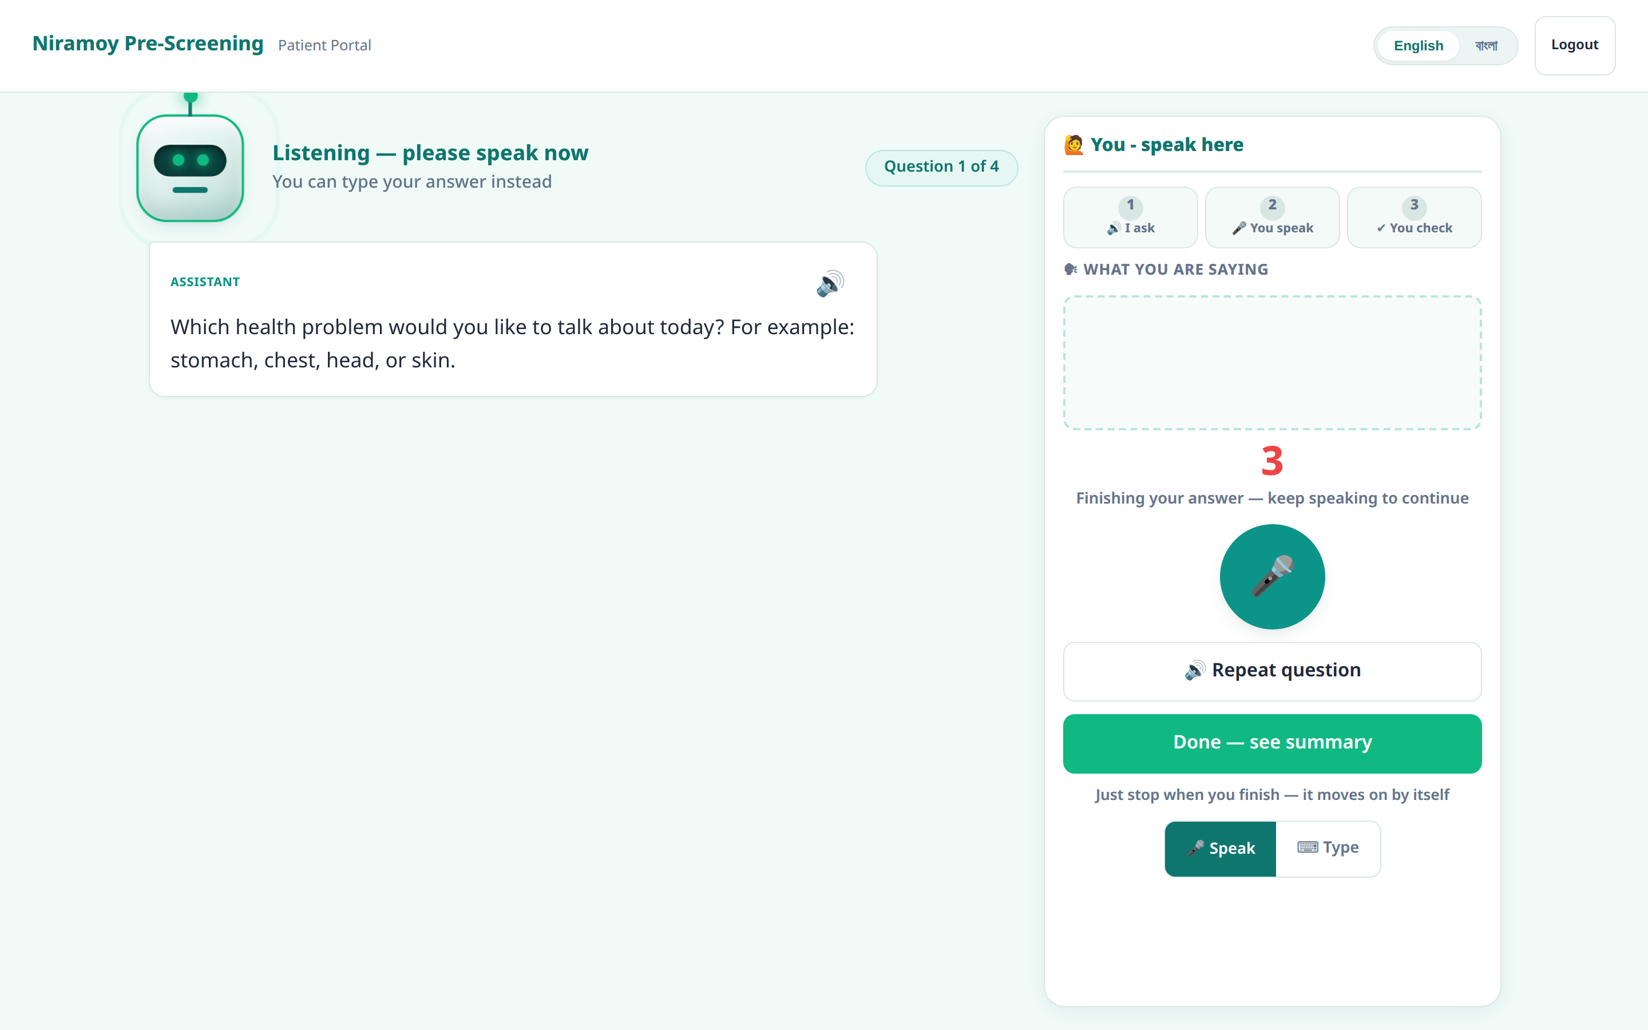
VOICE-FIRST INTERACTION
Hands-free by design
1
The assistant asks
the question is spoken aloud and shown on screen
2
The mic opens itself
after the audio ends — an echo guard keeps the AI's voice out of the transcript
3
The patient just talks
no button to hold; words appear live as they speak
4
A short silence → 3·2·1
a visible confirmation window — speaking again cancels it
5
The answer is submitted
the next question follows automatically
⌨ Typing is always available — same question, same pipeline, just a different input.
The 3·2·1 confirmation window — a safety pause, not a hard cut-off
Niramoy · Voice-First Pre-Screening
06
Notes:
This is the heart of the product and I want to be precise about it. The loop is genuinely hands-free on the happy path: the mic opens after the question, the patient speaks, a short silence triggers a visible three-two-one window, and if they resume speaking it cancels — a clipped answer would violate the raw-words rule, so the countdown is a confirmation, never a guillotine. Be honest: the final robustness — auto re-prompting on total silence, permission recovery — is the next hardening step I've scoped but not finished.

Slide 7
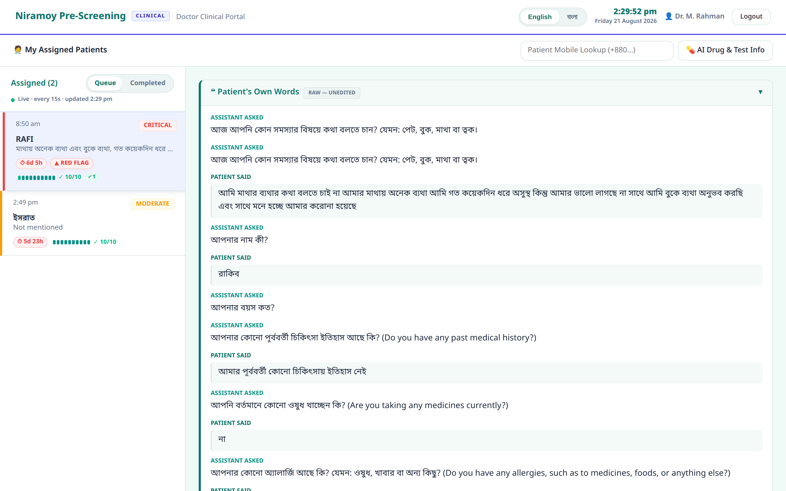
THE HARD PART
Why Bangla voice is genuinely hard
Code-switching (Banglish)
Real speech mixes Bangla and English mid-sentence — the case that breaks most recognisers.
Regional dialects
Sylheti and Chittagonian differ sharply from standard Bangla.
Medical terms & drug names
Out-of-vocabulary words the model has rarely, if ever, heard.
Noisy waiting rooms
Bystanders, family, ambient clinic noise.
The rule this forces: never change the patient's exact words.
Real case · the patient's own Bangla words, stored verbatim and read by the doctor
Niramoy · Voice-First Pre-Screening
07
Notes:
I'm not going to pretend Bangla speech is solved — it isn't, for anyone. Code-switching, dialects, medical vocabulary and clinic noise all fight you. That uncertainty is exactly why the architecture's first rule is that raw words are never altered: if the machine is unsure, the human still has the ground truth. On the right is a real case — the patient's own words, verbatim, in front of the doctor.

Slide 8
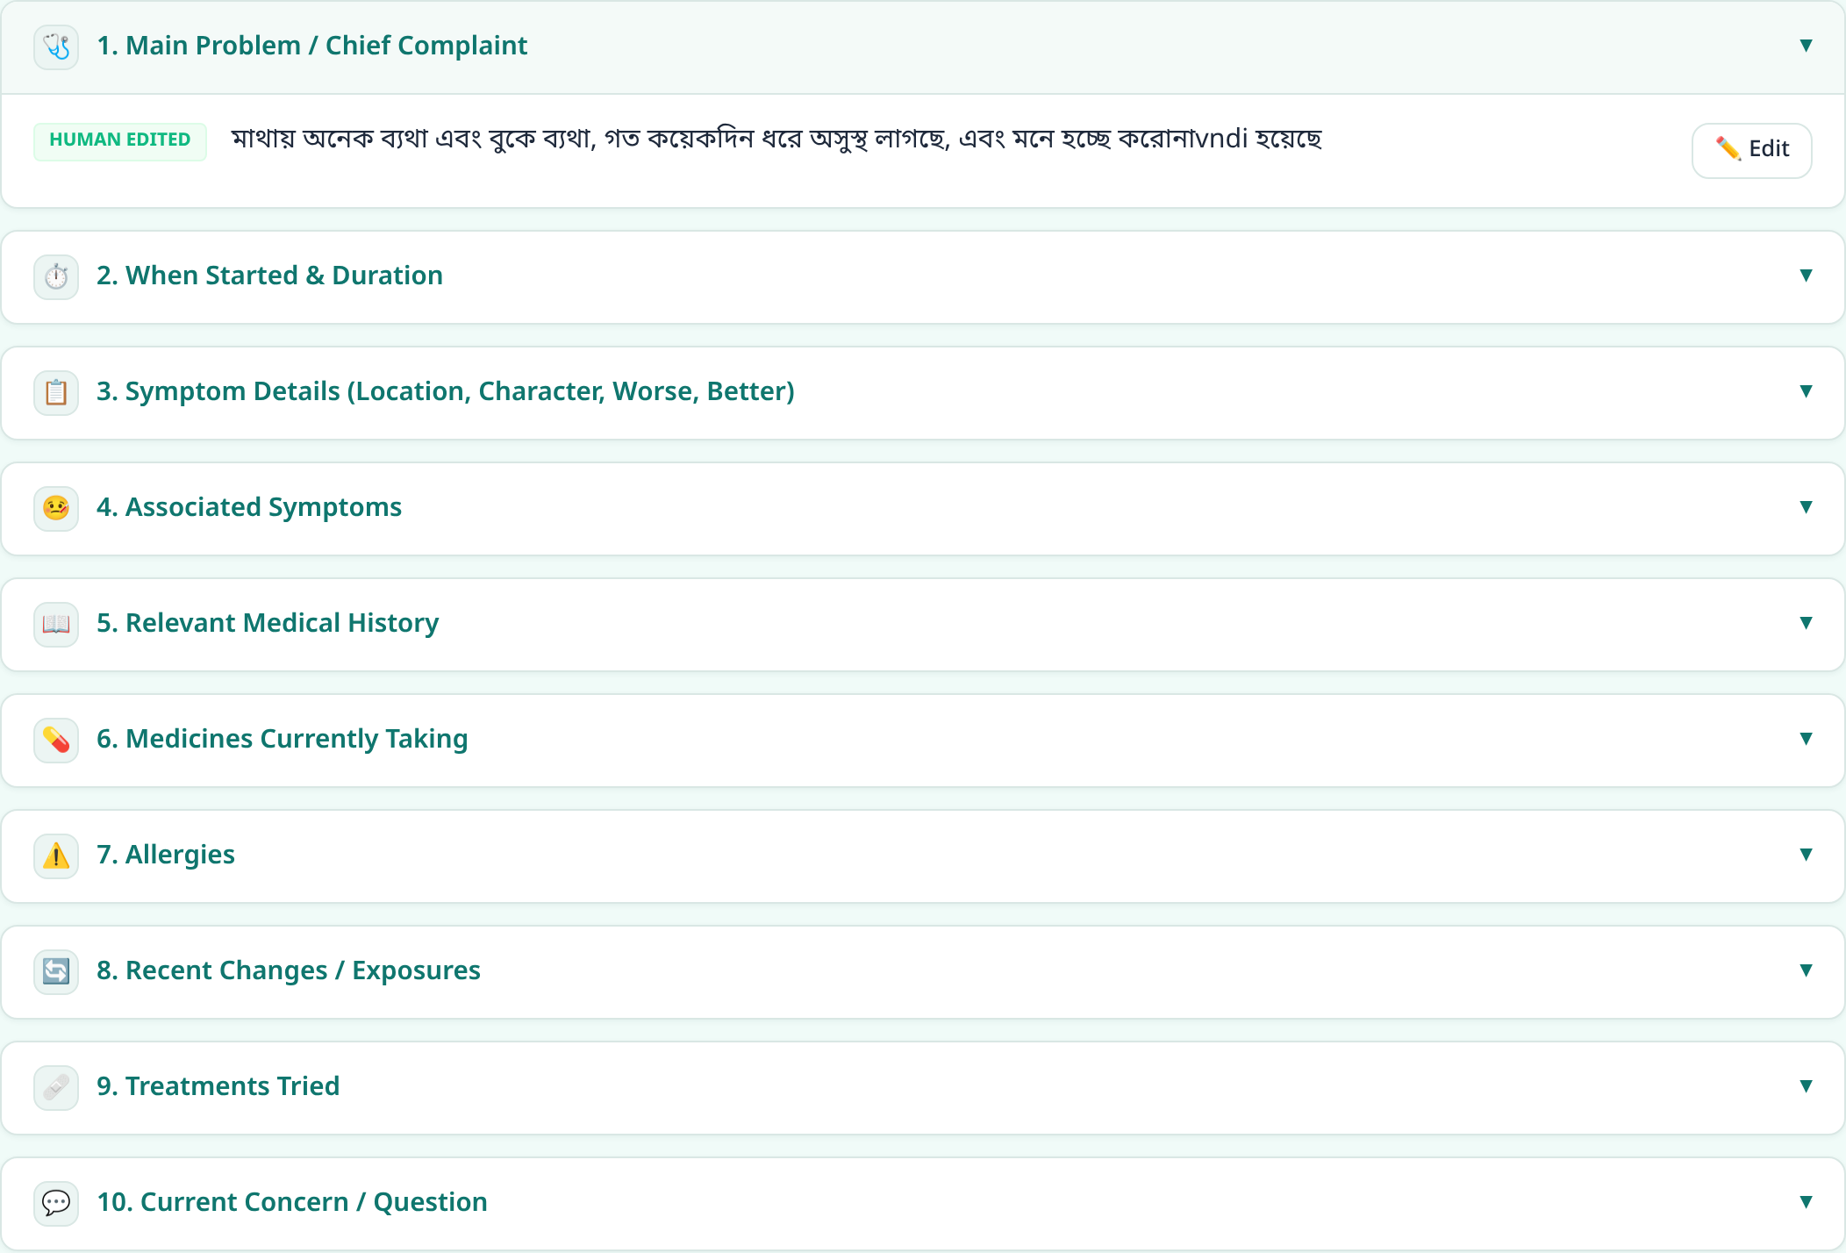
UNDER THE HOOD
The AI / LLM pipeline
Every AI task goes through one swappable, OpenAI-compatible client. That single seam is what lets a cloud model today become a local, on-device model tomorrow — with no pipeline rewrite.
1
Correct the Bangla/Banglish text (separate field)
2
Extract symptoms, duration, severity, meds, history
3
Find the gaps → generate targeted follow-ups
4
Summarise into 10 doctor-ready fields
Real output · free speech becomes 10 structured, staff-verifiable fields
5
Attach risk tier + explanation
Niramoy · Voice-First Pre-Screening
08
Notes:
The AI is a pipeline, not one magic call. Correct, extract, find gaps, ask follow-ups, summarise, assess. The key engineering decision is the single OpenAI-compatible client behind all of it — that seam is deliberate, because the faculty's next requirement is to drop in a local quantized model, and this design means that's a config change, not a rewrite. On the right is the real extracted 10-field profile the staff verify.

Slide 9
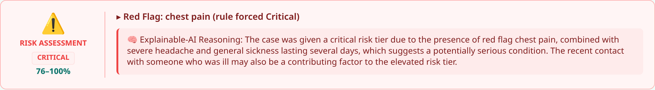
SAFETY & INTEGRITY
Built to assist — never to diagnose
🚫
It never diagnoses
⚠
Red flags are a rule, not a guess
The system narrows what's worth considering and surfaces information. The doctor decides — always.
Life-threatening words (e.g. chest pain) force a Critical tier through a rule that runs independently of the AI — so a bad model day can't hide an emergency.
🔢
No invented numeric score
🧠
Every risk carries its reasoning
Risk is a tier with reasons, not a false-precision percentage nobody can justify.
A plain-language explanation accompanies each assessment — auditable, not a black box.
Niramoy · Voice-First Pre-Screening
09
Notes:
Safety is a design stance, not a feature I bolted on. Four decisions: never diagnose; make red-flags a rule that runs independently of the model so an emergency can't be missed; refuse to invent a numeric score; and attach a plain-language reason to every risk. The strip at the bottom is a real Critical case — the red-flag rule fired on chest pain and forced Critical, and the explanation says exactly why.

Slide 10
RESILIENCE
Keeping it alive on free infrastructure
Niramoy runs on free AI tiers — which hit daily limits, and whose models get retired without notice. So the one LLM client fails over automatically across three independent dimensions.
Gemini
Groq
Cerebras
OpenRouter
Flash / Flash-Lite
fast LPU
high daily volume
universal fallback
provider × keys × models — each layer multiplies the fallbacks; a 429 cools down only that one path.
Why I built this: the night before a demo, my live chain went down — one model had been retired upstream, another was rate-limited. I re-architected the fallback into these three multiplying dimensions so a single dead provider can never again stop a patient mid-intake.
Niramoy · Voice-First Pre-Screening
10
Notes:
This is my favourite real-engineering story. It runs on free tiers by necessity, and free tiers are unreliable by nature. The fallback multiplies across providers, keys and models. And it isn't theoretical — it came out of a real outage the night before a demo, which taught me the failure mode and made me redesign it. No secrets on this slide, just the architecture.

Slide 11
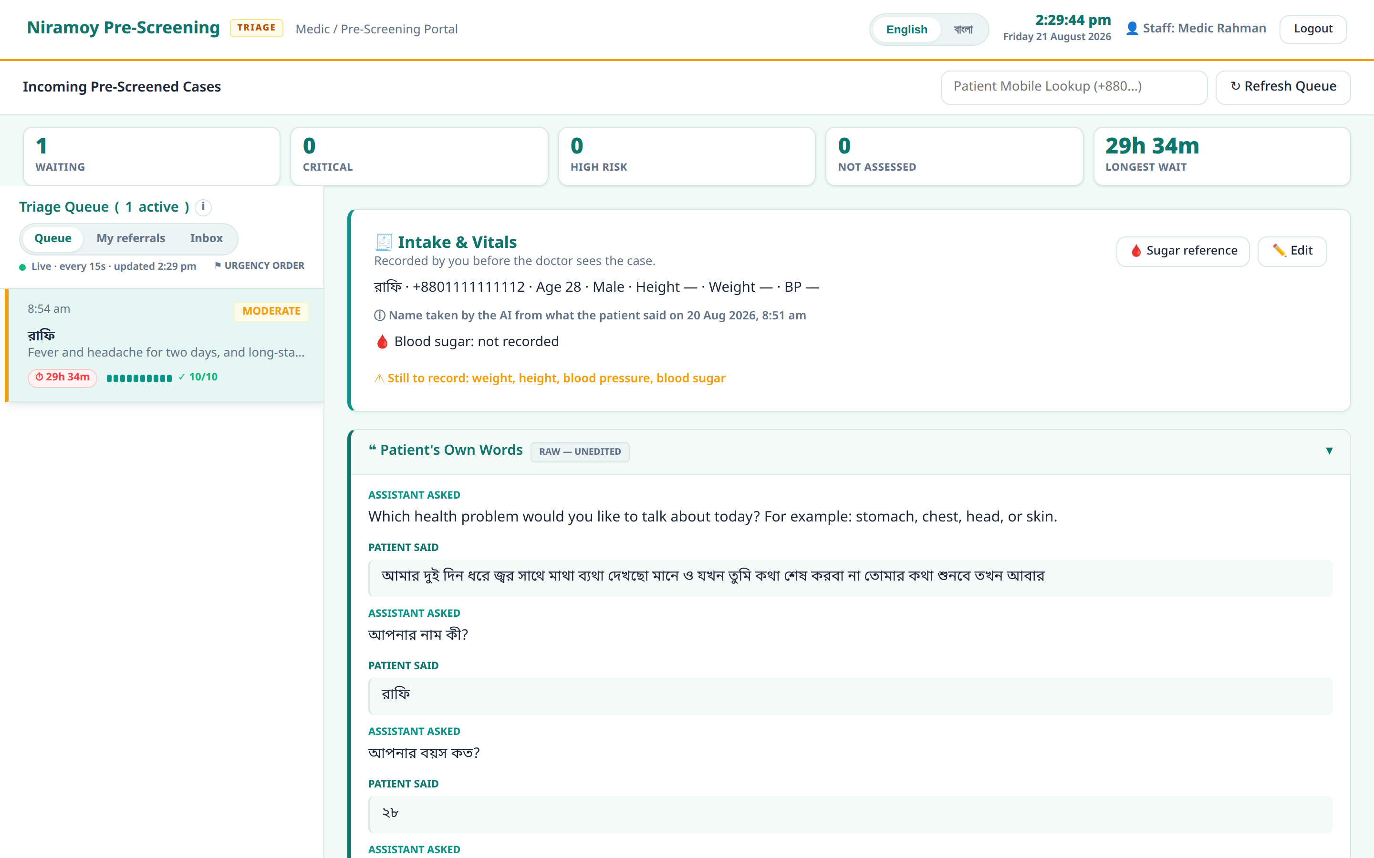
DEMONSTRATION
See it in action
One real run: the patient speaks hands-free → the medic verifies and triages → the doctor sees the safety story and prescribes.
1 · Patient speaks
2 · Medic verifies & triages
3 · Doctor decides
Niramoy · Voice-First Pre-Screening
11
Notes:
Cut to the walkthrough video here. Keep narration light — let the real UI carry it. The story is one continuous journey: patient speaks, medic verifies against the raw words and adds vitals, doctor reads the safety panel and writes the prescription.

Slide 12
CURRENT STATE
What actually works today
14
~1,196
18
3
modules built (of 15)
automated tests passing
database tables · 14 migrations
working role portals
Runs locally with one command · real OTP (hashed, expiring) · EHR export as DOCX, PDF (with correct Bangla shaping) and an HL7 FHIR bundle · all on synthetic / consented data.
Honest about what's not proven yet
Formal accuracy (word-error-rate) has not been measured yet — a live real-mic run passed and STT felt accurate, but I won't claim a number I haven't recorded. Live speech-to-text is browser-based (cloud), and staff login is still stubbed.
Niramoy · Voice-First Pre-Screening
12
Notes:
Be concrete and be honest — this is what earns trust. Fourteen of fifteen modules, around 1,196 passing tests, 18 tables, three real portals, real OTP, EHR export in three formats including correctly-shaped Bangla PDFs. And the amber box matters as much as the numbers: I have not measured formal WER, so I won't quote one. That honesty is deliberate.

Slide 13
LIMITS & ROADMAP
What's next
Today's limits
Where it goes
Cloud STT sends audio to Google's servers
Free-tier LLMs may train on inputs → synthetic / consented data only
Staff authentication is stubbed
SQLite single-node; no formal WER yet
Fully-automatic endpointing not finished
On-device quantized speech model → fully offline & private
Local quantized summary model (Moshi) → no patient data leaves the machine
Finish the fully hands-free voice loop
Real auth, Postgres, encryption at rest
Formal WER + precision/recall evaluation
Niramoy · Voice-First Pre-Screening
13
Notes:
I pair every limit with where it goes. The headline of the roadmap is on-device: a local quantized speech model and a local summary model mean nothing leaves the machine — which turns the biggest privacy limitation into the biggest future strength, and it's exactly what the single swappable client was designed to allow.

Slide 14
HOW I BUILT IT
I directed the build — and I own the system
I used AI coding assistance to move fast — and I made every decision that mattered.
Chose the architecture, the stack, and the non-negotiable rules (raw words immutable; never diagnose).
Debugged real defects myself — a CSS hit-target bug found only with real mouse events; a UTC-vs-Dhaka date bug.
Curated ~69 written decision records and a ~1,196-test suite; ran the live real-mic tests myself.
I know where every part lives, what it does, and why it's there.
The one line
Niramoy meets patients in their own language — by voice, hands-free — and hands the doctor structure, safely.
Next: on-device, offline, fully hands-free.
Thank you — happy to go deep on any part.
14
Notes:
Close on ownership, in your own voice. Say plainly: I used AI assistance to build fast, and I made every decision that mattered — architecture, rules, debugging, testing. I can open any file and tell you what it does and why. Then the one line, and the forward look: on-device, offline, fully hands-free. Invite the deep-dive questions — you're ready for them.

