Slide 1
VOICE-FIRST CLINICAL AI · BANGLADESH
Niramoy
A voice-first medical pre-screening system I designed and built for clinics in Bangladesh.
Patient speaks → AI structures → Medic verifies → Doctor decides → structured EHR
AI-assisted engineering — I directed, understood, tested, and debugged the whole system.

Slide 2
!
The problem I set out to solve
In a real Bangladeshi clinic, the hardest part happens before the doctor even speaks
⏱
👤
🗣
Two-minute consultations
Patients who can't fill forms
A language tools ignore
Doctors see huge volumes; history-taking gets compressed and details are missed before the exam even starts.
Elderly, low-literacy or anxious patients can't organise their own symptom history the way a form demands.
Real patients speak Bangla, Banglish and regional dialects — most digital tools assume English, or typing.
The people who most need help are exactly the ones today's tools leave out. That gap is the problem I wanted to close.
Niramoy · voice-first medical pre-screening
2

Slide 3
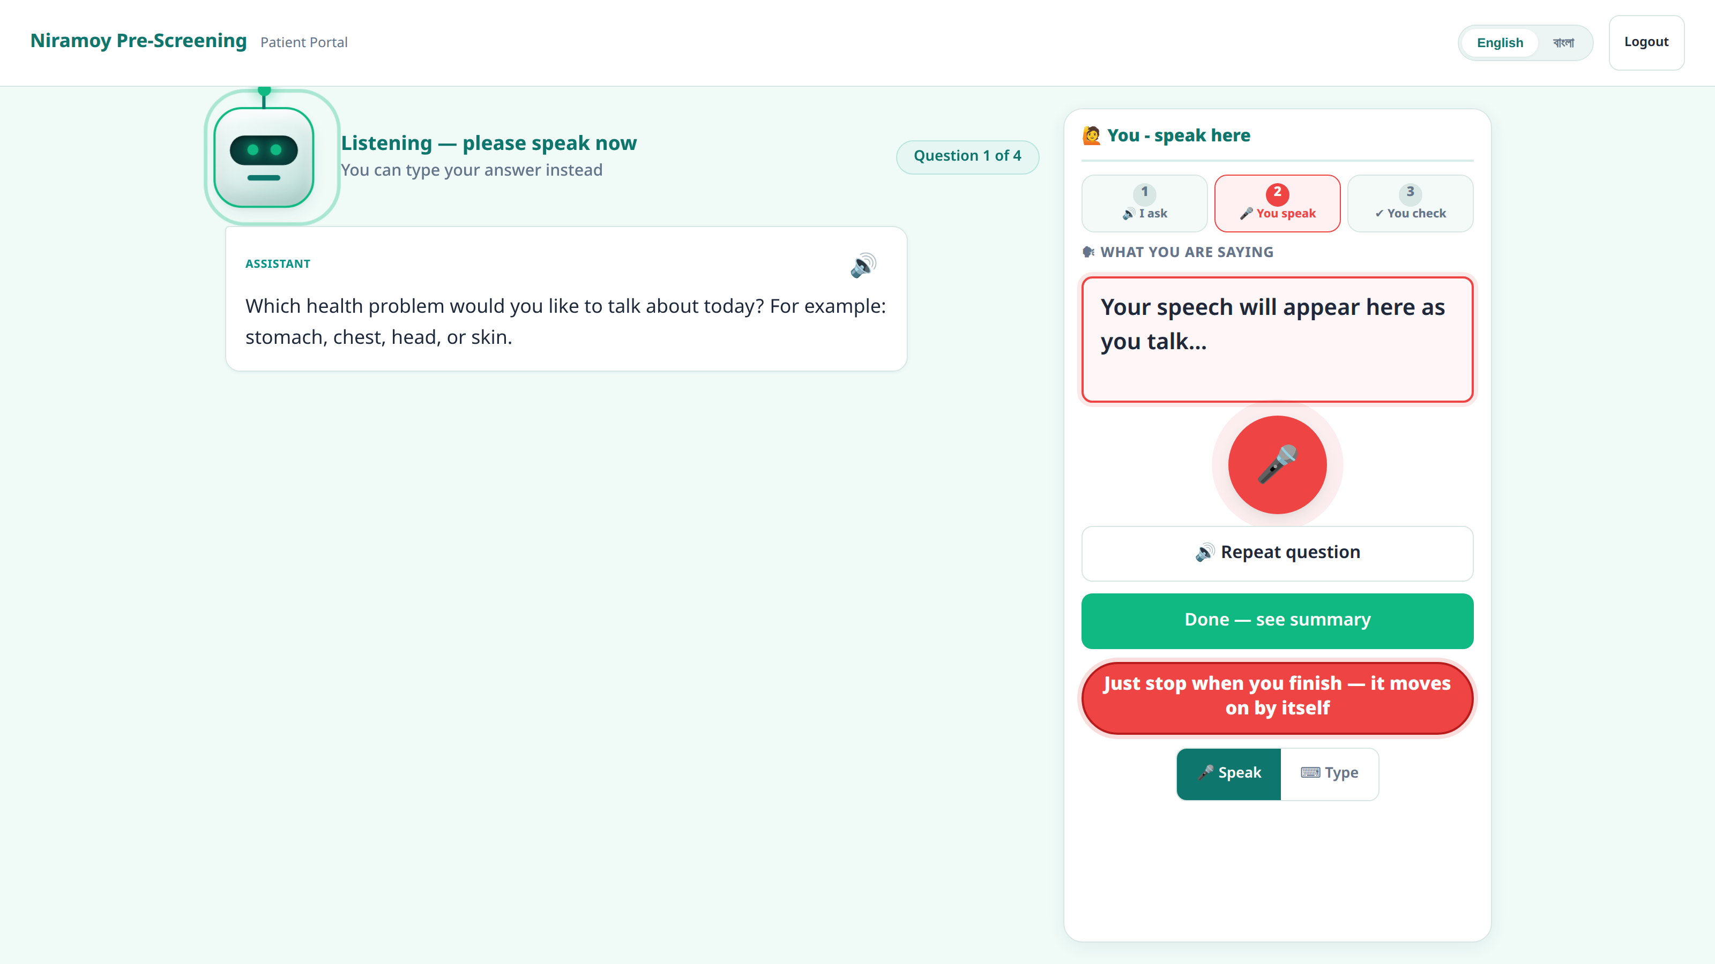
🎙
Why voice-first — and hands-free
The design bet the whole product is built on
Let people just speak.
The assistant asks a question out loud → the microphone opens by itself → the patient speaks → a visible 3-2-1 confirmation → the next question. Nothing to tap.
Voice is the default, not a bonus feature.
Typing is always available as a fallback and runs through the exact same pipeline — so a noisy room or a failed mic never blocks a patient.
Real patient screen — the mic is open and listening, hands-free.
Built for a patient who is elderly, non-technical, or can't read the screen — the interaction comes to them.
Niramoy · voice-first medical pre-screening
3

Slide 4
বাং
The hard part: Bangla, Banglish & regional speech
Why this is a genuinely difficult recognition problem — for anyone
1
Code-switching
2
Regional dialects
Patients mix Bangla and English mid-sentence ('mathay pain hocche') — this breaks most recognisers.
Sylheti and Chittagonian differ sharply from standard Bangla in words and pronunciation.
3
Out-of-vocabulary
4
Clinic noise
Medical terms and drug names are rarely in a general speech model's vocabulary.
Real waiting rooms are loud — far from clean recording conditions.
This uncertainty is exactly why the architecture's first rule is that the raw words are never altered. The doctor can always check the AI against what was actually said.
Niramoy · voice-first medical pre-screening
4

Slide 5
⛭
What I built: one system, three roles
A single FastAPI backend and one database, with a purpose-built portal per role
Voice-first intake
Verify & triage
Decide & record
Patient portal
Medic desk
Doctor workspace
Phone + one-time code → speak symptoms → follow-ups → review a structured summary → submit. Hands-free, bilingual.
An urgency-ordered queue; check the AI's fields against the raw words; record vitals; forward to a doctor.
Safety first — risk, red flags, reasoning; patient history; prescribe; write a structured EHR document.
15
18
~1,196
CPU-only
modules (M1–M14 built)
database tables
automated tests
no GPU needed
Niramoy · voice-first medical pre-screening
5

Slide 6
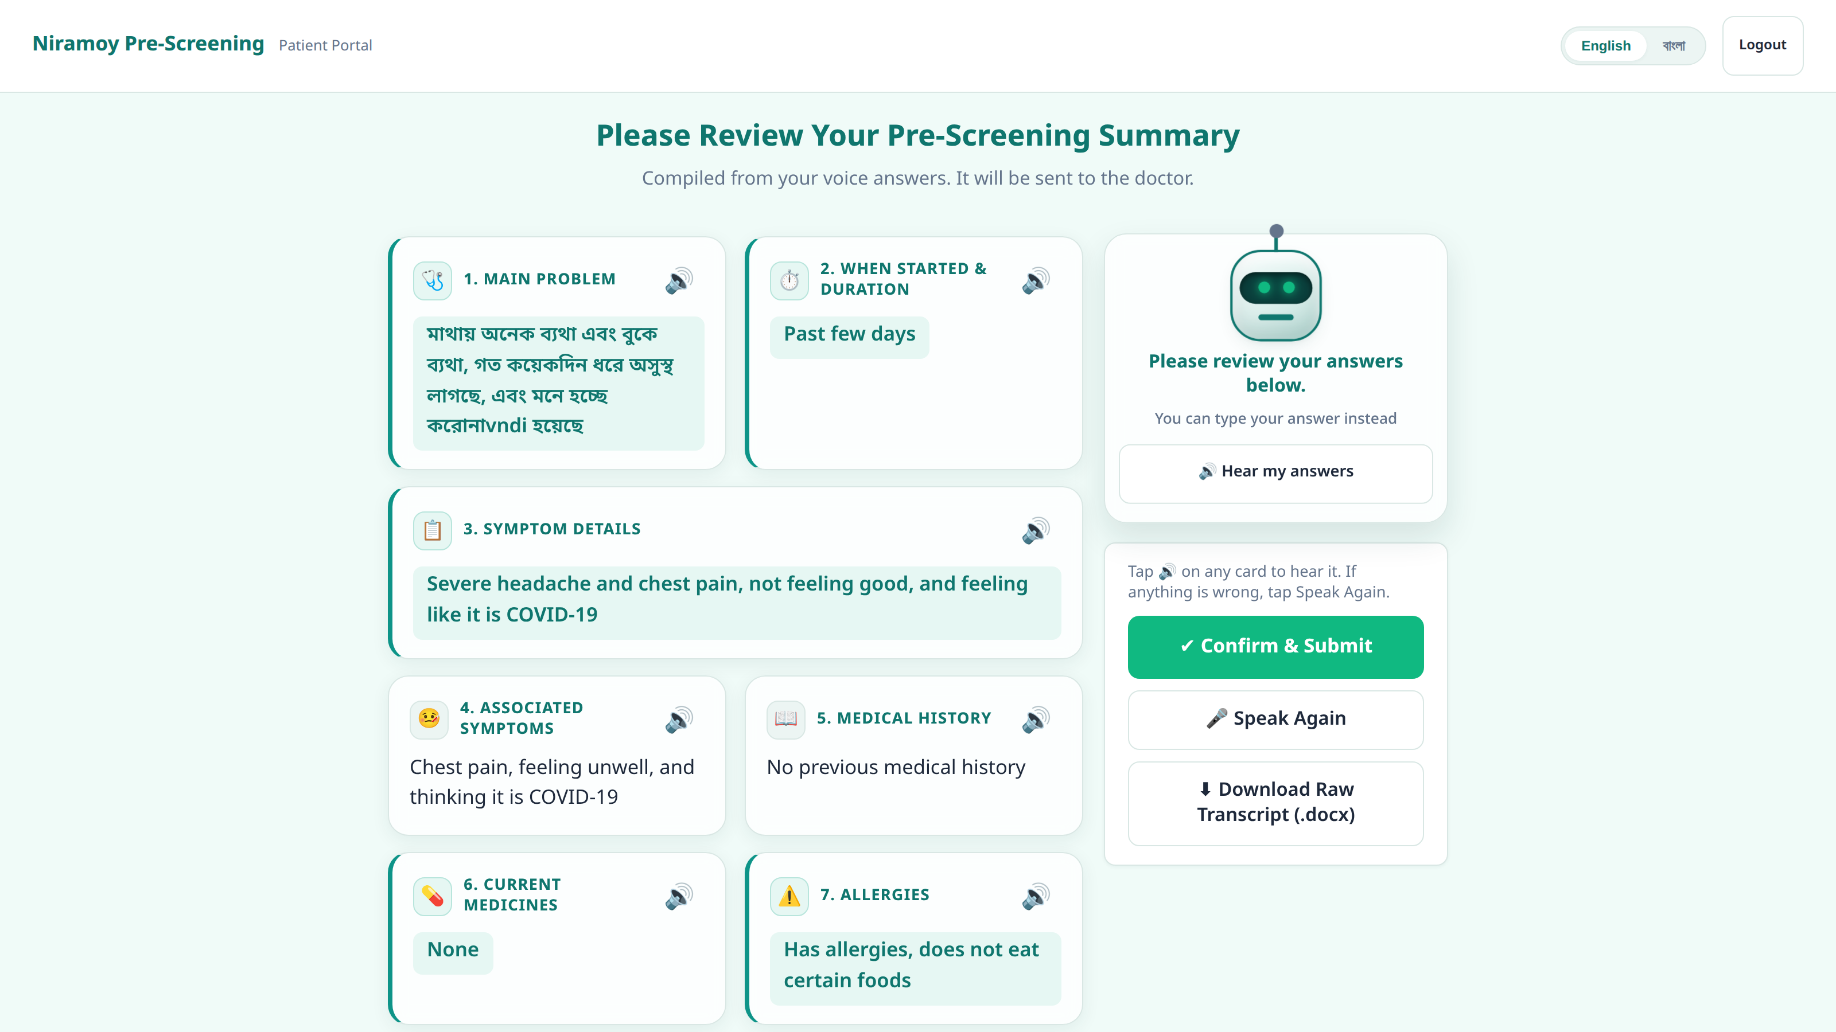
THE HEART OF THE SYSTEM
The patient experience, end to end
1
Sign in
2
Speak
3
Exact words kept
Phone number + one-time code. No app, no account.
Answers naturally in Bangla or Banglish — voice-first, hands-free.
Stored verbatim and read back. Never edited (rule #1).
4
Follow-ups
5
Summary
6
Submit
The system asks spoken follow-up questions; the patient answers by voice.
Everything organised into a structured summary — and read aloud.
Risk & red flags assessed in the background, for the doctor.
Real screen: the structured summary the patient reviews before it reaches the doctor.
Most of my demo video is this section — because this is where the product earns its name.

Slide 7
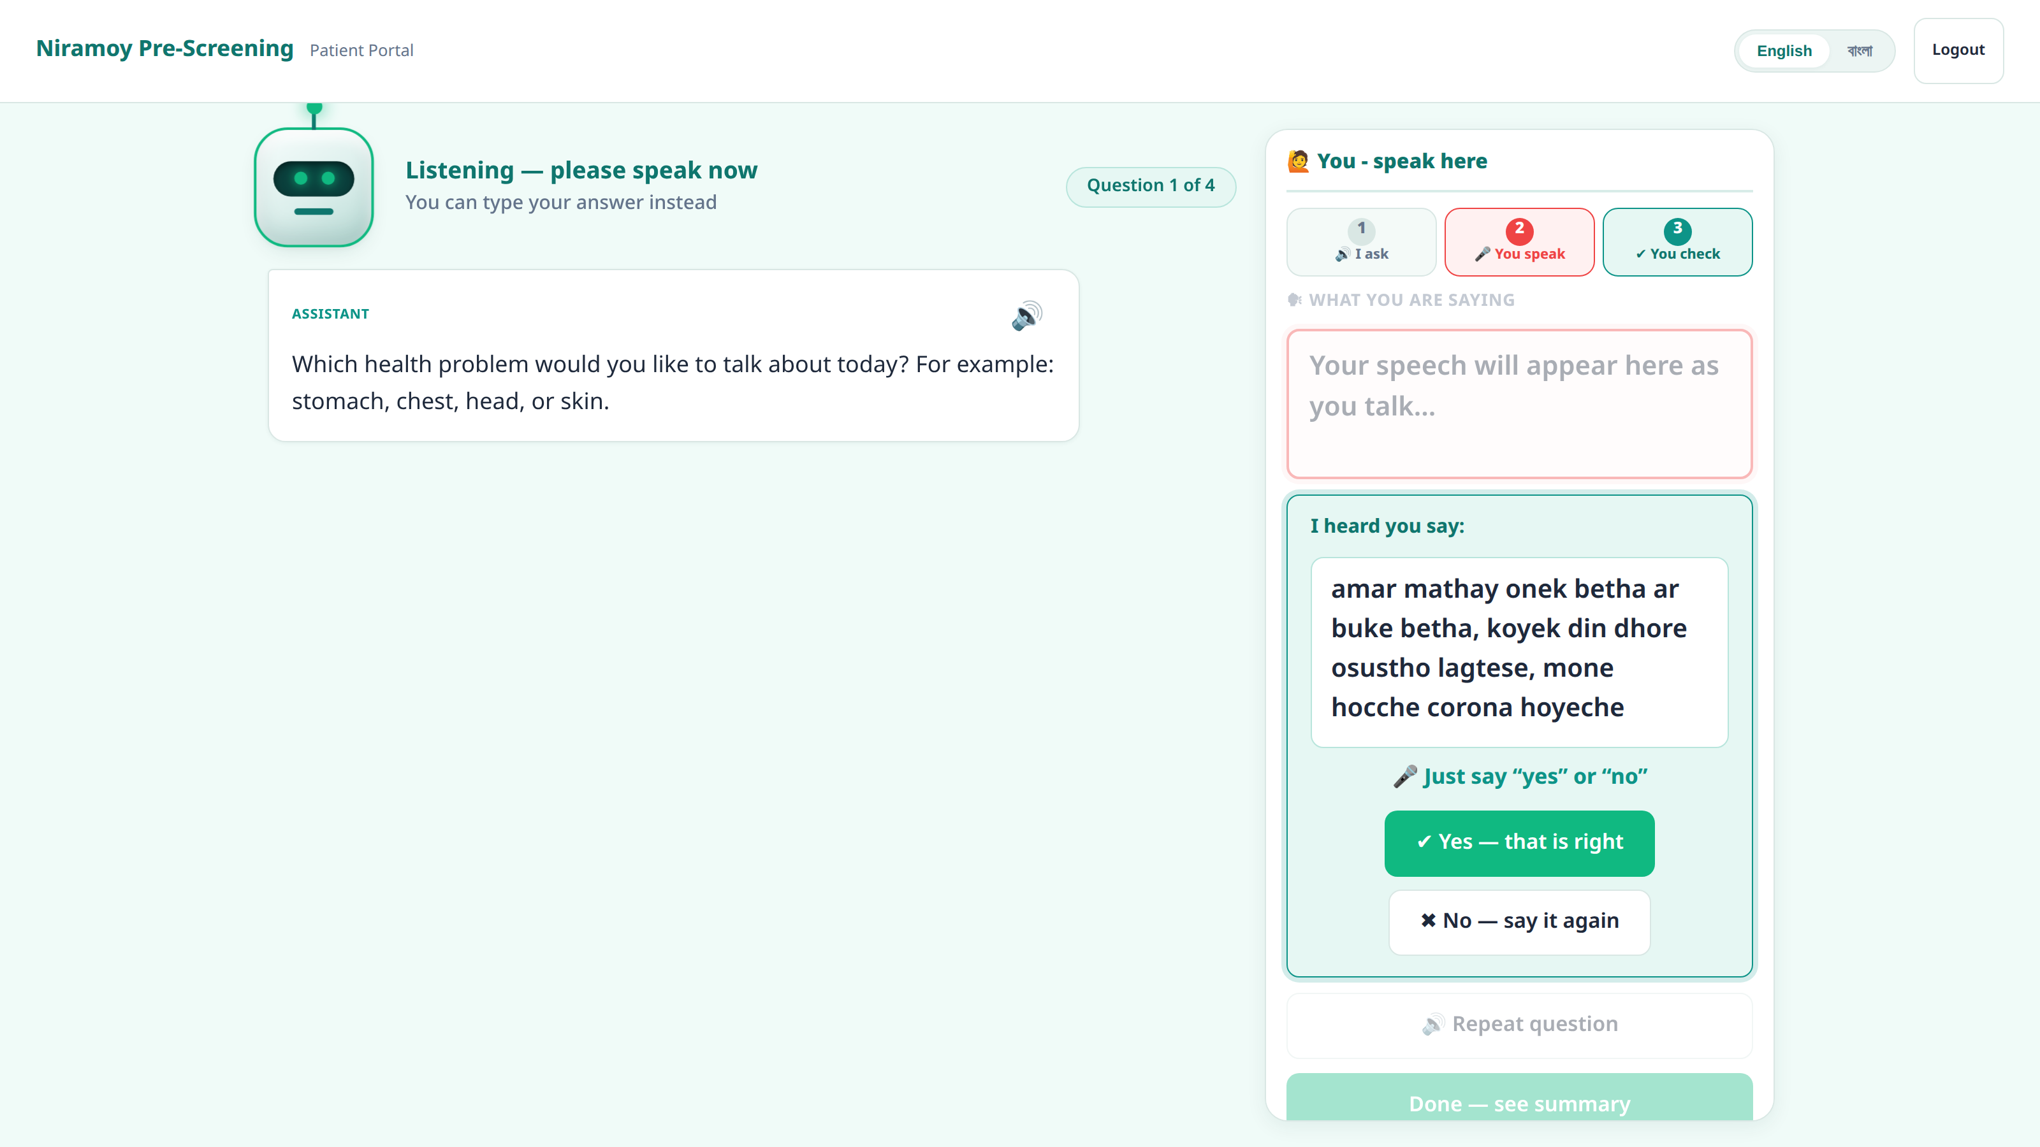
🔒
Rule #1: the patient's exact words are permanent
The single invariant the whole design protects
The raw transcript is written once and never changed.
Cleaning, correction and Banglish→Bangla normalisation happen in separate, later fields — never on top of the original.
Why it matters:
If the AI is ever unsure or wrong, the human still has the ground truth of what the patient actually said.
Enforced in code, and pinned by its own automated test.
Real screen: the system reads the answer back and stores it exactly as spoken.
Niramoy · voice-first medical pre-screening
7

Slide 8
⊞
How the system fits together
One request's path — from a browser microphone to a stored clinical record
Browser portals
HTML / JS — patient · medic · doctor
LLM client
Gemini · Groq · Cerebras · OpenRouter
FastAPI REST API
thin routers under /api
STT
Service layer
one file per module (M1–M16)
browser Web Speech (bn-BD)
Repository
SQLAlchemy models
TTS
edge-tts neural · espeak fallback
SQLite · Alembic migrations
config-driven URL → Postgres later
Every module output is a child of the visit aggregate root — a new module run is a new code, not a new table.
Niramoy · voice-first medical pre-screening
8

Slide 9
📁
Where each part is implemented
I can open any of these and explain what it does and why
Patient voice portal
Medic & doctor portals
›
›
frontend/kiosk.js · kiosk.html
frontend_medic/ · frontend_doctor/ · frontend_shared/
REST API
The 15 modules
›
›
backend/app/api/routes_*.py
backend/app/services/*.py (intake, followup, risk, red_flags…)
AI / LLM client + fallback
Speech (STT / TTS)
›
›
services/llm_client.py · core/llm_providers.py
browser Web Speech · services/tts/
Database & migrations
EHR export
›
›
db/models.py · migrations/versions/0001–0014
services/ehr_export.py (FHIR) · ehr_pdf.py (Bangla PDF)
Niramoy · voice-first medical pre-screening
9

Slide 10
🧠
The AI pipeline — one swappable client
Not one magic call: a pipeline, with provider independence engineered in
Correct
Extract
Find gaps
Follow-up
Summarise
Risk + explain
Redundancy that multiplies in 3 dimensions
What runs where
Buckets (providers, in a fallback order) × Keys (up to 3 per provider) × Models (comma-separated lists)
LLM correction · extraction · summary · follow-ups · risk tier · explanation · report
Local / no-API speech-to-text · completeness scoring · the red-flag rule
A rate-limit cools down only that one (provider, key, model) path — temporarily. Nothing is ever permanently disabled.
It came from a real pre-demo outage: a model was retired upstream and another was rate-limited. I re-architected the fallback so a single dead provider can never again stop a patient mid-intake.
The safety-critical red-flag check must never depend on a model's mood — so it's a rule.
Niramoy · voice-first medical pre-screening
10

Slide 11
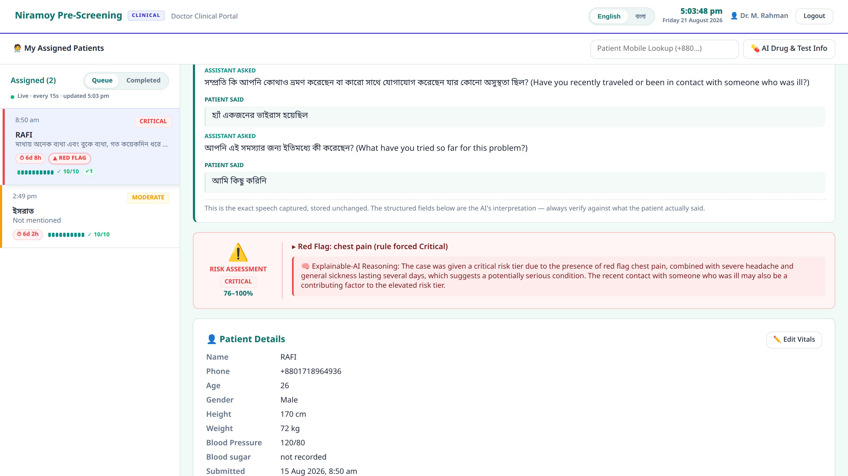
🛡
Safety is a design stance, not a feature
Four decisions that make the system safe to put in front of a patient
✓
Never diagnoses
It narrows what's worth considering; the doctor decides. No autonomous diagnosis, ever.
✓
Rule-based red flags
A red flag (e.g. chest pain) forces a Critical tier by a rule that runs independently of the AI.
✓
No invented score
Risk is a tier with reasons — not a false-precision percentage nobody could justify.
Always explained
Real doctor screen: a Critical tier, the red-flag rule fired on chest pain, and the reason stated.
✓
Every risk carries a plain-language reason the doctor can read and check.
Niramoy · voice-first medical pre-screening
11

Slide 12
🔧
Hard problems I diagnosed and solved
The kind of judgement and debugging that doesn't come from generated code
1
The provider outage
2
Bangla in the PDF
A live model was retired the night before a demo. I turned one flaky client into a provider × key × model fallback chain.
ReportLab can't shape Bengali conjuncts. I moved to fpdf2 + HarfBuzz and made the renderer refuse rather than ship mangled words.
3
The midnight date bug
4
The button that did nothing
Prescriptions written after midnight Dhaka got yesterday's date — a UTC bug. Fixed with a fixed UTC+6 offset and a date policy.
A CSS transform under a perspective moved a control out from under the cursor. Depth now lives in the shadow, not a transform.
Niramoy · voice-first medical pre-screening
12

Slide 13
🧪
How I test and debug
Confidence comes from an offline test suite and a documented paper trail
~1,196
~69
What's covered
Follow-up loop · intake · triage · risk & red-flag override · OTP · migrations · the multi-key fallback · raw-immutability
automated tests — all offline,
no network, no real API calls
decision records (ADRs)
documenting why each choice was made
A debugging lesson I can tell
A medic "Edit" button did nothing. It wasn't the handler or the API — a CSS transform was rescaling the card on press, so mousedown and mouseup landed on different elements and the click never fired. The meta-lesson: a programmatic .click() can't catch a hit-target defect — you have to drive a real mouse. There's a test pinning it now.
Niramoy · voice-first medical pre-screening
13

Slide 14
◑
What's not done — stated honestly
Knowing exactly what isn't finished is part of owning the system
Cloud STT today
No formal WER yet
Live speech-to-text is browser-based and sends audio to Google — so development uses synthetic/consented data only.
A live real-mic run passed and felt accurate, but I won't quote an accuracy number I haven't measured.
Auth is stubbed
Not yet hardened
Staff login is a demo stub; real authentication is a later phase.
No encryption at rest; single-node SQLite; the fully-automatic voice endpointing (S5) is unfinished.
I'd rather show you a true boundary than an invented number.
Niramoy · voice-first medical pre-screening
14

Slide 15
➜
Where this goes next
Each limitation is paired with the engineering that resolves it
1
On-device speech
Why the future is cheap to reach
A local quantized STT/TTS model — fully offline, removing the Google/Microsoft data path entirely.
Every AI call already goes through one OpenAI-compatible client, and speech sits behind a provider seam.
So swapping in a local, on-device model is a configuration change — not a rewrite.
That single design decision was made specifically to make this possible.
2
On-device summary
A local quantized summary model replaces the LLM API for extraction — private, no quota.
3
Productionise
Real auth, Postgres, encryption at rest, and a single-container deploy.
4
Measure
A formal WER + extraction precision/recall pass on a held-out Bangla/Banglish set.
Niramoy · voice-first medical pre-screening
15

Slide 16
WHAT I DEMONSTRATED AS AN ENGINEER
I built this with AI assistance — and I own it.
I chose the architecture and the stack, set the non-negotiable rules, debugged the hard defects, wrote and curated the tests and decision records, and ran the live tests myself.
I can open any file and tell you what it does and why it's there.
Niramoy meets patients in their own language, by voice, hands-free — and hands the doctor structure, safely. The next step is on-device, offline, and fully hands-free.
Thank you — I'd love to go deep on any part of it.

