Slide 1
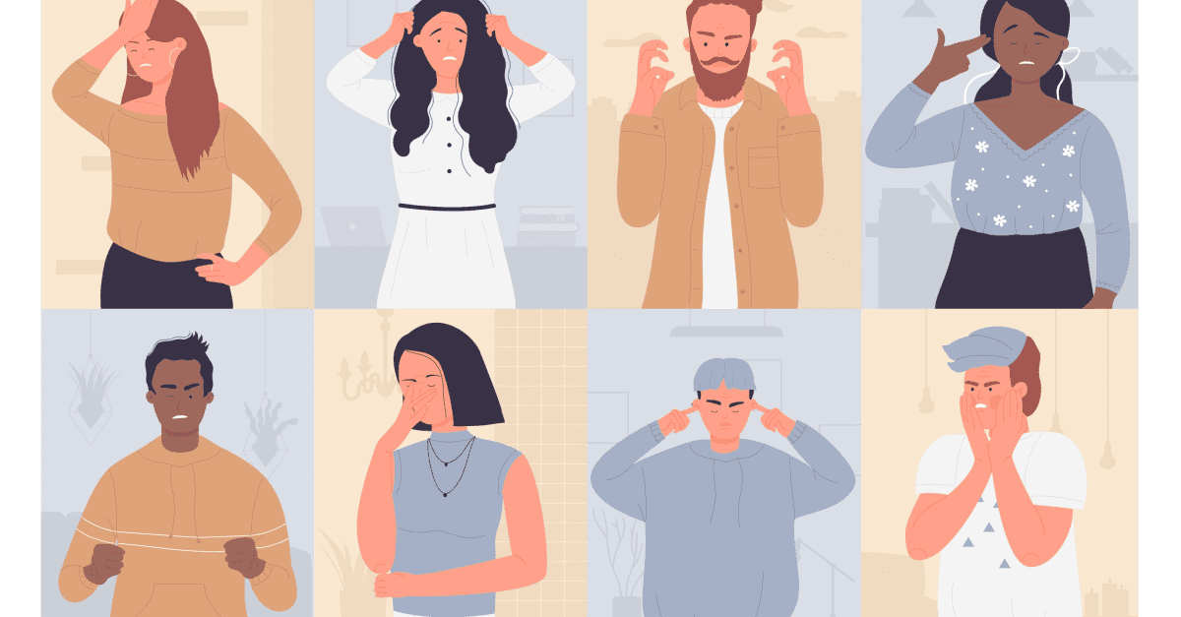
Nonverbal Messages
Week 3, NCA

Slide 2

Learning Objectives
Understand nonverbal communication
Identify the 4 characteristics of nonverbal communication
Identify the different types of nonverbal communication: body, voice, appearance

Slide 3
What is nonverbal message?

Slide 4

What is nonverbal message?
Communication exchanges are more than verbal messages. Communication exchanges are also rich in nonverbal communication.
Nonverbal communication consists of all the messages we send in ways that transcend spoken or written words. More specifically, nonverbal messages are cues we send with our body, voice and appearance to support, contradict, or even replace a verbal message.

Slide 5
What is nonverbal message?
Nonverbal messages play an important role in communication. In fact, 65-90% of meaning comes from the nonverbal messages we use to communicate in face-to-face interactions.
In other words, the meaning we assign to any utterance is based on our interpretation of both the verbal and the nonverbal messages that accompany it.
Interpreting nonverbal messages accurately is critical to understanding and responding appropriately to what others are saying.

Slide 6


Even though we don’t know what this person is speaking about, we can see his enthusiasm and engagement through his body language

Slide 7
Types of Nonverbal Communication

Slide 8
Types of Nonverbal Communication
Physical
Appearance
Use of Body
(Kinesics)
Voice (Paralanguage)

Slide 9
Use of Body: Kinesics

Slide 10
Use of Body: Kinesics
Kinesics is the technical name for what and how body motions communicate. We may use gestures, eye contact, facial expressions, posture and body movement. It looks at how things like posture, hand movements, eye contact, and facial expressions contribute to communication. Kinesics plays a huge role in public speaking because it can either enhance or undermine your message.
Gestures - Gestures are the movements of our hands, arms, and fingers to accompany or replace a verbal message. You can use gestures when delivering speeches to describe or emphasize what you are saying or refer to presentational aids. Hand gestures can help emphasize points and keep the audience engaged. Just as we rehearse our words for the best effect possible, we also need to think about and practice gestures that will convey the meanings and emotions that we intend. The best gestures to use are ones that are natural and that emphasize what you’re saying. Avoid gestures that distract the audience or change the meaning of your words.

Slide 11
Use of Body: Kinesics
Eye contact – The most important way to engage an audience is by looking at them. Eye contact is one of the key ingredients to successful speaking. Making eye contact with your audience helps build a connection and shows confidence. A speaker who reads their notes constantly, looks at their feet or their visuals, and never looks up at the audience communicates that they are nervous and unprepared. A speaker who tries to look at every part of the audience will be sure to win them over by confidently engaging them with the material.
Facial expression - Facial expression is using facial muscles to communicate and they are very important when speaking. They can also help animate your speech by enhancing the words you say, much like gestures. It’s very important that your nonverbal facial expression reinforces the message you’re trying to get across to your audience.

Slide 12
Use of Body: Kinesics
Posture - Posture is how we position our body. Posture can communicate attentiveness, respect, and dominance too. When giving a public speech, an upright stance communicate a sense of confidence, authority and credibility whereas speakers who slouch may be perceived as lacking self confidence and not caring about the topic, audience and occasion.
Body Movement - Body movement is changing body position. It can be motivated (movement that helps clarify meaning) or unmotivated (movement that distracts listeners from the point being made). It is important to engage only in motivated movement, movement with a specific purpose such as emphasizing an important idea, referencing a presentational air, etc.

Slide 13
Use of Voice: Paralanguage

Slide 14
Use of Voice: Paralanguage
Paralanguage refers to the vocal aspects of communication that go beyond the actual words spoken, encompassing elements such as pitch, speaking rate, pauses, and intonation. These vocal cues can provide a wealth of information about the speaker's emotions, intentions, or level of sincerity, which may not be immediately evident from the words themselves.
Pitch – Pitch is the highness or lowness of vocal tone. We raise and lower our pitch to emphasize ideas and emotion, as well as to signal a question. We sometimes raise our pitch when feeling nervous or afraid. It is important to practice your speech using the appropriate pitch.
Example: If someone speaks in a flat, monotonous way, their message might seem dull or lacking in sincerity, even if the content is interesting. If you speak with energy and passion (a lively tone and varied pitch), your audience is likely to feel more engaged and excited about the topic.

Slide 15
Use of Voice: Paralanguage
Rate – Rate is the speed at which a person speaks. Controlling the rate at which one speaks is often one of the most challenging things a speaker has to do. Control your pace—don’t rush through the material, and use pauses for emphasis. Speaking too quickly can also make your audience tune out from listening to the speech. Rapid speech can sometimes make you seem less credible or harder to understand.
Intonation - Intonation is the variety, melody, or inflection in one’s voice. Vocal variety is the key to making sure the audience stays connected to the speech. Without variety, the audience fails to engage with the speaker because the voice comes across as monotone (absent from pitch variety) or bored.

Slide 16
Use of Voice: Paralanguage
Articulation - Articulation is how clearly the speaker pronounces words. When some sounds are slurred together or dropped out of a word, the word may not be understood by the audience. To use proper articulation, a speaker must use their articulators: tongue, teeth, and lips. When a speaker uses improper diction, the hearer cannot make out the word spoken and often requests a repeat of what was said. In public speaking, a hearer cannot request a repeat and therefore poor articulation can make a listener tune out. It is important to say all parts of the word in order to speak clearly.

Slide 17
Use of Voice: Paralanguage
A speaker who adjusts their tone for emphasis, speaks with confidence, and uses pauses effectively is often more persuasive and compelling than one who speaks monotonously or without emotional variation.

Slide 18
Physical Appearance

Slide 19
Physical Appearance
When we meet new people, we are likely to form our first impression of them based on how they are dressed and groomed. Thus, we can influence how others are likely to perceive us by our clothing and grooming choices while speaking publicly.
A neatly groomed and professional appearance sends important message about a speaker’s commitment to the topic and occasion.
The “right” clothes for a speaking situation will depend on your personal tastes, preferences, and intentions as well as the situation in which you’ll be speaking, including the audience’s expectations and the nature of the event.

Slide 20
Physical Appearance
Consider the audience and occasion.
Consider your topic and purpose.
Avoid extremes.

Slide 21
Characteristics of Nonverbal Communication

Slide 22
Characteristics of Nonverbal Communciation
1. Nonverbal communication is inevitable – The phrase “We cannot NOT communicate” captures the essence of this characteristic. If you are in the presence of someone else, your nonverbal messages (whether intentional or not) are communicating. For example, when a student yawns and stares off into the distance during class, his or her teacher may notice this behaviour and assign meaning to it. They may either interpret it as a sign of boredom or as a sign of fatigue, or even disrespect. Meanwhile, the student maybe unaware of all the messages their behaviour is sending.

Slide 23
Characteristics of Nonverbal Communciation
2. Nonverbal communication is the primary conveyer of emotions – We interpret how others feel about what they are communicating based almost entirely on their verbal messages. In fact, 90 percent of the emotional meaning of messages is conveyed nonverbally. So, when your friend frowns, clenches her fists, and forcefully says, “I am NOT angry!” her friend ignores the verbal message and believes the contradicting nonverbal messages, which communicated that Sam is actually very angry.

Slide 24
Characteristics of Nonverbal Communciation
3. Nonverbal communication is multi-channeled – We perceive meaning from a combination of different nonverbal behaviours including, for example, posture, gestures, facial expression, vocal pitch and rate, and appearance. So, when a parent observes their child’s failure to maintain eye contact, their bowed head, the parent may decide that the child is lying when he/she says they did not hit their sibling. The fact that nonverbal communication is multi-channeled is one reason people are more likely to believe nonverbal communication when nonverbal behaviours contradict the verbal message.

Slide 25
Characteristics of Nonverbal Communciation
4. Nonverbal communication is ambiguous – Very few nonverbal messages mean the same thing to everyone. The meaning of one nonverbal behaviour can vary based on culture, gender, and even context or situation. For example, in the dominant American culture, direct eye contact is understood as a sign of respect. In some cultures, however, direct eye contact might be interpreted as being disrespectful. Not only can the meaning vary among different cultures, but the meaning of the same nonverbal message also can differ based on the situation.

Slide 26
Works Cited
Verderber, K. S., Verderber, R. F., & Sellnow, D. D. (2016). Verbal Messages. In COMM4 (pp. 44–47). essay, Cengage Learning.

Slide 27
Thank You

