Slide 1
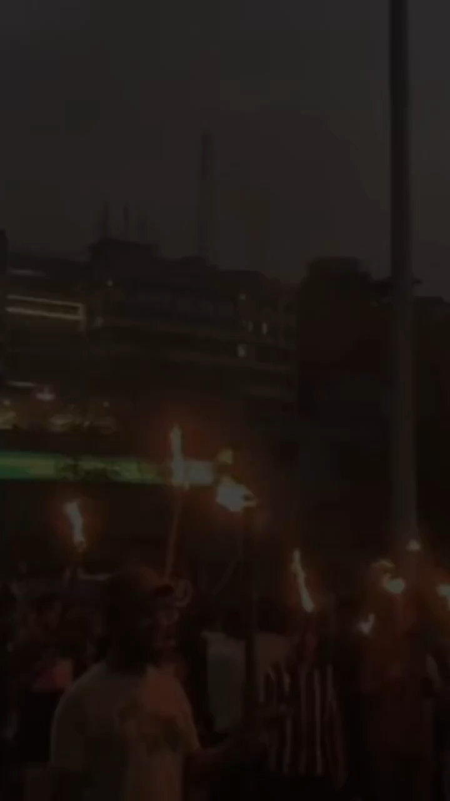

Slide 2
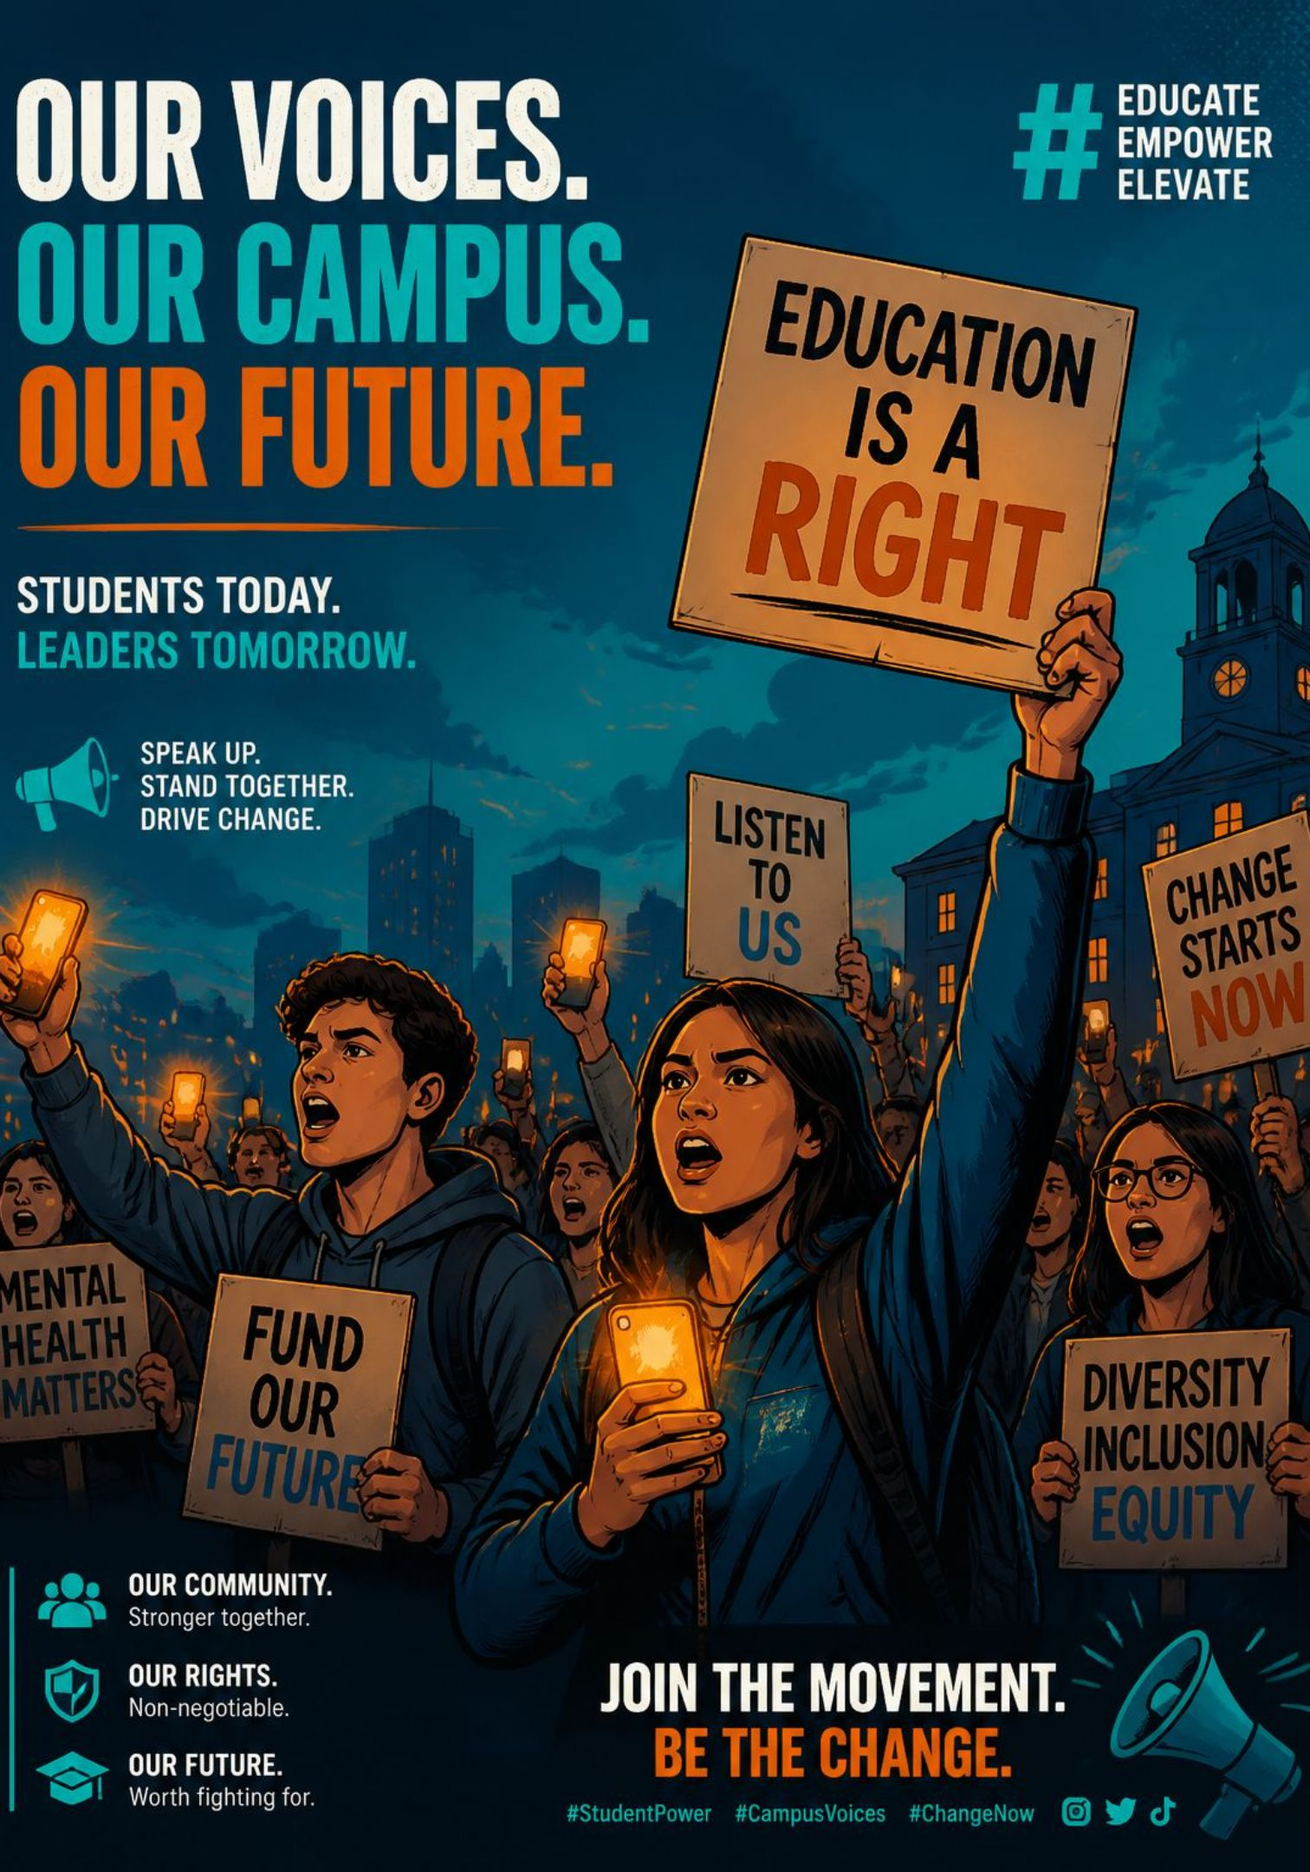
Youth Activism: How Young People Are Powering Today’s Movements for Change
How digital platforms and grassroots networks are accelerating global action
Presenter: Rafiur Rahman Mashrafi — North South University
"In July 2024, thousands of students walked out of their classrooms—and within weeks, a 15-year government had fallen."
Today, young people are leading movements for social, political, and environmental change by organizing through digital platforms and grassroots networks. This presentation explores three key examples: climate action, digital humanitarian campaigns, and Bangladesh's own 2024 student movement.

Slide 3
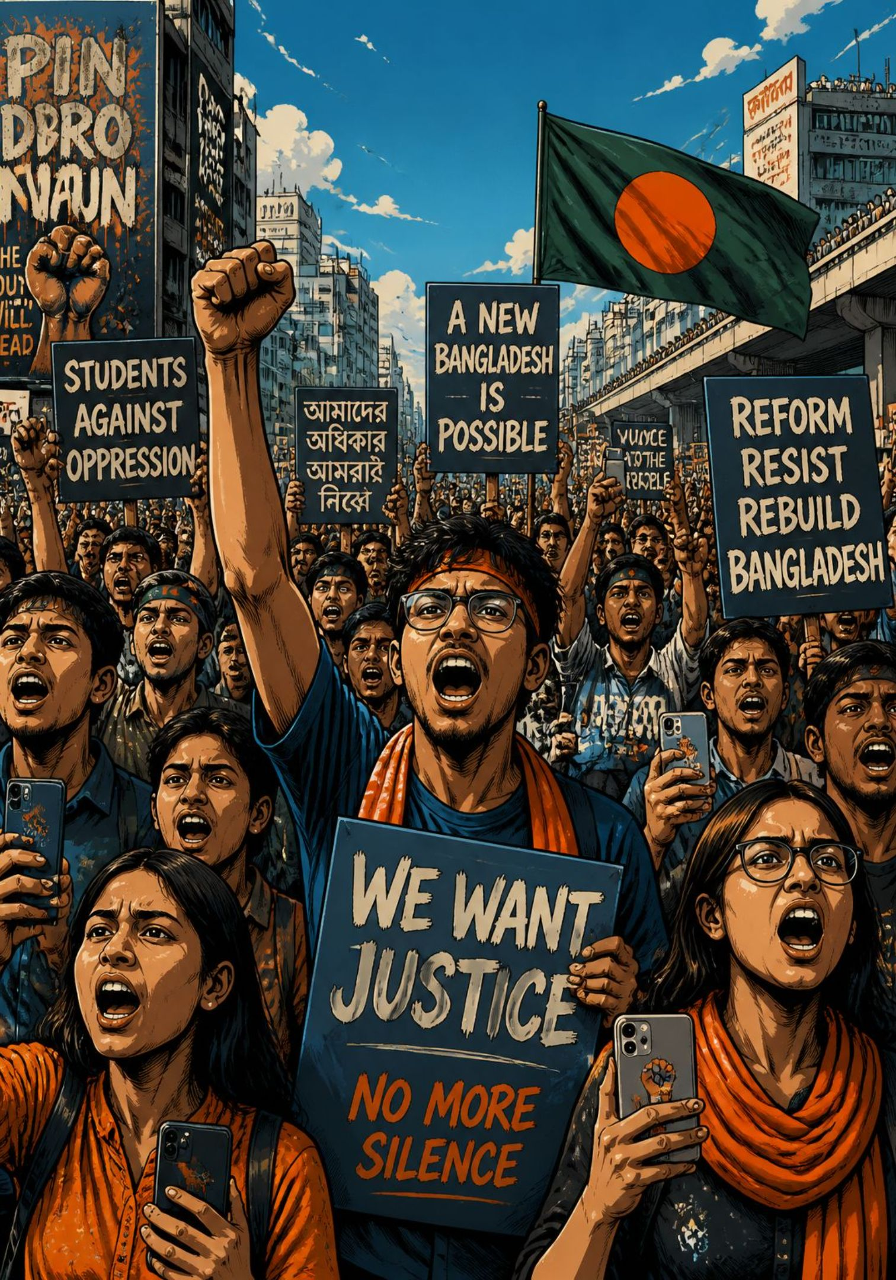
Why Youth Movements Matter
01
02
In July 2024, student protests in Dhaka helped trigger sweeping political change in Bangladesh.
Across the world, young people are reshaping politics, climate action, and social justice through digital platforms and grassroots organizing.
03
What’s Next
1) Climate action • 2) Digital humanitarian and social justice campaigns • 3) Bangladesh's July Uprising
Young people today are not just protesting—they are meeting directly with government leaders, taking their fights to international courts, and using social media to organize and fundraise for humanitarian causes. This generation is reshaping how movements for change happen.

Slide 4
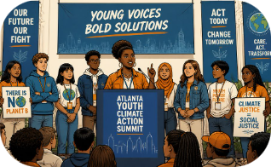
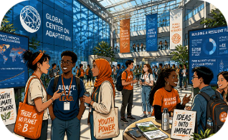
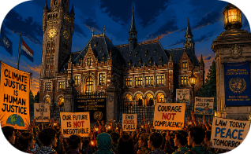
Student-Led Climate Action
Student-led climate action has grown into one of the most organized youth movements in the world. Students are not just protesting anymore—they are meeting directly with government leaders and taking their fight to international courts.
From classrooms to city hall
Building global adaptation networks
Turning advocacy into legal influence
On Earth Day 2025, student advisory boards brought youth voices directly to local leaders, including examples from the University of Vermont and the Atlanta Youth Climate Summit.
The Global Center on Adaptation’s Youth Climate Adaptation Action Day helped expand the Youth Adaptation Network by 20,000 members in 2025.
World’s Youth for Climate Justice helped drive the ICJ’s July 23, 2025 advisory opinion on states’ climate obligations.

Slide 5

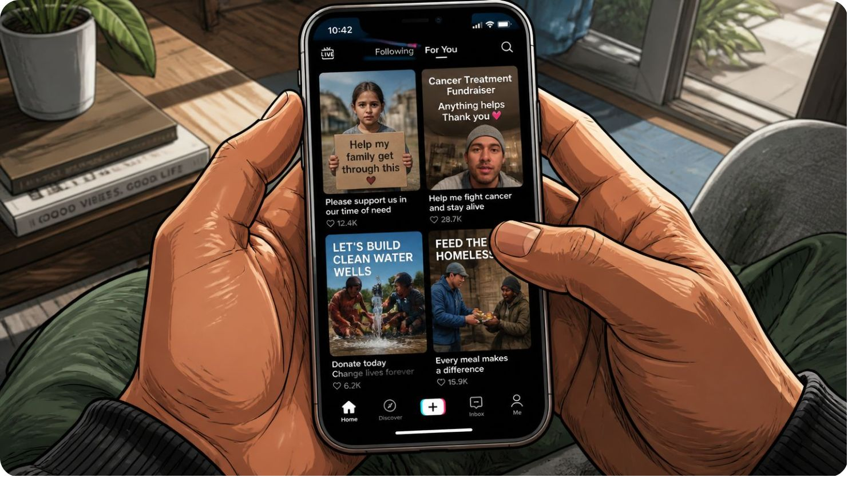


Digital Organizing for Humanitarian and Social Justice Campaigns
Digital platforms have become the main tool young people use to organize and fundraise for humanitarian and social justice causes. These campaigns have changed real political decisions across multiple countries.
Operation Olive Branch mobilized massive aid
More than 50,000 TikTok videos helped channel crowdsourced support for Gaza, Congo, and Sudan.
Friends of the Congo turned attention into resources
The campaign raised $19,000 for displaced families and women’s health initiatives.
Fast digital coordination can move people to action
In Kenya in June 2024, Instagram, TikTok, and Telegram helped drive a mass mobilization that forced a finance bill withdrawal; similar tactics spread to Nepal and Morocco in 2025.

Slide 6
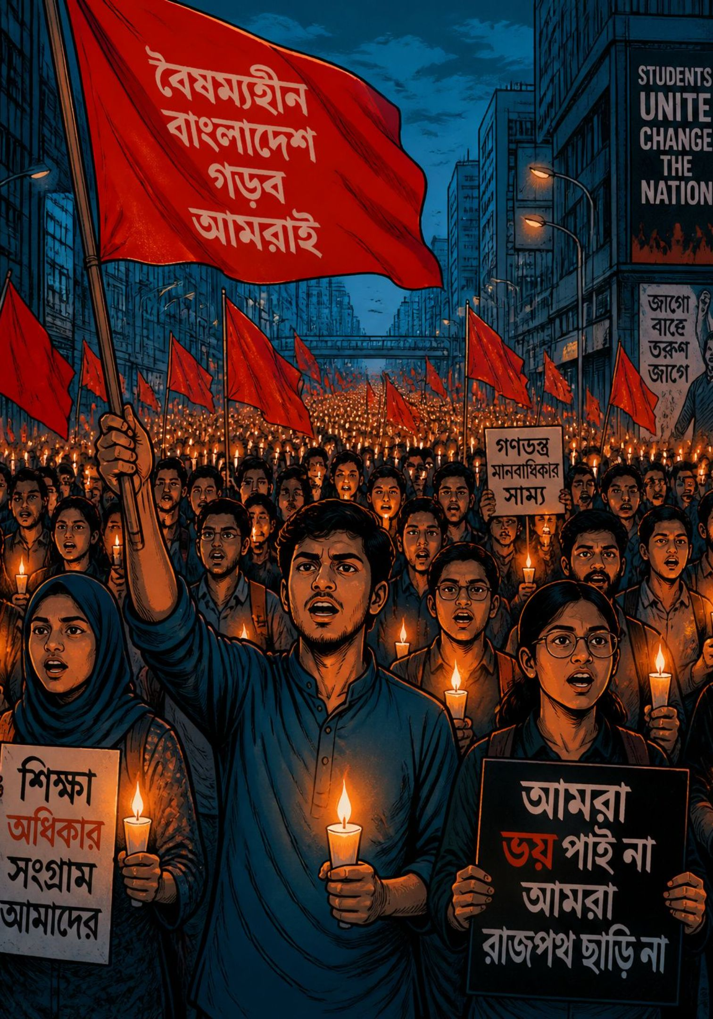

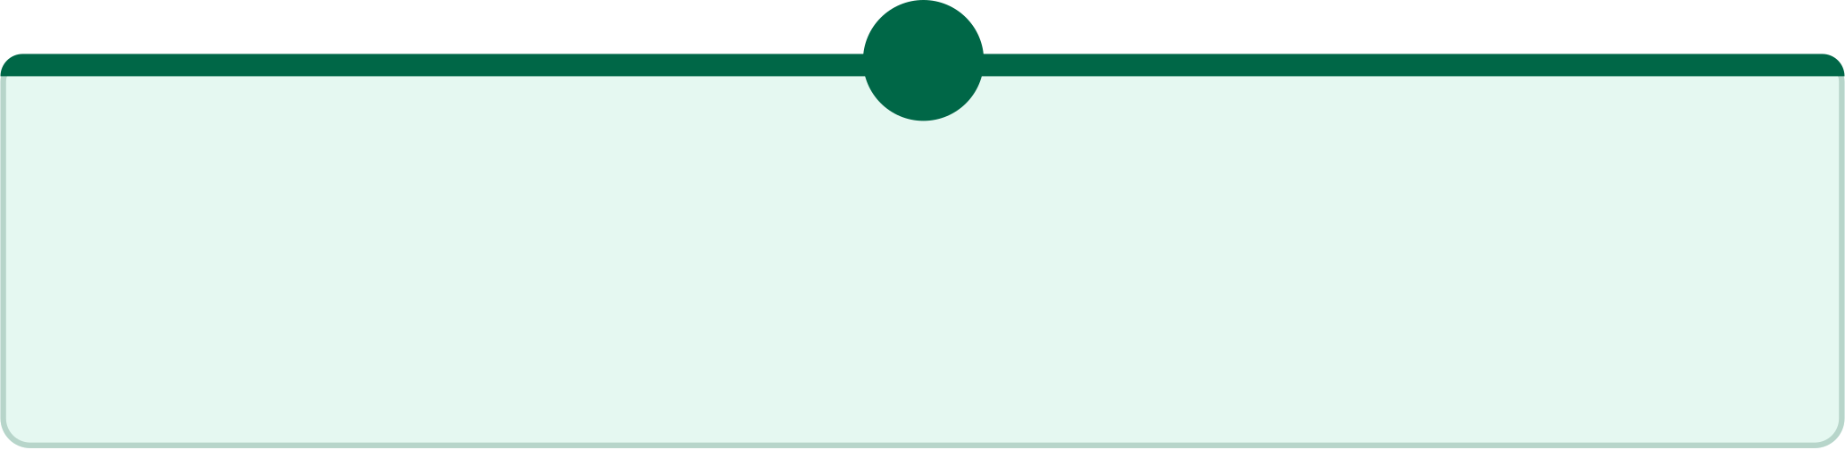
The 2024 Bangladesh July Uprising
The 2024 Bangladesh student movement, known as the July Uprising, shows how youth organizing can reshape a nation's future. What began as a protest against a job quota escalated into a nationwide uprising that changed the country's political trajectory.
1
2
3
From quota protest to national uprising
Crackdown and mass casualties
A turning point in Bangladeshi politics
The movement began as opposition to the reinstated 30% civil service quota for descendants of Liberation War veterans, then quickly escalated into a nationwide revolt.
Security forces responded with severe repression. At least 819 people were confirmed dead, while a UN assessment put the toll as high as 1,400 — a period widely remembered as the “July massacre.”
Prime Minister Sheikh Hasina resigned on August 5, 2024, marking a dramatic political shift and reshaping the country’s future trajectory.
4
Digital resistance under blackout
During a 22-day internet shutdown that began on July 18, 2024, activists sustained coordination through decentralized networks such as Bangla Blockade and symbolic acts like red profile pictures.

Slide 7
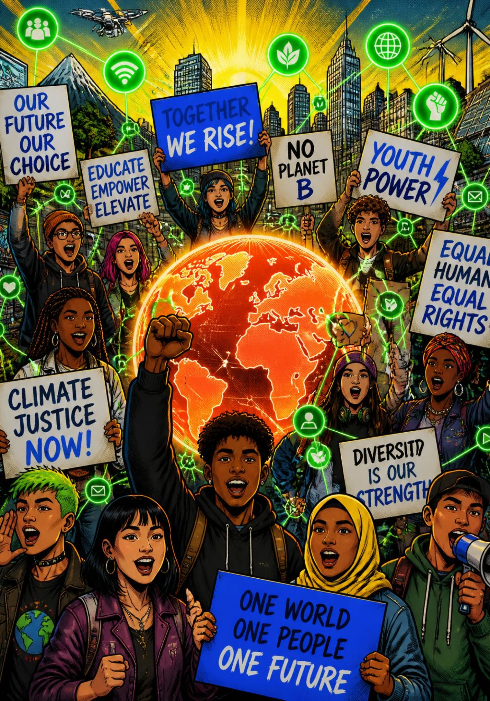
What This Movement Shows
Young people are driving transformative change by pairing digital coordination with grassroots organizing to demand accountability and reshape public life.
From courtrooms in the Hague to the streets of Dhaka, young people today are leading real movements for change—in the courts, on digital platforms, and in the streets—by organizing together and demanding accountability.
Mobilize locally, connect globally
Use a broad strategy
Solidarity multiplies impact
Combine protest, policy engagement, and legal action to sustain pressure from multiple directions.
Cross-border networks strengthen visibility, legitimacy, and collective power.
Build trust and momentum in communities while using digital tools to coordinate fast and widely.

Slide 8
Thank You
Rafiur Rahman Mashrafi — North South University

