Slide 1
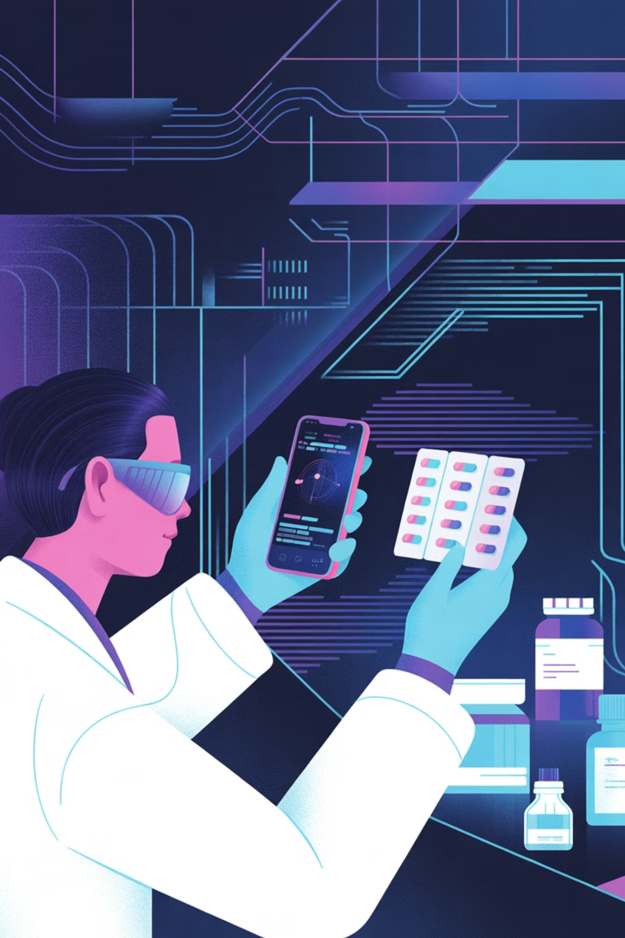
A Deployable Multimodal Framework for Automated Counterfeit Medicine Detection
Presented by Rafiur Rahman Mashrafi
ID: 2221971042

Slide 2
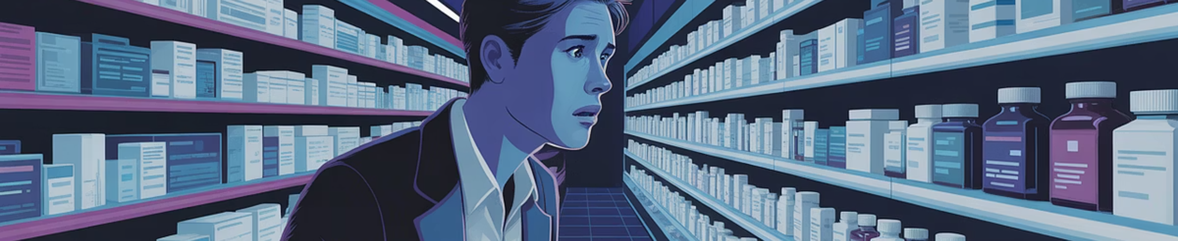
The Problem
Counterfeit Medicines: A Global Health Crisis
Fake drugs threaten lives across developing nations and developed markets alike—current detection fails consumers and pharmacists

Slide 3
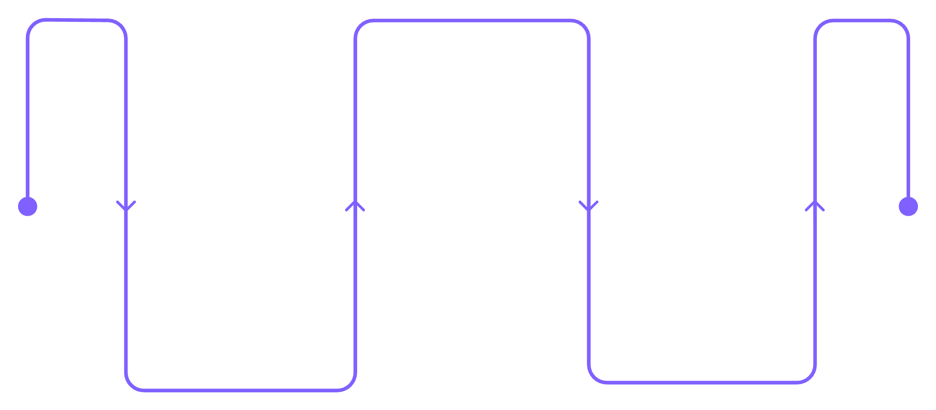
Why Existing Methods Fall Short
Lab Testing
Expensive, slow, requires expert chemists—inaccessible to most
Blockchain
Verifies chain but misses fakes
Blockchain-Only
Verifies supply chain but can't detect cloned QR codes or fake packaging
Lab Testing
Image AI
Slow and expensive, needs experts
Ignores text clues, yields gaps
Pure Image AI
Misses text verification—vulnerable to sophisticated visual copies

Slide 4
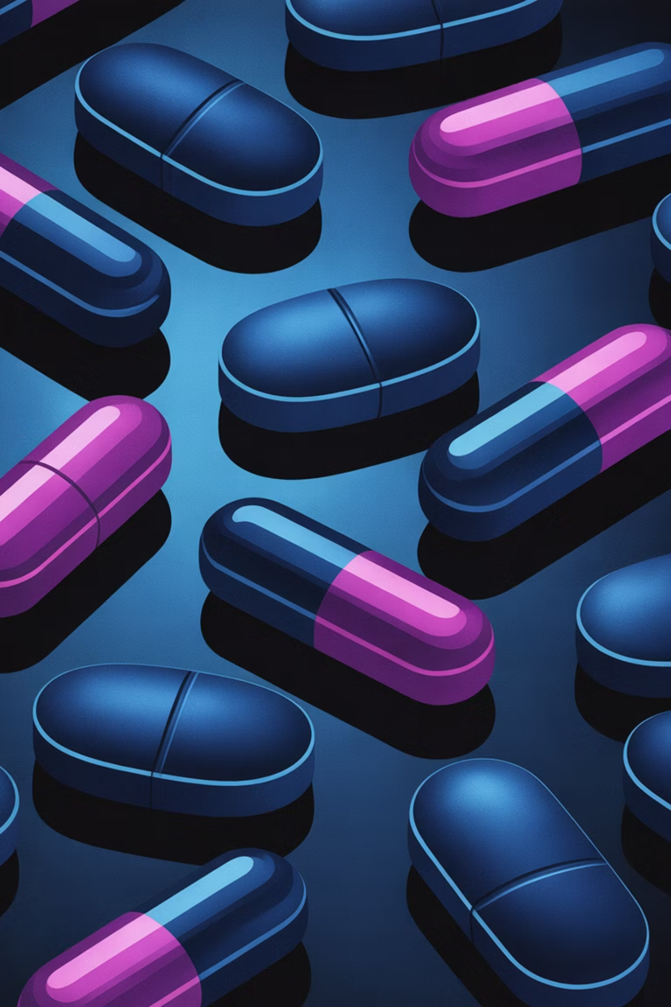
The Stakes Are High
USA: Fentanyl Crisis
Limited Datasets
Falsified prescription opioids evade traditional detection methods
Existing AI trained on small, synthetic, or private data—poor real-world performance
No Integration
Lack of multimodal, deployable systems for real-time consumer verification

Slide 5

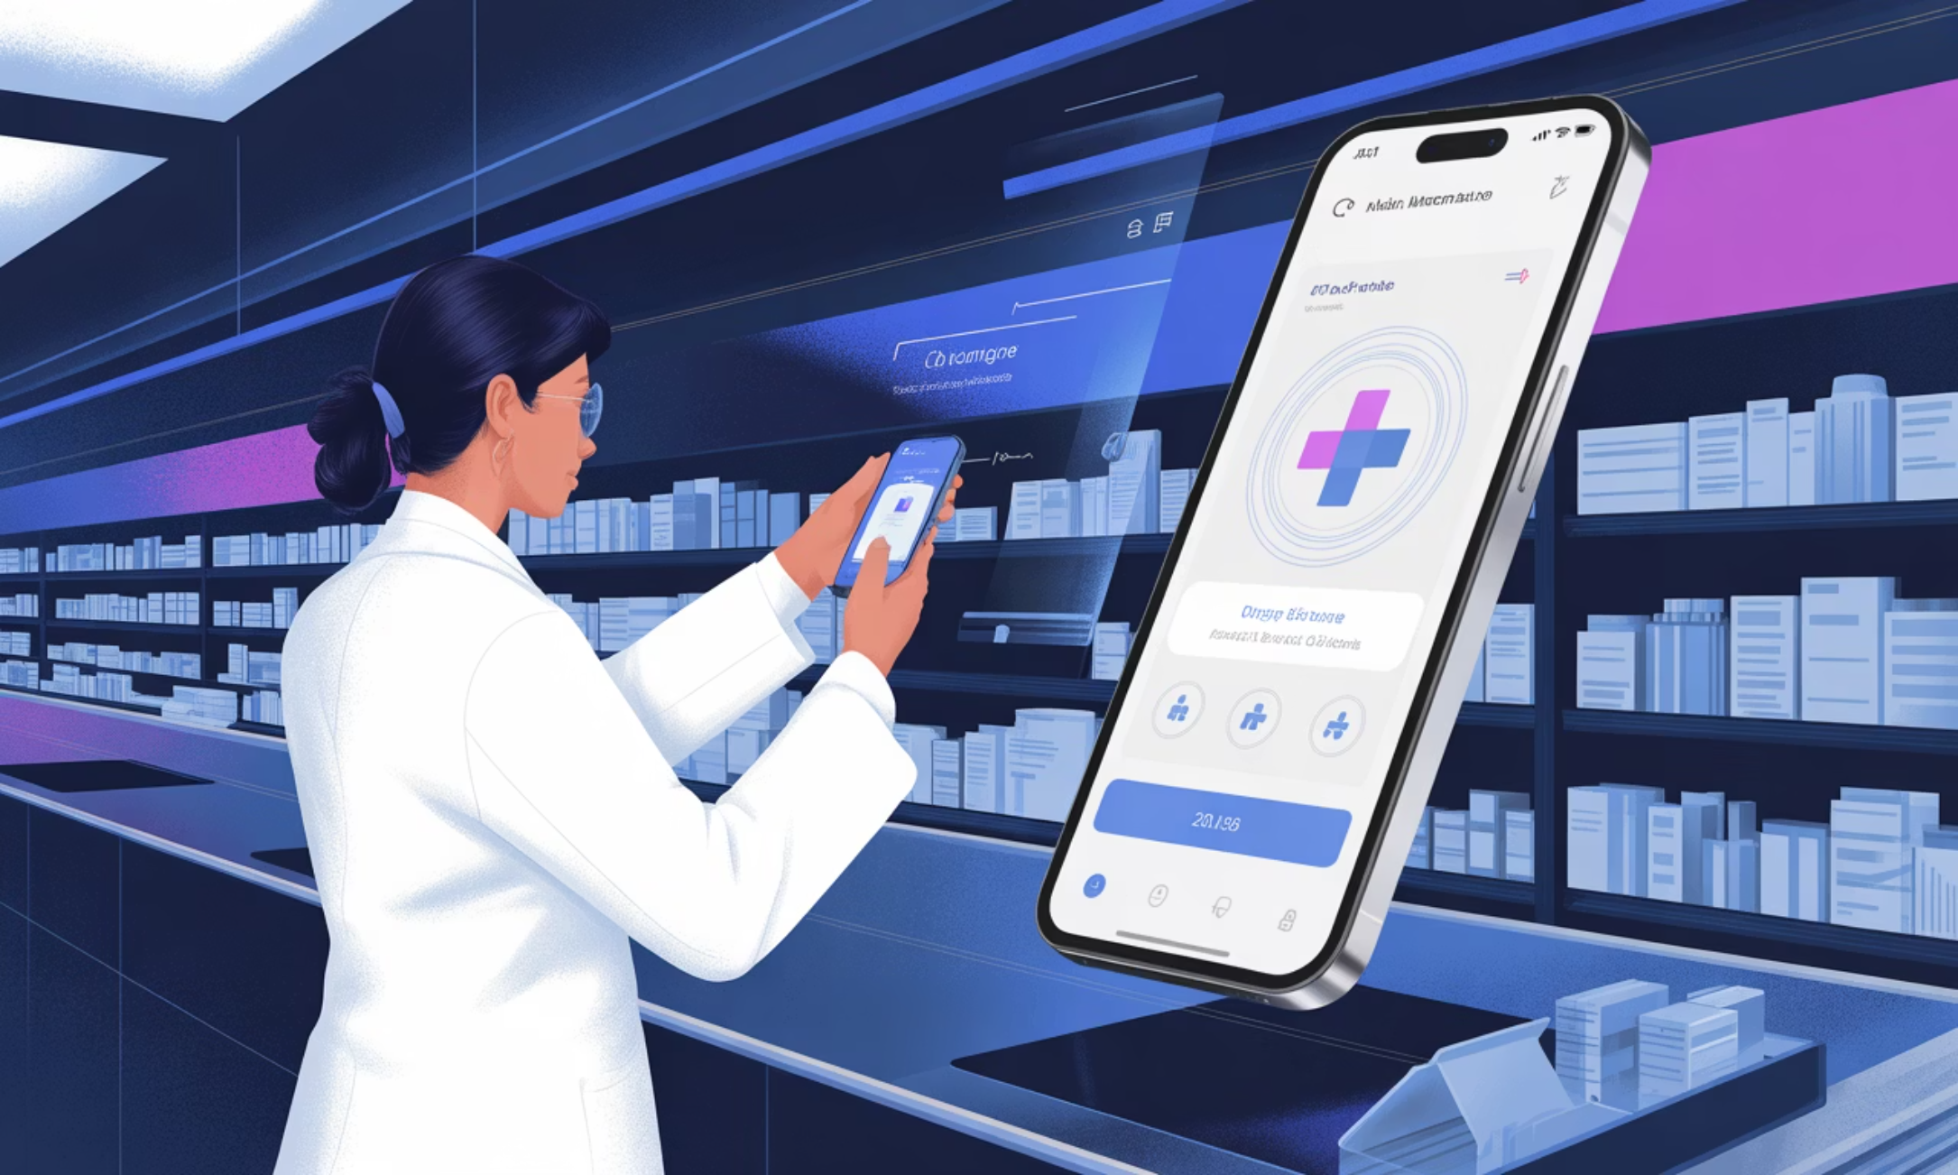
MISSION
Our Goal
Develop a low-cost, multimodal, AI-driven mobile system that detects counterfeit medicines by fusing:
Computer vision for packaging analysis
OCR for text and serial number verification
Lightweight smartphone deployment
Validated on real-world samples from low-resource regions

Slide 6
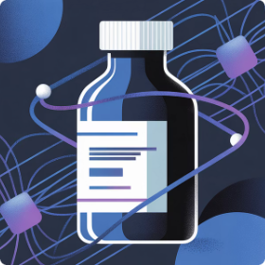
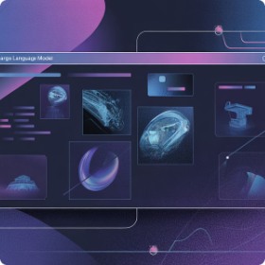

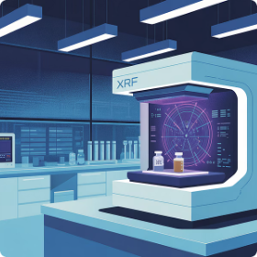
Related Works
Existing Approaches & Their Limitations
CNN-Based Classification
Multimodal LLMs
Blockchain-Only Systems
Hybrid AI + Analytics
Zakaria et al. (2024)
Alsallal et al. (2018)
Sanghi et al. (2021), Islam (2022)
Irhebhude et al. (2024), Thomson & Varuna (2025)
Low accuracy (~74%). Requires reference images. Not robust in poor lighting conditions
Small datasets. Not real-time. Requires specialized hardware like XRF analyzers
No AI detection capability. Assumes stakeholder cooperation. Scalability challenges
Limited to visual features only. Private datasets. No text or contextual analysis

Slide 7

The Research Gap
No Integration
Dataset Scarcity
Computer vision + OCR + blockchain + real-time deployment rarely combined
Lack of public, diverse, real-world medicine image datasets
Poor Explainability
Limited transparency and robustness testing across varied environments

Slide 8
TIMELINE
Proposed Work Plan
4-Phase, 4-Month Capstone Project
Phase 1: Dataset Curation
1
Weeks 1–4
Collect 5,000+ images (genuine + counterfeits)
Annotate logos, text regions, batch numbers
Augment with synthetic variations
2
Phase 2: Model Development
Weeks 5–10
Train YOLOv8n for logo detection
Integrate EasyOCR for text extraction
Build fusion logic + explainability layer
Phase 3: Mobile Integration
3
Weeks 11–14
Develop Android app prototype
Test varied conditions (lighting, blur)
Compare baseline approaches
4
Phase 4: Evaluation
Weeks 15–16
Measure accuracy, precision, recall, F1
User study with local pharmacists
Final report and demo video

Slide 9




Phase Breakdown
Key Innovations
Data
Curate diverse real-world samples
Multimodal Fusion: Combines visual + textual confidence scores for robust detection
Explainability: Grad-CAM visualization shows why AI flagged a medicine as counterfeit
AI Model
Fuse vision + text intelligence
Deploy
Real-World Focus: Tested on damaged packaging, poor lighting, and blur scenarios
Mobile-ready, accessible
Validate
Real-world pharmacist feedback

Slide 10
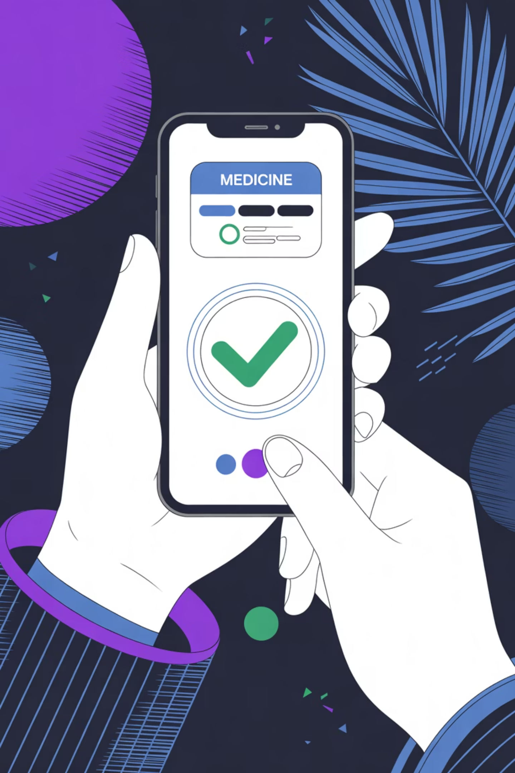
Expected Impact
Consumer Protection
Empower patients to verify medicines instantly before purchase
Global Scalability
Low-cost smartphone solution works across diverse regulatory environments
Research Advancement
Public dataset and open methodology accelerate future counterfeit detection research

