Slide 1

Enhanced Finance Tracker
Income and Expense Manager Command-Line Personal Finance Solution

Slide 2
The Problem & Our Solution
Challenges in Personal Finance
Our Solution
Difficulty tracking daily expenses
Automated tracking system
No spending visibility
Real-time balance updates
Manual calculation errors
Comprehensive reporting

Slide 3
Core Functionality
Income/expense tracking
Multi-account support
Track all your financial movements in one place
Manage multiple financial accounts simultaneously
Real-time balance calculation
Category-based analysis with filtering and export
Always know your current financial standing
Analyze spending patterns, filter by date, and export to CSV

Slide 4

Technology Stack
Built With Python Standard Library
sqlite3
No external dependencies required!
Database management
dataclasses
Data structures
datetime
Date/time handling
csv
Data export

Slide 5
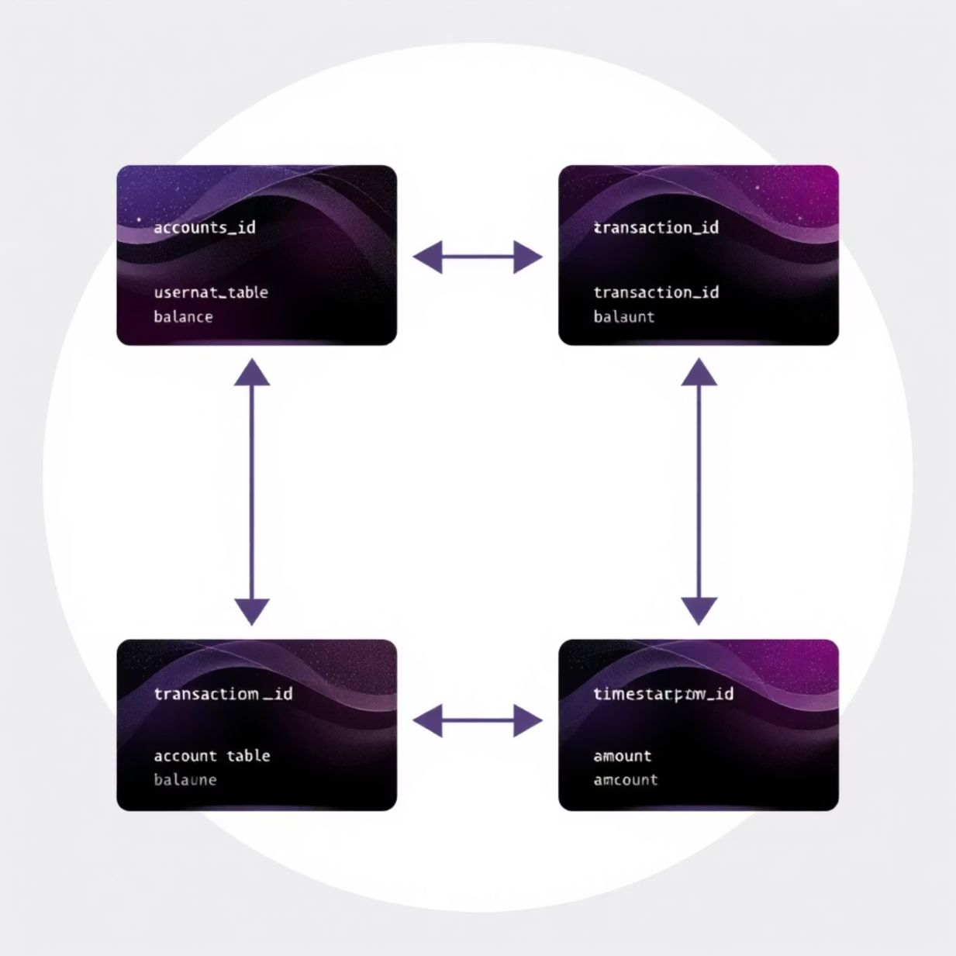
Database Architecture
SQLite Database Structure
Relational database with proper constraints
accounts (id, name, created_at)transactions (id, account_id, timestamp, amount, type, category, description)

Slide 6

Installation & Setup
Getting Started
git clone https://github.com/yourusername/finance-tracker.gitcd finance-trackerpython finance_tracker.py
No additional dependencies required!

Slide 7
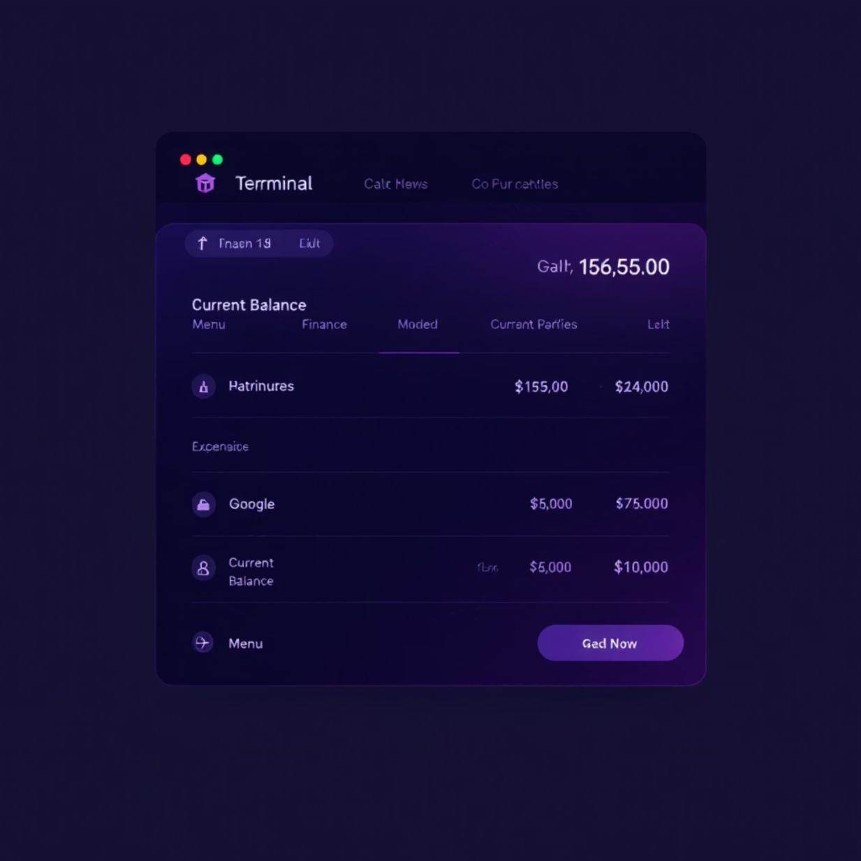
User-Friendly Command Line
========== PERSONAL FINANCE MANAGER ==========Current Balance: $1,250.751. Add Income2. Add Expense3. View Transactions4. View Spending Summary5. Manage Accounts6. Export Data7. Exit
Simple, intuitive interface that works on any platform

Slide 8
Transaction Management
Adding Transactions
========== ADD INCOME ==========Amount: 1000Category: SalaryDescription: Monthly salaryIncome of $1000.00 added successfully!New Balance: $2,250.75
Enter transaction details
Amount, category, and description
Automatic processing
Transaction recorded in database
Real-time balance update
See your new balance immediately

Slide 9

Reporting & Analysis
Spending Breakdown
========== SPENDING SUMMARY ==========Food : 250.00 (25.0%)Rent : 500.00 (50.0%)Transport: 150.00 (15.0%)Entertain: 100.00 (10.0%)------------------------------TOTAL : 1000.00
Visualize your spending patterns to make better financial decisions

Slide 10
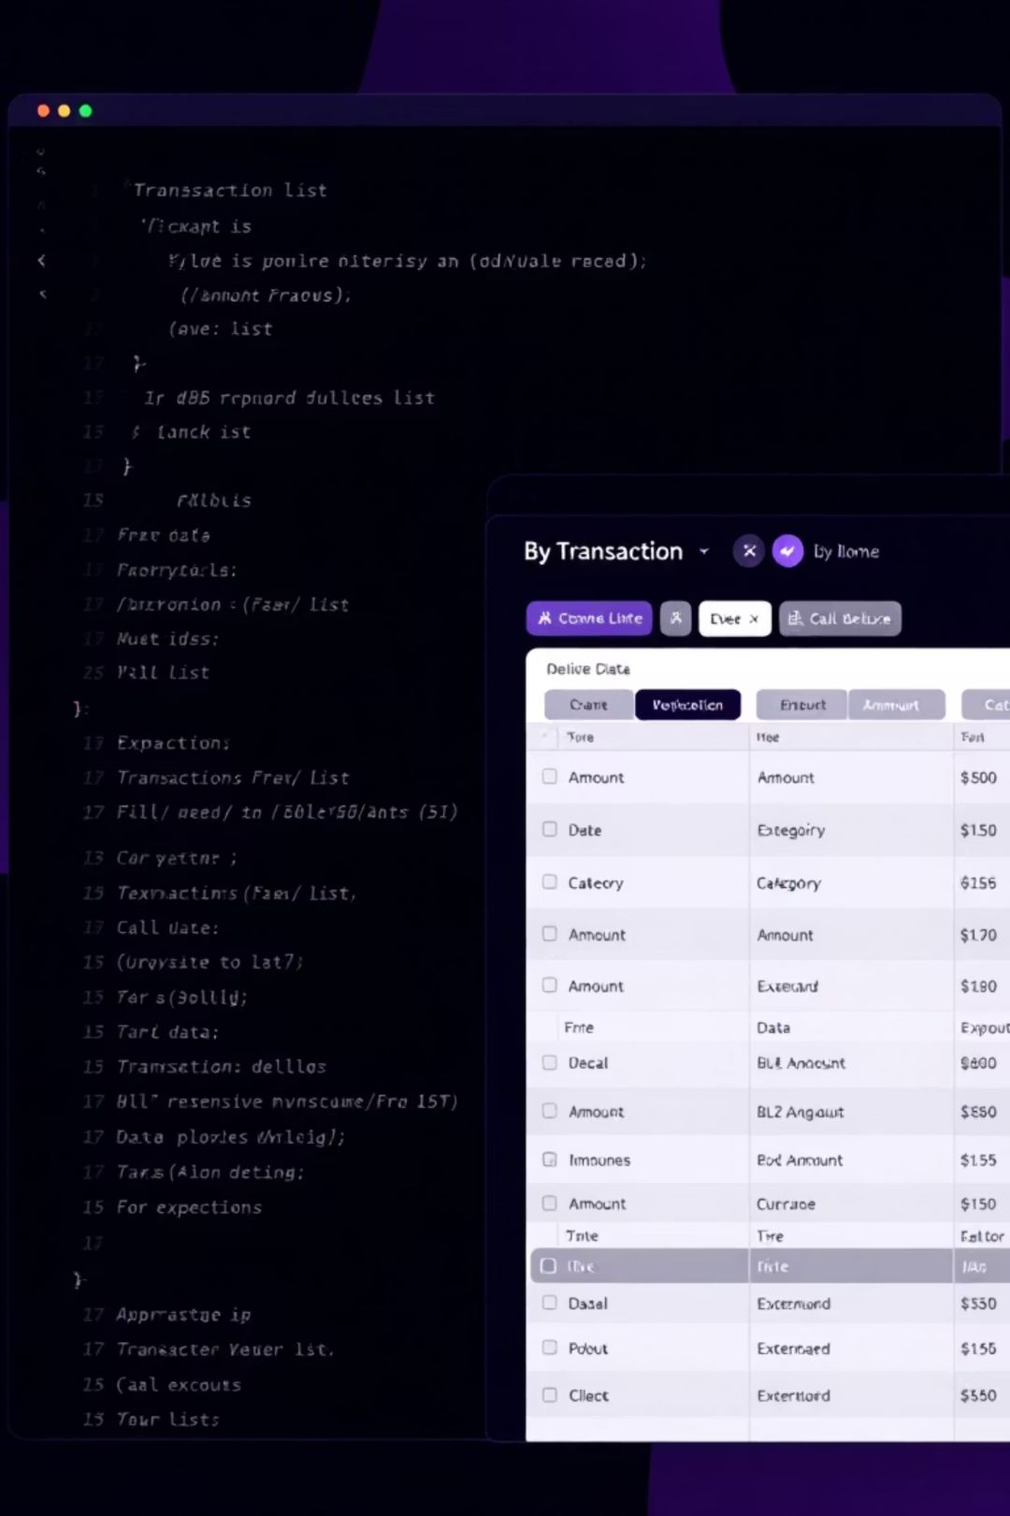
Data Export & Customization
Export to CSV
Custom Categories
db.export_transactions_to_csv(1, "transactions.csv")
DEFAULT_CATEGORIES = { "income": ["Salary", "Bonus", "Investment"], "expense": ["Food", "Rent", "Transport"]}
Export your data for use in spreadsheets or other applications
Customize categories to match your financial needs

