Slide 1

Nidheera Shopping Site
Java Spring Boot + React JS E-Commerce Project Plan

Slide 2
Technology Stack
Backend: Spring Boot, JPA, MySQL , API
Frontend: React JS, React Router, Axios, Bootstrap,CSS,JS

Slide 3
Application Pages
Home Page
Login/Register
Products Page
Cart Page
Orders Page
Admin Dashboard
Profile Page

Slide 4
System Architecture
React UI → REST APIs → Spring Boot Services → JPA Repository → MySQL

Slide 5
Backend Project Structure
com.nidheera
controller
service
service.impl
repository
entity
config
security
exception

Slide 6
Entity Classes
User(id,name,email,password,role)
Product(id,name,description,price,stock,imageUrl)
Order(id,user,totalAmount,status)
OrderItem(id,order,product,qty,price)
Cart(id,user)
CartItem(id,cart,product,qty)

Slide 7
Repository Interfaces
UserRepository
ProductRepository
OrderRepository
OrderItemRepository
CartRepository
CartItemRepository

Slide 8
Service Interfaces
UserService
ProductService
OrderService
CartService
AuthService

Slide 9
Controller Classes
AuthController
ProductController
CartController
OrderController
AdminController
UserController

Slide 10
Important Methods
login()
register()
addProduct()
updateProduct()
deleteProduct()
addToCart()
placeOrder()
getOrders()
updateOrderStatus()

Slide 11
Frontend Structure
src
├── pages
├── components
├── services
├── routes
├── context
└── assets

Slide 12
React Pages
Home.jsx
Login.jsx
Register.jsx
Products.jsx
Cart.jsx
Orders.jsx
AdminDashboard.jsx
ManageProducts.jsx
Profile.jsx

Slide 13
Frontend Components
Navbar
Sidebar
Footer
ProductCard
CartItem
OrderCard
ProtectedRoute

Slide 14
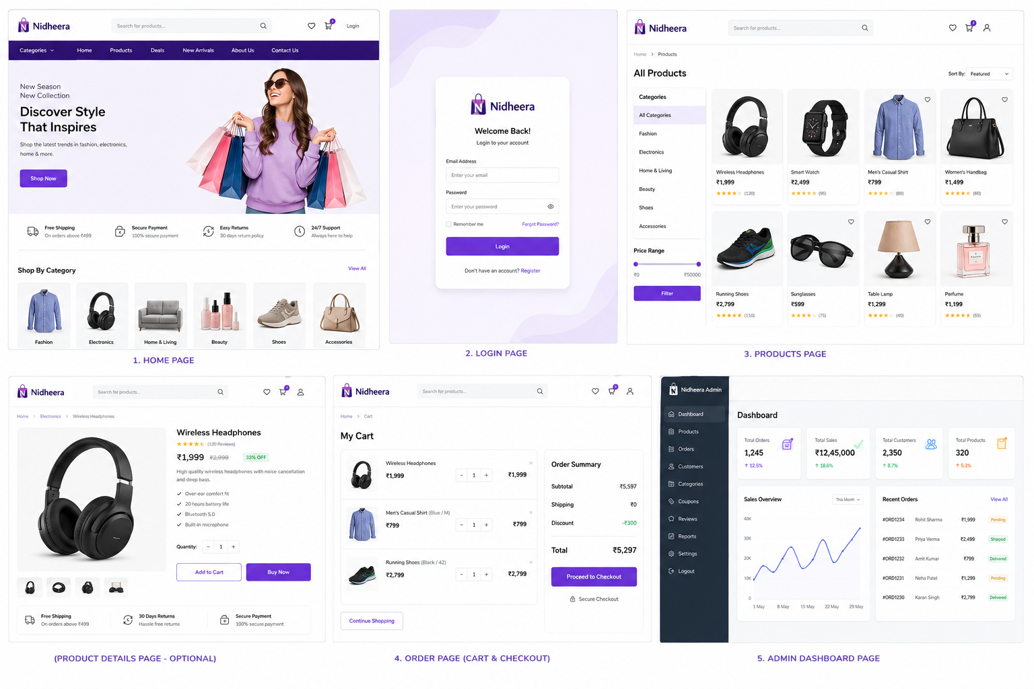
Sample Site Visual

