Slide 1



Slide 2
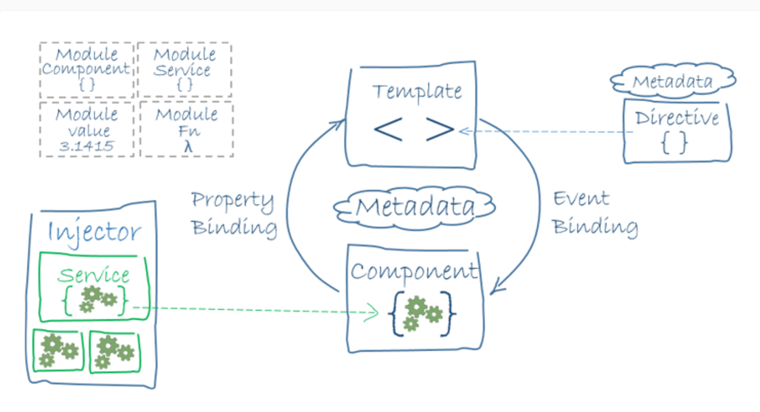
Architecture Overview

Slide 3
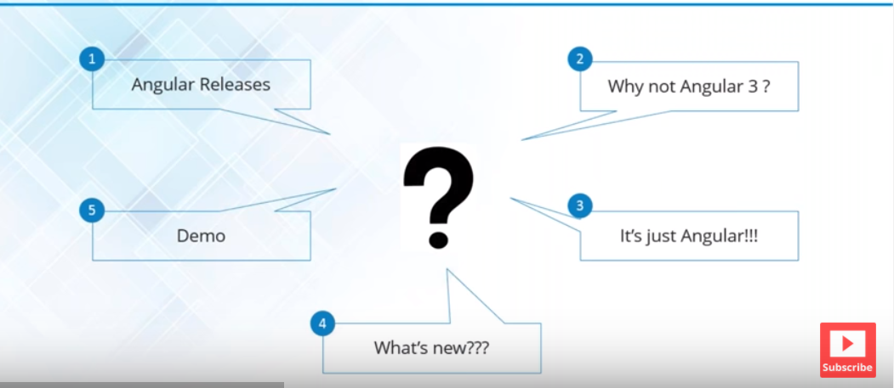

Slide 4
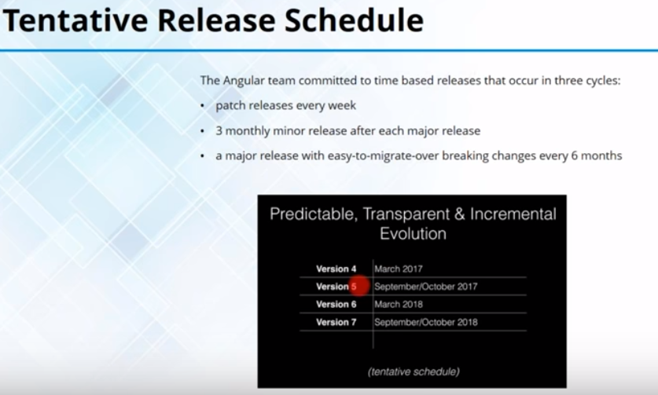

Slide 5
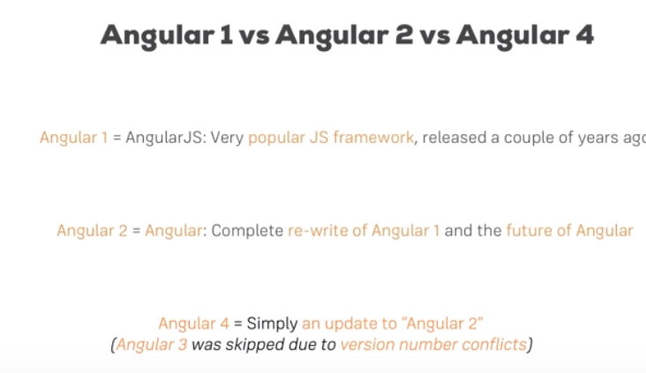

Slide 6
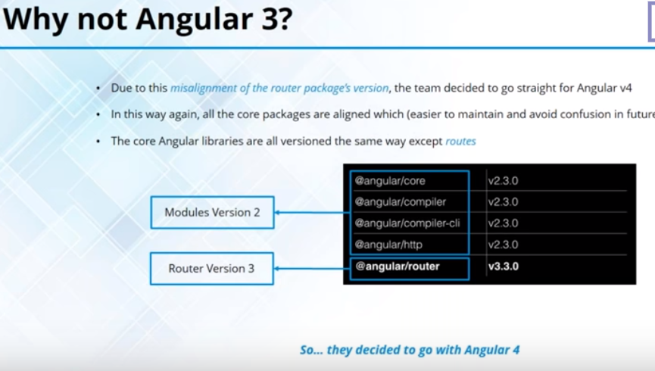

Slide 7
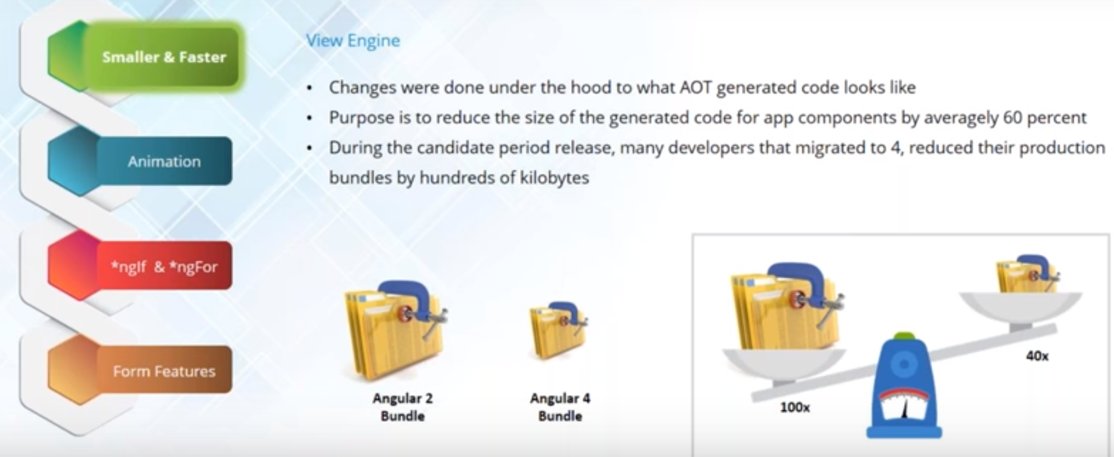
Smaller & Faster

Slide 8
Lets Create the Project !!!
?????????????????

Slide 9
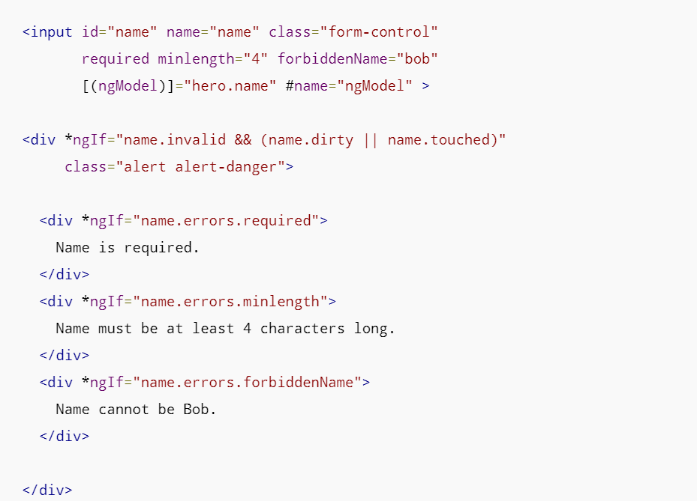
Form Validation

Slide 10
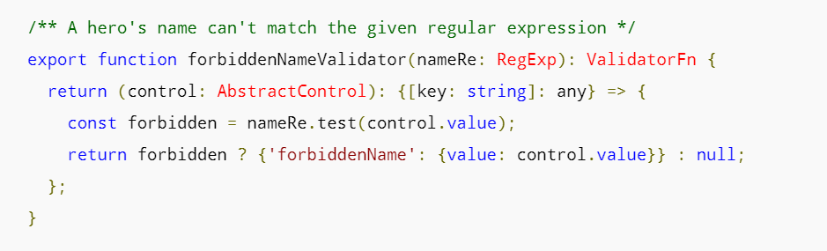
Custom Validator
https://angular.io/guide/form-validation

Slide 11
Animation Example :-> http://plnkr.co/edit/AfIB1i?p=preview
Animation Example

Slide 12
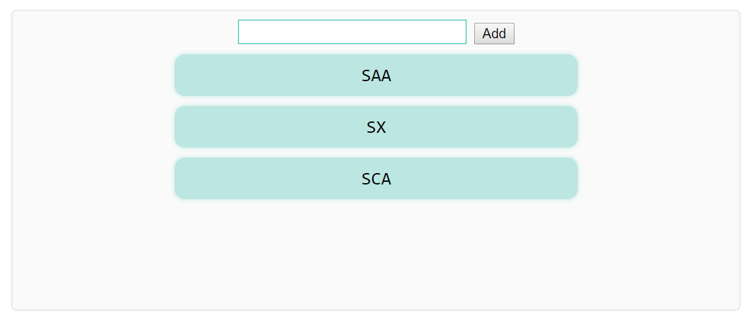
Basic Animation

Slide 13
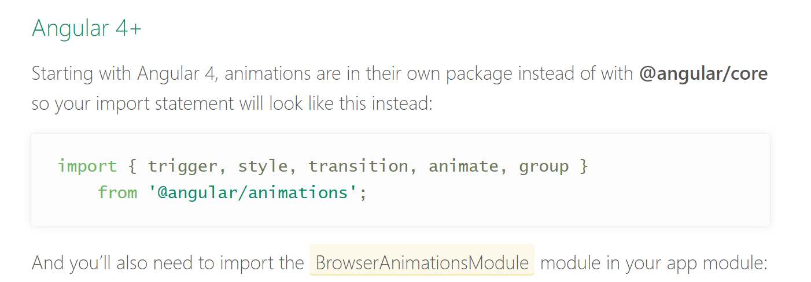

Slide 14
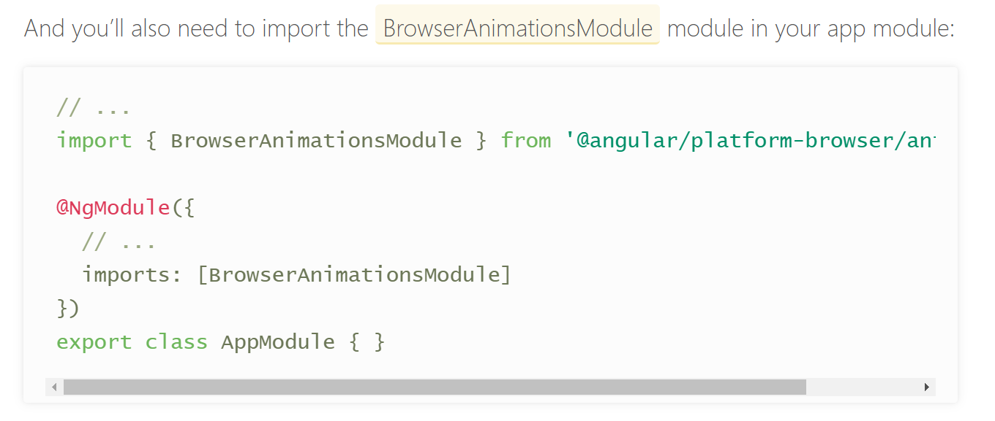

Slide 15
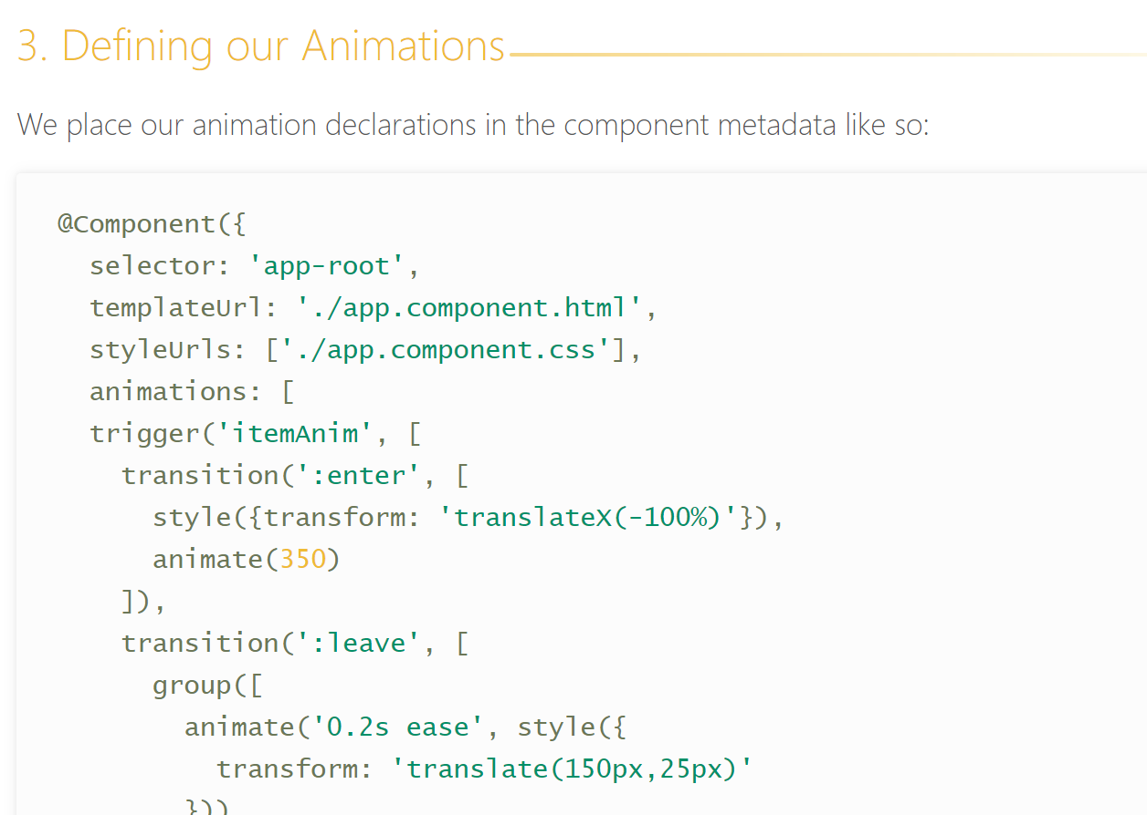

Slide 16
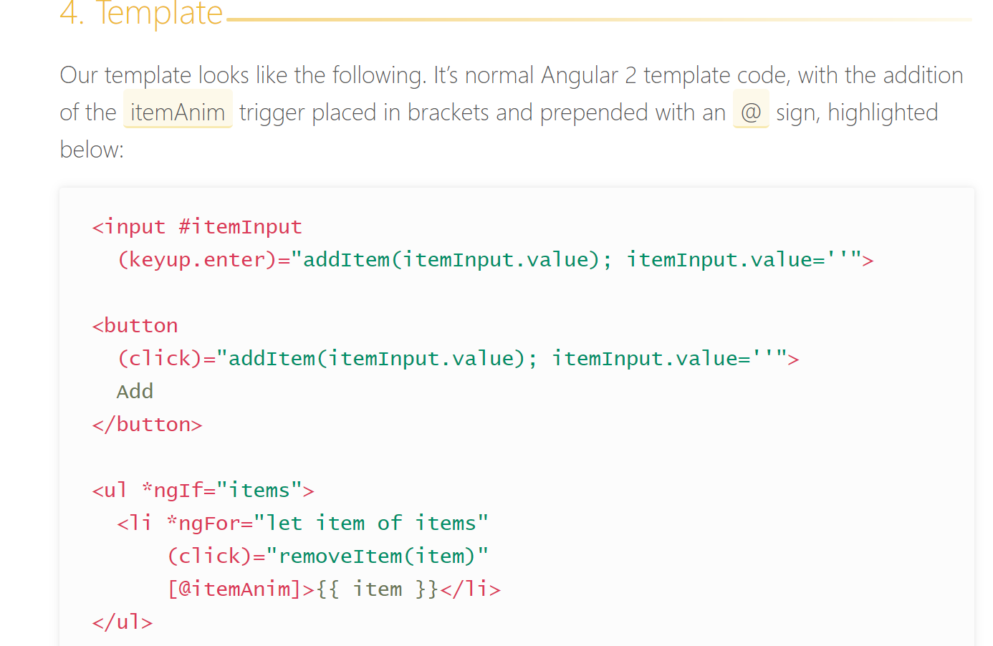

Slide 17
Refernece of Code :→
https://alligator.io/angular/animation-angular/

Slide 18
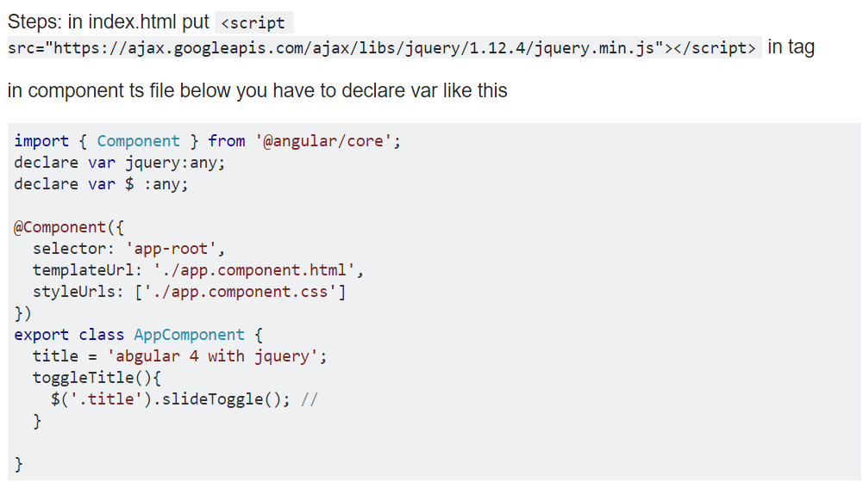
Add Jquery

Slide 19
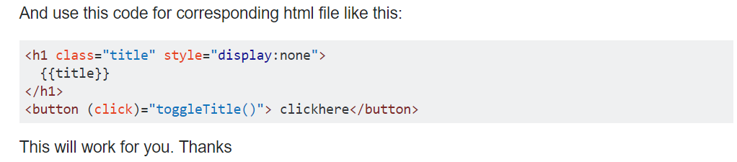
Add code in HTML

