Slide 1
Parasites and the microbiome in Douc and Howler monkeys
Results based on GreenGenes alignments
3/26/19

Slide 2
Differential taxa that are significantly different between lower and higher parasite loads (fdr q < 0.05)

Slide 3
Douc + Howler
Phylogenetic diversity vs semiquantitative index on ALL parasites
When looking at all samples and all parasites, stool microbial alpha diversity is significantly HIGHER in animals with higher parasite load (pairwise Wilcoxon; Moderate vs. None and Moderate vs. Low, both FDR q=0.01
Within the douc or howler, there are not strong correlations with alpha diversity and their respective common parasites.

Slide 4
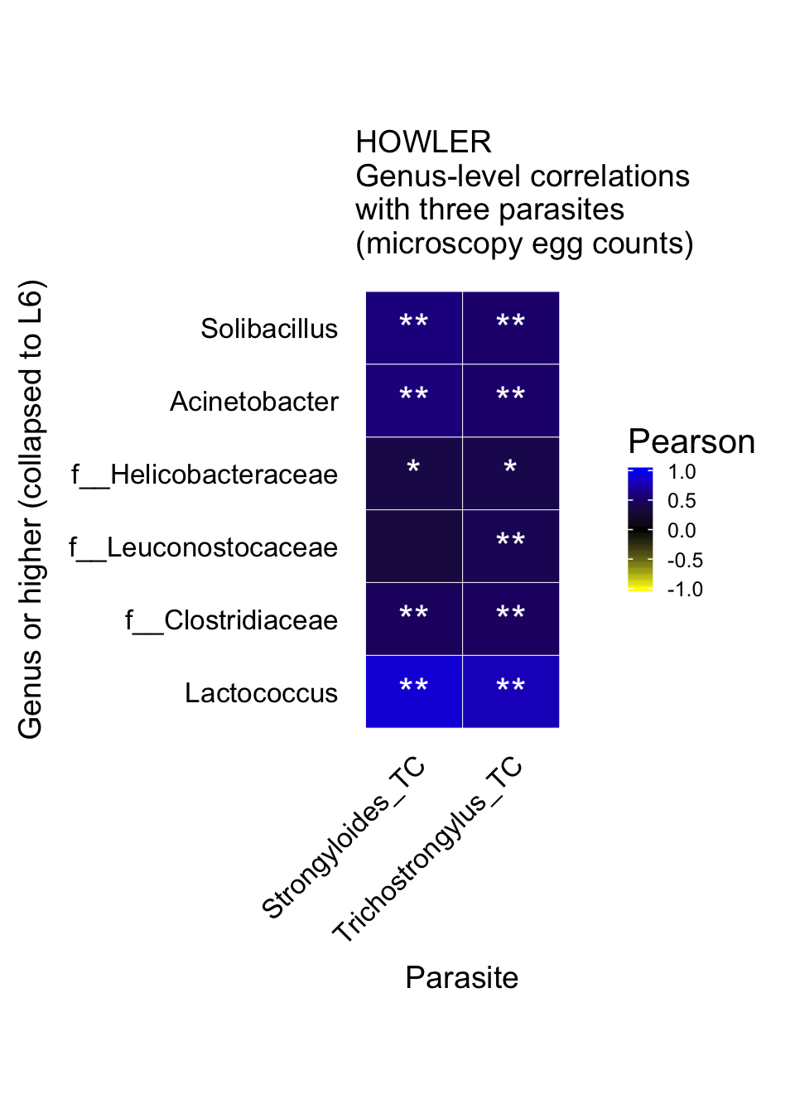
Pearson correlation heatmap for Howlers and egg counts of the two parasites indicated. **, FDR q< 0.05.
No significant correlations were found for Douc and trichuris.

Slide 5
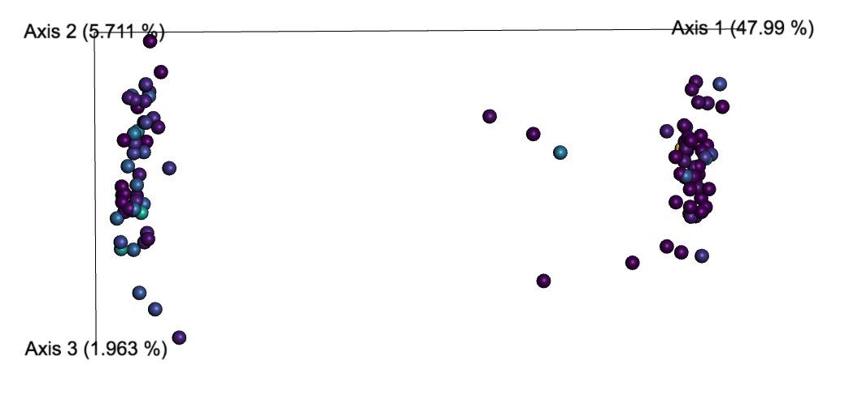
Unweighted unifrac with howlers on right and doucs on left.
Color gradient is purple-teal-yellow: 0 egg counts (dark purple) to high (143; yellow).

Slide 6
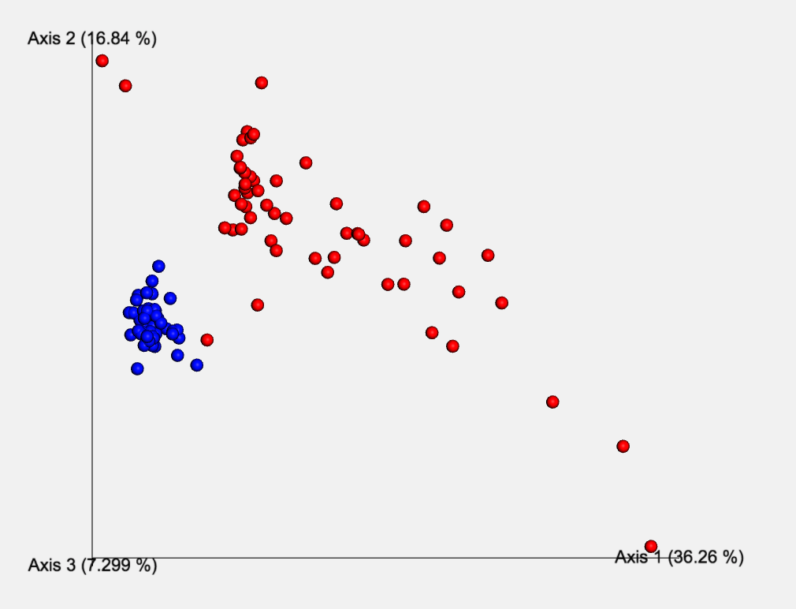
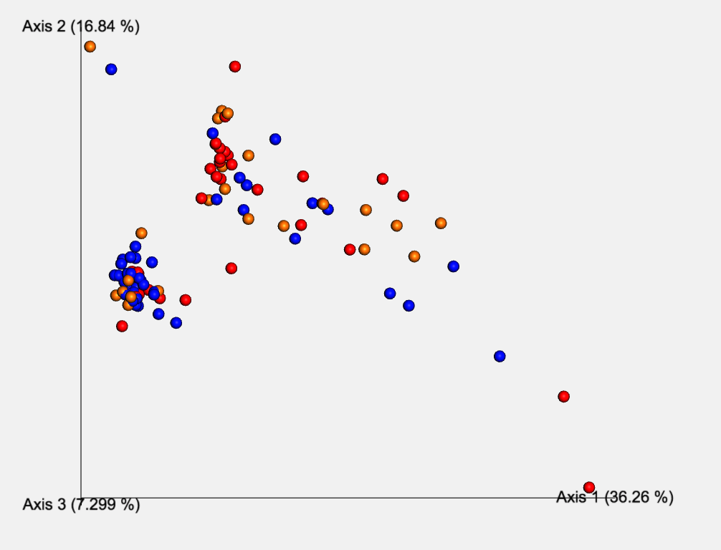
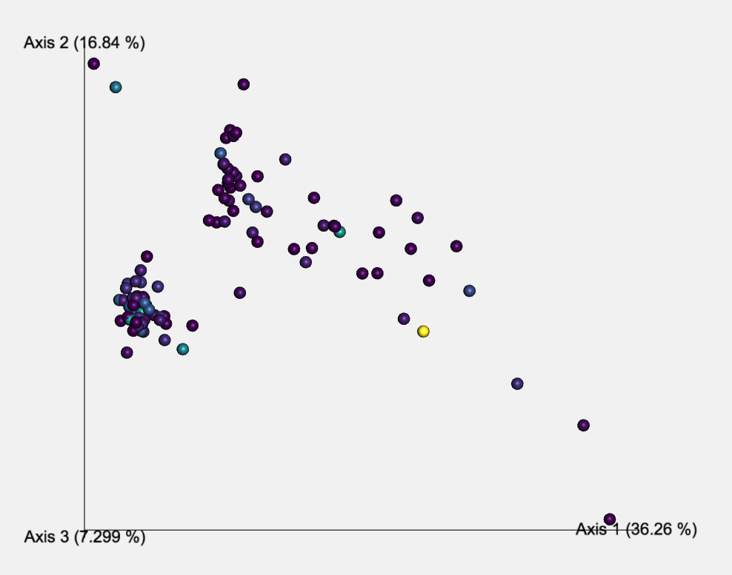
Weighted unifrac, red = howlers at right.
Bottom left is colored by the semi-quantitative egg scale (none=orange, low=red, moderate=blue).
Bottom right is the same scale as previous slide.
Here, the higher parasite count samples seem to be more distributed, in particular with the Douc. This goes along interestingly with the alpha diversity observation. Higher parasite load might mean greater more phylogenetically diverse guts, and also less similarity between individuals. Could this have a diet/behavioral link? We can quantify these distances if you all think it’s interesting and worth measuring.
Bray Curtis (not shown) has a similar shape to unweighted unifrac on prev. slide, but the groupings are more similar to the weighted here.

