Slide 1
Derivatives are Vectors
(See “Tensors for Beginners: Vectors” Video First)
(See Link in Description)

Slide 2

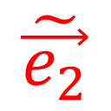
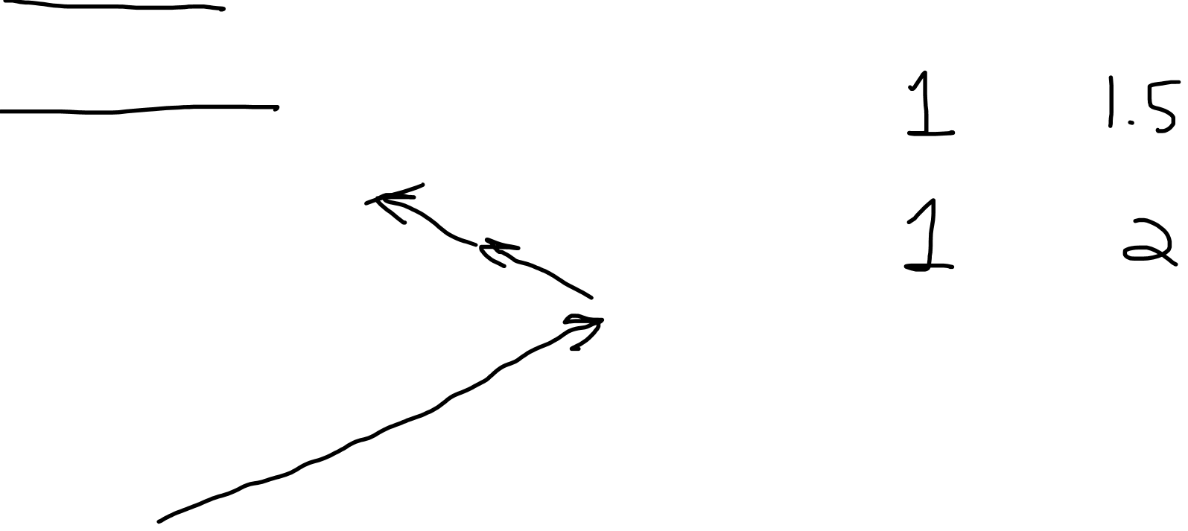
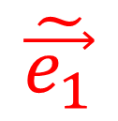
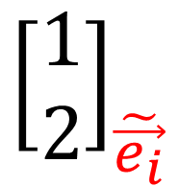
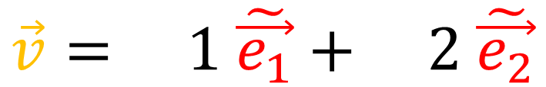



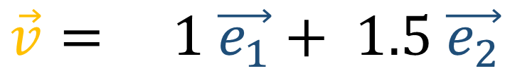


Old Basis: $\{\vec{e_{1}},\vec{e_{2}}\}$
New Basis: $\{\tilde{\vec{e_{1}}},\tilde{\vec{e_{2}}}\}$
$$\vec{v}= 1 \vec{e_{1}}+ 1.5 \vec{e_{2}}$$
$$\vec{v}$$
$$\vec{e_{2}}$$
$$\vec{v}= 1 \tilde{\vec{e_{1}}}+ \text{2 }\tilde{\vec{e_{2}}}$$
$$\tilde{\vec{e_{1}}}$$
$$\tilde{\vec{e_{2}}}$$
$${\left[\begin{matrix}1 \\ 1.5\end{matrix}\right]}_{\vec{e_{i}}}$$
$${\left[\begin{matrix}1 \\ 2\end{matrix}\right]}_{\tilde{\vec{e_{i}}}}$$
$$\vec{e_{1}}$$

Slide 3
Old Basis: $\{\vec{e_{1}},\vec{e_{2}}\}$
New Basis: $\{\tilde{\vec{e_{1}}},\tilde{\vec{e_{2}}}\}$
$$\vec{v}= 1 \vec{e_{1}}+ 1.5 \vec{e_{2}}$$
$$\vec{v}$$
$$\vec{e_{2}}$$
$$\vec{v}= 1 \tilde{\vec{e_{1}}}+ \text{2 }\tilde{\vec{e_{2}}}$$
$$\tilde{\vec{e_{1}}}$$
$$\tilde{\vec{e_{2}}}$$
$${\left[\begin{matrix}1 \\ 1.5\end{matrix}\right]}_{\vec{e_{i}}}$$
$${\left[\begin{matrix}1 \\ 2\end{matrix}\right]}_{\tilde{\vec{e_{i}}}}$$
$$\vec{e_{1}}$$

Slide 4
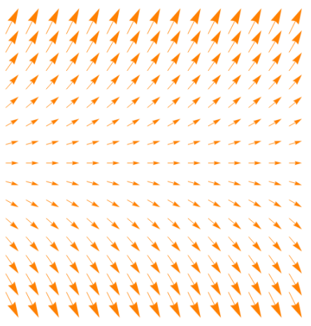



Vector
Vector Field
$$\vec{v}\left(p\right)$$
$$\vec{v}$$

Slide 5
Curves can give us vector fields from the tangent vectors.

Slide 6


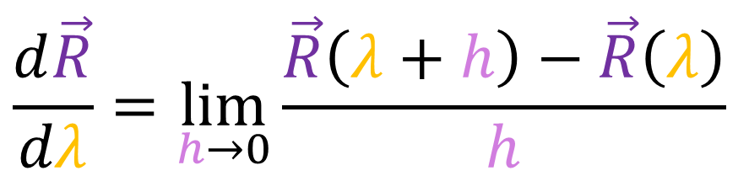



$$y$$
$$\frac{d\vec{R}}{dλ}=\lim_{h→0}\frac{\vec{R}\left(λ+h\right)−\vec{R}\left(λ\right)}{h}$$
$$\vec{R}\left(λ+h\right)$$
$$\vec{R}\left(λ+h\right)−\vec{R}\left(λ\right)$$
$$x$$
$$\vec{R}\left(λ\right)$$

Slide 7

$$y$$
$$\frac{d\vec{R}}{dλ}=\lim_{h→0}\frac{\vec{R}\left(λ+h\right)−\vec{R}\left(λ\right)}{h}$$
$$\vec{R}\left(λ+h\right)$$
$$\vec{R}\left(λ+h\right)−\vec{R}\left(λ\right)$$
$$x$$
$$\vec{R}\left(λ\right)$$

Slide 8

$$y$$
$$x$$

Slide 9
$$y$$
$$x$$

Slide 10
$$y$$
$$\frac{d\vec{R}}{dλ}=\lim_{h→0}\frac{\vec{R}\left(λ+h\right)−\vec{R}\left(λ\right)}{h}$$
$$\vec{R}\left(λ+h\right)$$
$$\vec{R}\left(λ+h\right)−\vec{R}\left(λ\right)$$
$$x$$
$$\vec{R}\left(λ\right)$$

Slide 11

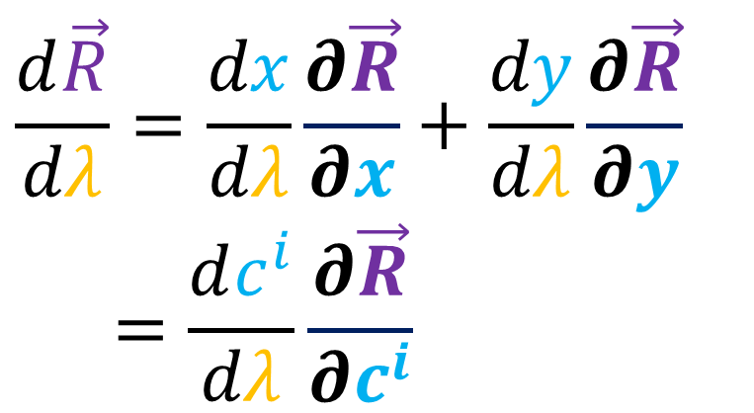
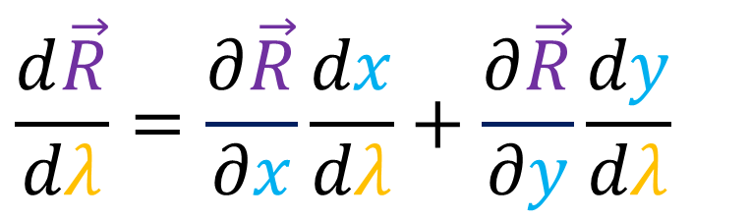

$$y$$
$$\frac{d\vec{R}}{dλ}=\frac{∂\vec{R}}{∂x}\frac{dx}{dλ}+\frac{∂\vec{R}}{∂y}\frac{dy}{dλ}$$
$$\frac{d\vec{R}}{dλ}=\frac{dx}{dλ}\frac{∂\vec{R}}{∂x}+\frac{dy}{dλ}\frac{∂\vec{R}}{∂y}$$
$$=\frac{dc^{i}}{dλ}\frac{∂\vec{R}}{∂c^{i}}$$
$$x$$
$$c^{1}=x c^{2}=y$$

Slide 12
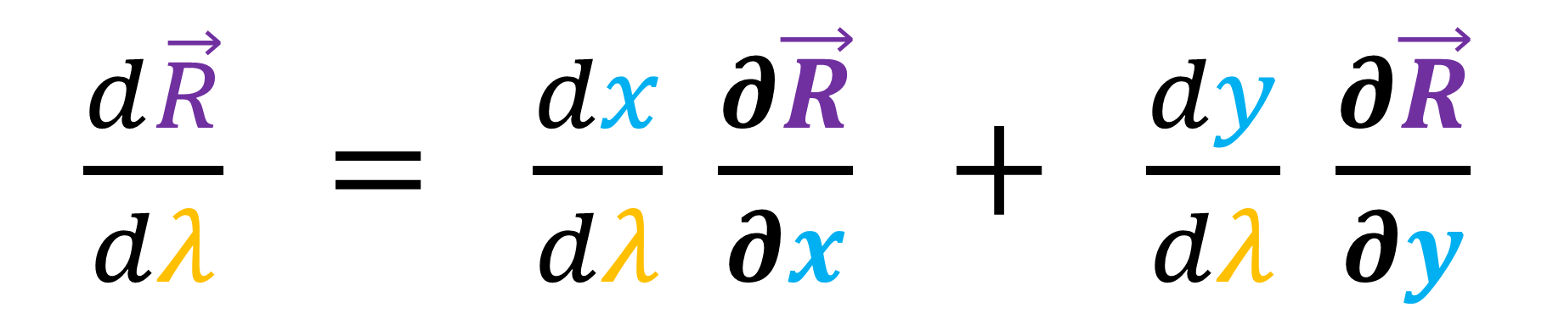
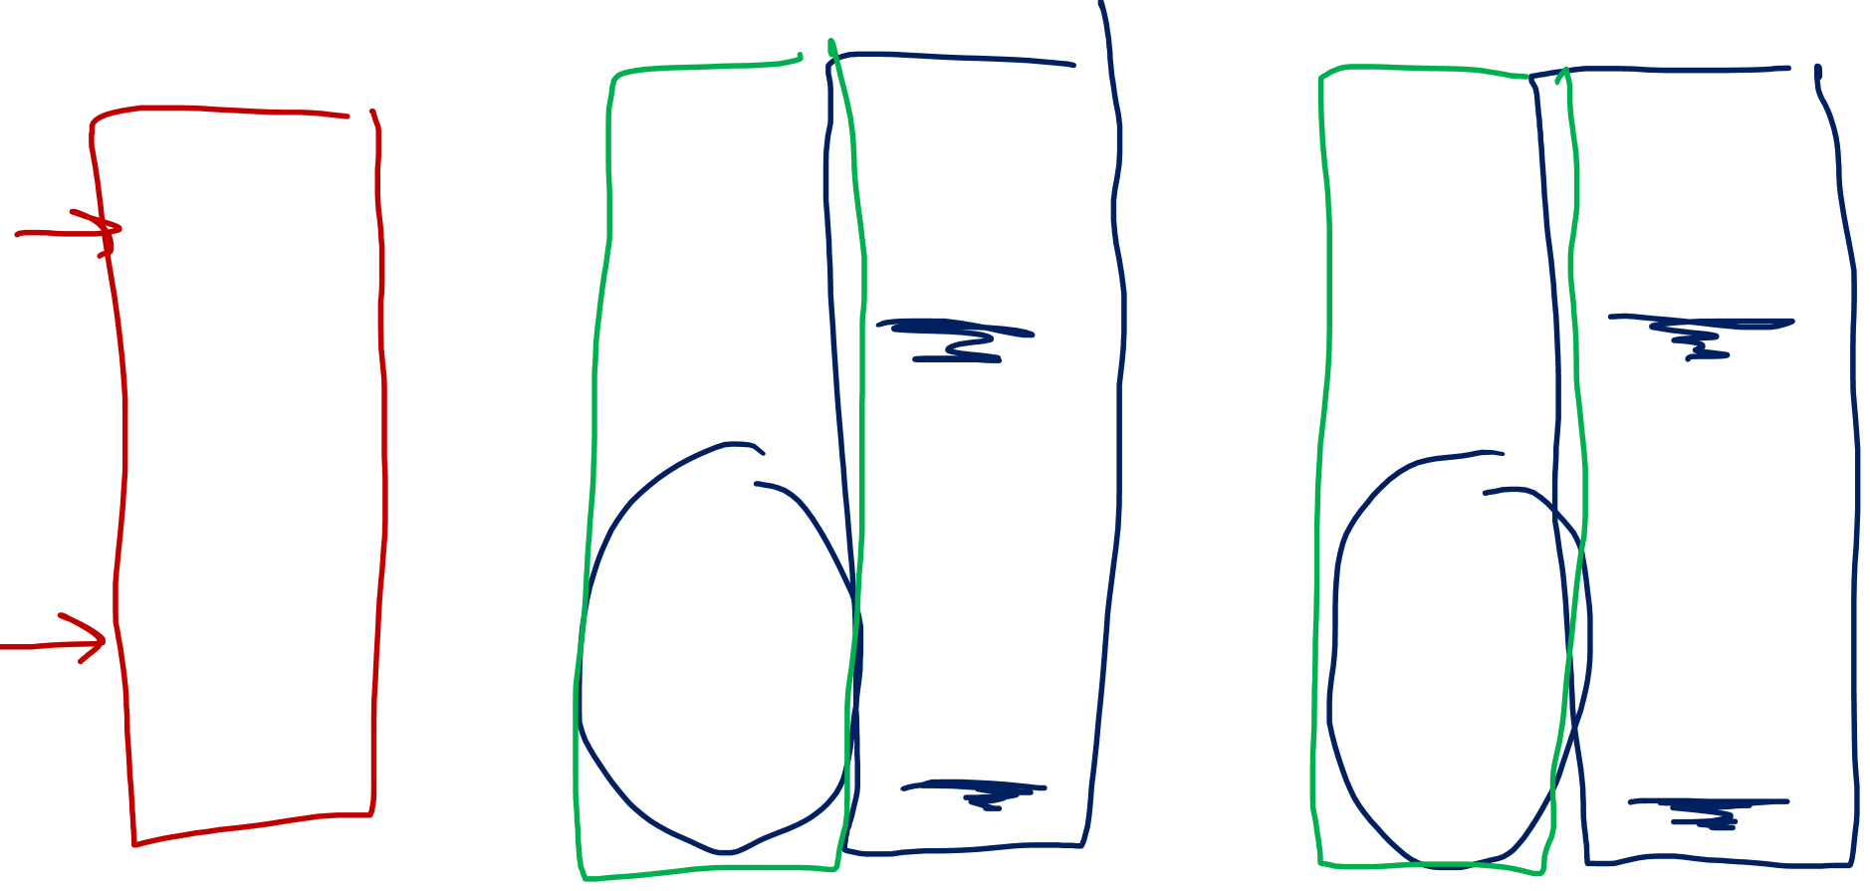

$$\vec{v} = v^{1} \vec{e_{1}} + v^{2} \vec{e_{2}}$$
$\frac{d\vec{R}}{dλ} = \frac{dx}{dλ} \frac{∂\vec{R}}{∂x} + \frac{dy}{dλ} \frac{∂\vec{R}}{∂y}$

Slide 13


$$\vec{v}= v^{i} \vec{e_{i}}$$
$\frac{d\vec{R}}{dλ}=\frac{dc^{i}}{dλ}\frac{∂\vec{R}}{∂c^{i}}$
$$c^{1}=x c^{2}=y$$

Slide 14
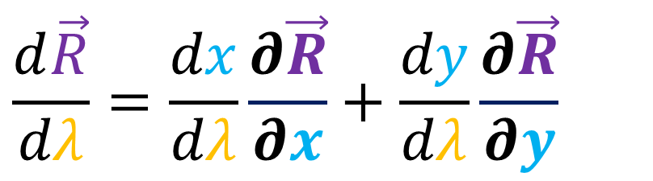




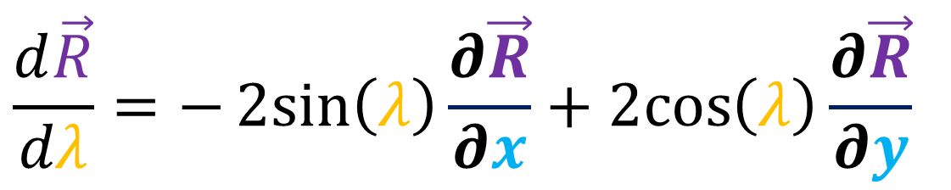

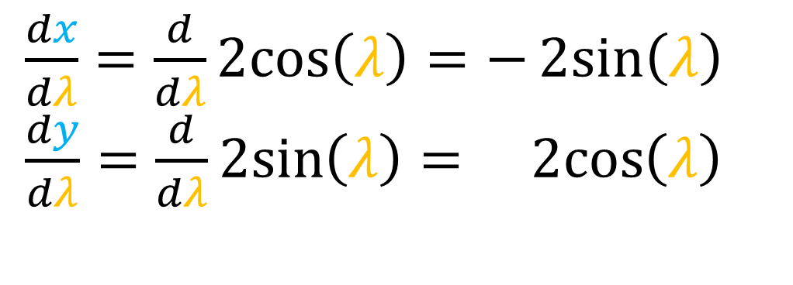
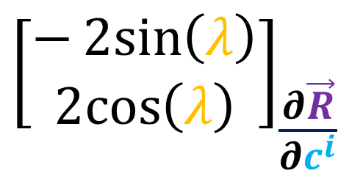
$$y$$
$$y$$
$$\vec{R}\left(λ\right)=\left(x\left(λ\right),y\left(λ\right)\right)=(2\cos\left(λ\right),2\sin\left(λ\right))$$
$$\frac{d\vec{R}}{dλ}=\frac{dx}{dλ}\frac{∂\vec{R}}{∂x}+\frac{dy}{dλ}\frac{∂\vec{R}}{∂y}$$
$$x$$
$$x$$
$\frac{dx}{dλ}=\frac{d}{dλ}2cos\left(λ\right)=−2sin\left(λ\right)$
$\frac{dy}{dλ}=\frac{d}{dλ}2sin\left(λ\right)= 2cos\left(λ\right)$
$${\left[\begin{aligned}−2sin\left(λ\right) \\ 2cos\left(λ\right)\end{aligned}\right]}_{\frac{∂\vec{R}}{∂c^{i}}}$$
$$\frac{d\vec{R}}{dλ}=−2sin\left(λ\right)\frac{∂\vec{R}}{∂x}+2cos\left(λ\right)\frac{∂\vec{R}}{∂y}$$

Slide 15

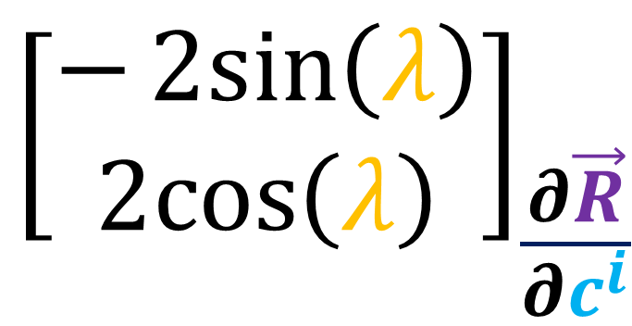



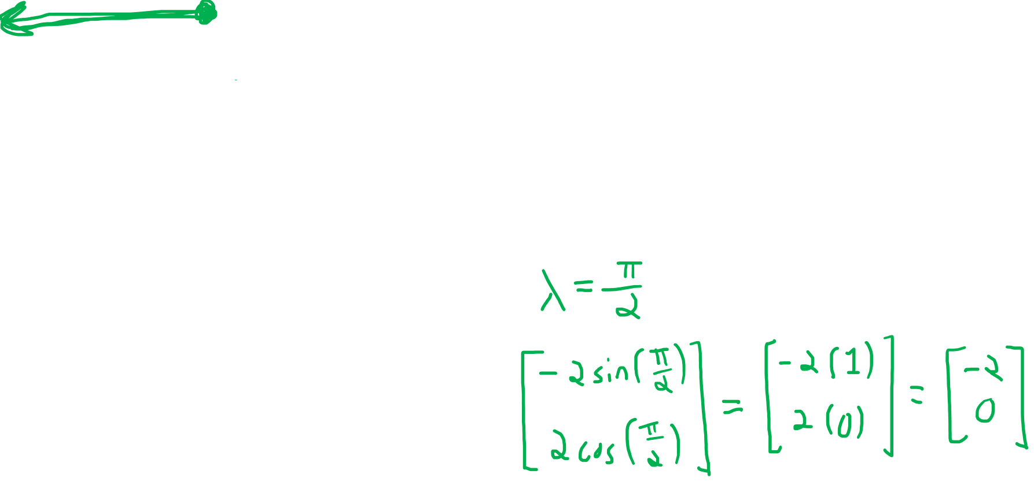
$$y$$
$$\left(x\left(λ\right),y\left(λ\right)\right)=(2\cos\left(λ\right),2\sin\left(λ\right))$$
$$y$$
$${\left[\begin{aligned}−2sin\left(λ\right) \\ 2cos\left(λ\right)\end{aligned}\right]}_{\frac{∂\vec{R}}{∂c^{i}}}$$
$$x$$
$$x$$

Slide 16

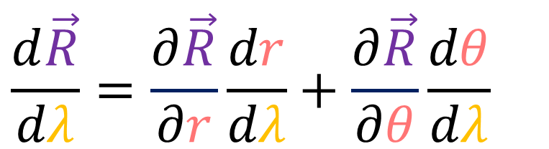

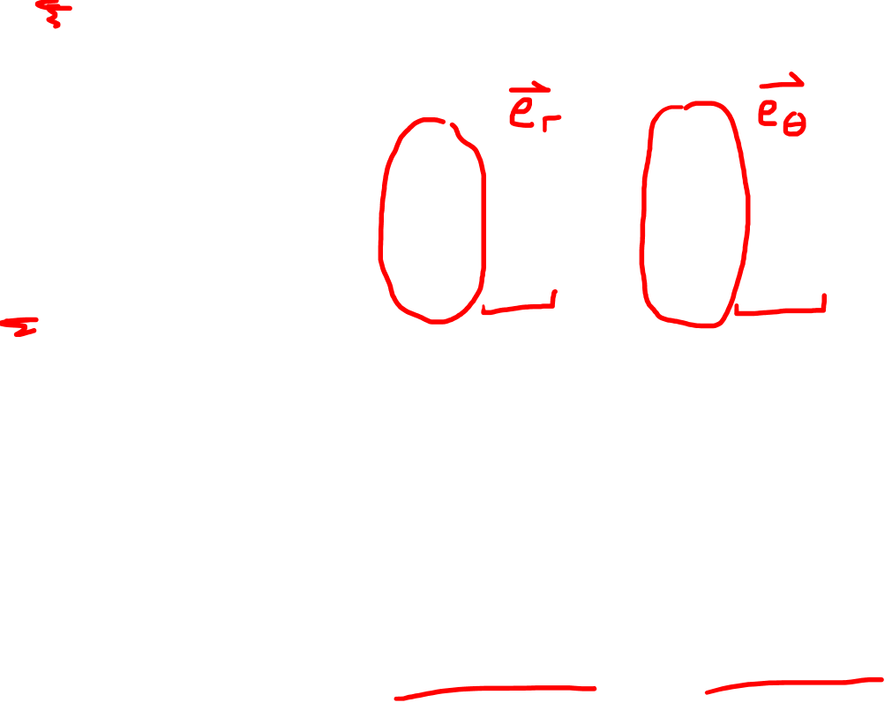

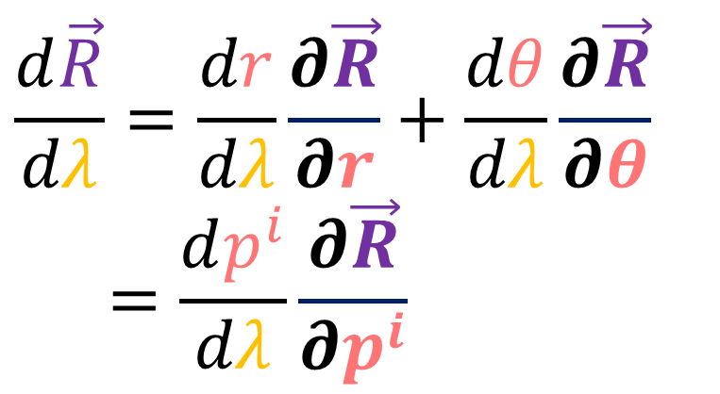
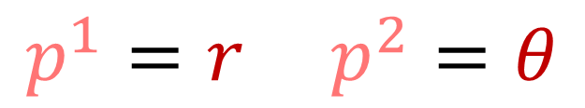
$$\frac{d\vec{R}}{dλ}=\frac{∂\vec{R}}{∂r}\frac{dr}{dλ}+\frac{∂\vec{R}}{∂θ}\frac{dθ}{dλ}$$
$$θ$$
$$\vec{R}\left(λ\right)$$
$$\frac{d\vec{R}}{dλ}=\frac{dr}{dλ}\frac{∂\vec{R}}{∂r}+\frac{dθ}{dλ}\frac{∂\vec{R}}{∂θ}$$
$$=\frac{dp^{i}}{dλ}\frac{∂\vec{R}}{∂p^{i}}$$
$$r$$
$$p^{1}=r p^{2}=θ$$

Slide 17
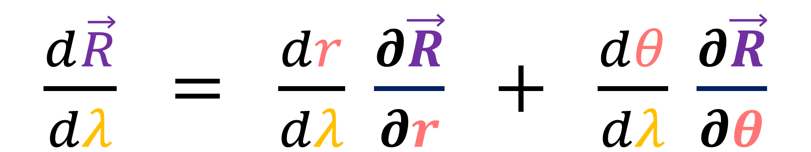

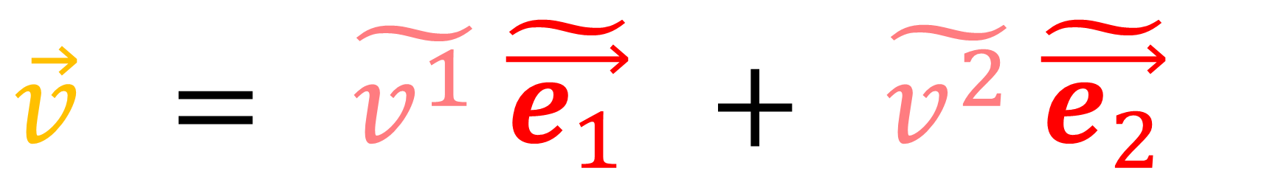
$$\vec{v} = \tilde{v^{1}} \tilde{\vec{e_{1}}} + \tilde{v^{2}} \tilde{\vec{e_{2}}}$$
$\frac{d\vec{R}}{dλ} = \frac{dr}{dλ} \frac{∂\vec{R}}{∂r} + \frac{dθ}{dλ} \frac{∂\vec{R}}{∂θ}$

Slide 18


$$\vec{v}=\tilde{v^{i}} \tilde{\vec{e_{i}}}$$
$\frac{d\vec{R}}{dλ}=\frac{dp^{i}}{dλ}\frac{∂\vec{R}}{∂p^{i}}$
$$p^{1}=r p^{2}=θ$$

Slide 19


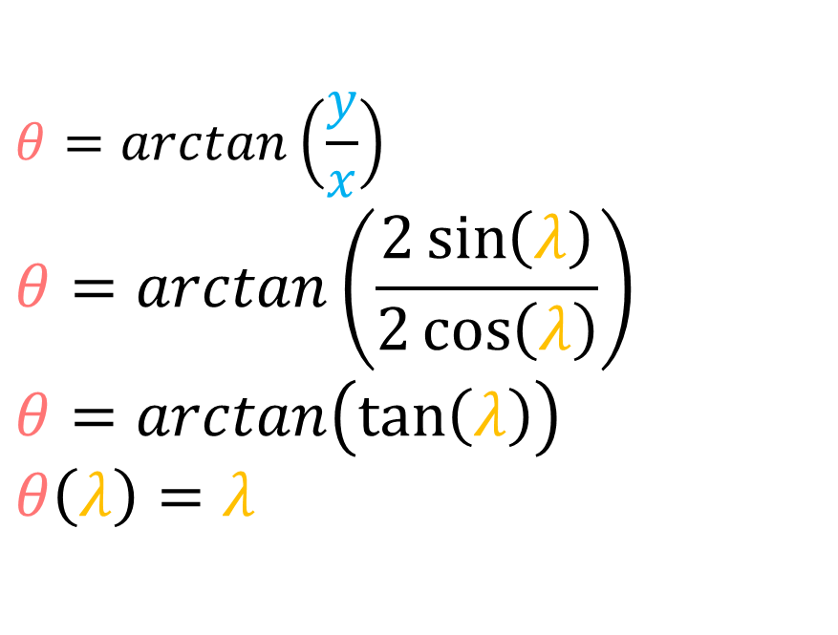
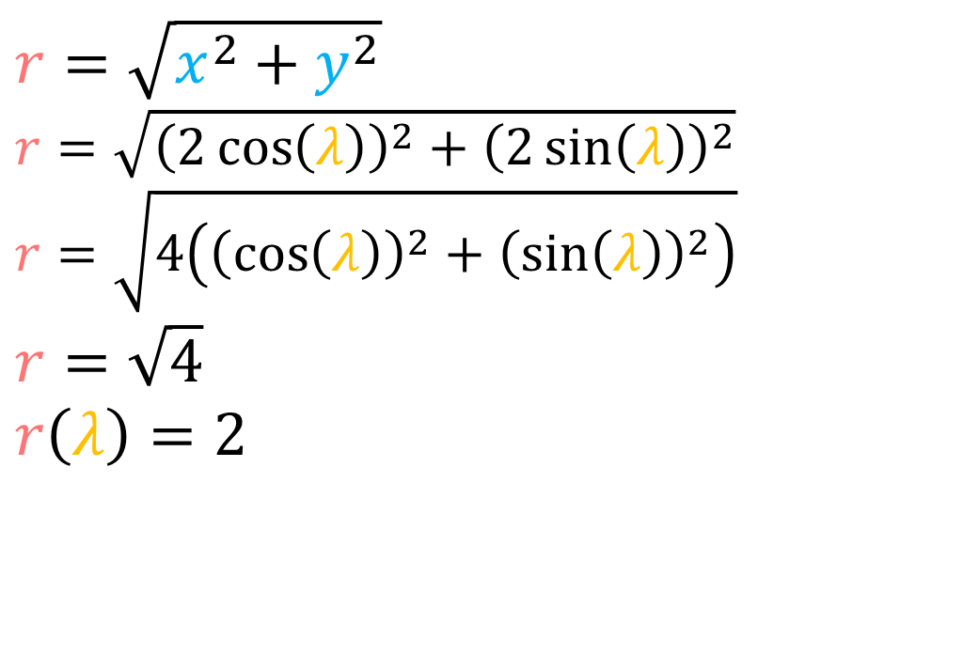
$$\vec{R}\left(λ\right)=\left(x\left(λ\right),y\left(λ\right)\right)=(2\cos\left(λ\right),2\sin\left(λ\right))$$
$$r=\sqrt{x^{2}+y^{2}}$$
$$r=\sqrt{{\left(2\cos\left(λ\right)\right)}^{2}+{\left(2\sin\left(λ\right)\right)}^{2}}$$
$$r=\sqrt{4\left({\left(\cos\left(λ\right)\right)}^{2}+{\left(\sin\left(λ\right)\right)}^{2}\right)}$$
$$r=\sqrt{4}$$
$$r\left(λ\right)=2$$
$$θ=arctan\left(\frac{y}{x}\right)$$
$$θ=arctan\left(\frac{2\sin\left(λ\right)}{2\cos\left(λ\right)}\right)$$
$$θ=arctan\left(tan⁡\left(λ\right)\right)$$
$$θ\left(λ\right)=λ$$
$$\vec{R}\left(λ\right)=\left(r\left(λ\right),θ\left(λ\right)\right)=(2,λ)$$

Slide 20

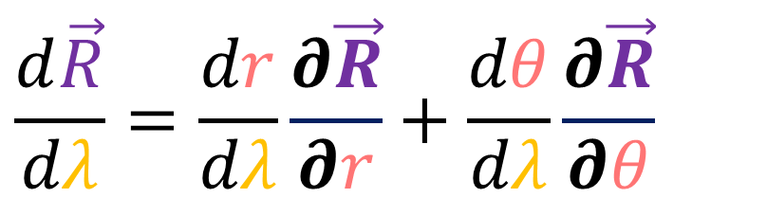


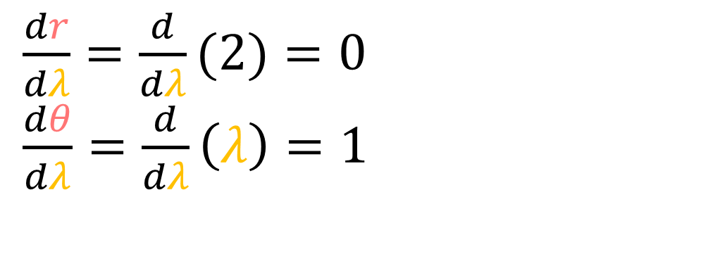
$$\vec{R}\left(λ\right)=\left(r\left(λ\right),θ\left(λ\right)\right)=(2,λ)$$
$$θ$$
$$\frac{d\vec{R}}{dλ}=\frac{dr}{dλ}\frac{∂\vec{R}}{∂r}+\frac{dθ}{dλ}\frac{∂\vec{R}}{∂θ}$$
$$r$$
$\frac{dr}{dλ}=\frac{d}{dλ}(2)=0$
$\frac{dθ}{dλ}=\frac{d}{dλ}\left(λ\right)=1$
${\left[\begin{aligned}0 \\ 1\end{aligned}\right]}_{\frac{∂\vec{R}}{∂p^{i}}}$
$$\frac{d\vec{R}}{dλ}=0\frac{∂\vec{R}}{∂r}+1\frac{∂\vec{R}}{∂θ}$$

Slide 21
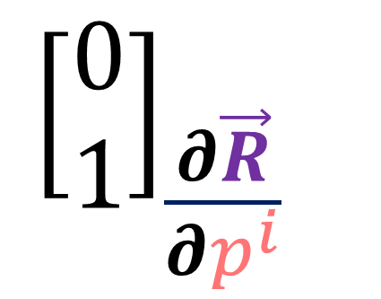
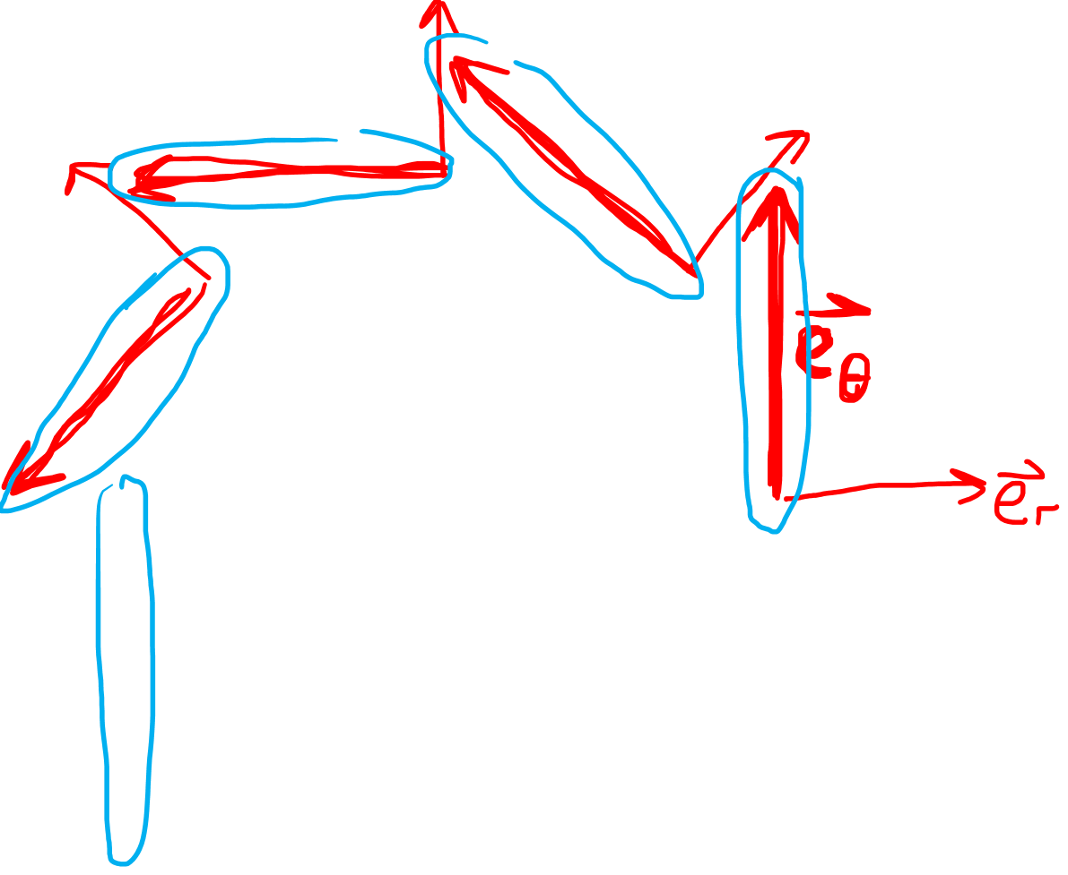
$$\left(r\left(λ\right),θ\left(λ\right)\right)=(2,λ)$$
$$θ$$
$${\left[\begin{aligned}0 \\ 1\end{aligned}\right]}_{\frac{∂\vec{R}}{∂p^{i}}}$$
$$r$$

Slide 22
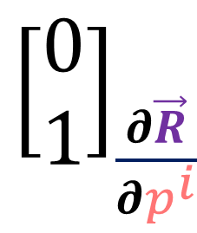
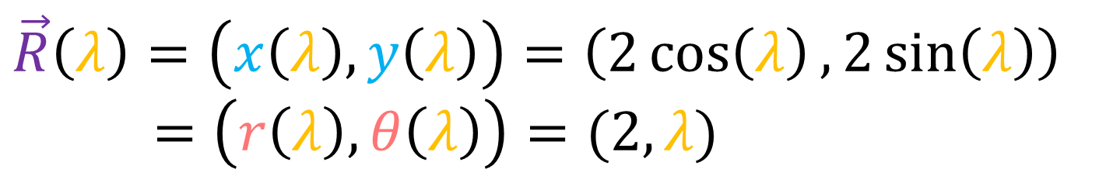

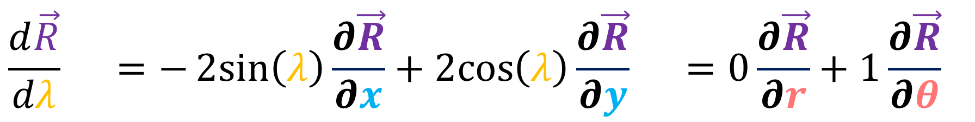
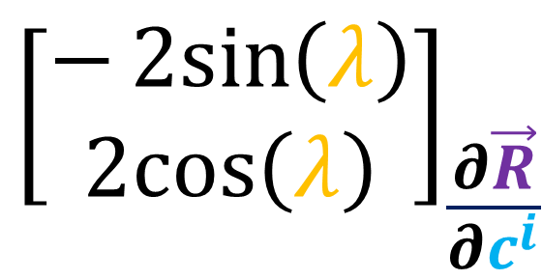
$$\vec{R}\left(λ\right)=\left(x\left(λ\right),y\left(λ\right)\right)=\left(2\cos\left(λ\right),2\sin\left(λ\right)\right)$$
$$=\left(r\left(λ\right),θ\left(λ\right)\right)=(2,λ)$$
$$\vec{R}\left(λ\right)$$
$${\left[\begin{aligned}−2sin\left(λ\right) \\ 2cos\left(λ\right)\end{aligned}\right]}_{\frac{∂\vec{R}}{∂c^{i}}}$$
${\left[\begin{aligned}0 \\ 1\end{aligned}\right]}_{\frac{∂\vec{R}}{∂p^{i}}}$
$$\frac{d\vec{R}}{dλ} =−2sin\left(λ\right)\frac{∂\vec{R}}{∂x}+2cos\left(λ\right)\frac{∂\vec{R}}{∂y} =0\frac{∂\vec{R}}{∂r}+1\frac{∂\vec{R}}{∂θ}$$

Slide 23
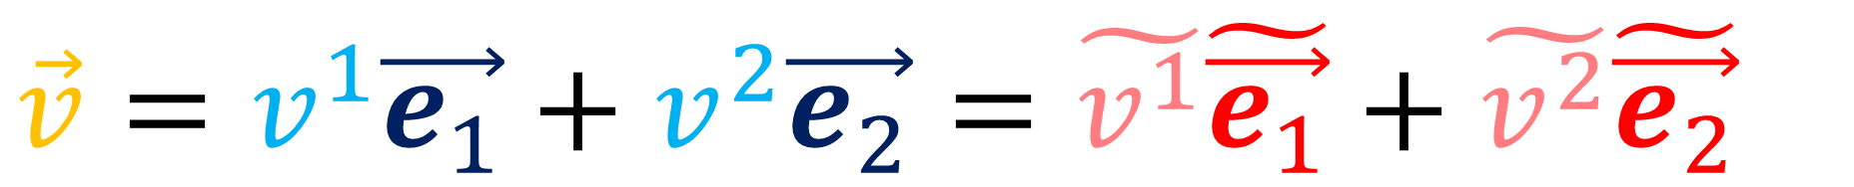
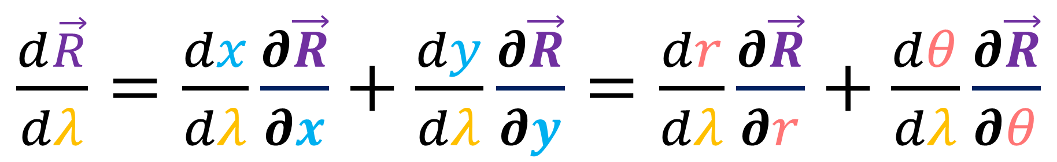
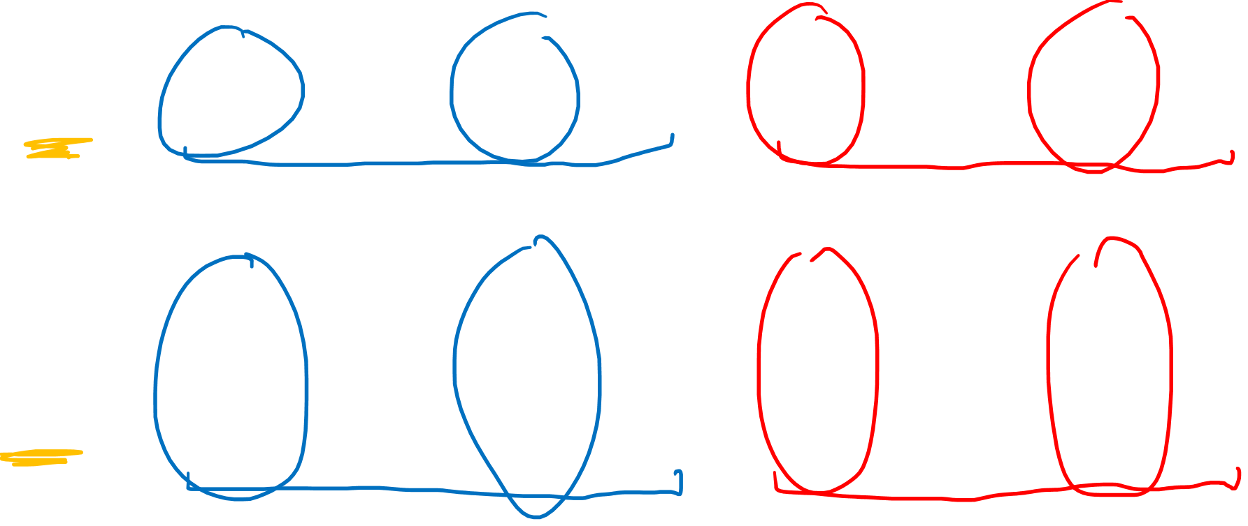
$$\vec{v}=v^{1}\vec{e_{1}}+v^{2}\vec{e_{2}}=\tilde{v^{1}}\tilde{\vec{e_{1}}}+\tilde{v^{2}}\tilde{\vec{e_{2}}}$$
$\frac{d\vec{R}}{dλ}=\frac{dx}{dλ}\frac{∂\vec{R}}{∂x}+\frac{dy}{dλ}\frac{∂\vec{R}}{∂y}=\frac{dr}{dλ}\frac{∂\vec{R}}{∂r}+\frac{dθ}{dλ}\frac{∂\vec{R}}{∂θ}$

Slide 24


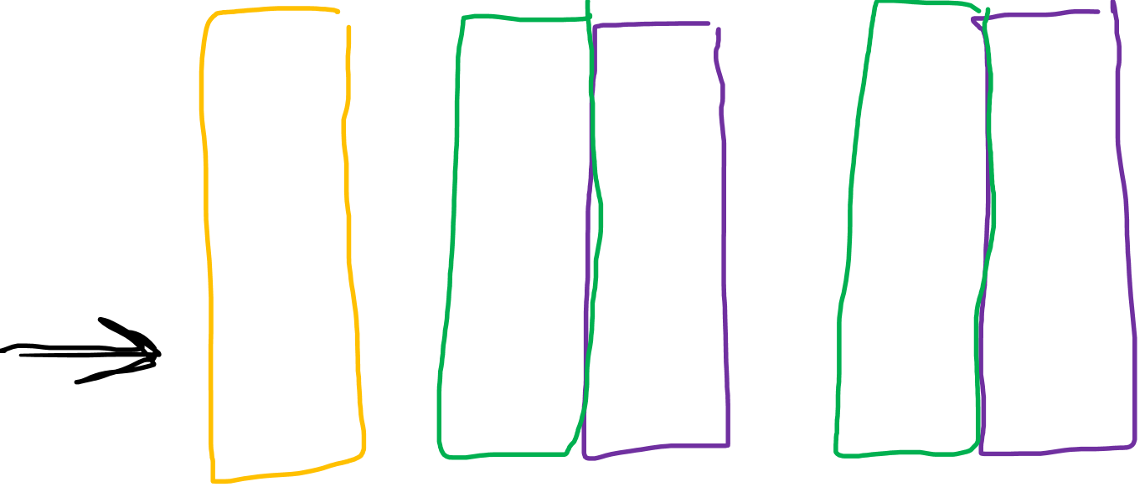
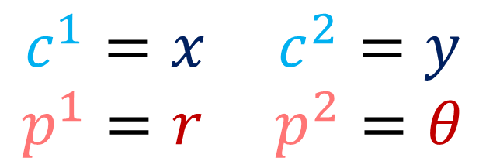
$$\vec{v}= v^{i}\vec{e_{i}} = \tilde{v^{i}}\tilde{\vec{e_{i}}}$$
$\frac{d\vec{R}}{dλ}=\frac{dc^{i}}{dλ}\frac{∂\vec{R}}{∂c^{i}}=\frac{dp^{i}}{dλ}\frac{∂\vec{R}}{∂p^{i}}$
$$c^{1}=x c^{2}=y$$
$$p^{1}=r p^{2}=θ$$

Slide 25

$$\vec{v}= v^{i}\vec{e_{i}} = \tilde{v^{i}}\tilde{\vec{e_{i}}}$$
$\frac{d\vec{R}}{dλ}=\frac{dc^{i}}{dλ}\frac{∂\vec{R}}{∂c^{i}}=\frac{dp^{i}}{dλ}\frac{∂\vec{R}}{∂p^{i}}$
$$c^{1}=x c^{2}=y$$
$$p^{1}=r p^{2}=θ$$

