Slide 1
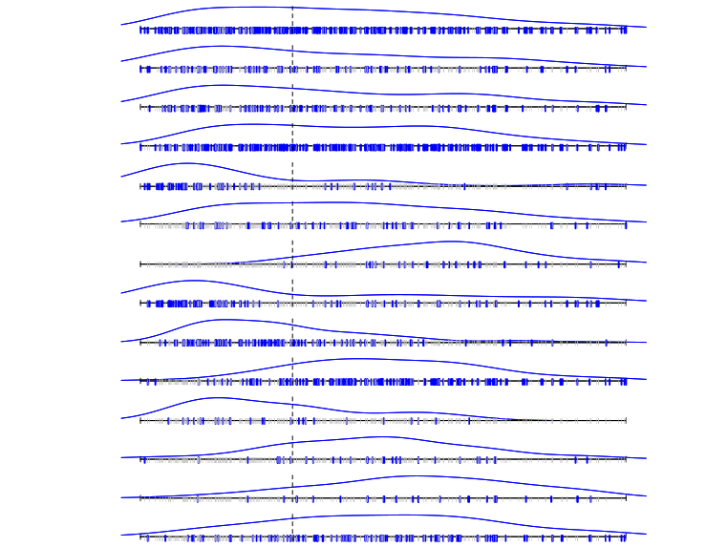
Male
STR
M2+
CLA
DN/MBEN
LCA
Case density
WNT
SHH
Grp3
Grp4
MYC
amplification
MYCN
amplification
TP53 mutation
iso17q
0
5
16
Age at diagnosis (years)
Notes:
Table 1 and Figure 1

