Slide 1




Development and validation of a novel cross-cancer immunogenomics analysis platform & web-based software
Dr Reza Rafiee, 26/06/2018

Slide 2

Development and validation of a novel cross-cancer immunogenomics analysis platform & web-based software
Develop an analytically validated, gene expression analysis model and software applicable to multiple platforms, including RNA-seq and cDNA microarray technology which can
Score the immune gene expression signatures of patient FFPE tumour samples (or a single sample)
Prospectively classify patient FFPE tumour samples into one of the six consensus immune molecular subtypes reported by PanCan Atlas.
Apply the software to clinically annotated gene expression data from multiple sites including prostate, breast, ovarian, lung, melanoma and colon cancer provided by Almac Diagnostics.
Assess the association between each immune molecular subtype and patient outcomes following conventional and immune-based therapies.

Slide 3
Completed
In progress
Not started
VM server
Specifying minimum hardware requirements for the project, assessing external prices from AWS and DigitalOcean company (8 cores, 16GB RAM, 256GB system disk)
Specifying software and libraries/packages required for the project
Install software, libraries and packages
PanCan Atlas dataset preparation
Downloading, extracting signature genes (based on The Immune Landscape of Cancer), extracting corresponding RNA-seq data matched with signature genes, extracting the overlapped genes across signatures (in two dataset)
Harmonising variables (sample Ids and gene Ids) in different datasets including retrieving alternative gene ids from genecard.org, assessing the distribution of missing data
Single sample gene set enrichment analysis (ssGSEA)
Training & validation dataset preparation and clustering analysis
Assess machine learning API tools and libraries for our platform such as TensorFlow
DDRD implementation (supervision and implementation)
Addressing missing with multiple imputation, exception handling modules (Amanda)
Identifying the DDRD threshold in an empirical manner (Amanda)
GUI designing (Myself)
Assessing confidence interval for each DDRD score (Myself)

Slide 4
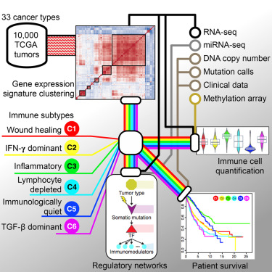
Dataset, resources and methods
30 Cancer subtypes (non-hematologic)
Total number of samples including immune subgroups (after removing samples without subgroups): 9126
Number of genes in 5 immune signatures: 446 (5 overlapped)
Number of missing genes in RNA-seq dataset: 1
Input data: Raw or normalised gene expression data from RNA-seq and cDNA microarray platforms
Normalisation:
Microarray: Log2 transformed of read count
RNA-seq: FPKM (normalised based on only the immune signature genes)
Immune gene expression signatures scoring (ssGSEA & WGCNA)
An ensemble classification model (including SVM classifier) or Deep learning model
Web-based software development running on a VM server hosted in Queen’s university Belfast: http://smg.qub.ac.uk:3838
The Immune Landscape of Cancer, Cell Press 2018

Slide 5
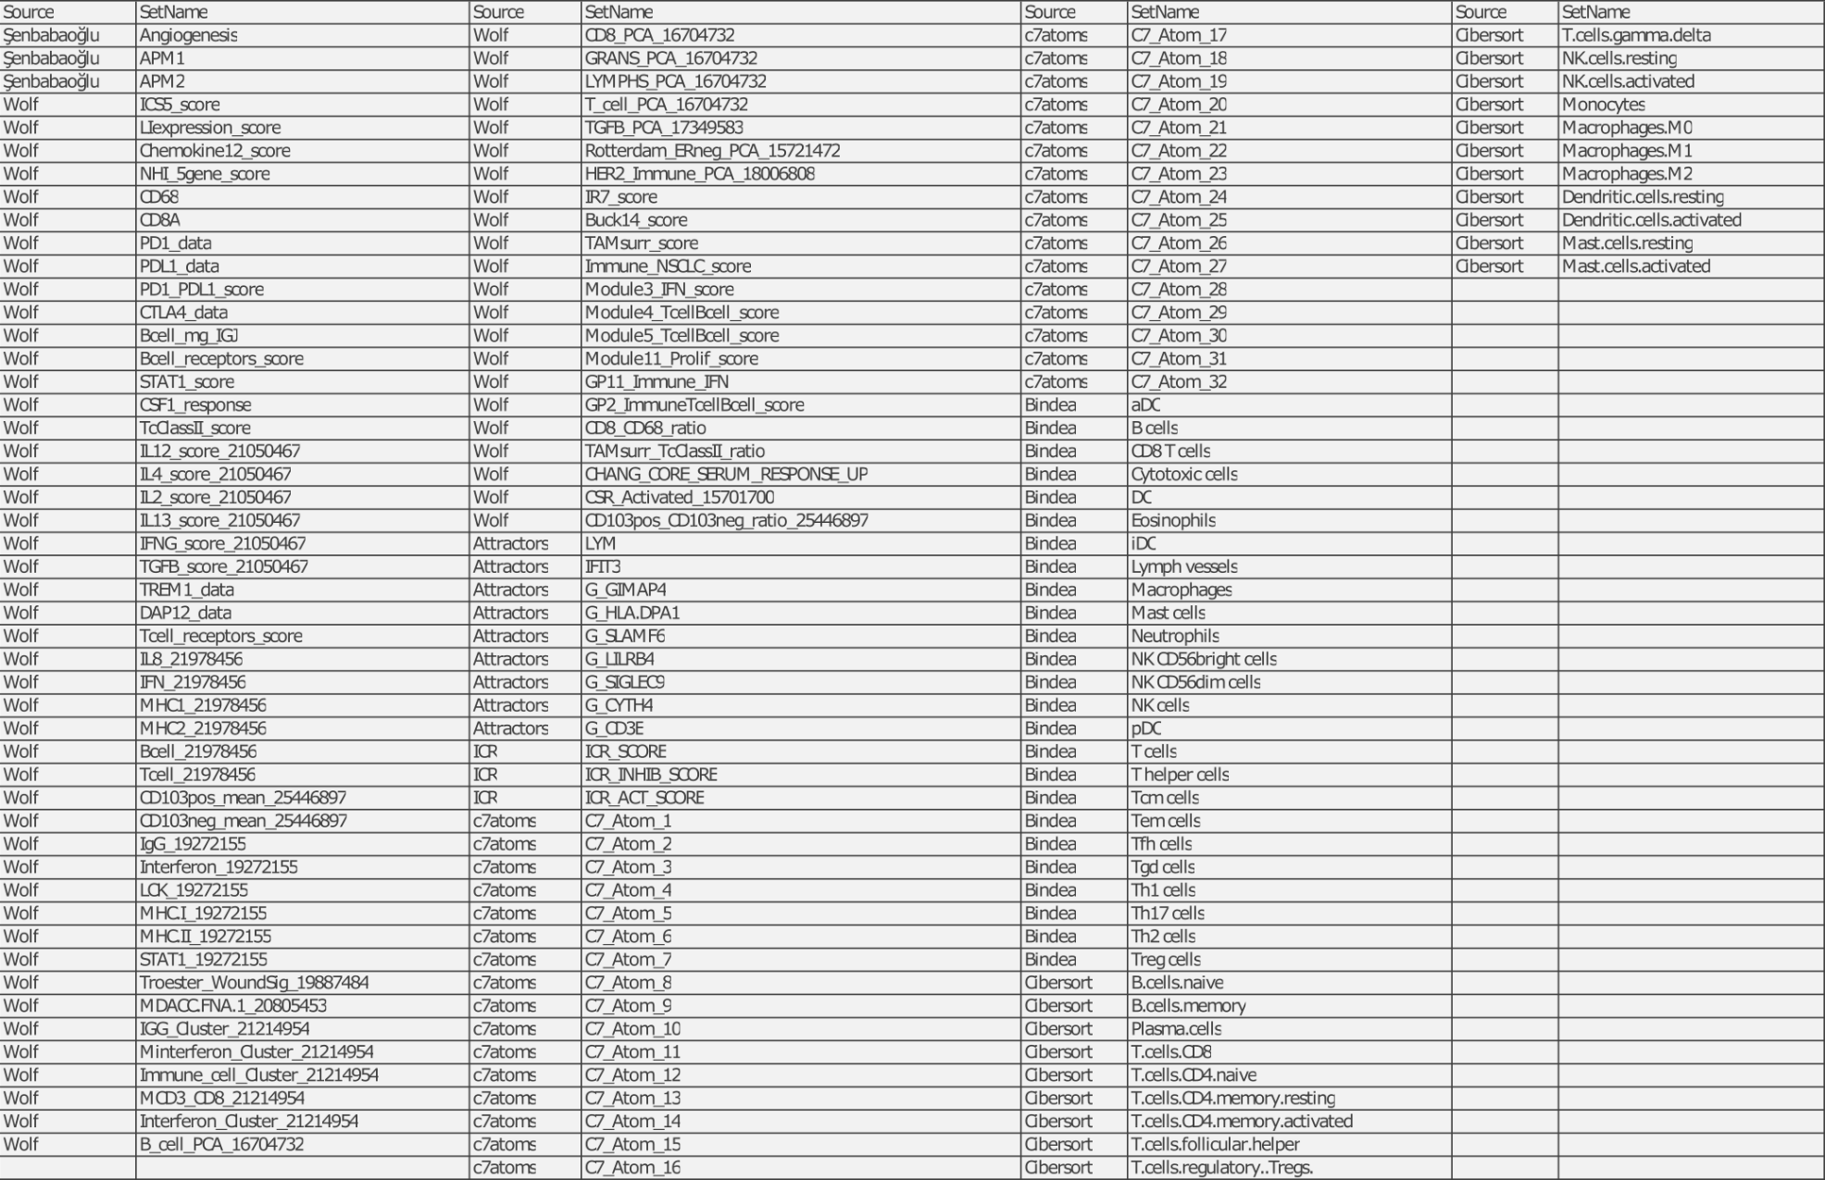
160 Immune signatures based on opinions of immuno-oncologist experts
Including 4691 genes

Slide 6
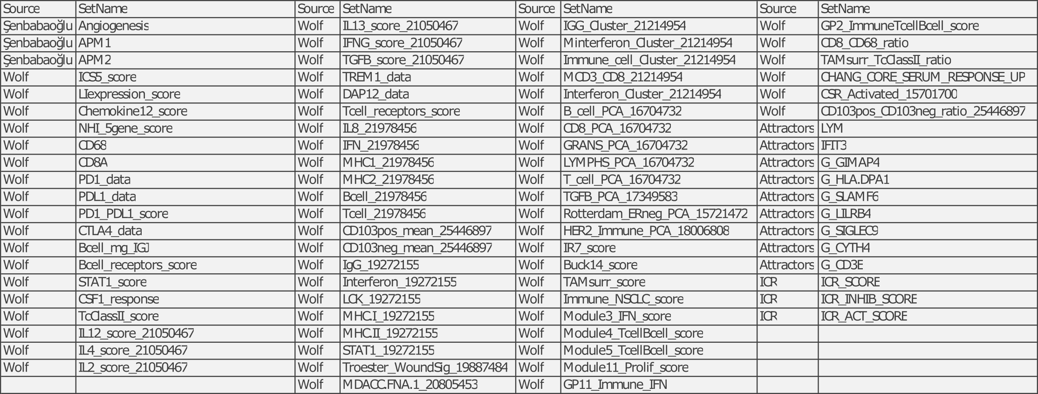
83 Immune signatures from 4 studies (n=2665 genes)
Which are known to be associated with immune activity in tumour tissue
# of genes
# of genes
# of genes
# of genes
80
212
18
112
24
Total = 446 genes
Of 160 signatures, 77 signatures did not affect the identified signature clusters and therefore have been removed from the final analysis.

Slide 7
Dataset preparation and harmonisation
 | IFN-γ response | TGB-β response | Activation of Macrophage /monocytes | Overall Lymphocyte infiltration | Wound healing | Total # of genes | Note
 | 24 | 80 | 112 | 18 | 212 | 446 | 5 overlapped genes between immune groups
 | 24 | 80 | 111 | 15 | 210 | 440 | IGLC1/IGLC is missing* (a protein coding gene, no RNA-seq data)
 |  | ITGB2 | ITGB2 CCL5 CD8A IL7R MSN | CCL5 CD8A | IL7R MSN |  | Overlapped genes In RNA-seq data (FPKM), 9 genes had alternative names (next slide)
Harmonising datasets including gene ids for the two datasets (FPKM RNA-seq and signature/subgroup datasets)
*Initially we had 10 missing genes ids ===> cross-checking all the alternative names of the missing gene ids (>30) across 20k genes

Slide 8
Dataset preparation and harmonisation – gene ids
# | Alternative/Aliases gene ids (used in RNA-seq dataset) | Gene ids (used in signature dataset) | Note
1 | CD247 | CD3Z | Lymphocyte (signature group)
2 | CD8B | CD8B1 | Lymphocyte
3 | VCAN | CSPG2 | TGF-β
4 | CTSL1 | CTSL | Macrophage
5 | CELF2 | CUGBP2 | Macrophage
6 | FPR3 | FPRL2 | Macrophage
7 | HDC | IGHG3 | Lymphocyte
8 | CYTIP | PSCDBP | Macrophage
9 | C13orf1 | SPRYD7 | Wound healing
www.Genecards.org

Slide 9
Dataset preparation and harmonisation – cancer subtypes
 | # of RNA-seq samples (440 genes) | # of samples (with subgroups) | Note
 | 10167 | 9126* | 1041 samples without any immune subgroup (Could be used for testing by the final classifier)
All 30 non-hematologic cancer types
 | Cancer Subtype | Number of Samples
15 | LUAD | 457
16 | LUSC | 486
17 | MESO | 83
18 | OV | 269
19 | PAAD | 151
20 | PCPG | 178
21 | PRAD | 405
22 | READ | 156
23 | SARC | 223
24 | SKCM | 103
25 | STAD | 391
26 | TGCT | 149
27 | THCA | 500
28 | UCEC | 528
29 | UCS | 57
30 | UVM | 80
*Matched with the number of samples in the paper prior to model-based clustering
 | Cancer Subtype | Number of Samples
1 | ACC | 78
2 | BLCA | 397
3 | BRCA | 1083
4 | CESC | 300
5 | CHOL | 35
6 | COAD | 441
7 | ESCA | 173
8 | GBM | 154
9 | HNSC | 514
10 | KICH | 65
11 | KIRC | 515
12 | KIRP | 279
13 | LGG | 514
14 | LIHC | 362

Slide 10
Sample distribution across cancers (n=9126)
BRCA: Breast Invasive Carcinoma
UCEC: Uterine Corpus Endometrial Carcinoma
KIRC: Kidney Renal Clear Cell Carcinoma
HNSC: Head and Neck Squamous Cell Carcinoma
LGG: Low Grade Glioma
THCA: Thyroid Carcinoma
LUSC: Lung Squamous Cell Carcinoma
LUAD: Lung Adenocarcinoma
COAD: Colon Adenocarcinoma
PRAD: Prostate Adenocarcinoma
BLCA: Bladder Urothelial Carcinoma
STAD: Stomach Adenocarcinoma
LIHC: Liver Hepatocellular Carcinoma
CESC: Cervical Squamous Cell Carcinoma and Endocervical Adenocarcinoma
KIRP: Kidney Renal Papillary Cell Carcinoma
OV: Ovarian Cancer
SARC: Sarcoma
PCPG: Pheochromocytoma and Paraganglioma
ESCA: Esophageal (Oesophageal) Carcinoma
READ: Rectum Adenocarcinoma
GBM: Glioblastoma Multiforme
PAAD: Pancreatic Adenocarcinoma
TGCT: Testicular Germ Cell Tumours
SKCM: Skin Cutaneous Melanoma
MESO: Mesothelioma
UVM: Uveal Melanoma
ACC: Adrenocortical carcinoma
KICH: Kidney Chromophobe
UCS: Uterine Carcinosarcoma
CHOL: Cholangiocarcinoma
Samples from below cancers (hematologic) without any immune subtypes
DLBC: Diffuse Large B-cell Lymphoma
LAML: Acute Myeloid Leukemia
THYM: Thymoma

Slide 11
Sample distribution across immune subtype (n=9126)
Immune subtype | Number of samples in each immune subtype
C1 | 2416
C2 | 2591
C3 | 2397
C4 | 1157
C5 | 385
C6 | 180
Imbalance data across 5 classes
Penalising c5 and c6, imbalanced data/classifier

Slide 12
Distribution of samples without immune subtype (n=1041)
No any immune subtype for these cancers:
DLBC: Diffuse Large B-cell Lymphoma
LAML: Acute Myeloid Leukemia
THYM: Thymoma

Slide 13
Assessing missing data across genes [9126×440]
All the analyses in the paper are based on non-missing values (genes/samples with missing data were excluded )
Gene | # of missing | Signature group | Note
RGS8 | 1396 | Wound healing | Total: 2536 out of [9126×440] (0.06%)
PLG | 833 | Wound healing
MMP3 | 307 | TGB-β

Slide 14
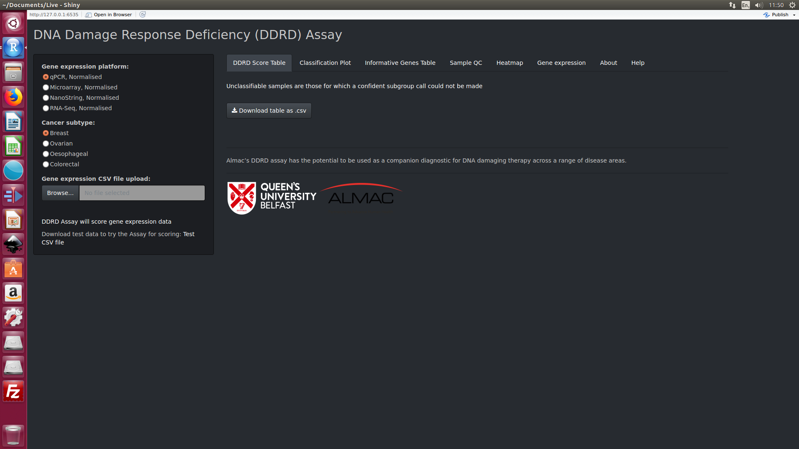
Developed GUI for the DDRD assay project

Slide 15
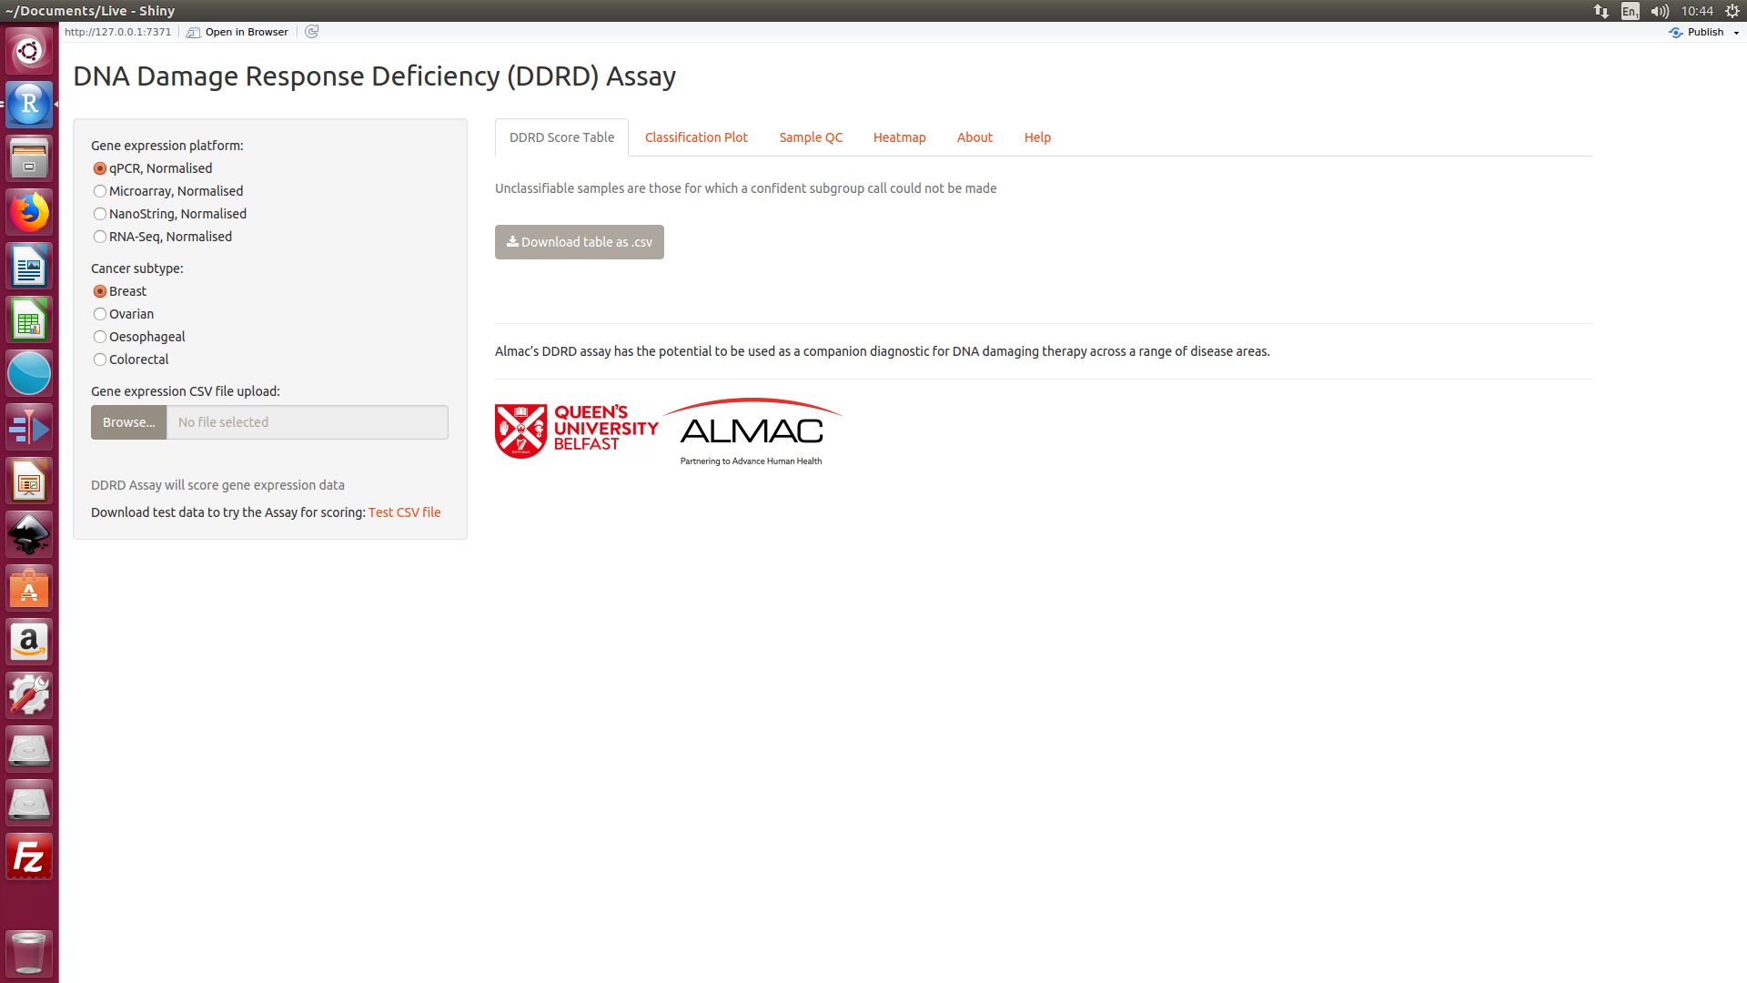
DDRD assay main page GUI
© 2018 Stratified Medicine Group, CCRCB, Queen’s University Belfast

Slide 16
Timescale and deliverables |  | Year1 |  |  |  | Year2
 |  | Q1* | Q2 | Q3 | Q4 | Q1 | Q2 | Contributors
WP1: Classification model development
WP1.1: Supervised learning model development & deployment
Immunogenomics classification model development | Resource preparation: normalised gene expression⁺ |  |  |  |  |  |  | Andrena
 | Resource preparation: 5 signatures & 6 immune subgroups |  |  |  |  |  |  | Reza
 | Training and test datasets preparation |  |  |  |  |  |  | Reza & Andrena
 | Supervised learning model selection |  |  |  |  |  |  | Reza
 | Model test and validation (methods) |  |  |  |  |  |  | Reza
 | Model validation by independent cohorts |  |  |  |  |  |  | Reza
Web-based package development and deployment | Application/Software adaptation |  |  |  |  |  |  | Reza
 | GUI web-based design, development & test (localhost) |  |  |  |  |  |  | Reza
 | Deployment, system/user-accepting test & bugs check (VM) |  |  |  |  |  |  | Reza
 | Documentation: software manuals (soft version) & handover |  |  |  |  |  |  | Reza
 | Post-development support and ongoing maintenance |  |  |  |  |  |  | Reza & Andrena
WP1.2: Reproducible immune signature generation, DDRD signature generation and classification
Immune signature generation | Application code development 1 (ssGSEA & WGCNA) |  |  |  |  |  |  | Andrena & Reza
 | Application code development 2 (ssGSEA & WGCNA) |  |  |  |  |  |  | Andrena & Reza
 | Integration, test and adaptation |  |  |  |  |  |  | Andrena & Reza
DDRD signature generation and classification | Application code development3 (DDRD assay classification) |  |  |  |  |  |  | Reza, Andrena & Amanda
 | GUI web-based design & integration with existing apps |  |  |  |  |  |  | Reza & Amanda
 | Deployment, system/user-accepting test & bugs check (VM) |  |  |  |  |  |  | Reza, Andrena & Amanda
 | Documentation: software manuals (soft version) & handover |  |  |  |  |  |  | Reza, Andrena & Amanda
 | Conference/Journal preparation & presentation
WP2: Cross-cancer clinical subgroup application
Applying the classification software to clinically annotated gene expression data (provided by Almac Diagnostics) | Assessing the association between each immune molecular subtype and patient outcomes across prostate, breast, ovarian, lung, melanoma and colon cancer Predication of drug responses (?)
Programme GANTT chart
*Three months: May-July 2018
⁺ Excluded for now (microarray, RNA-seq and so on)

