Slide 1
Async IO : Async & Await (In python)

Slide 2
What is Async IO
?
Async IO is a concurrent programming design that has received dedicated support in Python, evolving rapidly from Python 3.4 through 3.10, and probably beyond.
async IO is a single-threaded, single-process design
Coroutines (a central feature of async IO) can be scheduled concurrently, but they are not inherently concurrent
Coroutines are able to “pause” while waiting on their ultimate result and let other routines run in the meantime
What Coroutines mean ?
Coroutines are a special type of function that deliberately yield control over to the caller, but does not end its context in the process, instead maintaining it in an idle state.

Slide 3
Example
Chess master Judit Polgár hosts a chess exhibition in which she plays multiple amateur players. She has two ways of conducting the exhibition: synchronously and asynchronously.
Assumptions:
24 opponents
Judit makes each chess move in 5 seconds
Opponents each take 55 seconds to make a move
Games average 30 pair-moves (60 moves total)
Synchronous version:
Judit plays one game at a time, never two at the same time, until the game is complete. Each game takes (55 + 5) * 30 == 1800 seconds, or 30 minutes. The entire exhibition takes 24 * 30 == 720 minutes, or 12 hours.
Asynchronous version:
Judit moves from table to table, making one move at each table. She leaves the table and lets the opponent make their next move during the wait time. One move on all 24 games takes Judit 24 * 5 == 120 seconds, or 2 minutes. The entire exhibition is now cut down to 120 * 30 == 3600 seconds, or just 1 hour.

Slide 4
Conclusion:
We can accomplish same task in less time by working in asynchronous manner than by synchronous manner
It doesn’t work on the principle of threading and multiprocessing.
It converts long waiting period of time into productive time by using this time to complete other task in the loop

Slide 5
Lets start working with Async IO

Slide 6
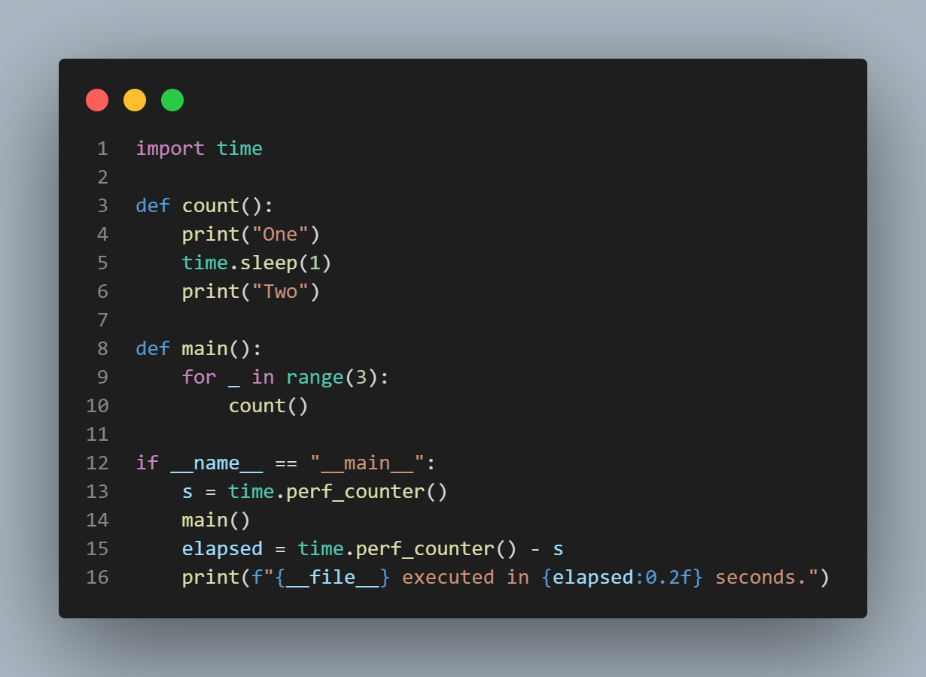
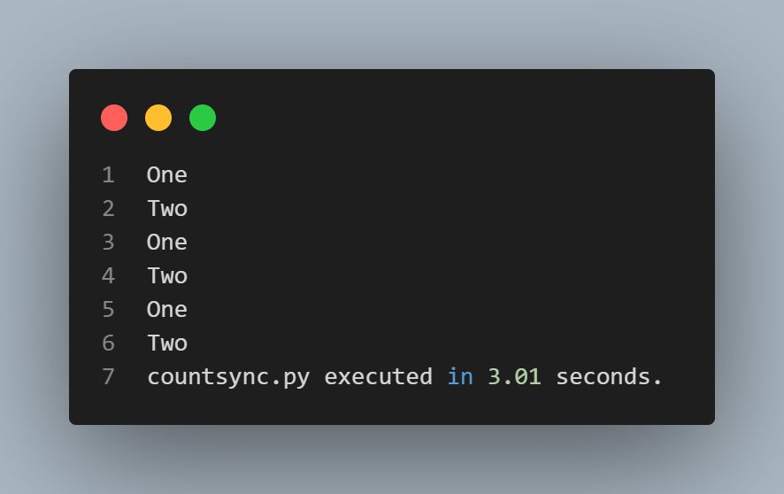
Code - 1 (Synchronous)
Output

Slide 7
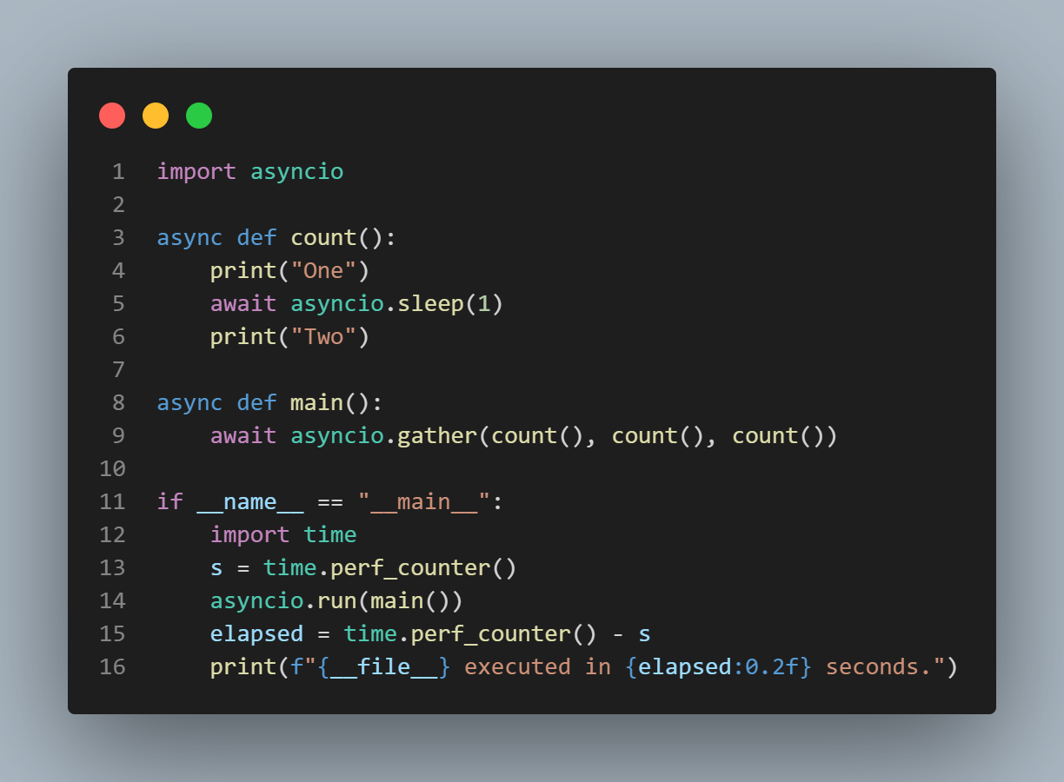
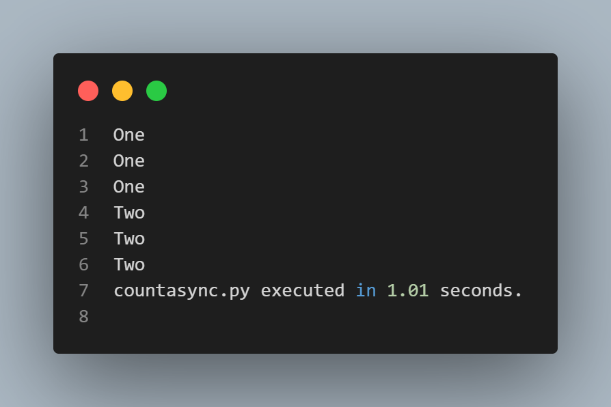
Code - 1 (Asynchronous)
Output

Slide 8
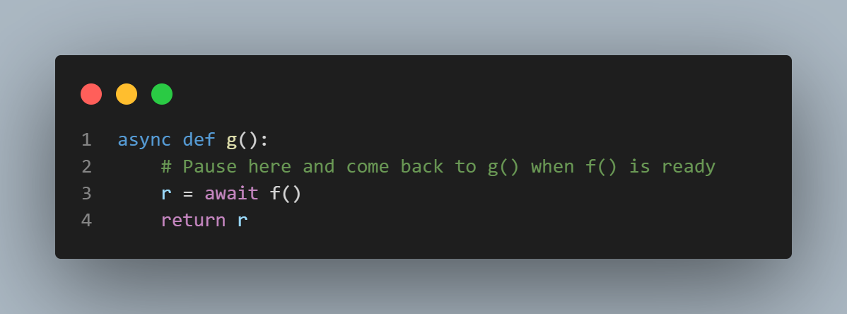
More about working of Async IO
The syntax async def introduces either a native coroutine or an asynchronous generator.
The keyword await passes function control back to the event loop. (It suspends the execution of the surrounding coroutine.) If Python encounters an await f() expression in the scope of g(), this is how await tells the event loop, “Suspend execution of g() until whatever I’m waiting on—the result of f()—is returned. In the meantime, go let something else run.”

Slide 9
Syntax of Async IO
A function that you introduce with async def is a coroutine. It may use await, return, or yield, but all of these are optional. Declaring async def funct(): pass is valid:
Using await and/or return creates a coroutine function. To call a coroutine function, you must await it to get its results.
It is less common (and only recently legal in Python) to use yield in an async def block. This creates an asynchronous generator, which you iterate over with async for. Forget about async generators for the time being and focus on getting down the syntax for coroutine functions, which use await and/or return.
Anything defined with async def may not use yield from, which will raise a SyntaxError.
Just like it’s a SyntaxError to use yield outside of a def function, it is a SyntaxError to use await outside of an async def coroutine. You can only use await in the body of coroutines.

Slide 10
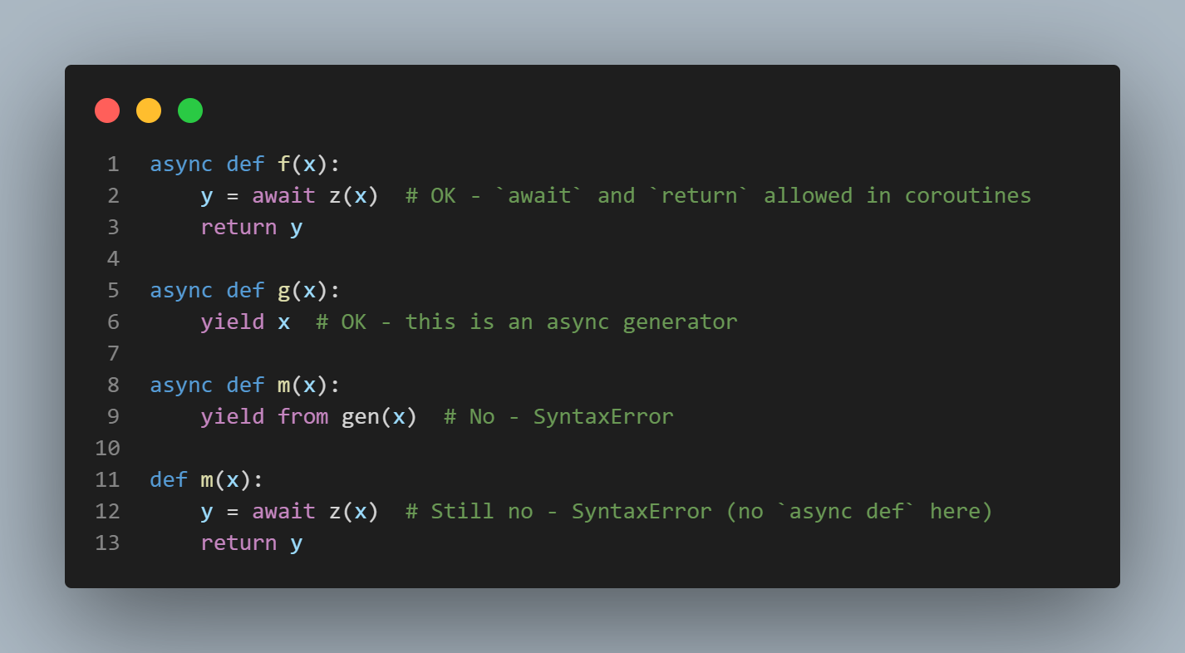

Slide 11
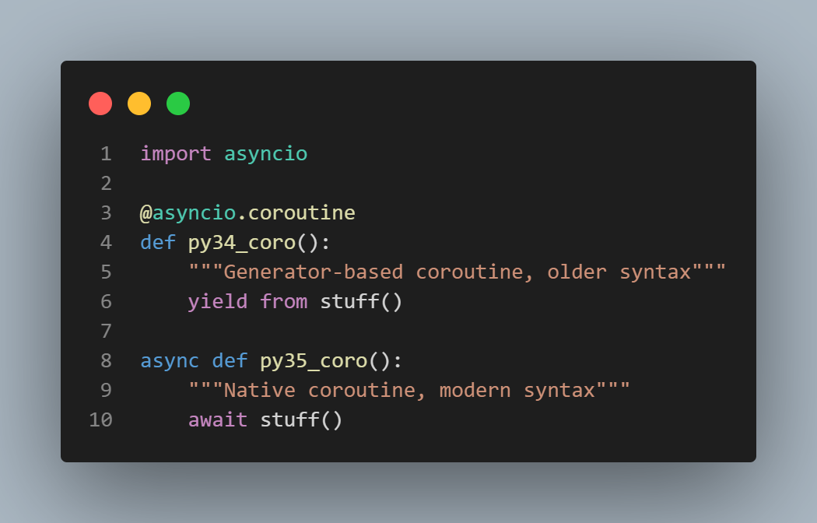
More syntax
For await f() to doesn’t throw syntax error, it is required that f() is a awaitable function.
an awaitable object is either (1) another coroutine or (2) an object defining an .__await__() under method that returns an iterator.
Its better to use native syntax than older syntax for sake of being explicit rather than implicit
Generator-based coroutines will be removed in Python 3.10.

Slide 12
Code - 2

Slide 13
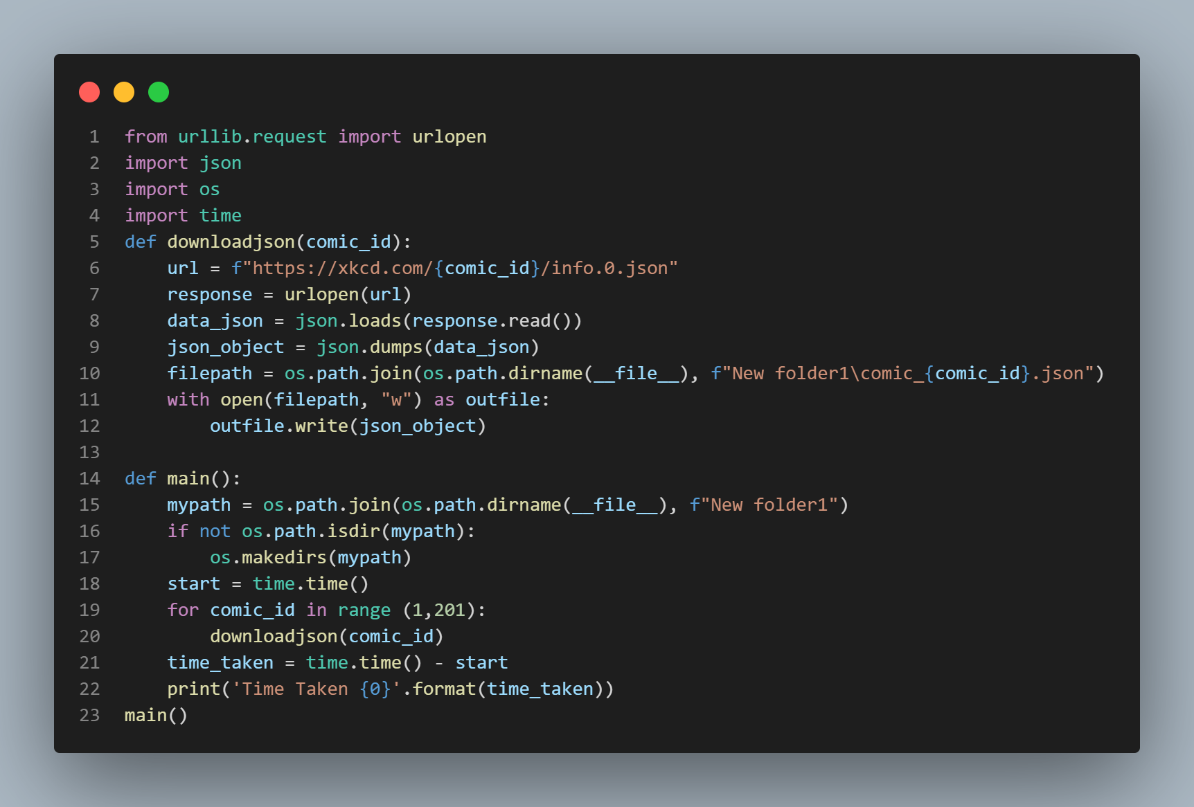
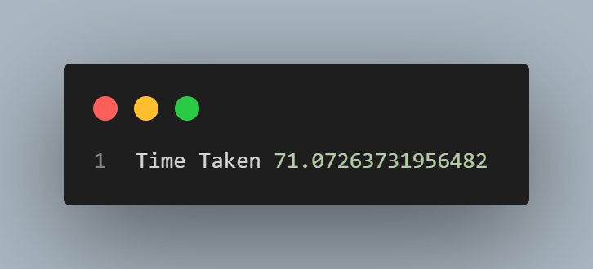
Code – 2 (Synchronous)
Output

Slide 14
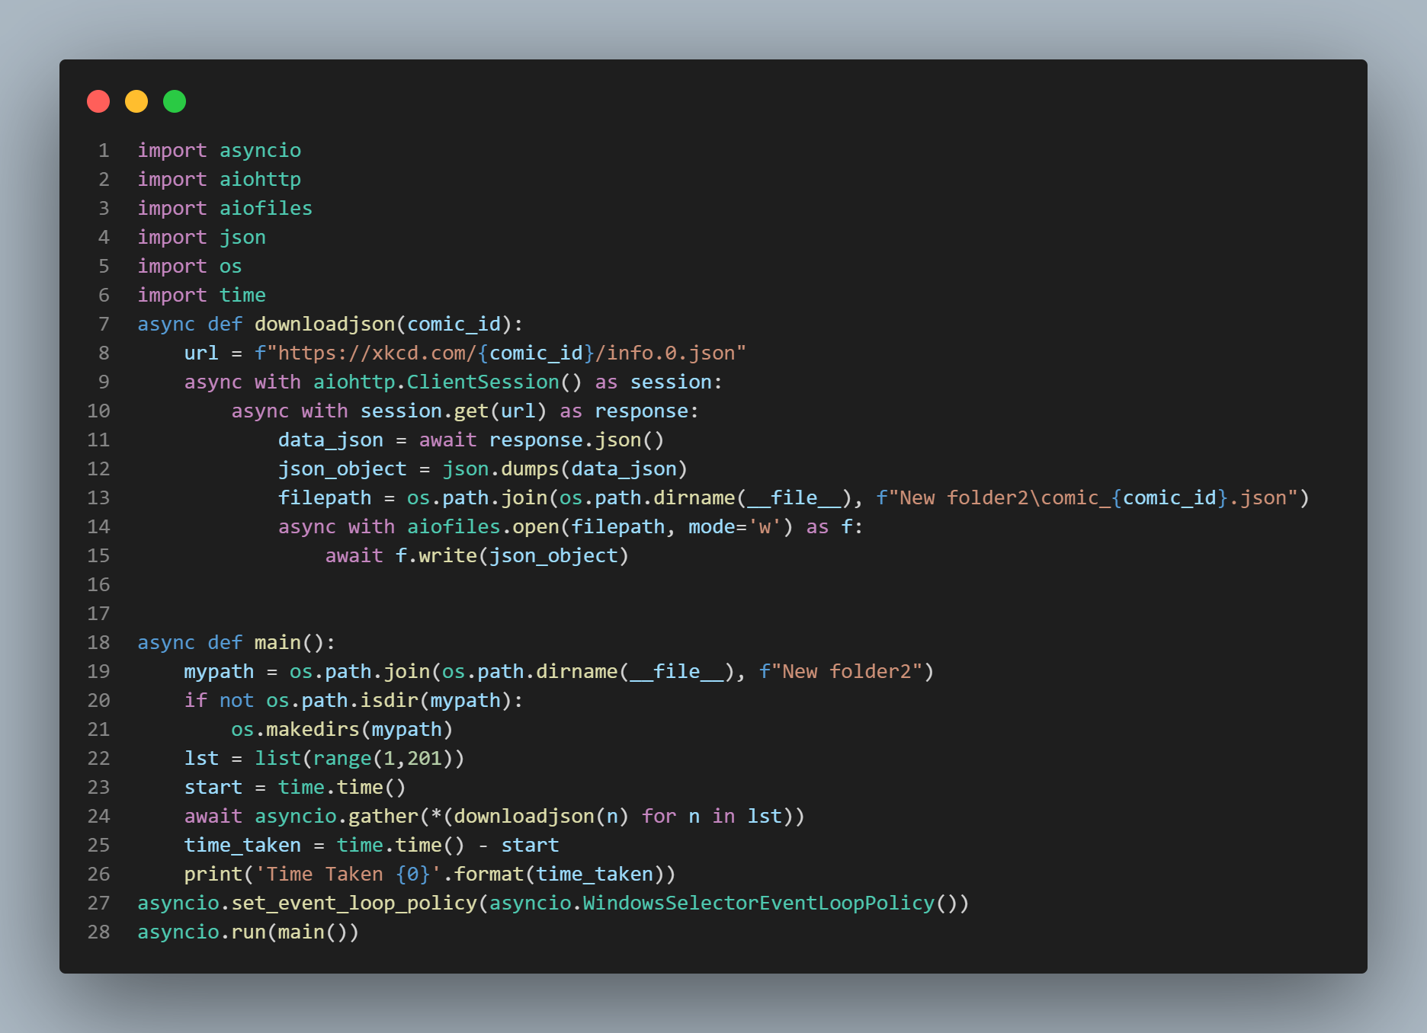

Code – 2 (Asynchronous)
Output

Slide 15
Result :
As you have seen the result of using an asynchronous function is quite big as asynchronous used less than 2 sec for process and synchronous took more than 70 sec to process
We also saw the use of async and await, how the coroutine is made using async def

Slide 16
Futures
A Future object is a type of awaitable. Unlike a coroutine object when a future is awaited it does not cause a block of code to be executed. Instead a future object can be thought of as representing some process that is ongoing elsewhere and which may or may not yet be finished.
If the process the future represents has finished and returned a value then the await statement immediately returns that value.
If the process the future represents has finished and raised an exception then the await statement immediately raises that exception.
If the process the future represents has not yet finished then the current Task is paused until the process has finished. Once it is finished it behaves as described in the first two bullet points here.
Can create by loop.create_future()

Slide 17
More about Futures
All Future objects f have the following synchronous interface in addition to being awaitable:
f.done() returns True if the process the future represents has finished.
f.exception() raises an asyncio.InvalidStateError exception if the process has not yet finished. If the process has finished it returns the exception it raised, or None if it terminated without raising.
f.result() raises an asyncio.InvalidStateError exception if the process has not yet finished. If the process has finished it raises the exception it raised, or returns the value it returned if it finished without raising.

Slide 18
Task object
Tasks are used to run coroutines in event loops. If a coroutine awaits on a Future, the Task suspends the execution of the coroutine and waits for the completion of the Future. When the Future is done, the execution of the wrapped coroutine resumes.
Event loops use cooperative scheduling: an event loop runs one Task at a time. While a Task awaits for the completion of a Future, the event loop runs other Tasks, callbacks, or performs IO operations.
Use the high-level asyncio.create_task() function to create Tasks
It contains many function like cancel() , cancelled() , done(), result(), etc.
For more info visit this https://docs.python.org/3/library/asyncio-task.html#task-object

Slide 19
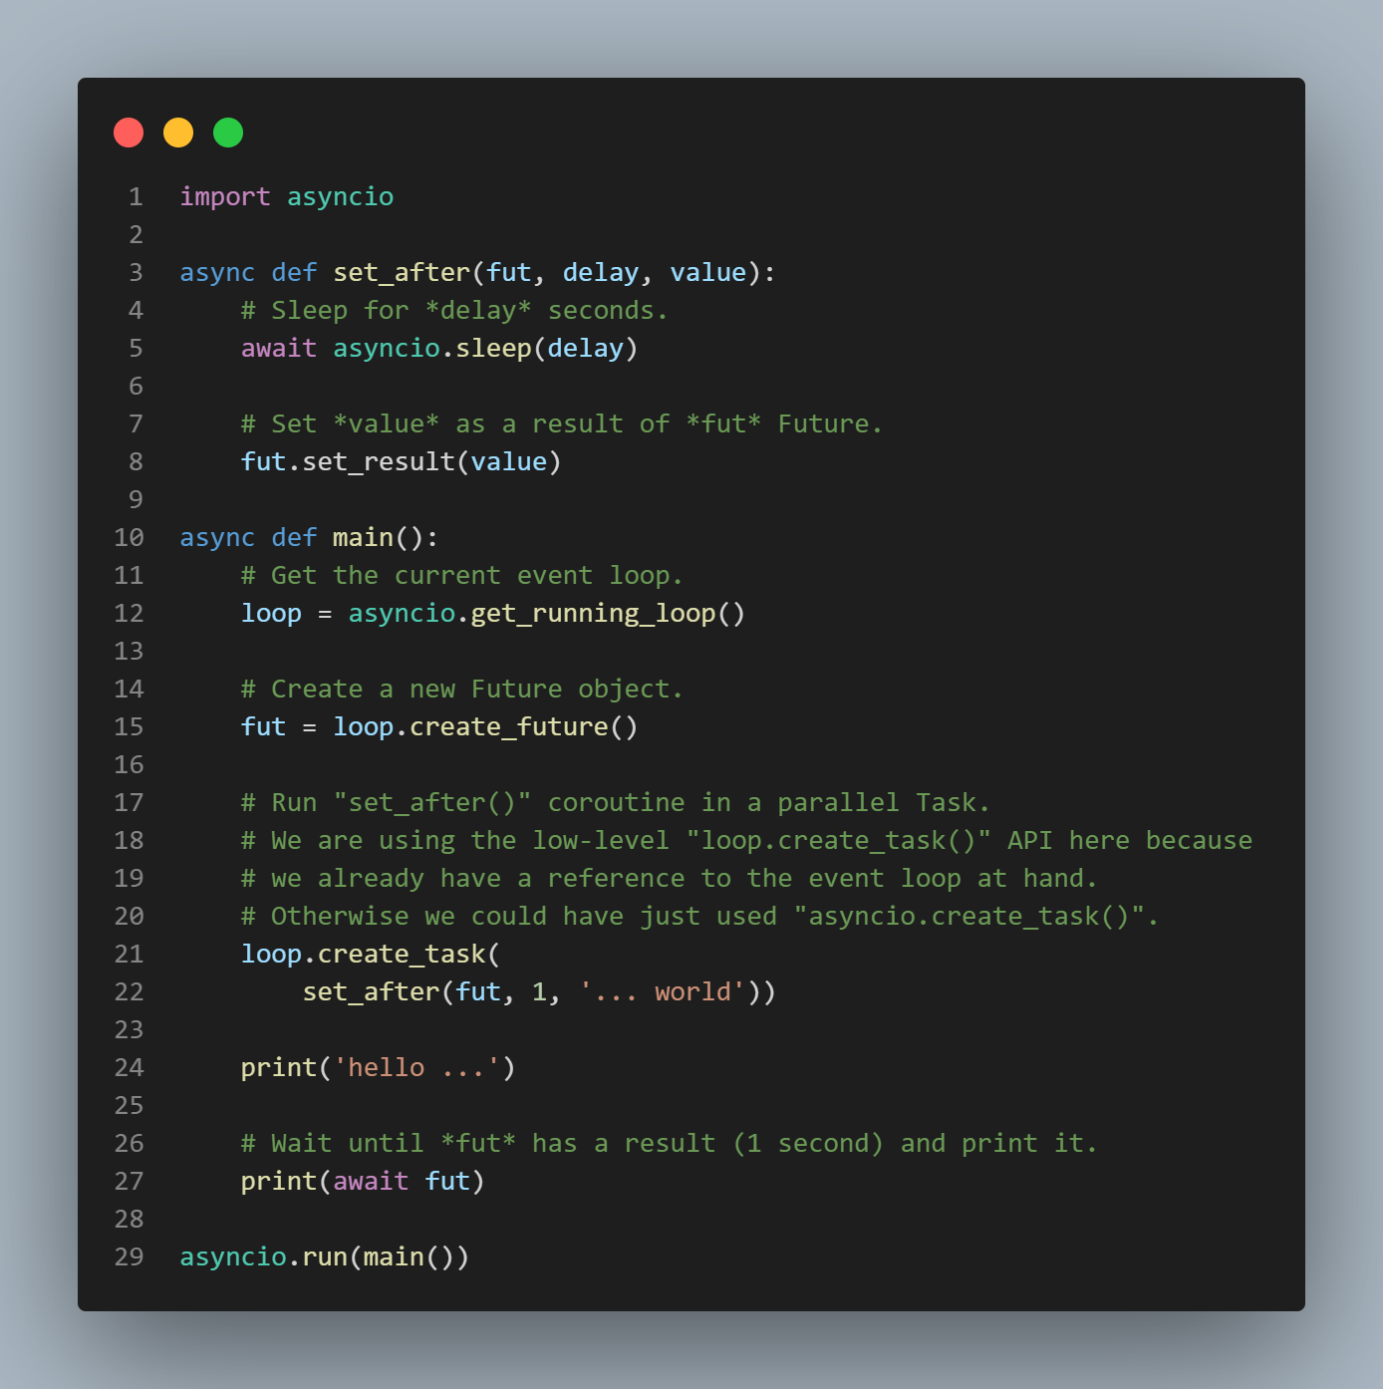
Example

Slide 20
MY TASK

Slide 21
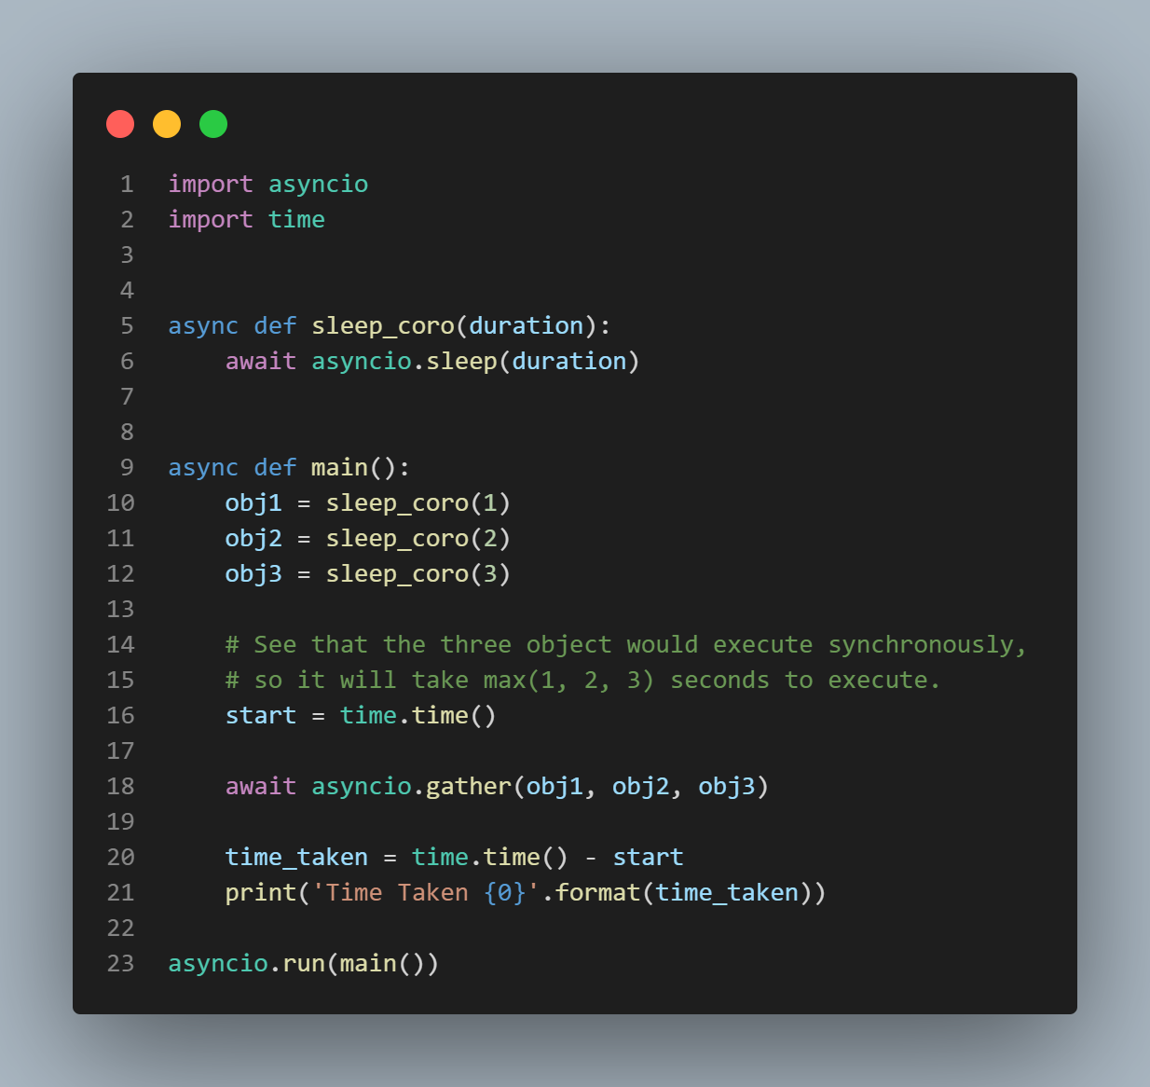
Task - 1
Task - Now replace the sleep_coro with a function that would download a page from https://reqres.in/api/users?page{el} where el is an element in arr = [1, 2, 3]

Slide 22
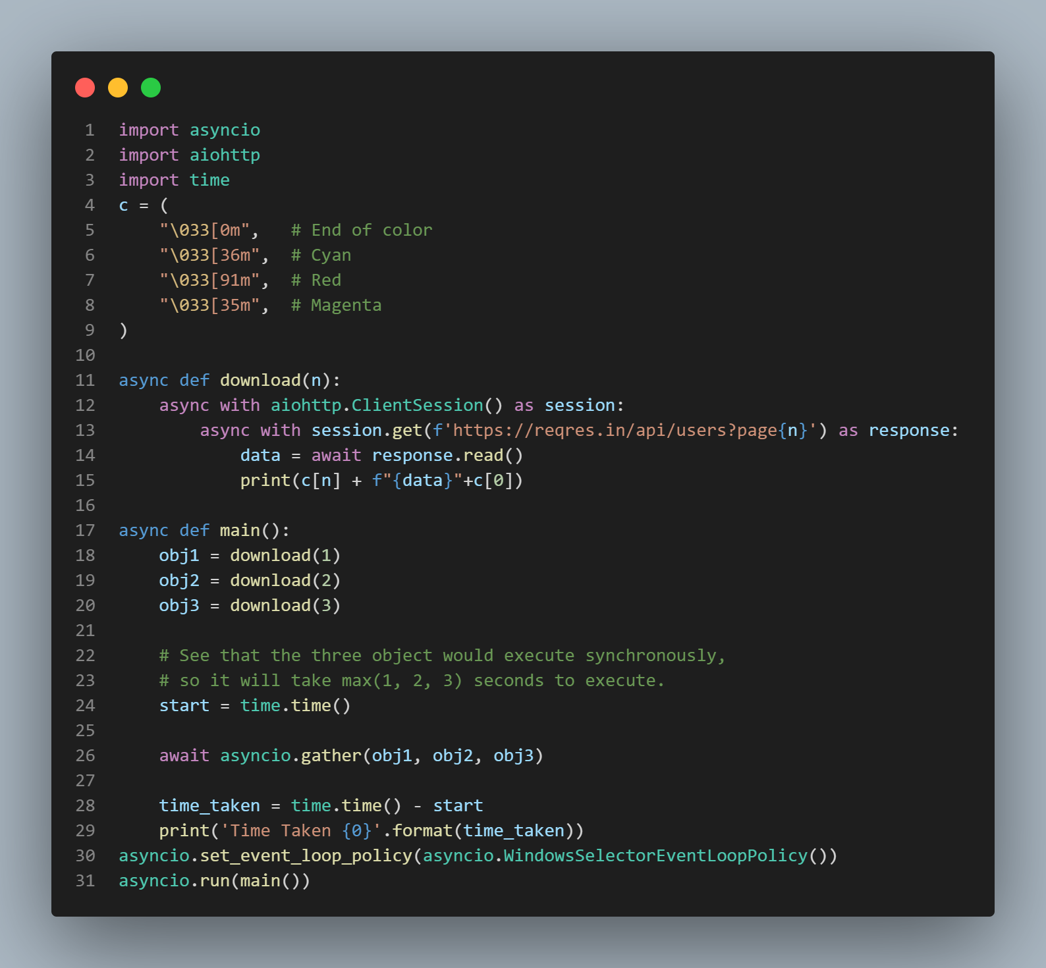
Task 1 solution

Slide 23
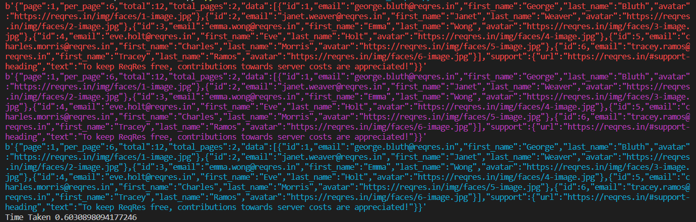
Output Task -1

Slide 24
Task - 2
Now, using Async/Await, try to parallelize the downloading of files, so that you can accelerate the execution. Record the time taken, and compare the time difference of execution.

Slide 25
Task – 2 (Synchronous)
Output

Slide 26
Task – 2 (Asynchronous)
Output

Slide 27
CREDITS
https://realpython.com/async-io-python/
https://docs.python.org/3/library/asyncio.html
https://docs.aiohttp.org/en/stable/#client-example

Slide 28
Thanks!

