Slide 1
Welcome !
Programming in Python
Lecture 13

Slide 2
Today’s topics
Review of the previous lecture
StyleSheet
Selectors
Properties

Slide 3
Layouts
Layouts
QBoxLayout
QVBoxLayout(), QHBoxLayout
addWidget(QWidget), addStretch(int)
QFormLayout
addRow(label, QWIdget), insertRow(idx, label, QWidget), removeRow(idx)
setLabelAlignment(Qt.QAlignment)
QGridLayout
addWidget(QWidget, x, y, xspan, yspan)

Slide 4
StyleSheet
setStyleSheet(str) - QApplication, QWidget
Similar to CSS
Selector {
property1: value1;
property2: value2;
}

Slide 5
Selectors
setStyleSheet(str) - QApplication, QWidget
Similar to CSS
Selector {
property1: value1;
property2: value2;
}
Selectors
className - apply to all elements in class
className#variableName - apply to a specific instance of a class
className:state - apply to a specific state
className:subcontrol - apply to specific sub-controls. up-arrow , etc.
className[property=value] - apply to all elements that satisfy the property condition
classname1 classname2 - apply to all elements of classname2 that are children of classname1
classname1, classname2 - apply to both classname1 and classname2

Slide 6
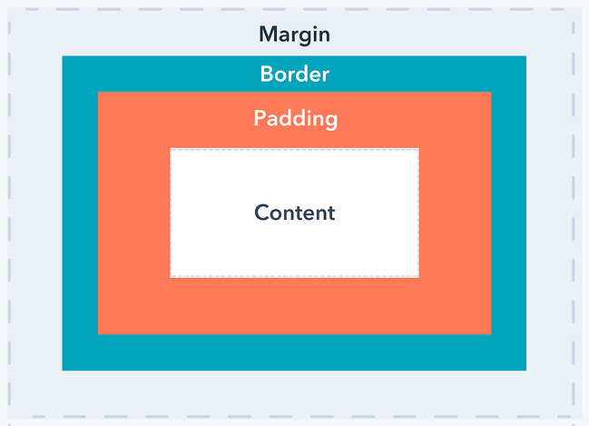
Properties
setStyleSheet(str) - QApplication, QWidget
Similar to CSS
Selector {
property1: value1;
property2: value2;
}
Properties
color - text color:red
height: 10px
background-color: #FF0000
width: 50px
background-image: url(path.jpg)
margin, padding
border: width style color
text-align: left
border: 2px dashed rgb(255, 0, 0)
border-radius: 5px
font: bold italic large “Times New Roman”

