Slide 1
Welcome !
Programming in Python
Lecture 6

Slide 2
Today’s topics
Review of the previous lecture
What is a Set
Set and List Set functions
Set operators
Check your understanding
What we’ve learned

Slide 3
What we’ve learned
Function | def
What is a function | Code block
Why we need a function | Readability, reusable, …..
Scopes | Local scopes
inputs | Arguments (positional, default, keyword)
outputs | return

Slide 4
Today’s topics
Review of the previous lecture
What is a Set
Set and List Set functions
Set operators
Check your understanding
What we’ve learned

Slide 5
Set
What data structures do we know?
List
Do we have another data structures?
Yes
Which one?
See the title

Slide 6
Set
Collection
Group of elements
set 1
set 2
It's like list?
Yes, but….
Every set element is unique
Unordered collection of items

Slide 7
Set
fruits
gmails
apple
orange
raffo.kalandadze@gmail.com
cherry
mango
pythonprogramming@gmail.com
banana
kiwi
helloworld@gmail.com
grapes

Slide 8
Today’s topics
Review of the previous lecture
What is a Set
Set and List Set functions
Set operators
Check your understanding
What we’ve learned

Slide 9

Set and List
 | Mutable | Ordered | Indexing | Duplicate elements
List
Set

Slide 10
Set and List
why?
when?
highly optimized
Don’t care ordering
If the conditions are true definitely use a set
Uniqueness is guaranteed

Slide 11
Today’s topics
Review of the previous lecture
What is a Set
Set and List Set functions
Set operators
Check your understanding
What we’ve learned

Slide 12
Set functions
{“apple”, “banana”}
type()
set([“apple”, “banana”])
<class 'set'>
set((“apple”, “banana”))
set(“python”)

Slide 13
Set functions
s = set(range(10))
{0, 1, 2, 3, 4, 5, 6, 7, 8, 9}
s.add(11)
{0, 1, 2, 3, 4, 5, 6, 7, 8, 9, 11}

Slide 14
Set functions
s = set(range(10))
s.remove(5)
s.discard(6)
{0, 1, 2, 3, 4, 7, 8, 9}

Slide 15
Set functions
s = set( [10, 1, 3, -1] )
len(s) | 4
max(s) | 10
min(s) | -1
sum(s) | 13
sorted(s) | [-1, 1, 3, 10]

Slide 16
Set functions
for i in set(["python", "programming", "hello", "world"]):
print(i)
python
world
hello
programming

Slide 17
Today’s topics
Review of the previous lecture
What is a Set
Set and List Set functions
Set operators
Check your understanding
What we’ve learned

Slide 18
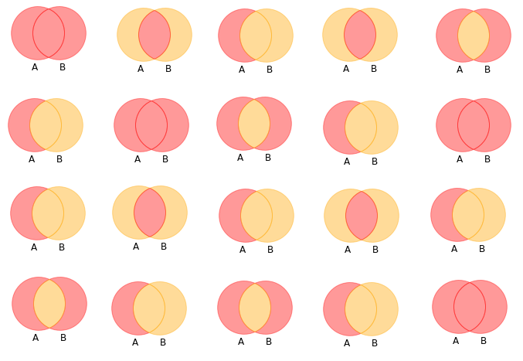
Set operators

Slide 19
Set operators
mammals
aquatic
mammals = {'Tiger', 'Camel', 'Sheep', 'Whale', 'Walrus'}
aquatic = {'Octopus', 'Squid', 'Crab', 'Whale', 'Walrus'}
'Octopus'
'Tiger'
'Whale'
'Squid'
'Camel'
'Walrus'
'Crab'
'Sheep'
mammals | aquatic
mammals & aquatic
mammals - aquatic
mammals ^ aquatic
{'Camel', 'Crab', 'Octopus', 'Sheep', 'Squid', 'Tiger', 'Walrus', 'Whale'}
{'Walrus', 'Whale'}
{'Camel', 'Sheep', 'Tiger'}
{'Camel', 'Crab', 'Octopus', 'Sheep', 'Squid', 'Tiger'}

Slide 20
Today’s topics
Review of the previous lecture
What is a Set
Set and List Set functions
Set operators
Check your understanding
What we’ve learned

Slide 21




Check your understanding
{1, 2, 3, 4}
error
{0, 1, 2, 3, 4, 6, 8}
{1, 3}

Slide 22



Check your understanding
{'h', 'o', 'e', 'l'}
<class 'dict'>
error

Slide 23
Today’s topics
Review of the previous lecture
What is a Set
Set and List Set functions
Set operators
Check your understanding
What we’ve learned

Slide 24
What we’ve learned
Collection
fruits
gmails
Group of elements
apple
orange
raffo.kalandadze@gmail.com
Set
add | s.add(value)
remove | s.remove(value) s.discard(value)
functions | max() min() len() sum() len()
operators | | & - ^
cherry
mango
pythonprogramming@gmail.com
banana
kiwi
helloworld@gmail.com
grapes

