Slide 1
Welcome !
Programming in Python
Lecture 9

Slide 2
Today’s topics
Review of the previous lecture
We need custom data types
What is a class Class main parts Create custom class
Check your understanding
What we’ve learned

Slide 3
Today’s topics
Dictionary
A container data type that maps “keys” to their associated “values”
get
keys
values
remove
opel
bmw
mercedes
toyota
tesla
ford
2000
15000
20000
7000
60000
30000
d[“opel”]
del d[“opel”]
d.get(“opel”)
d.pop(“opel”)
d.get(“opel”, -1)
functions
update/add
list(d.values())
d[“bmw”] = 20_000
list(d.keys())
list(d.items())

Slide 4
Today’s topics
Review of the previous lecture
We need custom data types
What is a class Class main parts Create custom class
Check your understanding
What we’ve learned

Slide 5
We need custom data types
built-in Python data types
Ints, floats, strings, booleans, lists, tuple, set, dictionaries ……
Our own data types ?

Slide 6
We need custom data types
How and why would we define our own data types?

Slide 7
We need custom data types
How and why would we define our own data types?
For ourselves
Grouping related data and the functions that act on it
Modular code development (isolation of particular tasks)
For others
We hide the implementation details of our code so others don’t need to worry about them.
They can just use the class, like we do for random

Slide 8
We need custom data types
How and why would we define our own data types?
We need a class A Python class defines a new data type for our programs to use.

Slide 9
Today’s topics
Review of the previous lecture
We need custom data types
What is a class Class main parts Create custom class
Check your understanding
What we’ve learned

Slide 10
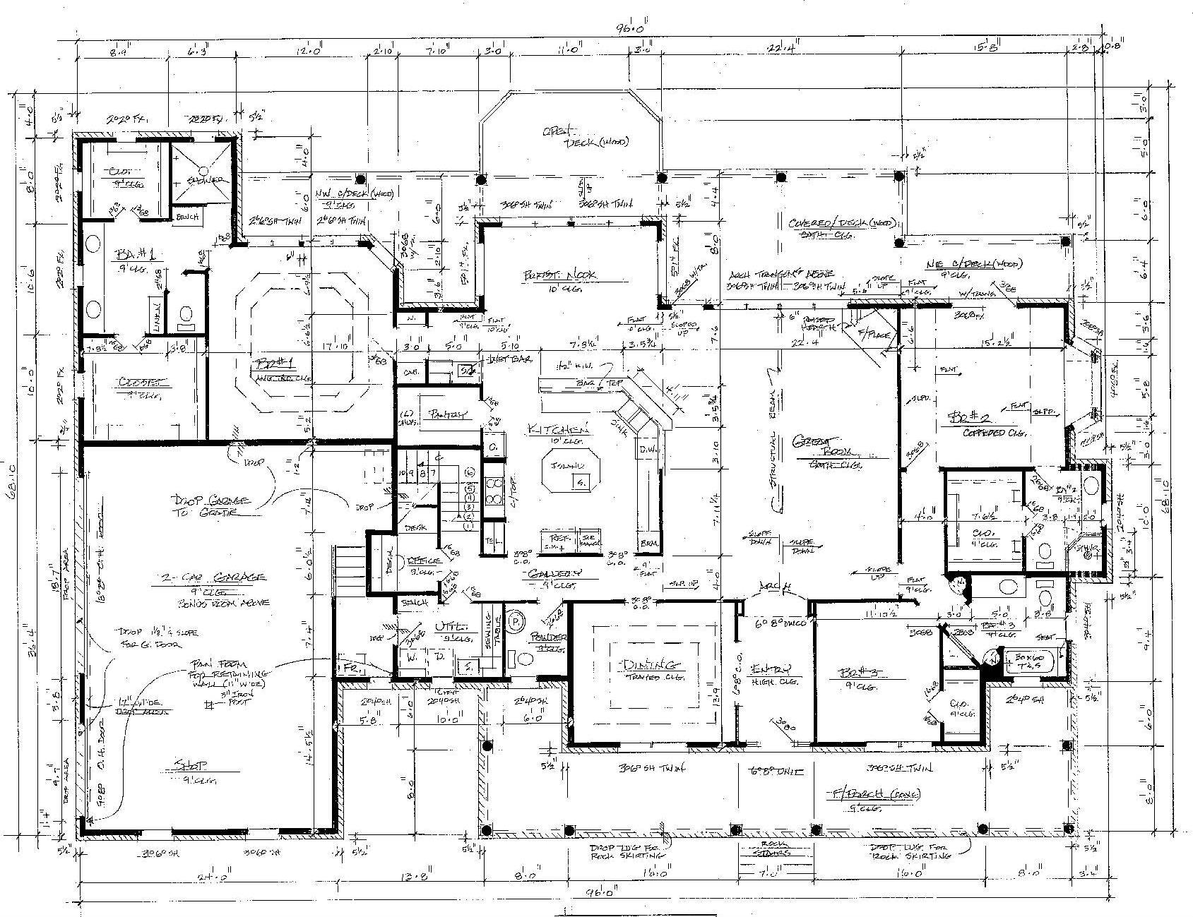
What is a class
Structure

Slide 11
What is a class
Person
name
person1 = Person()
person1.name = “Jack”
person1.surname = “White”
person1.age = 30
person1.gmail = “jackwite@gmail.com”
surname
age
gmail

Slide 12
What is a class
Person
person1 = Person()
person1.name = “Jack”
person1.surname = “White”
person1.age = 30
person1.gmail = “jackwite@gmail.com”
person2 = Person()
person2.name = “Ema”
person2.surname = “Smith”
person2.age = 28
person2.gmail = “emasmith@gmail.com”
name
surname
age
Instances
gmail

Slide 13
Today’s topics
Review of the previous lecture
We need custom data types
What is a class Class main parts Create custom class
Check your understanding
What we’ve learned

Slide 14
Class main parts
Person
What is a class
3 main parts
Attributes (name, surname ….)
Methods (say_hello(), write_code() …..)
Constructor (Person(“Jack”, “White”, 30, “jackwite@gmail.com”)
name
surname
age
gmail

Slide 15
Class main parts
How do we design a class?
Let’s create a person class
Attributes
Name
Age
Methods
say_hello()
write_code()
Constructor
Person(Name, Age)

Slide 16
Today’s topics
Review of the previous lecture
We need custom data types
What is a class Class main parts Create custom class
Check your understanding
What we’ve learned

Slide 17
Create custom class
class Person:
The name of our new class
Tells Python we’re creating a new class

Slide 18
Create custom class
class Person:
def __init__(self, name, age):
Add name and age as a parameter for our constructor
Whenever we create methods inside our class, we must pass in self
The constructor method for our class

Slide 19
Create custom class
class Person:
def __init__(self, name, age):
self.name = name
self.age = age
Create and initialize the attributes for this instance of the class

Slide 20

Create custom class
How do we design a class?
Let’s create a person class
Attributes
Name
Age
Methods
say_hello()
write_code()
Constructor
Person(Name, Age)

Slide 21
Create custom class
class Person:
def __init__(self, name, age):
self.name = name
self.age = age
Create and initialize the attributes for this instance of the class
Person
name
jack
p = Person(“Jack”, 20)
print(p.age)
age
20
20

Slide 22
Create custom class
class Person:
def __init__(self, name, age):
self.name = name
self.age = age
def say_hello(self):
…
def write_code(self):
…
Define methods

Slide 23
Create custom class
class Person:
def __init__(self, name, age):
self.name = name
self.age = age
def say_hello(self):
print(“Hi all”)
def write_code(self):
print(“Writing code”)
p = Person(“Jack”, 30)
p.say_hello()
Hi all

Slide 24
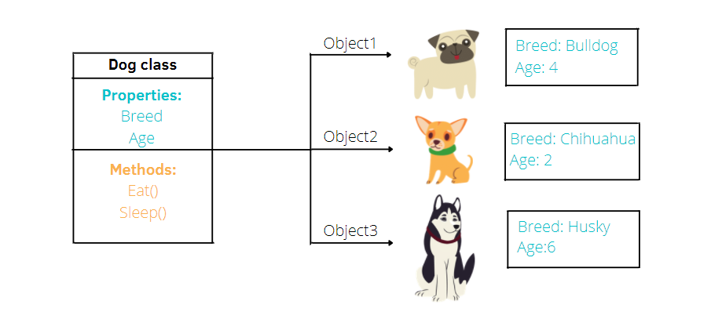
Create custom class
examples
Dog class
Attributes
breed
age
methos
eat()
sleep()

Slide 25
Create custom class
examples
Student class
Vehicle class
Attributes
Name
Id
Grades
faculty
Attributes
brand
model
gas_tank_size
fuel_level
methos
average_score()
maximum_score()
minimum_score()
methos
fuel_up()
drive

