Slide 1
Welcome !
Programming in Python

Slide 2
Today’s topics
Who are we?
Why Python Programming?
About our course
Who is BoB?
What’s next

Slide 3
Today’s topics
Who are we?
Why Python Programming?
About our course
Who is BoB?
What’s next

Slide 4
Today’s topics
Who are we?
Why Python Programming?
About our course
Who is BoB?
What’s next

Slide 5
Today’s topics
Who are we?
Why Python Programming?
About our course
Who is BoB?
What’s next

Slide 6
Today’s topics
Who are we?
Why Python Programming?
About our course
Who is BoB?
What’s next

Slide 7
Today’s topics
Who are we?
Why Python Programming?
About our course
Who is BoB?
What’s next

Slide 8
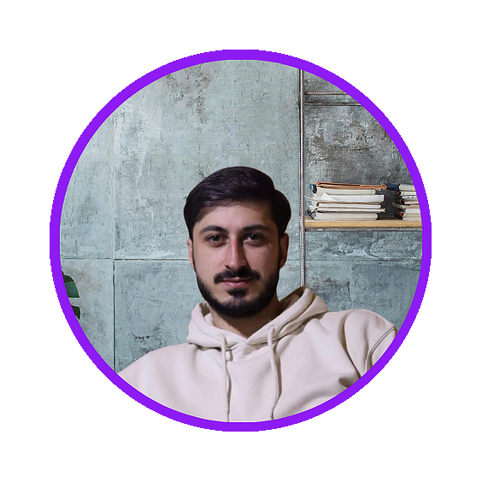

1. Who are we?

Slide 9
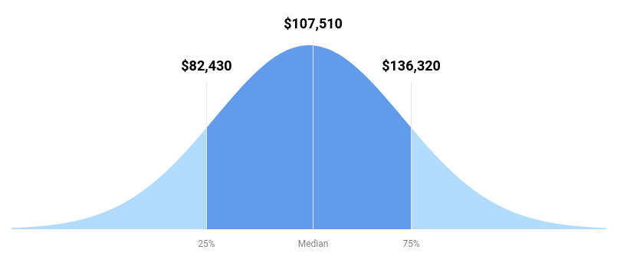
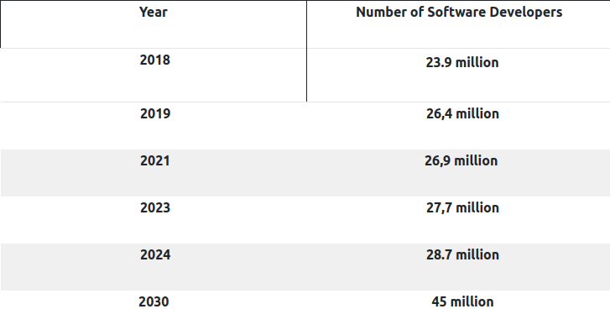
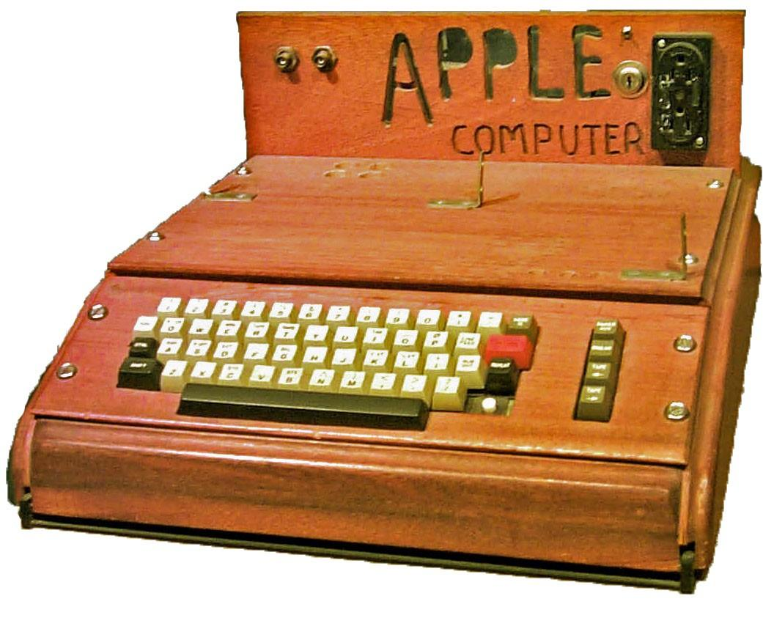
2. Why Python Programming?
Technology in everyday life
Job guarantee
High salary
Automatize your daily tasks
Improve your problem-solving
Flexible, Work from anywhere
Anyone can do it

Slide 10
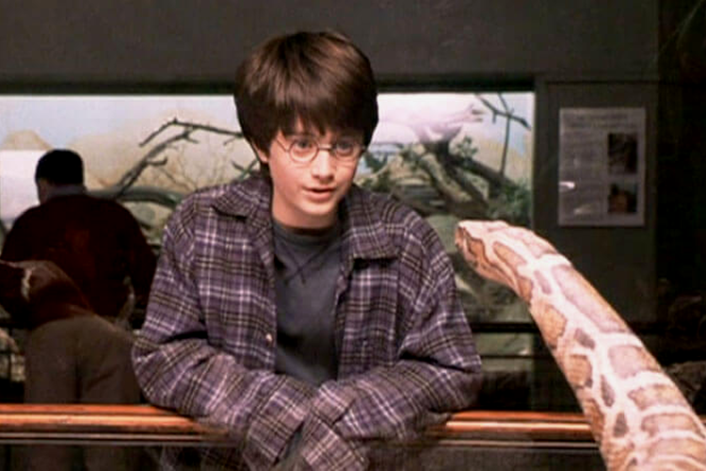
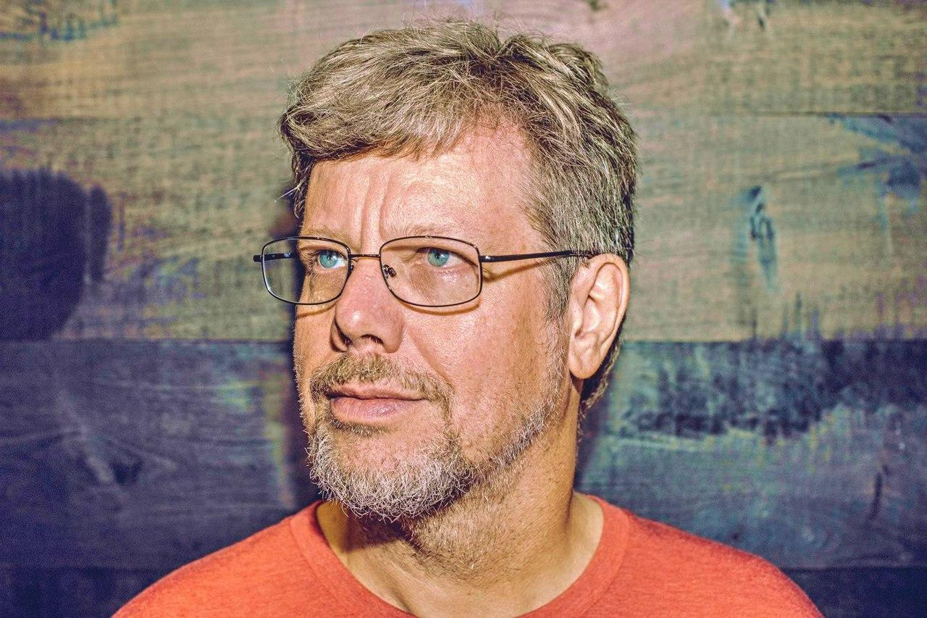
2. Why Python Programming?
Harry Potter is the first one
to understand the python language
Sorry ?!
Guido van Rossum 1991

Slide 11
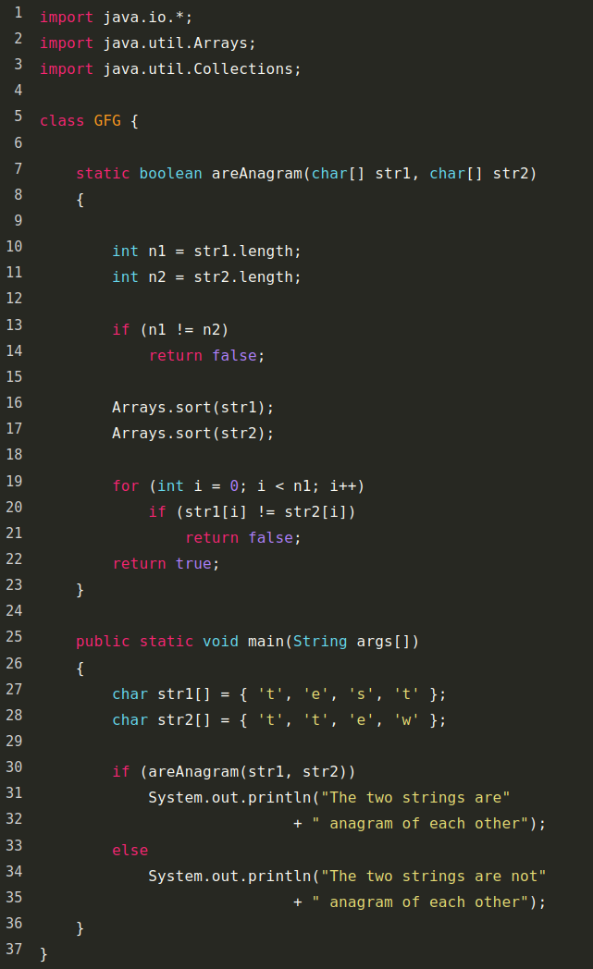

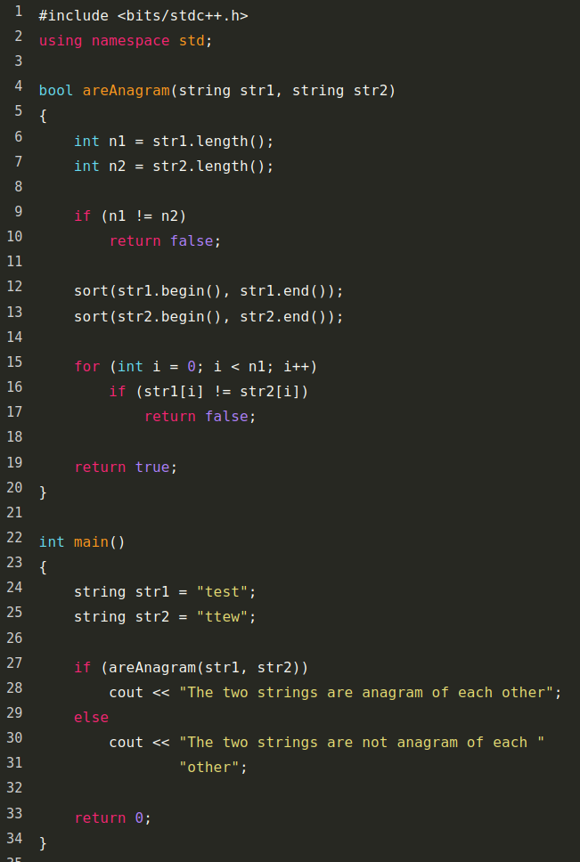

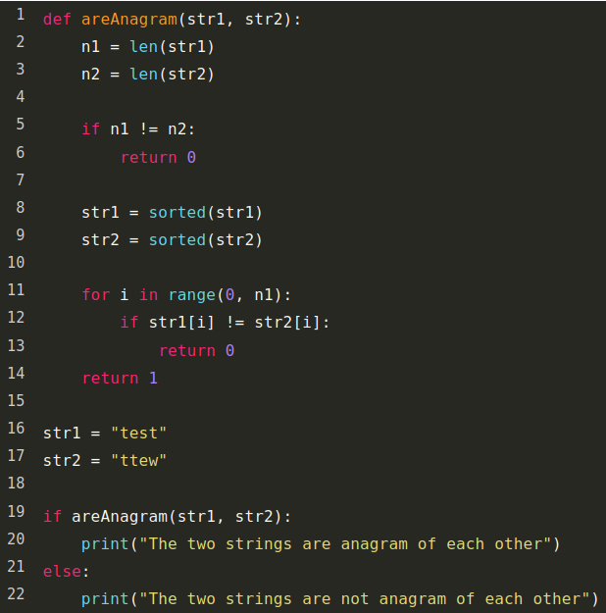

2. Why Python Programming?
More easy and readable than most programming languages

Slide 12
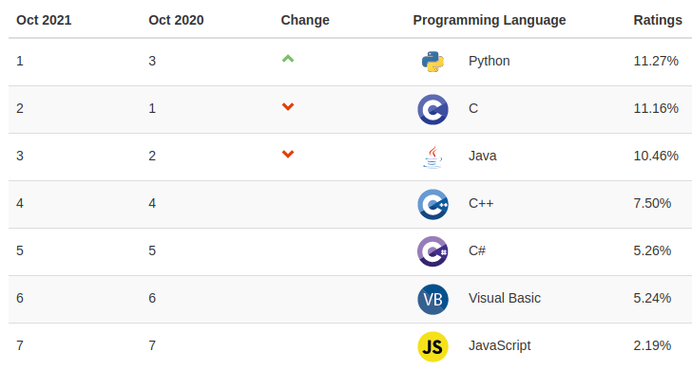
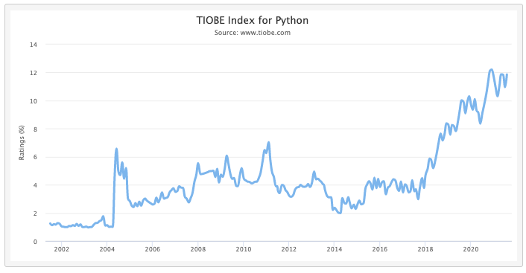
2. Why Python Programming?
More easy and readable than most programming languages
One of the most popular language

Slide 13
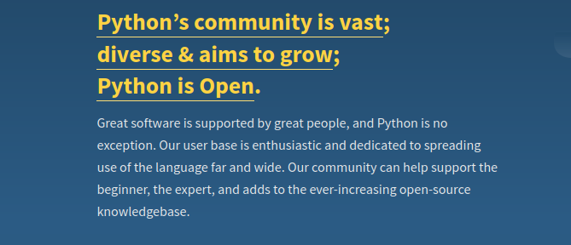
2. Why Python Programming?
More easy and readable than most programming languages
One of the most popular language
Mature and Supportive Python Community

Slide 14






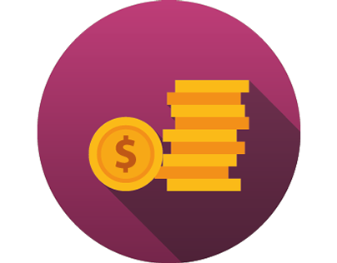

2. Why Python Programming?
More easy and readable than most programming languages
One of the most popular language
Mature and Supportive Python Community
Popular in many fields
AI
Data Analytics
Data Visualisation
Programming applications
Web development
Game development
Finance
Design

Slide 15
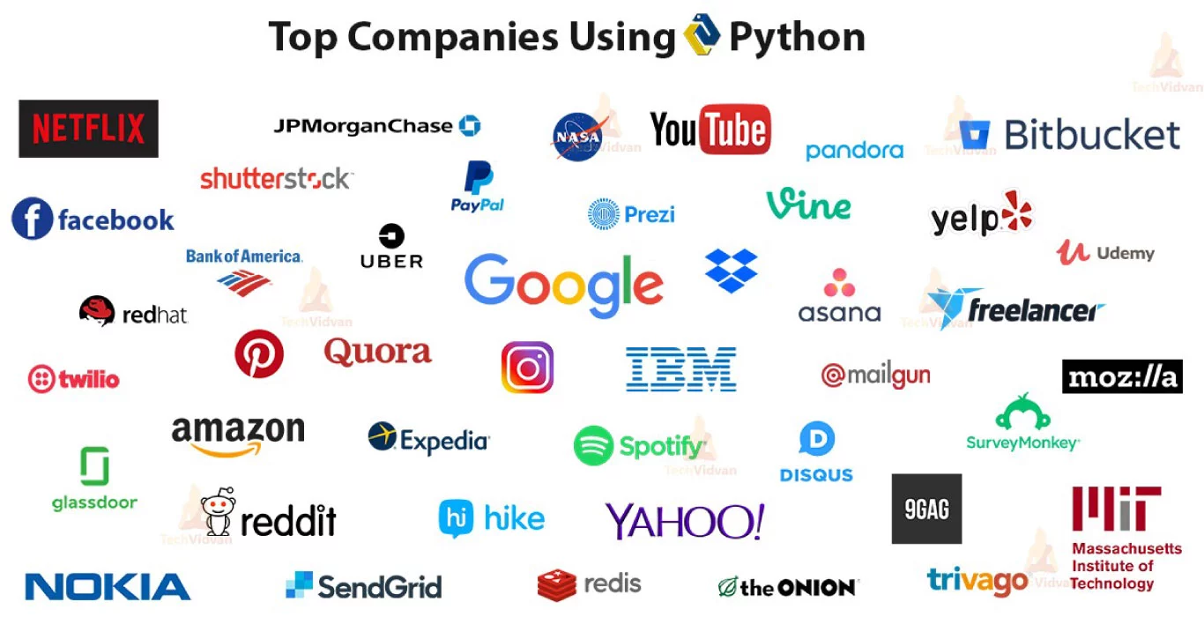
2. Why Python Programming?
More easy and readable than most programming languages
One of the most popular language
Mature and Supportive Python Community
Popular in many fields
Most companies use python

Slide 16

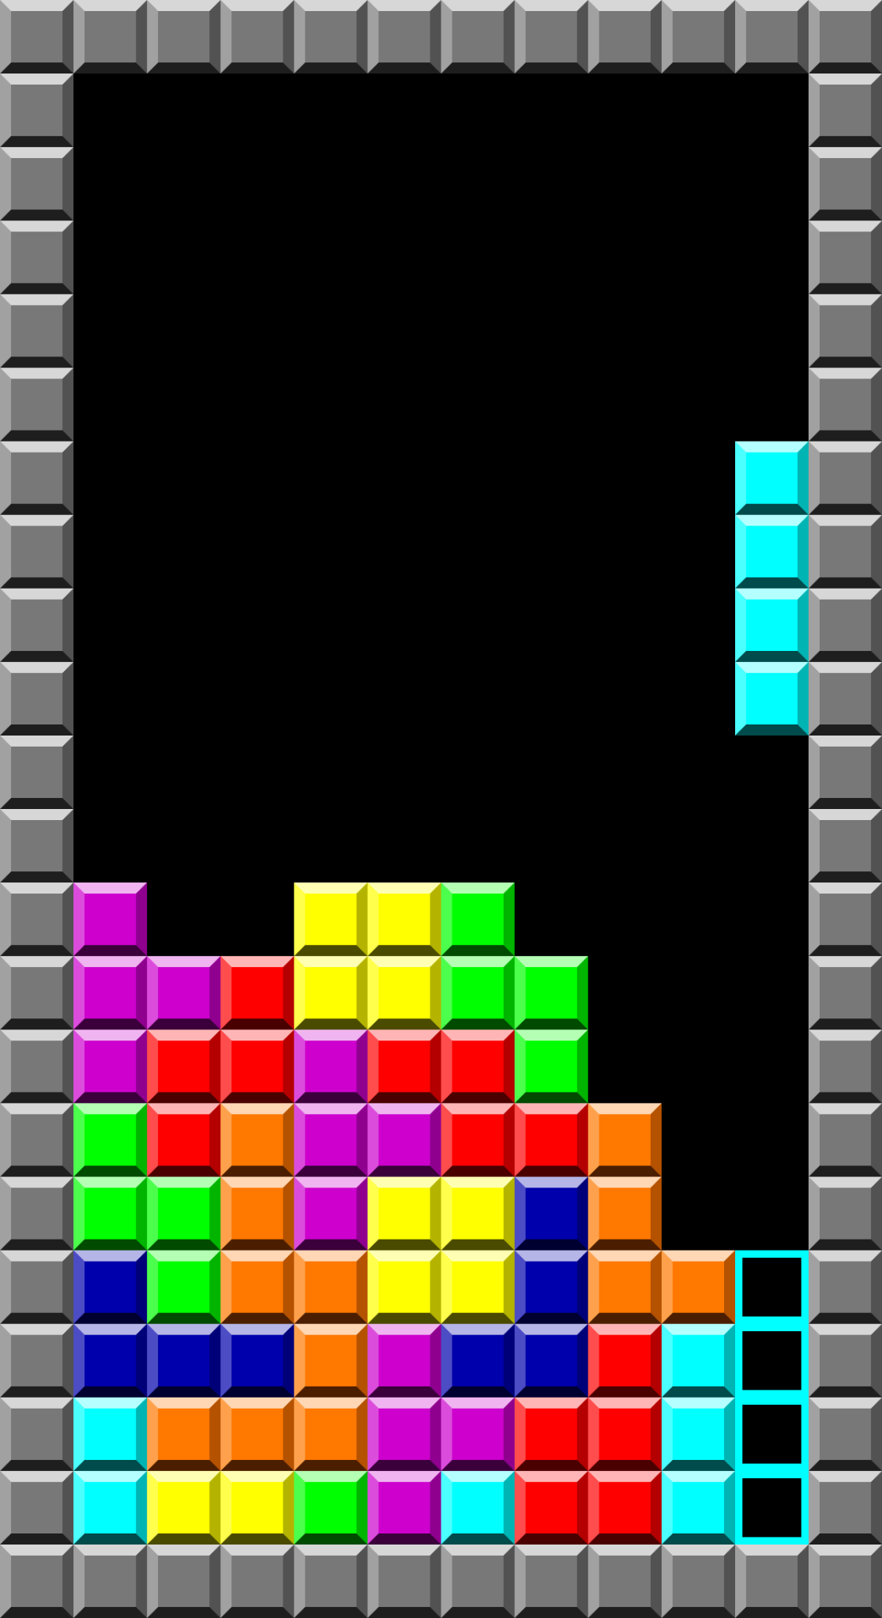
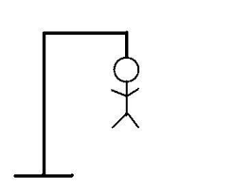
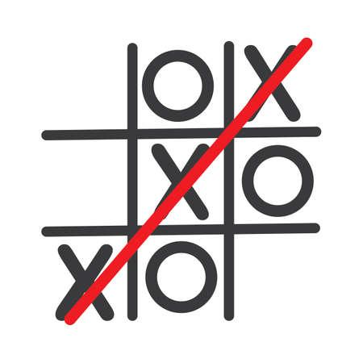
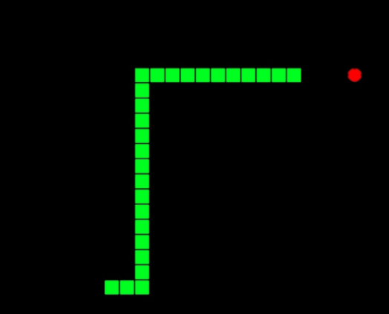
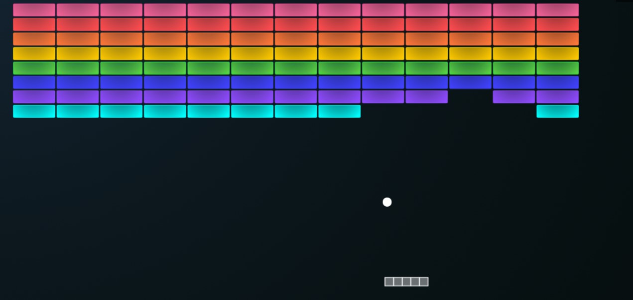
3. About our course (Starter)
16 Lecture -- 32 Hours (+Bonus)
Guess number
Assignment, Quizzes
Frequency Counter
Find prime numbers
Fibonacci
Palindrome
List shuffle
Anagram
scissors rock paper
Power with recursion
BoB

Slide 17
3. About our course (Starter)
16 Lecture -- 32 Hours
Not only python programming
Assignment, Quizzes
For everyone
Well structured
Just Fun

Slide 18

3. About our course (Starter)
What I need
Internet
Laptop
Math
Free time

Slide 19
3. About our course (Starter)
What should I be ready for
Lots of practice
A lot of bugs
Google
Patience

Slide 20
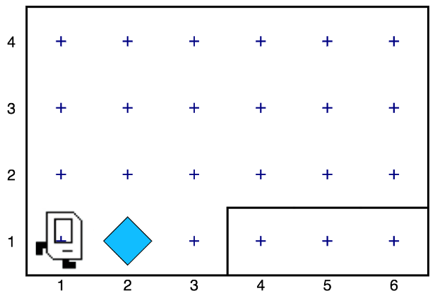
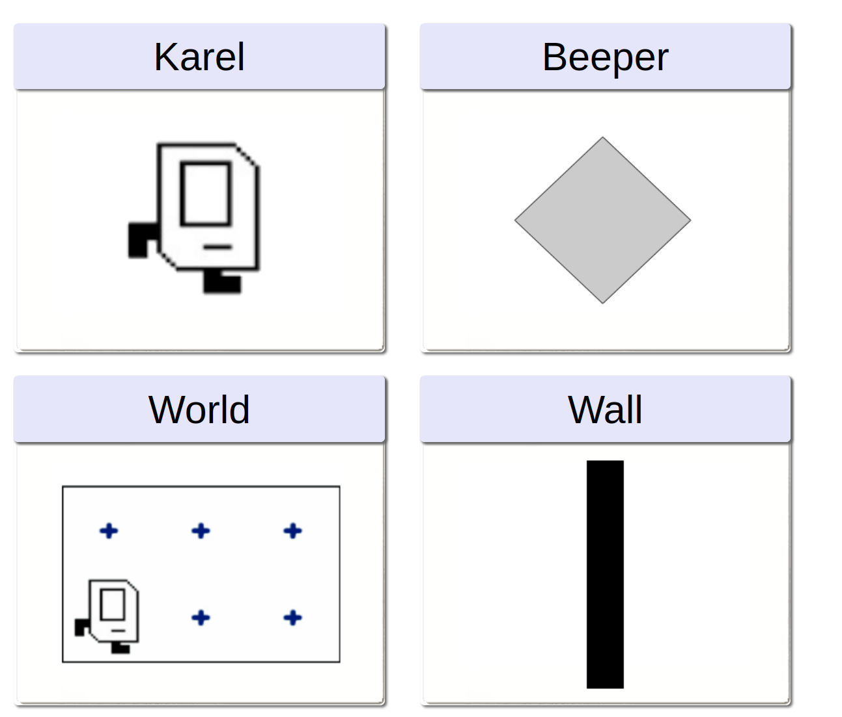
4. Who is BoB?
https://compedu.stanford.edu/karel-reader/docs/python/en/intro.html

Slide 21
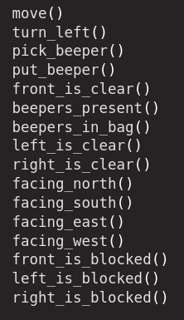
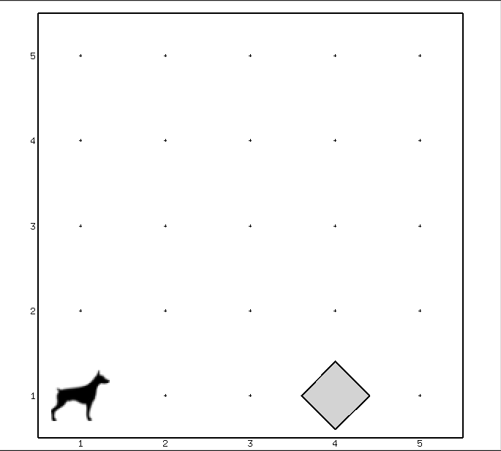
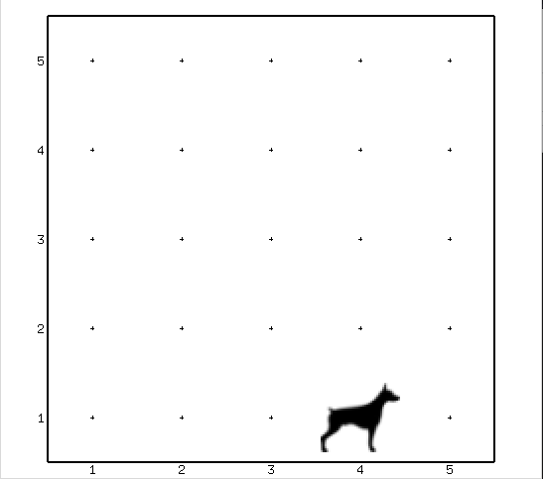

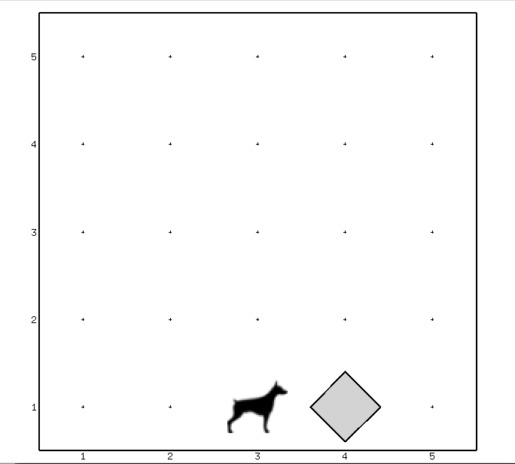
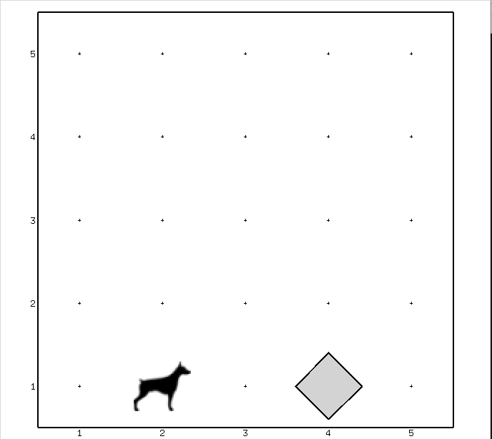
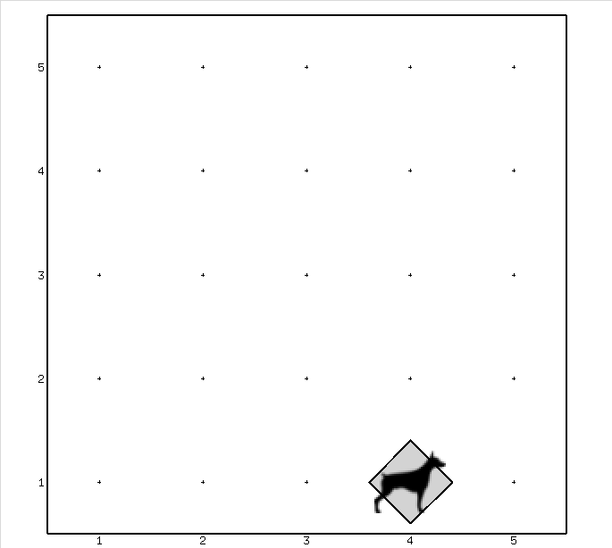

BoB

Slide 22
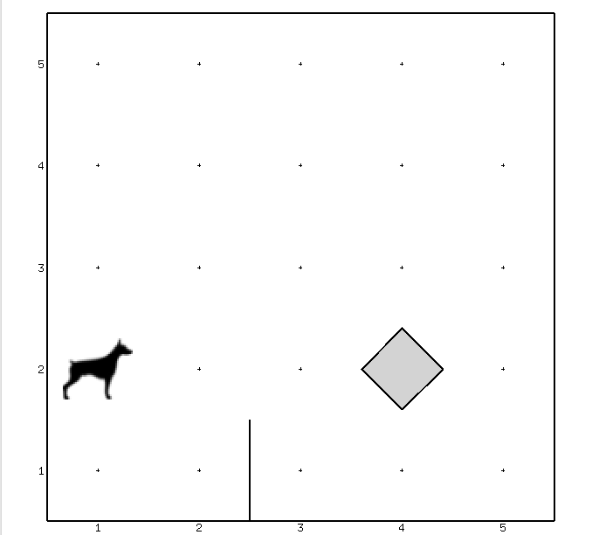

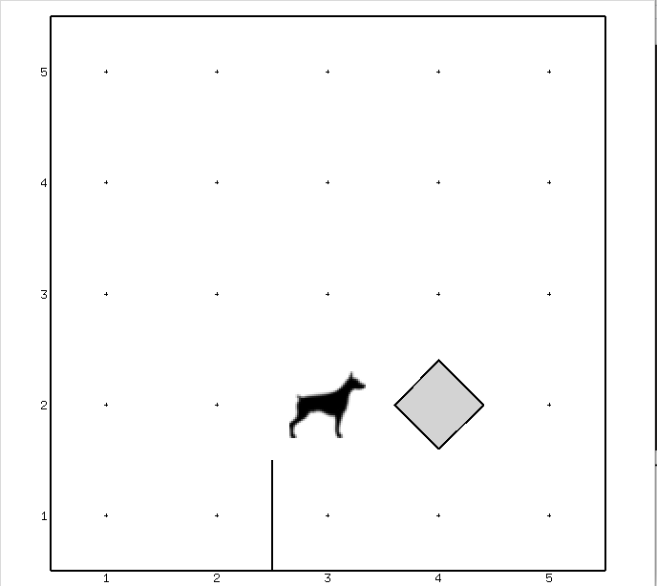
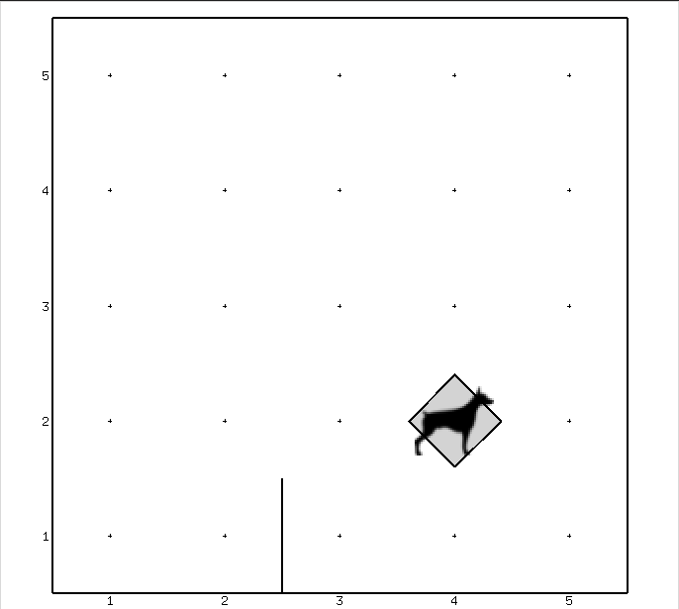

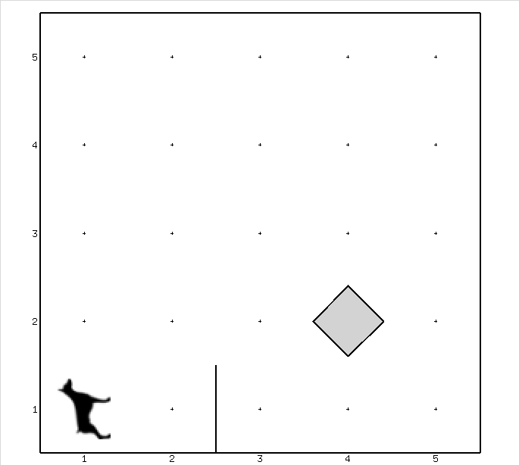
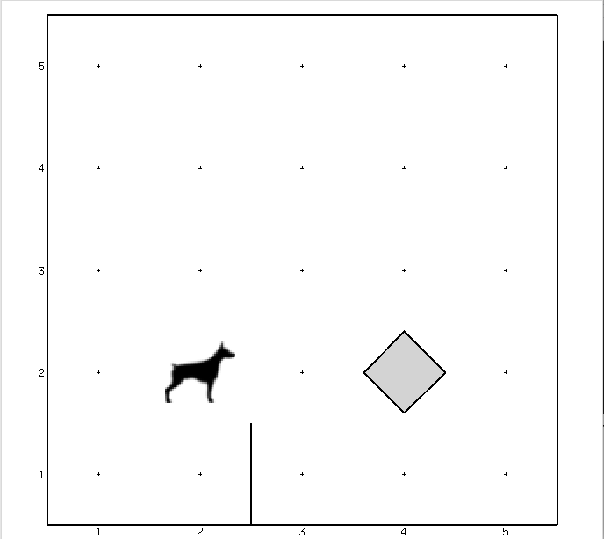
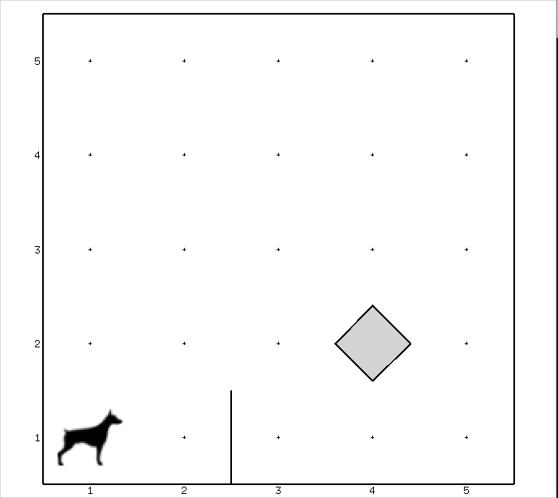
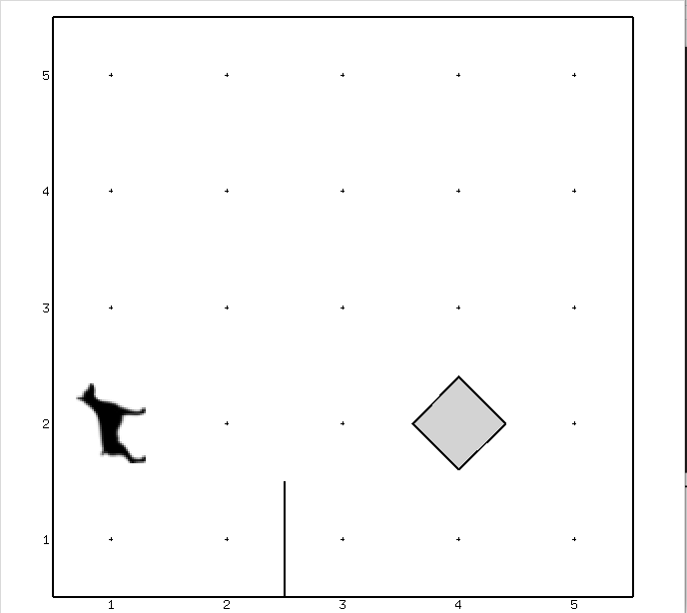

BoB

Slide 23
5. What’s next
Fill the form
Installation resources
Join to classroom

Slide 24
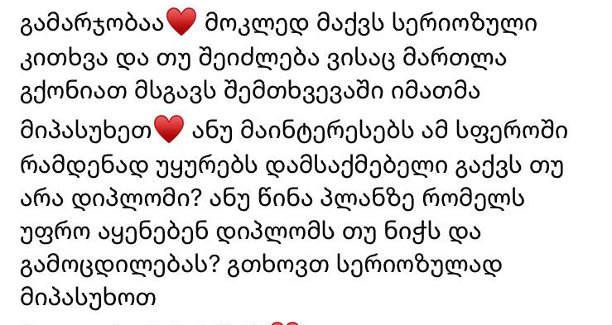
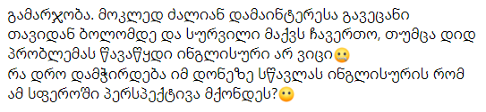


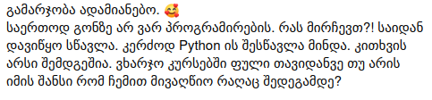
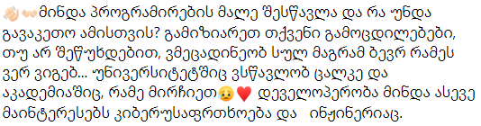
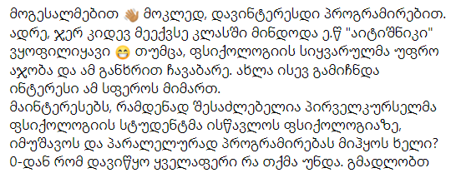
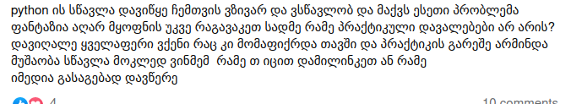
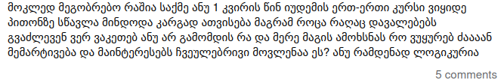
Questions?

