Slide 1
Welcome !
Programming in Python
Lecture 1

Slide 2
Today’s topics
Review of the previous lecture
Numbers and variables
Operators
What actually variable is
String
Bool
Casts
Basic built-in functions
Control flow
Check your understanding
What we’ve learned

Slide 3
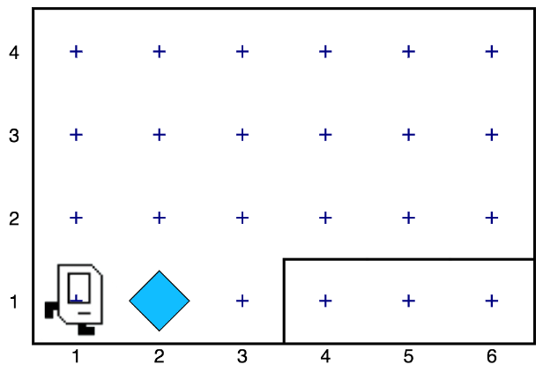
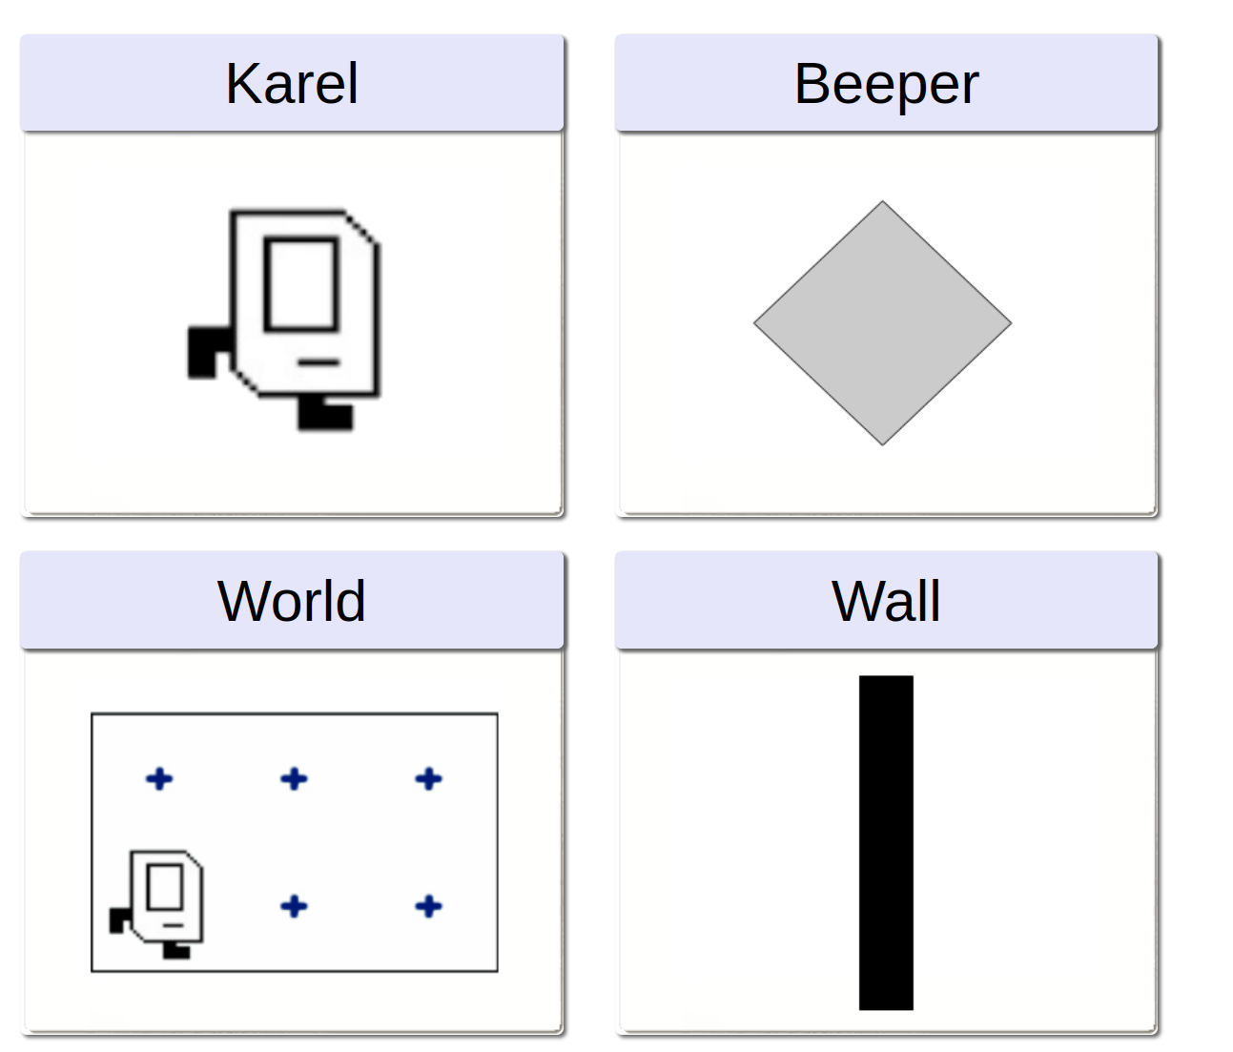
Review of the previous lecture
https://compedu.stanford.edu/karel-reader/docs/python/en/intro.html

Slide 4
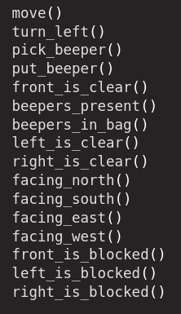
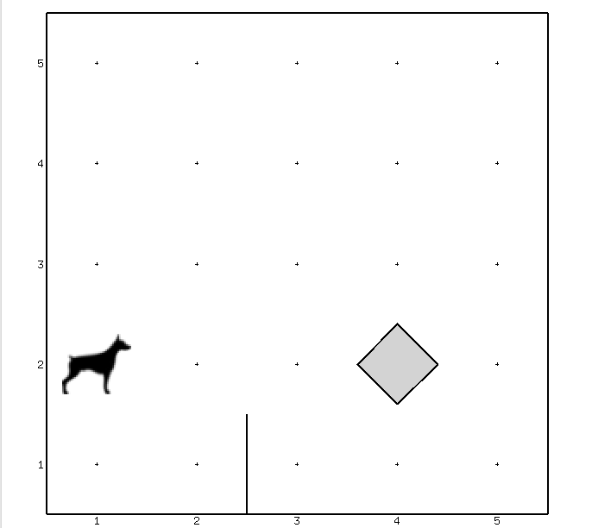

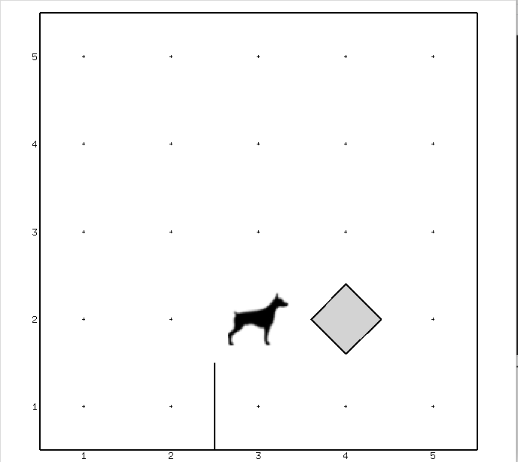
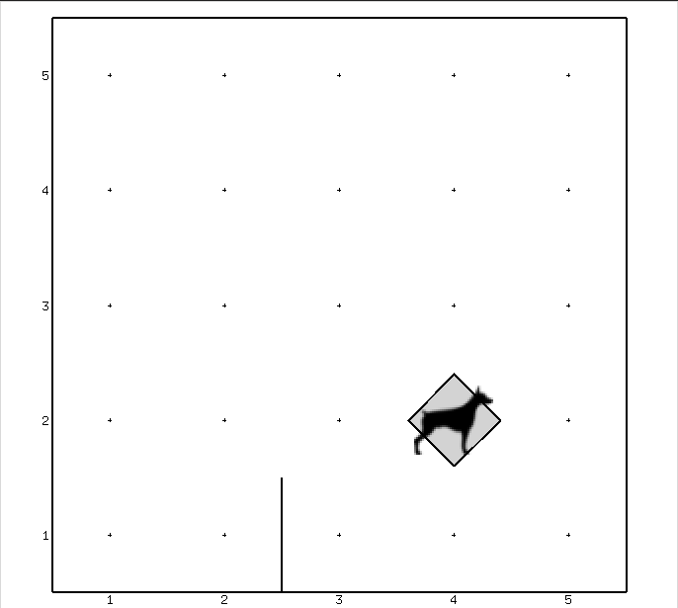

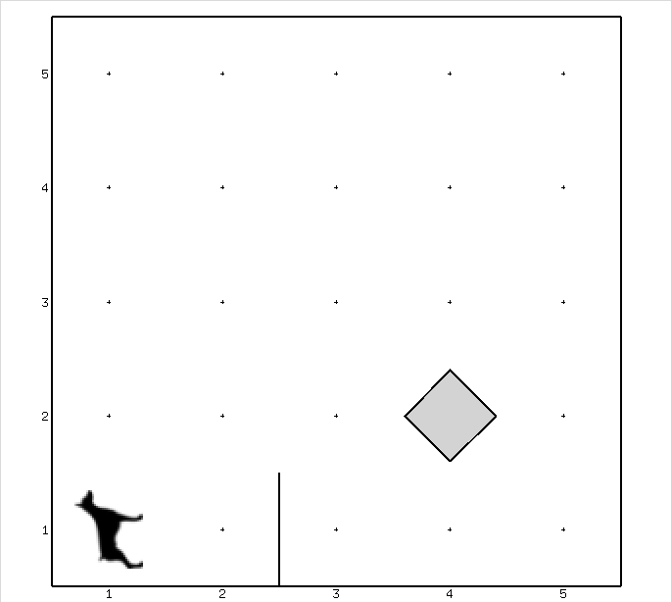
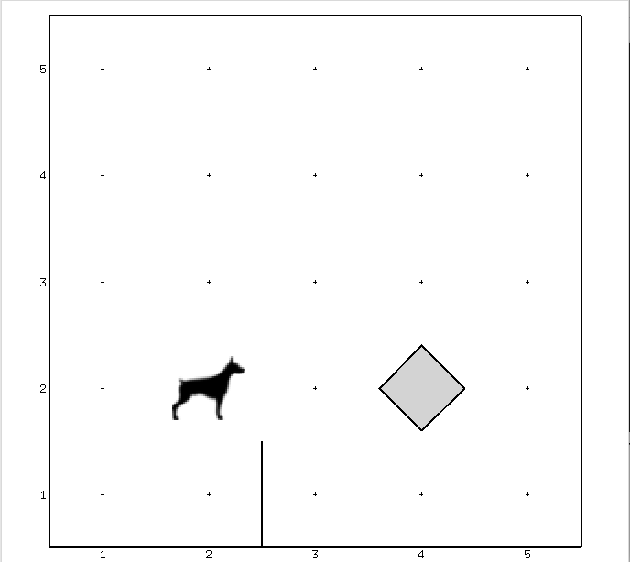
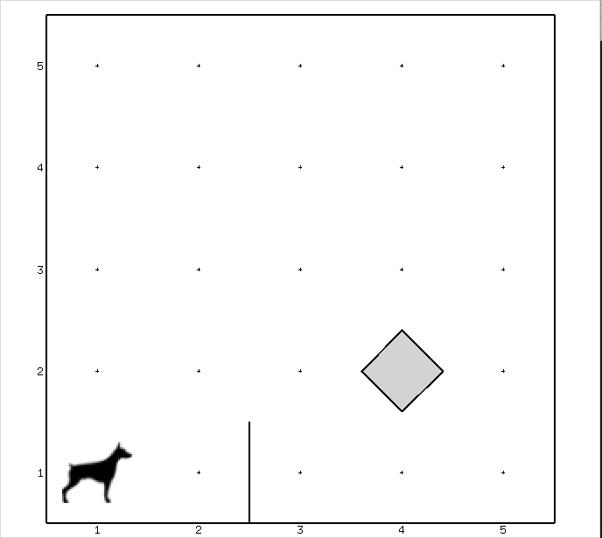
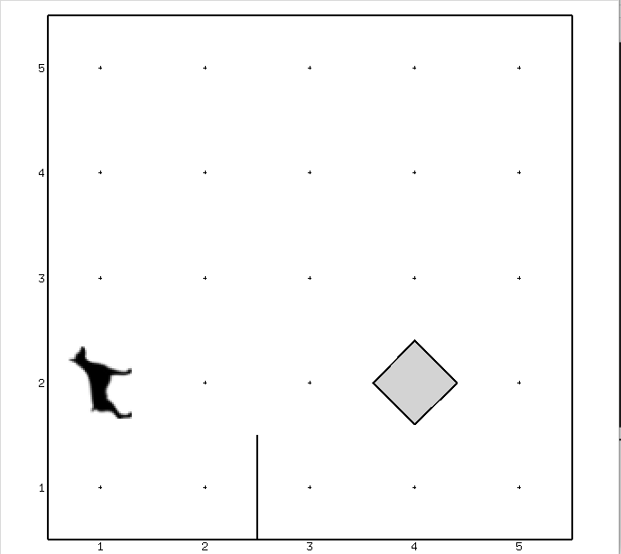


Review of the previous lecture

Slide 5
Today’s topics
Review of the previous lecture
Numbers and variables
Operators
What actually variable is
String
Bool
Casts
Basic built-in functions
Control flow
Check your understanding
What we’ve learned

Slide 6
Numbers and variables
name = value
1 + 2
3
x = 17
x + 2
19
2 * 3
6
y = 8
y * 3
24
10 - 2 * 4
2
Y = 25
Y - y - x
0

Slide 7
Numbers and variables
shoes_price = 200
trouser_price = 200
tshirt_price = 100
shoes_price + trouser_price + 2 * tshirt_price
600
200
200
2 * 100
shoes_price = 250
shoes_price + trouser_price + 2 * tshirt_price
650
250
200
2 * 100

Slide 8
Today’s topics
Review of the previous lecture
Numbers and variables
Operators
What actually variable is
String
Bool
Casts
Basic built-in functions
Control flow
Check your understanding
What we’ve learned

Slide 9
Operators
x = 4
y = 3
+ | Addition
- | Subtraction
* | Multiplication
/ | Division
// | Division (floor)
% | Modulus
** | Power
x + y
X - y
X * y
X / y
X // y
X % y
X ** y
7
1
12
1.3
1
1
64

Slide 10
Operators
x = 4
y = 3
> | Greater than
>= | Greater than or equal
< | Less than
<= | Less than or equal
== | Equal
!= | Not equal
x > y
X >= y
X < y
X <= y
X == y
X != y
True
True
False
False
False
True

Slide 11
Operators
x = 4
y = 3
x > 0 and y == 7 x < 5 and y > 1 x == 4 and y == 8
x > 0 or y == 7 x < 5 or y > 1 x != 4 or y == 8
not (x > 0 ) not (x < 5) not (x == 4 and y == 8)
False True False
True True False
False False True
and
or
not

Slide 12
Today’s topics
Review of the previous lecture
Numbers and variables
Operators
What actually variable is
String
Bool
Casts
Basic built-in functions
Control flow
Check your understanding
What we’ve learned

Slide 13
What actually variable is
y
y = 8
8
type(y)
(int)
Y
Y = 25
25
type(Y)
(int)
y
y = 8.0
8.0
type(y)
(float)
Y
Y = 12.1
12.1
type(Y)
(float)

Slide 14
What actually variable is
x
x = 17
17
x = 15
15

Slide 15
Today’s topics
Review of the previous lecture
Numbers and variables
Operators
What actually variable is
String
Bool
Casts
Basic built-in functions
Control flow
Check your understanding
What we’ve learned

Slide 16

String
y
y = ’’python’’
python
type(y)
(str)
Y
Y = ’’programming’’
programming
type(Y)
(str)

Slide 17
String
x = ’’hello’’
x + ’’world’’
helloworld
x = ’’python’’
x + y
pythonprogramming
y = ’’programming’’
x + ’’ ’’ + y
python programming
’’Hello’’ + 5
error
x + 5
error

Slide 18
String
x = ’’python’’
x + y + Y
pythonprogramminglanguage
y = ’’programming’’
Y = ’’language’’
x + ’’ ’’ + y + ’’ ’’ + Y
python programming language
’’Welcome to {} {}’’.format(x, y)
Welcome to python programming
f’’Welcome to {x} {y}’’
Welcome to python programming

Slide 19
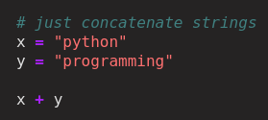
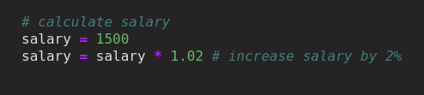
String

Slide 20
String
x
x = 17
17
y
y = ’’python’’
python
y = ’’programming’’
programming
z
z = y

Slide 21
String
temp
x = 17
x
x = 17
x
y = ’’python’’
17
y = ’’python’’
17
y
temp = x
y
x = y
python
x = y
python
y = temp

Slide 22
Today’s topics
Review of the previous lecture
Numbers and variables
Operators
What actually variable is
String
Bool
Casts
Basic built-in functions
Control flow
Check your understanding
What we’ve learned

Slide 23
Bool
x
x = True
True
type(x)
(bool)
y
y = False
False
type(y)
(bool)
Age
20
(int)
Knows_python
True
(bool)

Slide 24
Today’s topics
Review of the previous lecture
Numbers and variables
Operators
What actually variable is
String
Bool
Casts
Basic built-in functions
Control flow
Check your understanding
What we’ve learned

Slide 25
Casts
int
float
str
bool
-5
-2.7
1.0
’’hello’’
’’5’’
True
False
1
0
23
0.3
23.6
’’True’’
’’3.7’’

Slide 26
Casts
-1 | 0 | 5 | 1.4 | ’’’’ | ’’5’’ | ’’hello’’ | True | False
int()
-1 | 0 | 5 | 1 | error | 5 | error | 1 | 0
-1.0 | 0.0 | 5.0 | 1.4 | error | 5.0 | error | 1.0 | 0.0
float()
str()
’’-1’’ | ’’0’’ | ’’5’’ | ’’1’’ | ’’’’ | ’’5’’ | ’’hello’’ | ’’True’’ | ’’False’’
bool()
True | False | True | True | False | True | True | True | True

Slide 27
Today’s topics
Review of the previous lecture
Numbers and variables
Operators
What actually variable is
String
Bool
Casts
Basic built-in functions
Control flow
Check your understanding
What we’ve learned

Slide 28
Basic built-in functions
print(x)
17
print(x + y)
x = 17
20
y = 3
print(y)
print(x + 2)
3
19
print(z)
print(y + ’’!’’)
z = ’’python’’
python
python!

Slide 29
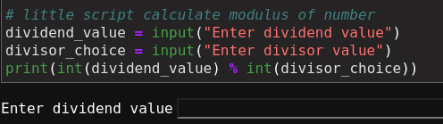
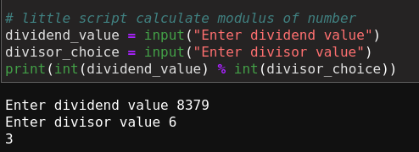
Basic built-in functions
input
x = input()
age = input(“please enter your age”)

Slide 30
Today’s topics
Review of the previous lecture
Numbers and variables
Operators
What actually variable is
String
Bool
Casts
Basic built-in functions
Control flow
Check your understanding
What we’ve learned

Slide 31
Control flow
If
:
If
:
# Do something
# Do something
else:
elif
:
# Do something else
# Do something different
else:
# Do something else

Slide 32
Control flow
x >= 0
x > 0
If
:
If
:
print(’’Positive or zero’’)
print(’’Positive’’)
x < 0
else:
elif
:
print(’’Negative’’)
print(’’Negative’’)
else:
print(’’Zero’’)

Slide 33
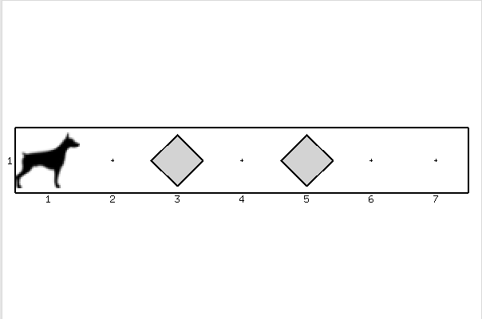
Control flow for BoB
move()
turn_left()
pick_beeper()
beepers_present()
If beepers_present():
pick_beeper()

Slide 34
Today’s topics
Review of the previous lecture
Numbers and variables
Operators
What actually variable is
String
Bool
Casts
Basic built-in functions
Control flow
Check your understanding
What we’ve learned

Slide 35

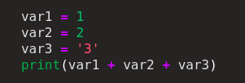
Check your understanding
Correct syntax to output something ?
Correct syntax to output the type of object ?
print()
print(type())
’Hello’ == ’’Hello’’
’Hello’ == ’’hello’’
print(’3’ + ’4’)
print(3+4)
Yes
No
’34’
7
What is a variable?
Hello

Slide 36
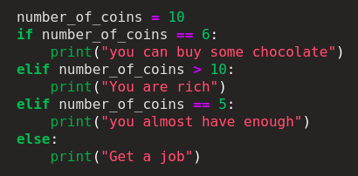







Check your understanding
x is {x}
’’python’’
x is 5
Get a job
True
False
True
float
4

Slide 37
Today’s topics
Review of the previous lecture
Numbers and variables
Operators
What actually variable is
String
Bool
Casts
Basic built-in functions
Control flow
Check your understanding
What we’ve learned

Slide 38
What we’ve learned
Numbers and variables int float
String ’’hello’’
Bool True False
What actually variable is
address
Operators
Arithmetic + - / * // % **
Comparison > >= < <= = == !=
Logical and or not
Casts int() float() str() bool()
Basic built-in functions print() input()
Control flow if: elif: else:

