Slide 1
Welcome !
Programming in Python
Lecture 11

Slide 2
Today’s topics
Review of the previous lecture
Absolute positioning
Layouts
Compound

Slide 3
Review of the previous lecture
Command line driven procedural programs have limited user interaction
Qt / PyQt
QLabel
Graphical
Text input
Button
Check bx
File selector
Slider
QFont
QPushButton
QIcon
Events
Click
Change
QLineEdit

Slide 4
Absolute positioning
Absolute positioning
Lots of work
Not elastic
Better way?
Layouts

Slide 5
Layouts
Layouts
QBoxLayout
QVBoxLayout(), QHBoxLayout
addWidget(QWidget), addStretch(int)
QFormLayout
addRow(label, QWIdget), insertRow(idx, label, QWidget), removeRow(idx)
setLabelAlignment(Qt.QAlignment)
QGridLayout
addWidget(QWidget, x, y, xspan, yspan)

Slide 6
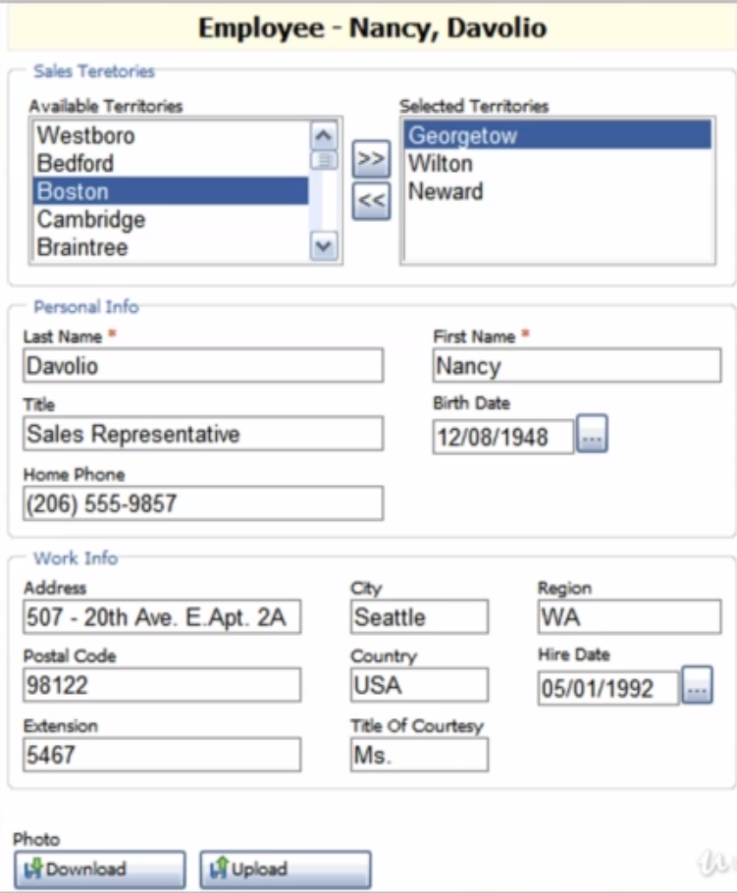
Compound
QLabel
QHBoxLayout
QListBox
45 %
QVBoxLayout
10 %
2 QPushButton
QListBox
45 %
QHBoxLayout
2 QFormLayout
QHBoxLayout
3 QFormLayout
QHBoxLayout
2 QPushButton
Stretch

Slide 7
(row, column)
columns
(0, 0) | (0, 1)
(1, 0) | (1, 1)
row

