Slide 1
Welcome !
Programming in Python
Lecture 2

Slide 2
Today’s topics
Review of the previous lecture
List
For each loop
Regular for loop Regular while loop Random Karel
Check your understanding
What we’ve learned

Slide 3
What we’ve learned
Numbers and variables int float
String ’’hello’’
Bool True False
What actually variable is
address
Operators
Arithmetic + - / * // % **
Comparison > >= < <= = == !=
Logical and or not
Casts int() float() str() bool()
Basic built-in functions print() input()
Control flow if: elif: else:

Slide 4
Today’s topics
Review of the previous lecture
List
For each loop
Regular for loop Regular while loop Random Karel
Check your understanding
What we’ve learned

Slide 5
List (Why do we need)
car1 = 2000
car2 = 5000
car3 = 7500
car4 = 20000
car5 = 11000
car6 = 100000
.
.
.
.

Slide 6
List
indexes
0 | 1 | 2 | 3 | 4 | 5
my_list =
20 | 30 | 10 | 50 | 100 | 120

Slide 7
List (retrieve)
0 1 2 3 4 5
my_list =
[20, 30, 10, 50, 100, 120]
print(my_list[0])
20
print(my_list[1])
30
print(my_list[4])
100
print(my_list[5])
120

Slide 8
List (retrieve)
0 1 2 3 4 5
my_list =
[20, 30, 10, 50, 100, 120]
print(my_list.index(20))
0
print(my_list.index(30))
1
print(my_list.index(100))
4
print(my_list.index(120))
5

Slide 9
\
List
0 1 2 3 4 5
my_list =
[20, 30, 10, 50, 100, 120]
len()
print(len(my_list))
6

Slide 10
List (add element)
0 1 2 3 4 5
my_list =
[20, 30, 10, 50, 100, 120]
my_list.insert(0, 10)
index
value
0 1 2 3 4 5 6
print(my_list)
[10, 20, 30, 10, 50, 100, 120]

Slide 11
List (add element)
0 1 2 3 4 5
my_list =
[20, 30, 10, 50, 100, 120]
my_list.insert(4, 10)
index
value
0 1 2 3 4 5 6
print(my_list)
[20, 30, 10, 50, 10, 100, 120]

Slide 12
List (add element)
0 1 2 3 4 5
my_list =
[20, 30, 10, 50, 100, 120]
my_list.insert(6, 10)
my_list.insert(len(my_list), 10)
index
value
6
0 1 2 3 4 5 6
print(my_list)
[20, 30, 10, 50, 100, 120, 10]

Slide 13
List (add element)
0 1 2 3 4 5
my_list =
[20, 30, 10, 50, 100, 120]
my_list.append(10)
0 1 2 3 4 5 6
print(my_list)
[20, 30, 10, 50, 100, 120, 10]

Slide 14
List (add element)
0 1 2 3 4 5
my_list =
[20, 30, 10, 50, 100, 120]
my_list = my_list + [200, 300]
my_list.extend([200, 300])
0 1 2 3 4 5 6 7
print(my_list)
[20, 30, 10, 50, 100, 120, 200, 300]

Slide 15
List (add element)
0 1 2 3 4 5
my_list =
[20, 30, 10, 50, 100, 120]
my_list.extend([200, 300])
my_list.append([200, 300])
0 1 2 3 4 5 6 7
0 1 2 3 4 5 6
[20, 30, 10, 50, 100, 120, 200, 300]
[20, 30, 10, 50, 100, 120, [200, 300] ]
my_list[6]
[200, 300]
my_list[6][0]
200

Slide 16
List (add element)
0 1
my_list =
[20, 30]
my_list = my_list * 2
0 1 2 3
print(my_list)
[20, 30, 20, 30]

Slide 17
List (update element)
0 1 2 3 4 5
my_list =
[20, 30, 10, 50, 100, 120]
my_list[0] = 10
0 1 2 3 4 5
print(my_list)
[10, 30, 10, 50, 100, 120,]

Slide 18
List (update element)
0 1 2 3 4 5
my_list =
[20, 30, 10, 50, 100, 120]
my_list[4] = 10
0 1 2 3 4 5
print(my_list)
[20, 30, 10, 50, 10, 120,]

Slide 19
List (remove element)
0 1 2 3 4 5
my_list =
[20, 30, 10, 50, 100, 120]
my_list.pop(0)
0 1 2 3 4 5
print(my_list)
[20, 30, 10, 50, 100, 120]

Slide 20
List (remove element)
0 1 2 3 4 5
my_list =
[20, 30, 10, 50, 100, 120]
my_list.pop(3)
0 1 2 3 4
print(my_list)
[20, 30, 10, 100, 120,]

Slide 21
List (remove element)
0 1 2 3 4 5
my_list =
[20, 30, 10, 50, 100, 120]
my_list.pop()
0 1 2 3 4
print(my_list)
[20, 30, 10, 50, 100]

Slide 22
List (remove element)
0 1 2 3 4 5
my_list =
[20, 30, 10, 50, 100, 120]
my_list.remove(30)
0 1 2 3 4
print(my_list)
[20, 10, 50, 100, 120]

Slide 23
List (slice)
0 1 2 3 4 5 6 7 8 9 10
my_list =
[10, 11, 12, 13, 14, 15, 16, 17, 18, 19, 20]
my_list[0:3]
[10, 11, 12]
my_list[5:8]
[15, 16, 17]
my_list[0:8:2]
[10, 12, 14, 16]
my_list[5:]
[15, 16, 17, 18, 19, 20]
[10, 11, 12, 13, 14]
my_list[:5]
my_list[::]
[10, 11, 12, 13, 14, 15, 16, 17, 18, 19, 20]

Slide 24
List (slice)
0 1 2 3 4 5 6 7 8 9 10
my_list =
[10, 11, 12, 13, 14, 15, 16, 17, 18, 19, 20]
-11 -10 -9 -8 -7 -6 -5 -4 -3 -2 -1
my_list[-1]
20
my_list[-5:-3]
[16, 17]
my_list[-3:]
[18, 19, 20]
my_list[:-6]
[10, 11, 12, 13, 14]
[20, 19, 18, 17, 16, 15, 14, 13, 12, 11, 10]
my_list[::-1]

Slide 25
List
indexes
0 | 1 | 2 | 3 | 4 | 5
2 | 3 | 1 | 5 | 10 | 12
’’a’’ | ’’b’’ | ’’hello’’’ | ’’world’’ | ‘’python’’ | ’’ ’’
True | False | False | True | True | True
2 | ’’a’’ | True | ’’hello’’ | 12 | False

Slide 26
List
my_list =
2 | ’’a’’ | True | ’’hello’’ | 12 | False
2 | in | my_list
’’a’’’ | in | my_list
True | in | my_list
0 | in | my_list
’’python’’ | in | my_list
True
True
True
False
False

Slide 27
List
our_car_models =
’’opel’’ | ’’bmw’’ | ’’mercedes’’ | ’’toyota’’ | ’’tesla’’ | ’’ford’’
our_car_price =
2000 | 15000 | 20000 | 7000 | 60000 | 30000
True
user_car = ’’tesla’’
If user_car in our_car_models:
car_index = our_car_models.index(user_car)
print(our_car_price[car_index])
else:
print(’’we do not have a car of this brand’’)
4
60000

Slide 28
prices =
[20, 30, 10, 50, 100, 120]
min(prices)
max(prices)
sum(prices)
len(prices)
10
120
330
6

Slide 29
prices =
[20, 30, 10, 50, 100, 120]
prices = sorted(prices)
prices.sort()
print(prices)
print(prices)
[10, 20, 30, 50, 100, 120]
[10, 20, 30, 50, 100, 120]

Slide 30
Today’s topics
Review of the previous lecture
List
For each loop
Regular for loop Regular while loop Random Karel
Check your understanding
What we’ve learned

Slide 31
our_car_models =
’’opel’’ | ’’bmw’’ | ’’mercedes’’ | ’’toyota’’ | ’’tesla’’ | ’’ford’’
for car_model in our_car_models:
print(car_model)
car_model =
’’opel’’
’’opel’’

Slide 32
our_car_models =
’’opel’’ | ’’bmw’’ | ’’mercedes’’ | ’’toyota’’ | ’’tesla’’ | ’’ford’’
for car_model in our_car_models:
print(car_model)
car_model =
’’bmw’’
’’opel’’
’’bmw’’

Slide 33
our_car_models =
’’opel’’ | ’’bmw’’ | ’’mercedes’’ | ’’toyota’’ | ’’tesla’’ | ’’ford’’
for car_model in our_car_models:
print(car_model)
car_model =
’’mercedes’’
’’opel’’
’’bmw’’
’’mercedes’’

Slide 34
our_car_models =
’’opel’’ | ’’bmw’’ | ’’mercedes’’ | ’’toyota’’ | ’’tesla’’ | ’’ford’’
for car_model in our_car_models:
print(car_model)
car_model =
’’toyota’’
’’opel’’
’’bmw’’
’’mercedes’’
’’toyota’’

Slide 35
our_car_models =
’’opel’’ | ’’bmw’’ | ’’mercedes’’ | ’’toyota’’ | ’’tesla’’ | ’’ford’’
for car_model in our_car_models:
print(car_model)
car_model =
’’tesla’’
’’opel’’
’’bmw’’
’’mercedes’’
’’toyota’’
’’tesla’’

Slide 36
our_car_models =
’’opel’’ | ’’bmw’’ | ’’mercedes’’ | ’’toyota’’ | ’’tesla’’ | ’’ford’’
for car_model in our_car_models:
print(car_model)
car_model =
’’ford’’
’’opel’’
’’bmw’’
’’mercedes’’
’’toyota’’
’’tesla’’
’’ford’’

Slide 37
variable_name
list
for __________ in ______:
# Do something

Slide 38
threshold = 50
prices =
[20, 30, 10, 50, 100, 120]
prices.sort()
[10, 20, 30, 50, 100, 120]
for price in prices:
if price > threshold:
break
print(price)
10
20
30
50
https://pythontutor.com/visualize.html#mode=edit

Slide 39
threshold = 50
prices =
[20, 30, 120, 10, 100, 50]
for price in prices:
if price > threshold:
continue
print(price)
20
30
10
50
https://pythontutor.com/visualize.html#mode=edit

Slide 40
Today’s topics
Review of the previous lecture
List
For each loop
Regular for loop Regular while loop Random Karel
Check your understanding
What we’ve learned

Slide 41
our_car_models =
’’opel’’ | ’’bmw’’ | ’’mercedes’’ | ’’toyota’’ | ’’tesla’’ | ’’ford’’
our_car_price =
2000 | 15000 | 20000 | 7000 | 60000 | 30000
’’opel’’ | 2000
’’bmw’’ | 15000
’’mercedes’’ | 20000
’’toyota’’ | 7000
’’tesla’’ | 60000
’’ford’’ | 30000
How to print?
Indexes !!

Slide 42
our_car_models =
’’opel’’ | ’’bmw’’ | ’’mercedes’’ | ’’toyota’’ | ’’tesla’’ | ’’ford’’
our_car_price =
2000 | 15000 | 20000 | 7000 | 60000 | 30000
Indexes_list = [0, 1, 2, 3, 4, 5]
for idx in Indexes_list:
model = our_car_models[idx]
price = our_car_price[idx]
print( f’’{model} costs {price} $’’ )
opel costs 2000 $
bmw costs 15000 $
mercedes costs 20000 $
toyota costs 7000 $
tesla costs 60000 $
ford costs 30000 $

Slide 43
our_car_models =
’’opel’’ | ’’bmw’’ | ’’mercedes’’ | ’’toyota’’ | ’’tesla’’ | ’’ford’’
our_car_price =
2000 | 15000 | 20000 | 7000 | 60000 | 30000
Indexes_list = [0, 1, 2, 3, 4, 5]
range(0, 6)
for idx in range(0, 6):
model = our_car_models[idx]
price = our_car_price[idx]
print( f’’{model} costs {price} $’’ )
opel costs 2000 $
bmw costs 15000 $
mercedes costs 20000 $
toyota costs 7000 $
tesla costs 60000 $
ford costs 30000 $

Slide 44
range( ___, ___, ___ )
start
stop
step
range(0, 6)
list(range(0, 6))
list(range(6))
list(range(3, 6))
list(range(6, 6))
list(range(0, 6, 2))
list(range(3, 0, -1))
range(0, 6)
[0, 1, 2, 3, 4, 5]
[0, 1, 2, 3, 4, 5]
[3, 4, 5]
[]
[0, 2, 4]
[3, 2, 1]

Slide 45
Today’s topics
Review of the previous lecture
List
For each loop
Regular for loop Regular while loop Random Karel
Check your understanding
What we’ve learned

Slide 46
index = 0
while index < 5:
print(index)
index = index + 1
while condition:
# Do something
0
1
2
3
4

Slide 47
while condition:
# Do something
condition == False
break
while True:
# Do something
while 3 < 5:
# Do something

Slide 48
stop_number = -1
while True:
user_number = int(input())
If user_number == stop_number:
break
If (user_number % 2) == 0:
print(’’number is even’’)
else:
print(’’number is odd’’)
print(’’program finished’’)

Slide 49
our_car_models =
’’opel’’ | ’’bmw’’ | ’’mercedes’’ | ’’toyota’’ | ’’tesla’’ | ’’ford’’
car_index = 0
while car_index < len(our_car_models):
print(our_car_models[car_index])
car_index += 1
’’opel’’
’’bmw’’
’’mercedes’’
’’toyota’’
’’tesla’’
’’ford’’

Slide 50
Today’s topics
Review of the previous lecture
List
For each loop
Regular for loop Regular while loop Random Karel
Check your understanding
What we’ve learned

Slide 51
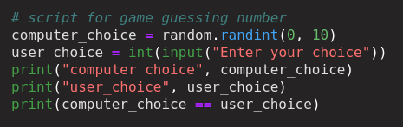

Basic built-in functions
random
Import random
random.randint(start, end)
random.randint(0, 10)

Slide 52
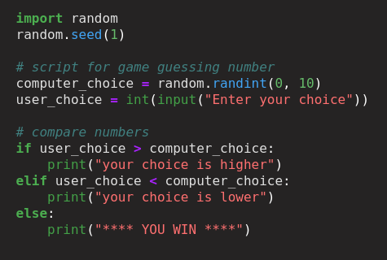
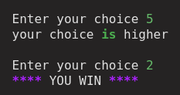
Guess number

Slide 53
Today’s topics
Review of the previous lecture
List
For each loop
Regular for loop Regular while loop Random Karel
Check your understanding
What we’ve learned

Slide 54
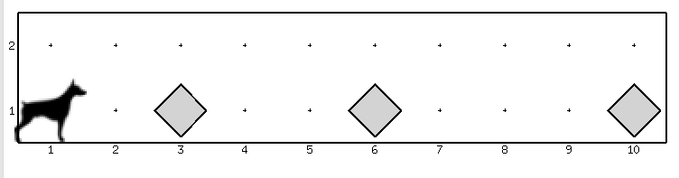
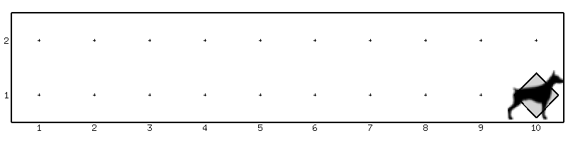
Karel
move()
turn_left()
pick_beeper()
put_beeper()
front_is_clear()
beepers_present()
while front_is_clear():
If beepers_present():
pick_beeper()

Slide 55
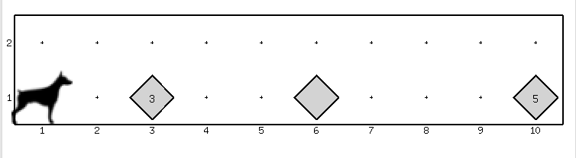
Karel
move()
turn_left()
pick_beeper()
put_beeper()
front_is_clear()
beepers_present()
while front_is_clear():
while beepers_present():
pick_beeper()

Slide 56
Today’s topics
Review of the previous lecture
List
For each loop
Regular for loop Regular while loop Random Karel
Check your understanding
What we’ve learned

Slide 57


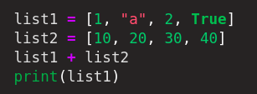
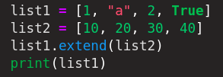
Check your understanding
How to join?
[1, “a”, 2, “3”, True]
[1, “a”, 2, True]
[1, “a”, 2, True, 10, 20, 30, 40]

Slide 58





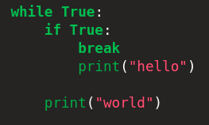
Check your understanding
[1, 2, 3, 5]
[1, 2, 4, 5]
[1, 2, 3, 30, 4, 5]
[1, 2, 3, 30, 5]
[20, 10]

Slide 59
Today’s topics
Review of the previous lecture
List
For each loop
Regular for loop Regular while loop Random Karel
Check your understanding
What we’ve learned

Slide 60
What we’ve learned
List
Initialization [ … ]
retrieve [ ] .index()
add .insert() .append() .extend() + *
delete .pop() .remove()
update [ ] =
functions max() min() len() sum()
sort sorted() .sort()
slices [from:to:step] [from:] [:to]
Regular for loop
for i in range(10): print(i) break Continue
For each loop
lst = [’’hello’’, ’’python’’] for item in lst: print(item) break continue
While loop
Index = 1 while index < 10 print(index) index += 1 break Continue

