Slide 1
Welcome !
Programming in Python
Lecture 4

Slide 2
Today’s topics
Review of the previous lecture
What is a function
Function Inputs (arguments) Function output
Function scopes mutable immutable arguments
Check your understanding
What we’ve learned

Slide 3
What we’ve learned
String
retrieve [ ] .index() .find()
add +
delete [:idx] + [idx:]
update .replace() [:idx] + char + [idx:]
functions lower() upper() isdigit() isalpha() join() split()
slices [from:to:step] [from:] [:to]
Function | def
What is a function | Code block
Why we need a function | Readability, reusable, …..
inputs | arguments
outputs | return

Slide 4
Today’s topics
Review of the previous lecture
What is a function
Function Inputs (arguments) Function output
Function scopes mutable immutable arguments
Check your understanding
What we’ve learned

Slide 5
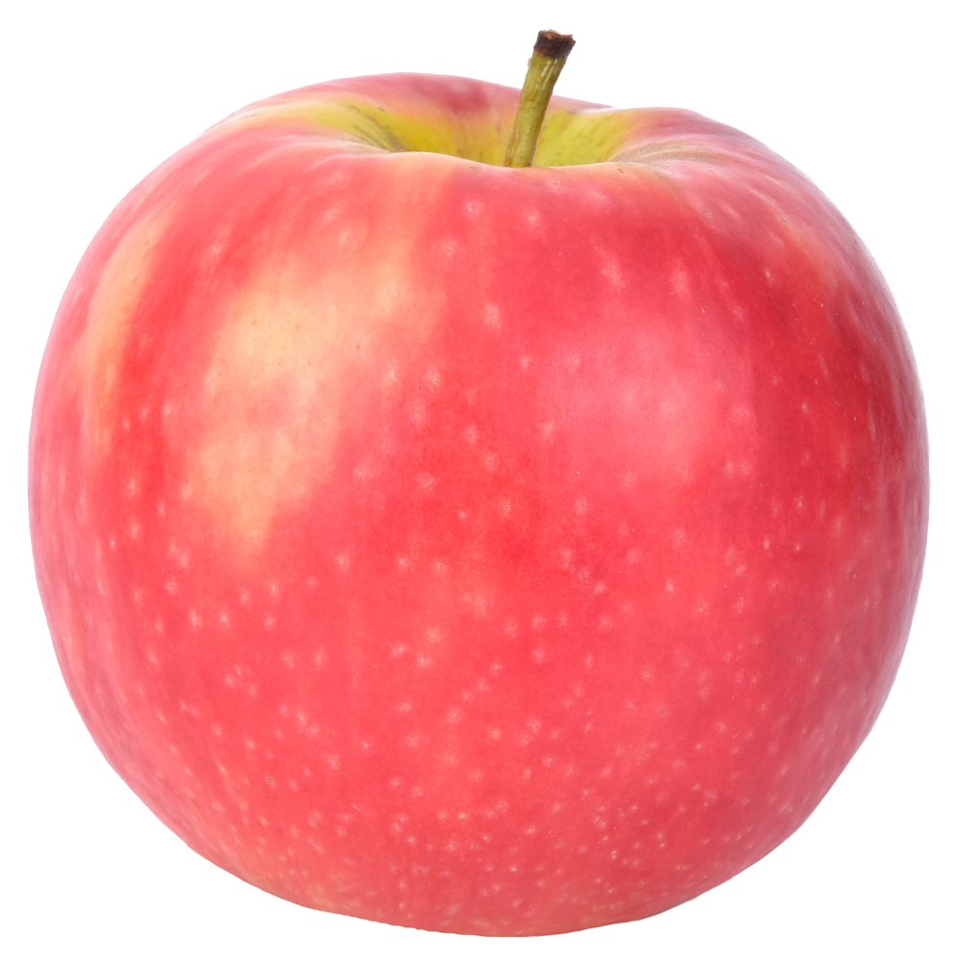

What is a function
Just a code block
For simplicity
function

Slide 6
What is a function
function name
Input (arguments)
def square( x ):
res = x ** 2
return res
output

Slide 7
What is a function
def even_or_odd(x):
if x % 2 == 0:
return True
else:
return False
user_input = int(input(“Enter number”)
res = even_or_odd(user_input)
If res == True:
print(user_input // 2)
else:
print(3*user_input + 1)

Slide 8

What is a function
def turn_right():
turn_left()
turn_left()
turn_left()

Slide 9
Today’s topics
Review of the previous lecture
What is a function
Function Inputs (arguments) Function output
Function scopes mutable immutable arguments
Check your understanding
What we’ve learned

Slide 10
Function Inputs (arguments)
Positional arguments
Default arguments
Keyword arguments
def my_function(a, b):
print(a + b)
def my_function(a, b=1):
print(a + b)
def my_function(a, b, c):
print(a + b + c)
my_function(3, 5)
my_function(3)
my_function(b=3, a=5, c=1)
8
4
9

Slide 11
Function Inputs (arguments)
Positional arguments
def my_function(a, b):
print(a / b)
my_function(8, 2)
my_function(2, 8)
my_function(3)
my_function(3, 5, 10)
4
0.25
error
error

Slide 12
Function Inputs (arguments)
default arguments
def my_function(a, b=2):
print(a / b)
my_function(8, 4)
my_function(8, 2)
my_function(8)
my_function(3, 5, 10)
2.0
4.0
4.0
error

Slide 13
Function Inputs (arguments)
keyword arguments
def my_function(a, b=2):
print(a / b)
my_function(b=4, a=8)
my_function(a=8, b=4)
2.0
4.0

Slide 14
Today’s topics
Review of the previous lecture
What is a function
Function Inputs (arguments) Function output
Function scopes mutable immutable arguments
Check your understanding
What we’ve learned

Slide 15
Function output
def multiply_divider(a, b):
return a*b, a/b
def caller():
mult, div = multiply_divider(10, 5)
print(mult)
print(div)

Slide 16
Today’s topics
Review of the previous lecture
What is a function
Function Inputs (arguments) Function output
Function scopes mutable immutable arguments
Check your understanding
What we’ve learned

Slide 17
Function scopes
user_input
mod
res
x
def even_or_odd(x):
mod = x % 2
if mod == 0:
return True
else:
return False
user_input = int(input(“Enter number”)
res = even_or_odd(user_input)
If res == True:
print(user_input // 2)
else:
print(3*user_input + 1)

Slide 18
Today’s topics
Review of the previous lecture
What is a function
Function Inputs (arguments) Function output
Function scopes mutable immutable arguments
Check your understanding
What we’ve learned

Slide 19
Mutable immutable arguments
def my_function(x):
x = x + 1
def my_function(lst):
lst.append(4)
def caller():
a = 5
my_function(a)
print(a)
def caller():
l = [1, 2, 3]
my_function(l)
print(l)
5
[1, 2, 3, 4]

Slide 20
Today’s topics
Review of the previous lecture
What is a function
Function Inputs (arguments) Function output
Function scopes mutable immutable arguments
Check your understanding
What we’ve learned

Slide 21
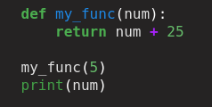



Check your understanding
Jack 25
Error
Error
12

Slide 22
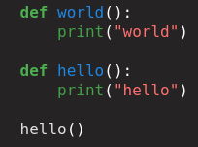
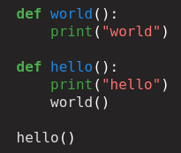
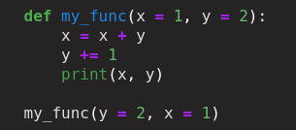
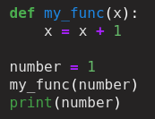
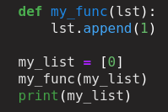
Today’s topics
3 3
hello
Hello
world
1
[0, 1]

Slide 23
Today’s topics
Review of the previous lecture
What is a function
Function Inputs (arguments) Function output
Function scopes mutable immutable arguments
Check your understanding
What we’ve learned

Slide 24
What we’ve learned
Function | def
What is a function | Code block
Why we need a function | Readability, reusable, …..
Scopes | Local scopes
inputs | Arguments (positional, default, keyword)
outputs | return

