Slide 1
Welcome !
Programming in Python
Lecture 7

Slide 2
Today’s topics
Review of the previous lecture
What is Dictionary
Dictionary functions Dictionary for cycle
Check your understanding
What we’ve learned

Slide 3
Review of the previous lecture
Tuple
what?
why?
when?
Data structure
efficient
When we know exact size of items
Less problems when variable remains unchangeable
List but written with parentheses
immutable
hash
ordered
Indexing, slicing
in
Foreach loop
len() max() min() sum()

Slide 4
Today’s topics
Review of the previous lecture
What is Dictionary
Dictionary functions Dictionary for cycle
Check your understanding
What we’ve learned

Slide 5
What is Dictionary
our_car_models =
’’opel’’ | ’’bmw’’ | ’’mercedes’’ | ’’toyota’’ | ’’tesla’’ | ’’ford’’
our_car_price =
2000 | 15000 | 20000 | 7000 | 60000 | 30000
Can we save this in a better format?
Dictionary
A container data type that maps “keys” to their associated “values”

Slide 6
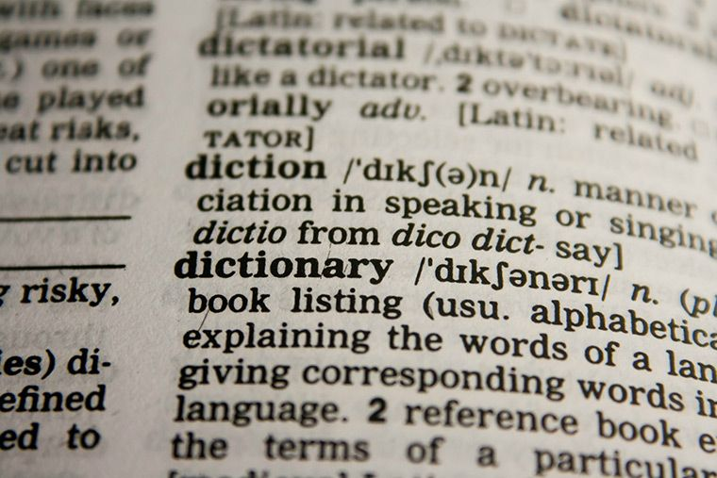
What is Dictionary

Slide 7
What is Dictionary
dict
keys
values
opel
bmw
mercedes
toyota
tesla
ford
2000
15000
20000
7000
60000
30000

Slide 8
Today’s topics
Review of the previous lecture
What is Dictionary
Dictionary functions Dictionary for cycle
Check your understanding
What we’ve learned

Slide 9
Dictionary functions
d = { “opel”: 2000, “bmw”:15000, “mercedes”:20000, “toyota”:7000, “tesla”:60000, “ford”:30000 }
dict
d[“opel”]
2000
keys
values
opel
bmw
mercedes
toyota
tesla
ford
2000
15000
20000
7000
60000
30000
d[“tesla”]
60000
d.get(“ford”)
30000

Slide 10
Dictionary functions
d = { “opel”: 2000, “bmw”:15000, “mercedes”:20000, “toyota”:7000, “tesla”:60000, “ford”:30000 }
dict
keys
values
d[“tesla”] = 100 000
opel
bmw
mercedes
toyota
tesla
ford
2000
15000
20000
7000
100 000
30000
d[“audi”] = 40 000
print(d[“lamborghini”])
KeyError
print(d.get(“lamborghini”))
None
print(d.get(“lamborghini”, -1))
-1
audi
40000

Slide 11
Dictionary functions
d = { “opel”: 2000, “bmw”:15000, “mercedes”:20000, “toyota”:7000, “tesla”:60000, “ford”:30000 }
dict
keys
values
“tesla” in d
True
opel
bmw
mercedes
toyota
tesla
ford
2000
15000
20000
7000
100000
30000
“Lamborghini” in d
False
audi
40000

Slide 12
Dictionary functions
person = { }
dict
person[“name”] = “Jack”
keys
values
name
Jack
person[“age”] = 23
age
23
height
1.85
person[“height”] = 1.85

Slide 13
Dictionary functions
person = { }
dict
person[“name”] = “Jack”
keys
values
name
Jack
person[“age”] = 23
age
24
height
1.85
person[“height”] = 1.85
person[“age”] = person[“age”] + 1

Slide 14
Dictionary functions
dict
keys
values
name
Jack
age
24
height
1.85

Slide 15
Dictionary functions
dict
del person[“height”]
keys
values
name
Jack
age
24

Slide 16
Dictionary functions
dict
del person[“height”]
keys
values
name
Jack
person.pop(“age”)

Slide 17
Dictionary functions
d = {}
d[0] = 0
d
keys
values
d["text"] = "text"
0
0
text
text
d[ (1, 2) ] = [1, 2]
(1, 2)
[1, 2]

Slide 18
Dictionary functions
students = {"0001": {"name":"Jack", "age":27, "sex": "Male"},
"0002": {"name":"Emma", "age":22, "sex": "Female"}}
students
keys
values
students[”0001”]
Jack
27
Male
name
age
sex
Jack
27
Male
0001
name
age
sex
Emma
22
Female
name
age
sex
0002
students[”0001”][”name”]
Jack

Slide 19
Dictionary functions
list(d.keys())
dict
keys
values
['name', 'age', 'height']
name
Jack
age
24
list(d.values())
height
1.85
['jack', 24, 1.85]
list(d.items())
[('name', 'jack'), ('age', 24), ('height', 1.85)]

Slide 20
Today’s topics
Review of the previous lecture
What is Dictionary
Dictionary functions Dictionary for cycle
Check your understanding
What we’ve learned

Slide 21
Dictionary for cycle
d = { “opel”: 2000, “bmw”:15000, “mercedes”:20000, “toyota”:7000, “tesla”:60000, “ford”:30000 }
dict
for car_brand in d.keys():
print(car_brand)
keys
values
opel
bmw
mercedes
toyota
tesla
ford
2000
15000
20000
7000
100000
30000
opel bmw mercedes toyota tesla Ford audi
audi
40000

Slide 22
Dictionary for cycle
d = { “opel”: 2000, “bmw”:15000, “mercedes”:20000, “toyota”:7000, “tesla”:60000, “ford”:30000 }
dict
for car_price in d.values():
print(car_price)
keys
values
opel
bmw
mercedes
toyota
tesla
ford
2000
15000
20000
7000
100000
30000
2000 15000 20000 7000 100000 30000 40000
audi
40000

Slide 23
Dictionary for cycle
d = { “opel”: 2000, “bmw”:15000, “mercedes”:20000, “toyota”:7000, “tesla”:60000, “ford”:30000 }
dict
for car_brand, car_price in d.items():
print(f”{car_brand} costs {car_price} $”)
keys
values
opel
bmw
mercedes
toyota
tesla
ford
2000
15000
20000
7000
100000
30000
opel costs 2000 $ bmw costs 15000 $ mercedes costs 20000 $ toyota costs 7000 $ tesla costs 100000 $ ford costs 30000 $ audi costs 40000 $
audi
40000

Slide 24
Today’s topics
Review of the previous lecture
What is Dictionary
Dictionary functions Dictionary for cycle
Check your understanding
What we’ve learned

Slide 25
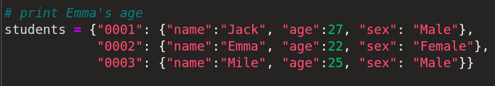
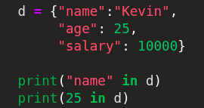
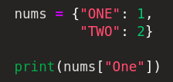
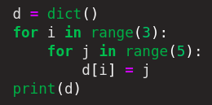
Check your understanding
students[”0002”][age”]
True
False
KeyError
{0:4, 1: 4, 2:4}

Slide 26
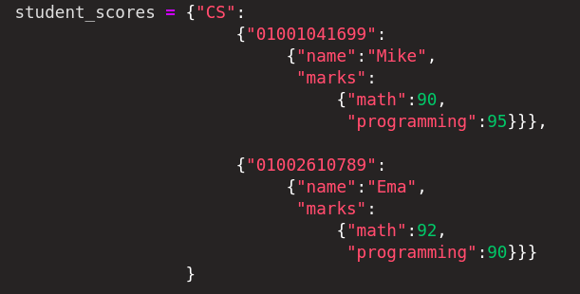
Check your understanding
Print Ema’s math grade
student_scores[“CS”][“01002610789”][“marks”][“math”]

Slide 27
Today’s topics
Review of the previous lecture
What is Dictionary
Dictionary functions Dictionary for cycle
Check your understanding
What we’ve learned

Slide 28
Today’s topics
Dictionary
A container data type that maps “keys” to their associated “values”
get
keys
values
remove
opel
bmw
mercedes
toyota
tesla
ford
2000
15000
20000
7000
60000
30000
d[“opel”]
del d[“opel”]
d.get(“opel”)
d.pop(“opel”)
d.get(“opel”, -1)
functions
update/add
list(d.values())
d[“bmw”] = 20_000
list(d.keys())
list(d.items())

