Slide 1
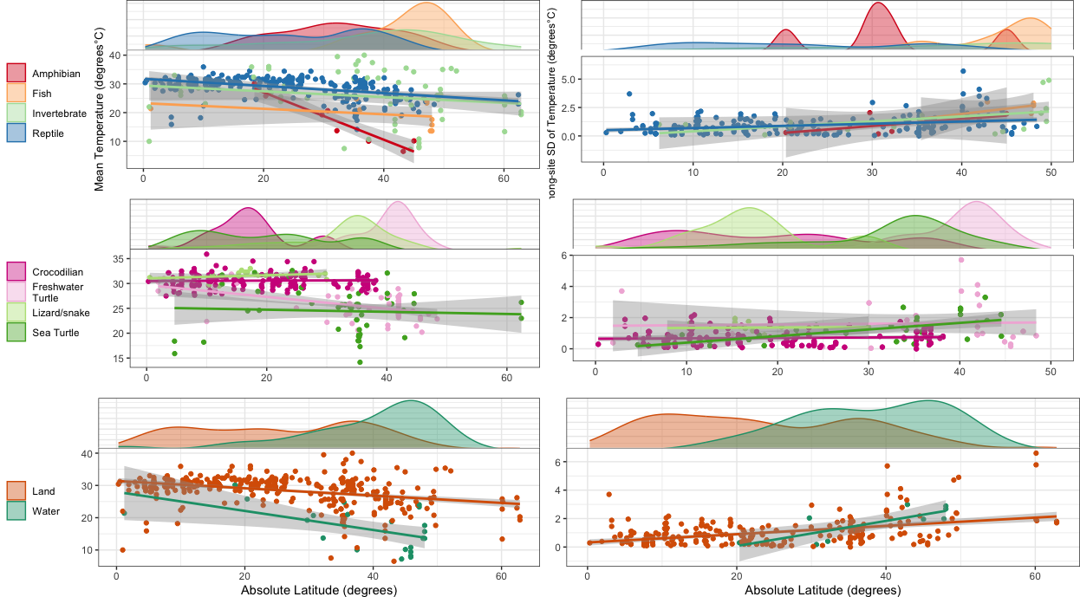
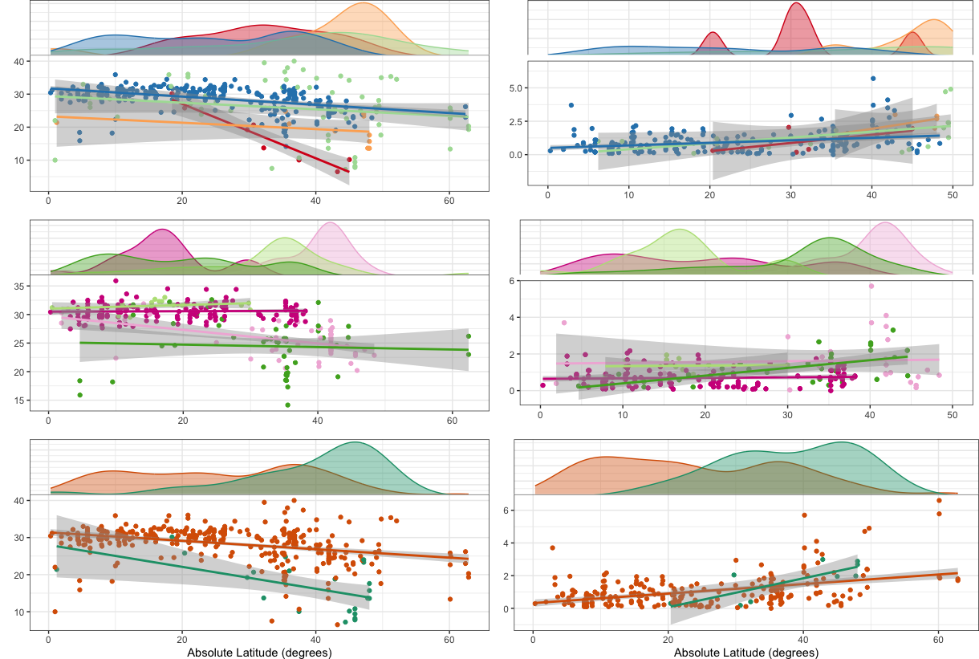
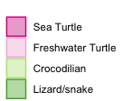
Among-site SD of Temperature (degrees°C)
Mean Temperature (degrees°C)
Absolute latitude (degrees)

