Slide 1
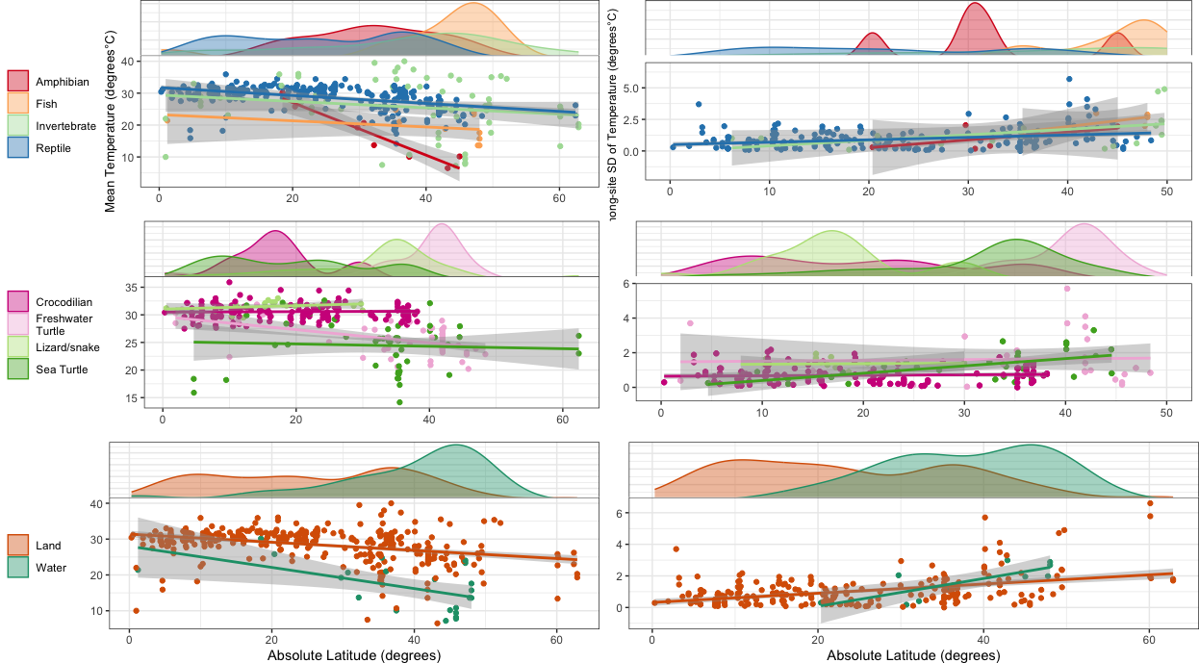
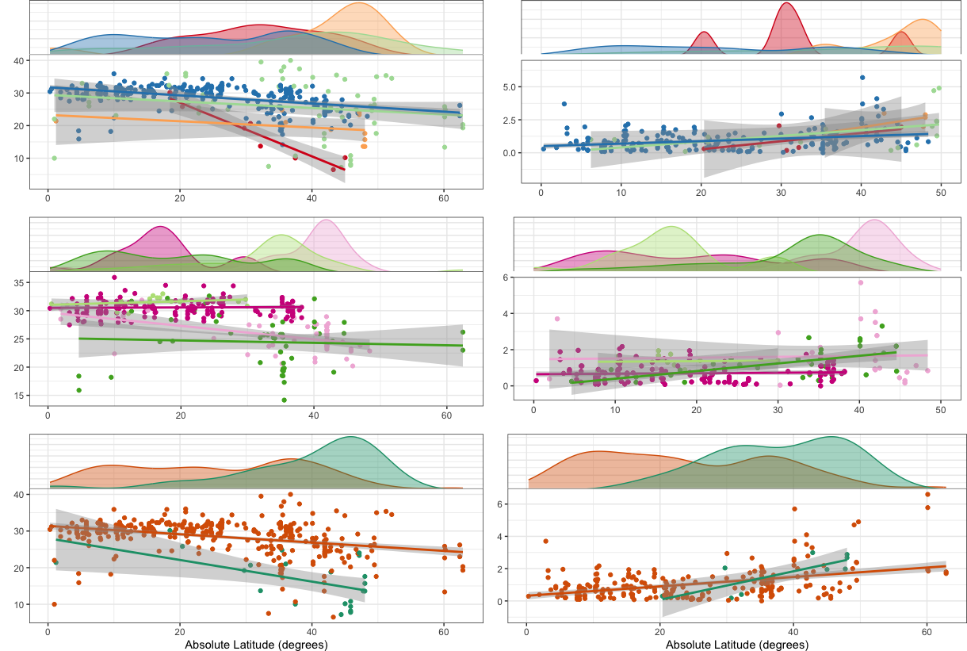
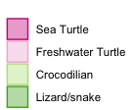
Among-site SD of Temperature (degrees°C)
Mean Temperature (degrees°C)
Absolute latitude (degrees)

Slide 2
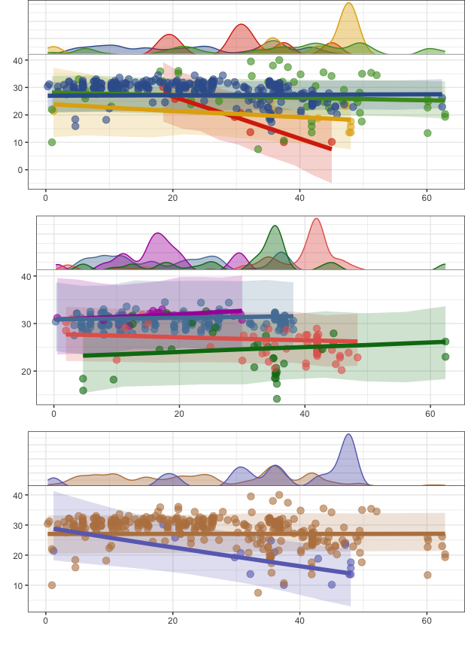
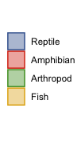
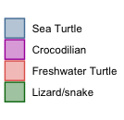
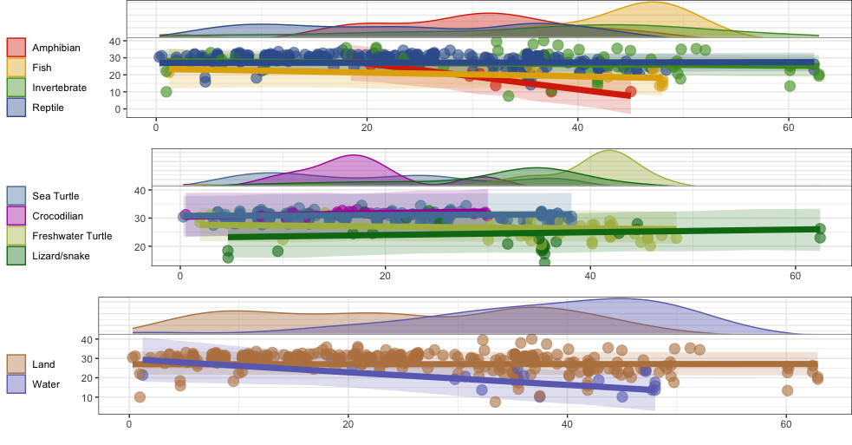
Mean temperature (°C)
Absolute latitude (Degrees)

Slide 3
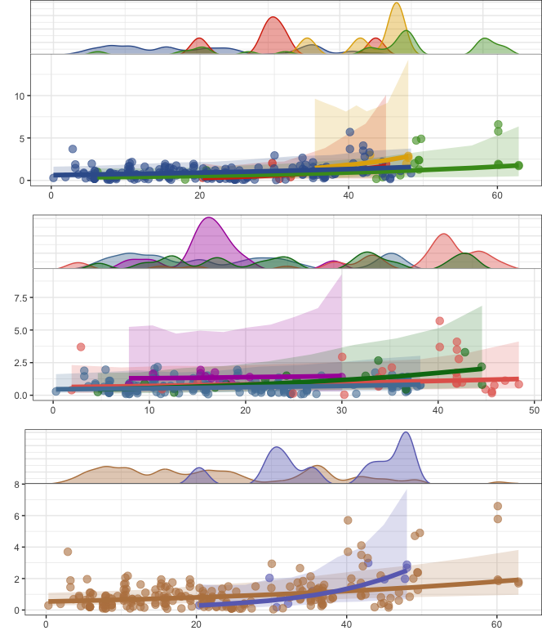
Standard deviation among site (°C)
Absolute latitude (Degrees)

Slide 4
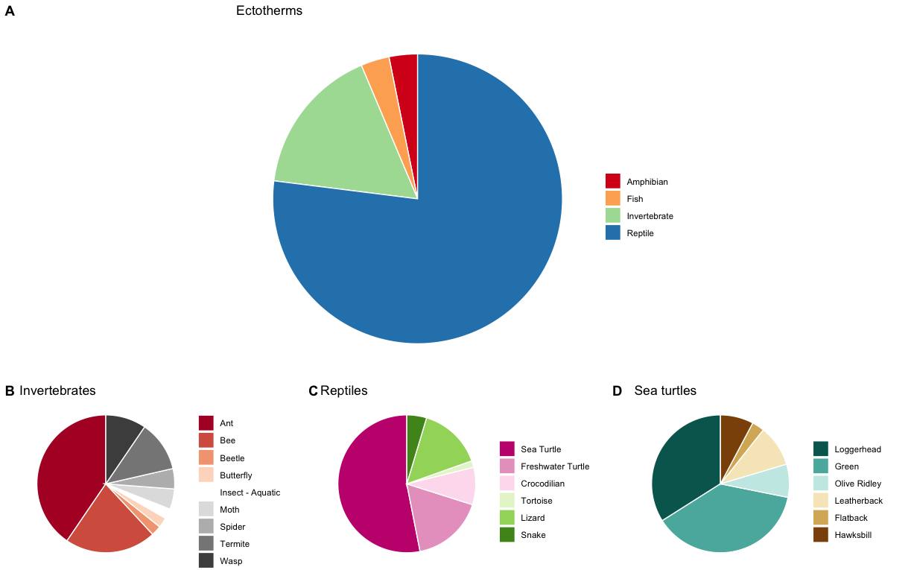
A. Ectotherms
B. Invertebrates
C. Reptiles
D. Sea Turtles

Slide 5
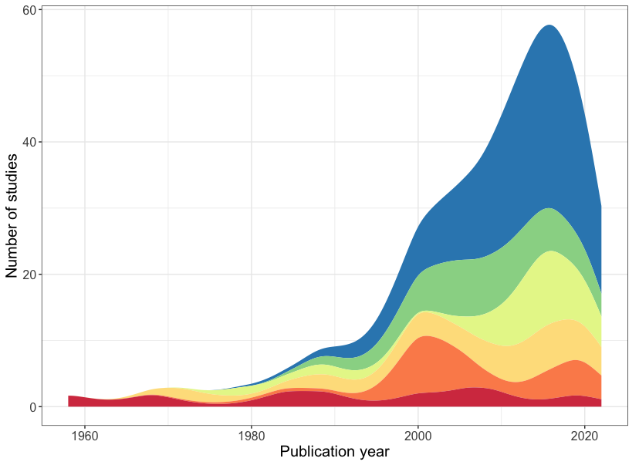
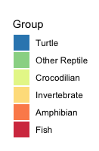

Slide 6
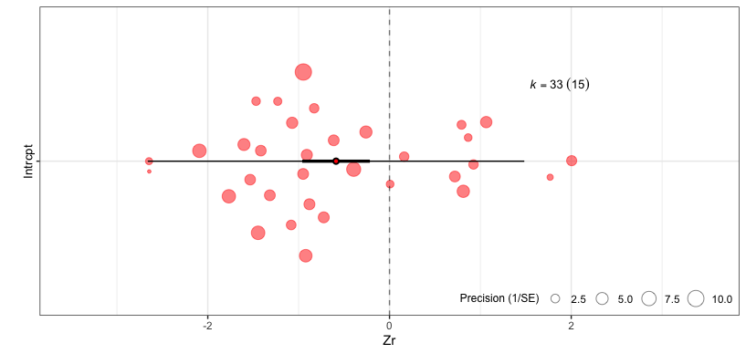
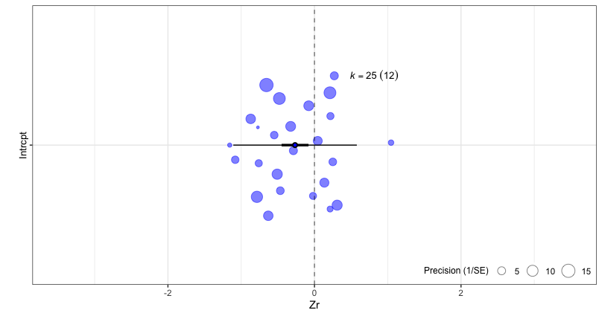
A
Intercept
-2
0
2
B
Intercept
-2
0
2

Slide 7
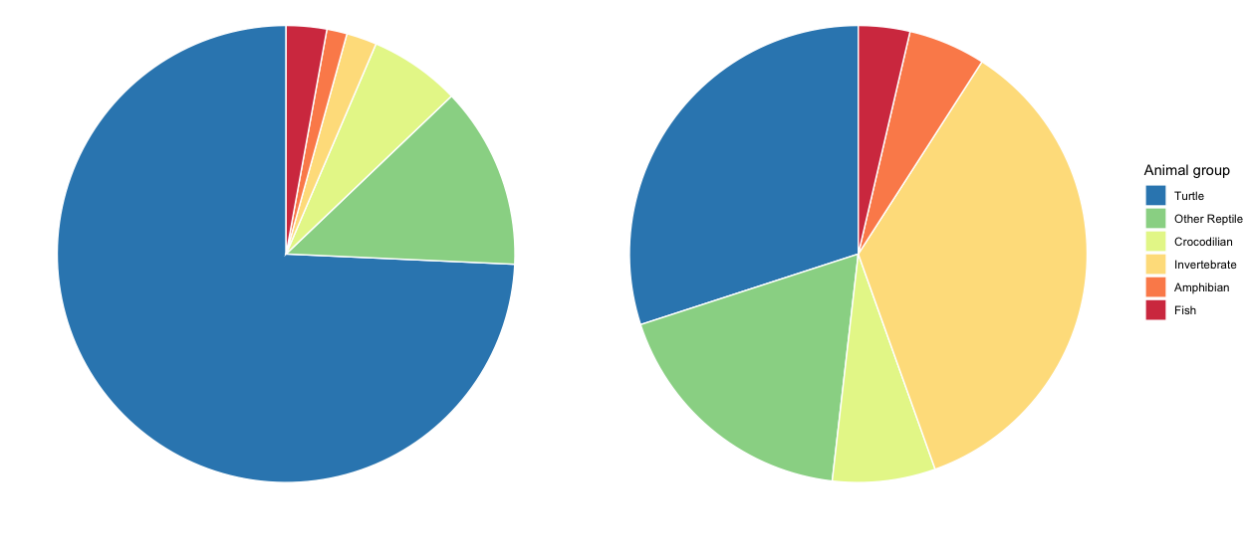
A
B
A
B

Slide 8
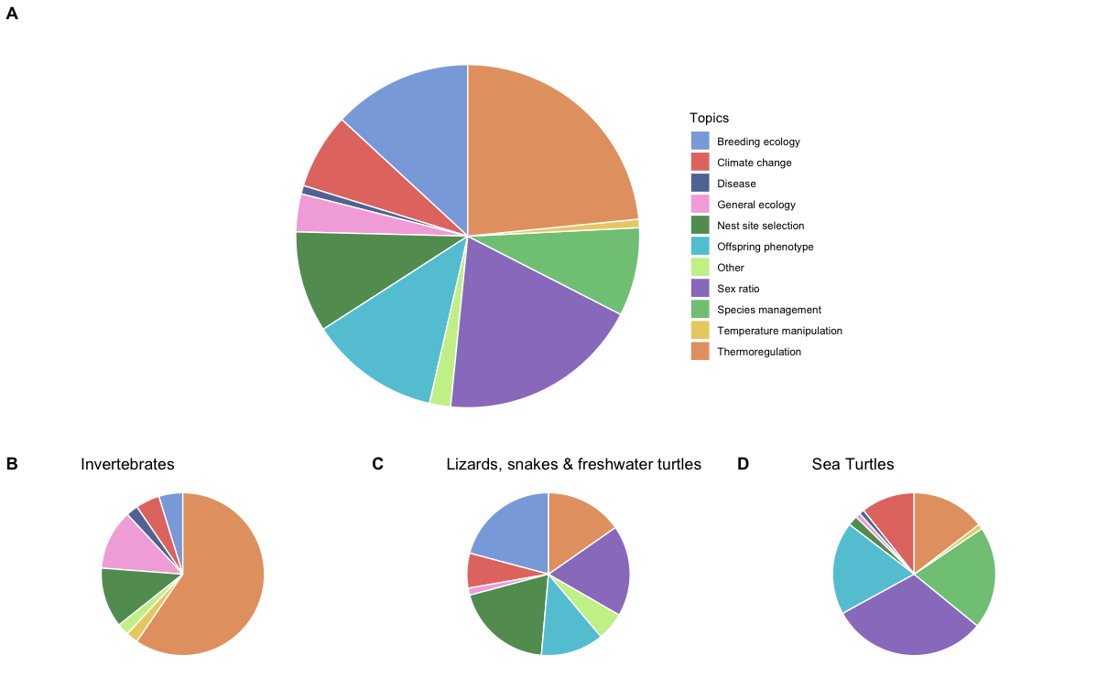
A. Ectotherms

Slide 9
