Slide 1

Which degrees really pay off?

Slide 2


In 2022, 12.8 million, or 42.1% of American 18 to 24 year olds are enrolled in college or graduate school.
But the amount of student debt held in America is roughly equal to the size of the economy of Brazil or Australia
Are degrees worth the financial strain?

Slide 3

How much do the different degrees pay on average?

Slide 4
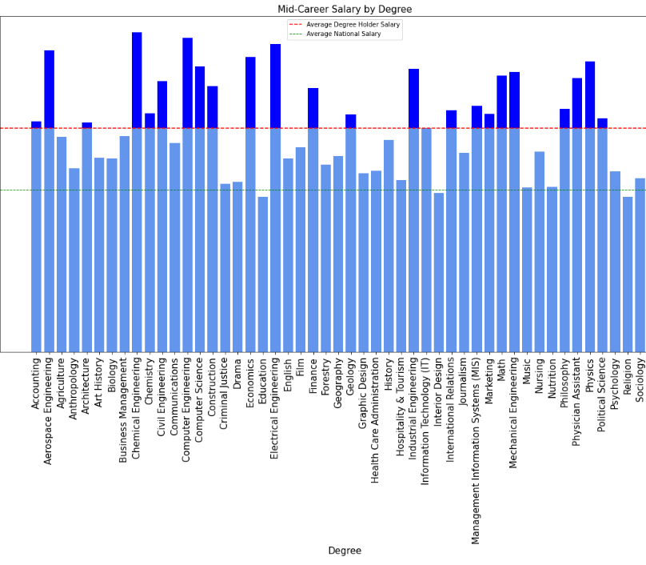
Not all degrees grant an average pay above the national average.
The difference in average pay amongst degree holders can be substantial depending on the degree.

Slide 5
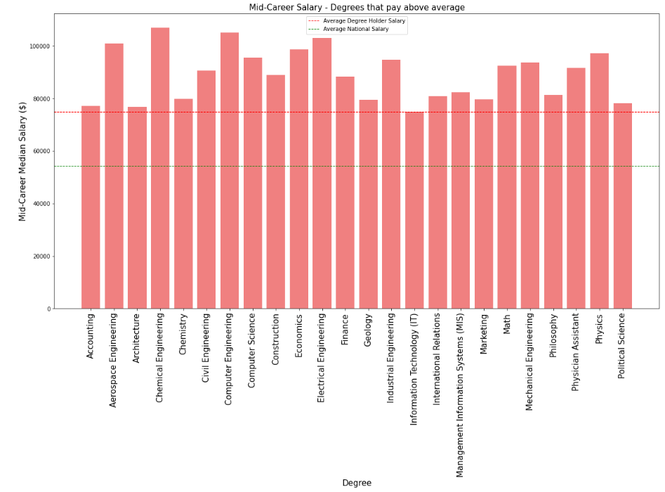
These degrees pay above both the national average and the average of degree holders.

Slide 6
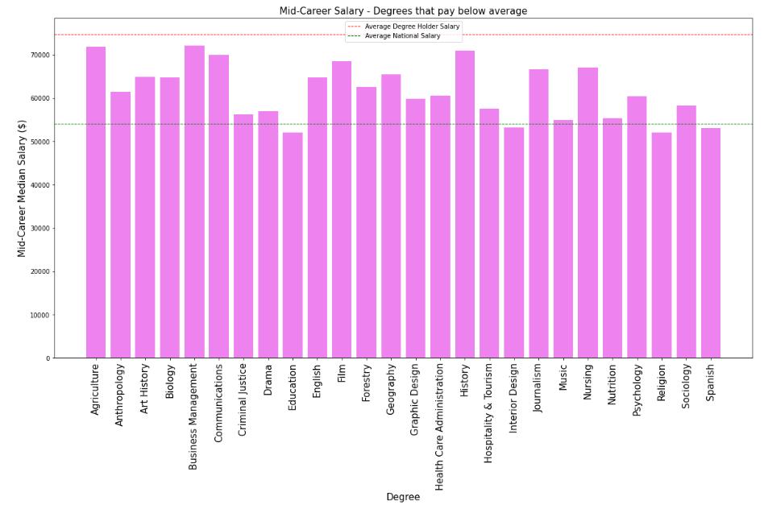
Some degrees don’t even pay above the national average salary

Slide 7

But these averages don’t tell the full story…

Slide 8

Does it matter which University you choose?

Slide 9
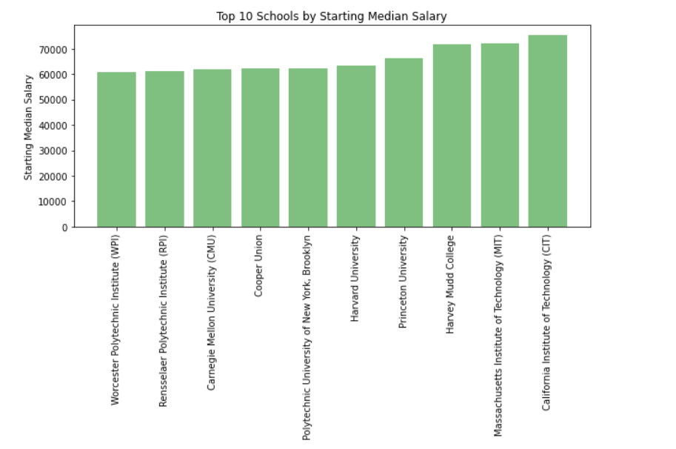
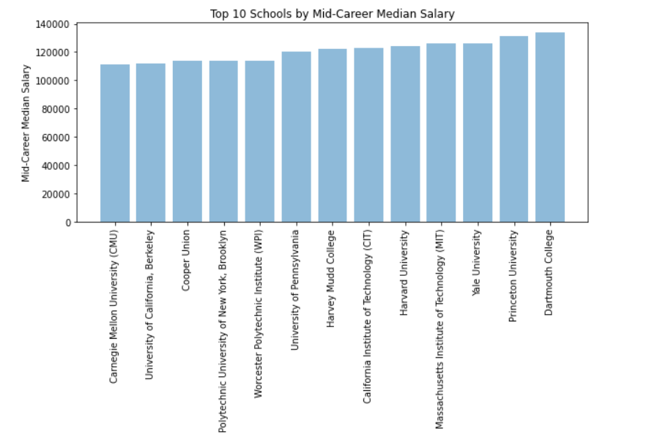
On average, the top 10 Schools pay more than $100,000.00. Twice as much as the national average salary ($54.132)!!
And the average starting salary is also above the national average.

Slide 10
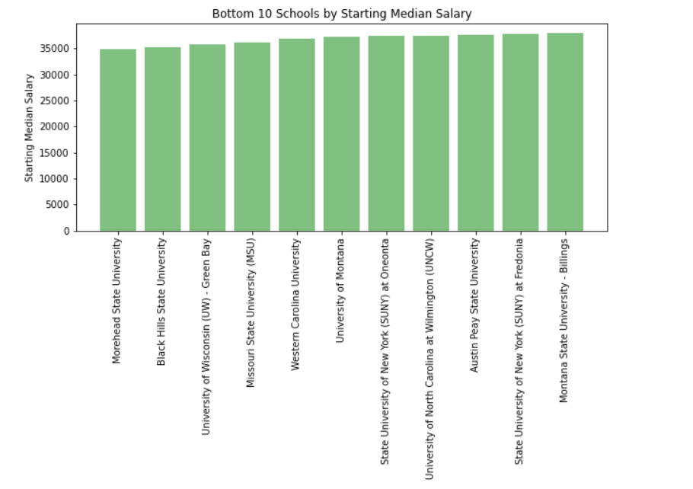
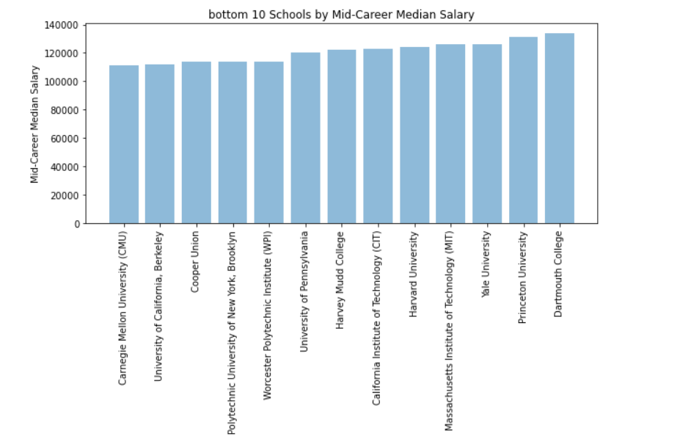
On the other hand, the average starting salary for the bottom 10 Schools doesn’t even reach $40.000.

Slide 11
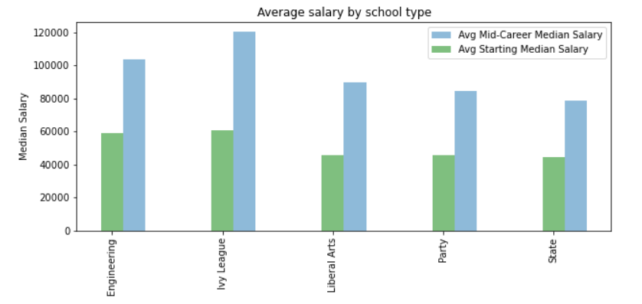
What School type has better and worse prospects?

Slide 12
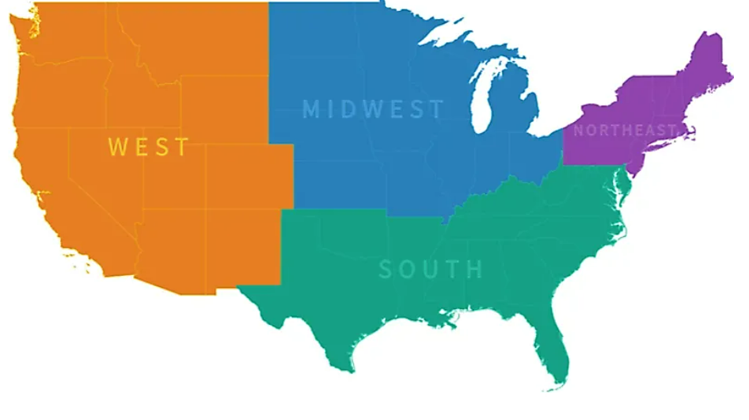
Does it matter where?

Slide 13
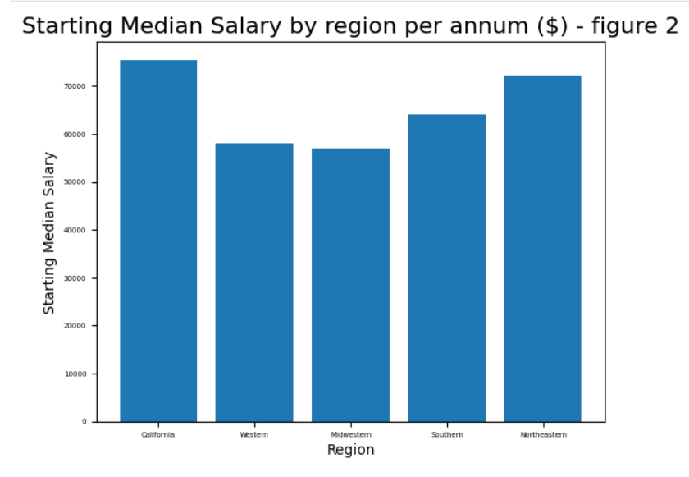
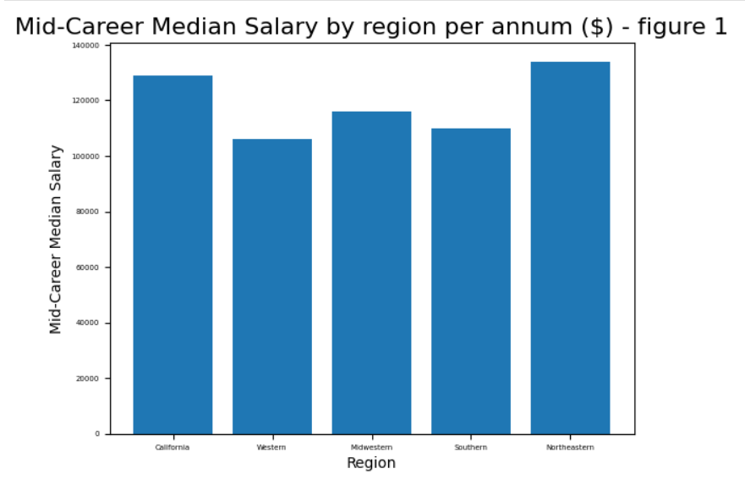
Graduates from Californian universities start roughly with the same salary than graduates from Northeastern region.
Universities from the Northern area take the top spot (Ivy schools) followed closely by the universities in California when it comes to mid-career salaries.

Slide 14
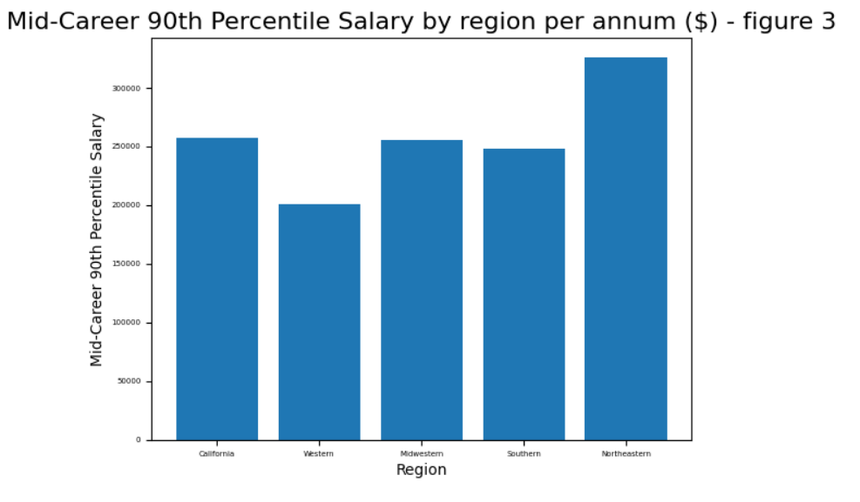
Mid-career salaries for the top 10% are higher for those who studied in the Northeast (Ivy League Universities).

Slide 15


Do all degrees have the same growth prospects salary-wise?

Slide 19

Which disciplines pay best?

Slide 22

So… What should I study?

