Slide 1
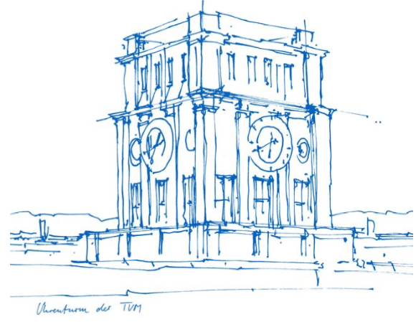
Introduction into R
Raoul Rothfeld (raoul.rothfeld@tum.de)
Based on material from Hema Sharanya Rayaprolu
19 November 2018

Slide 2
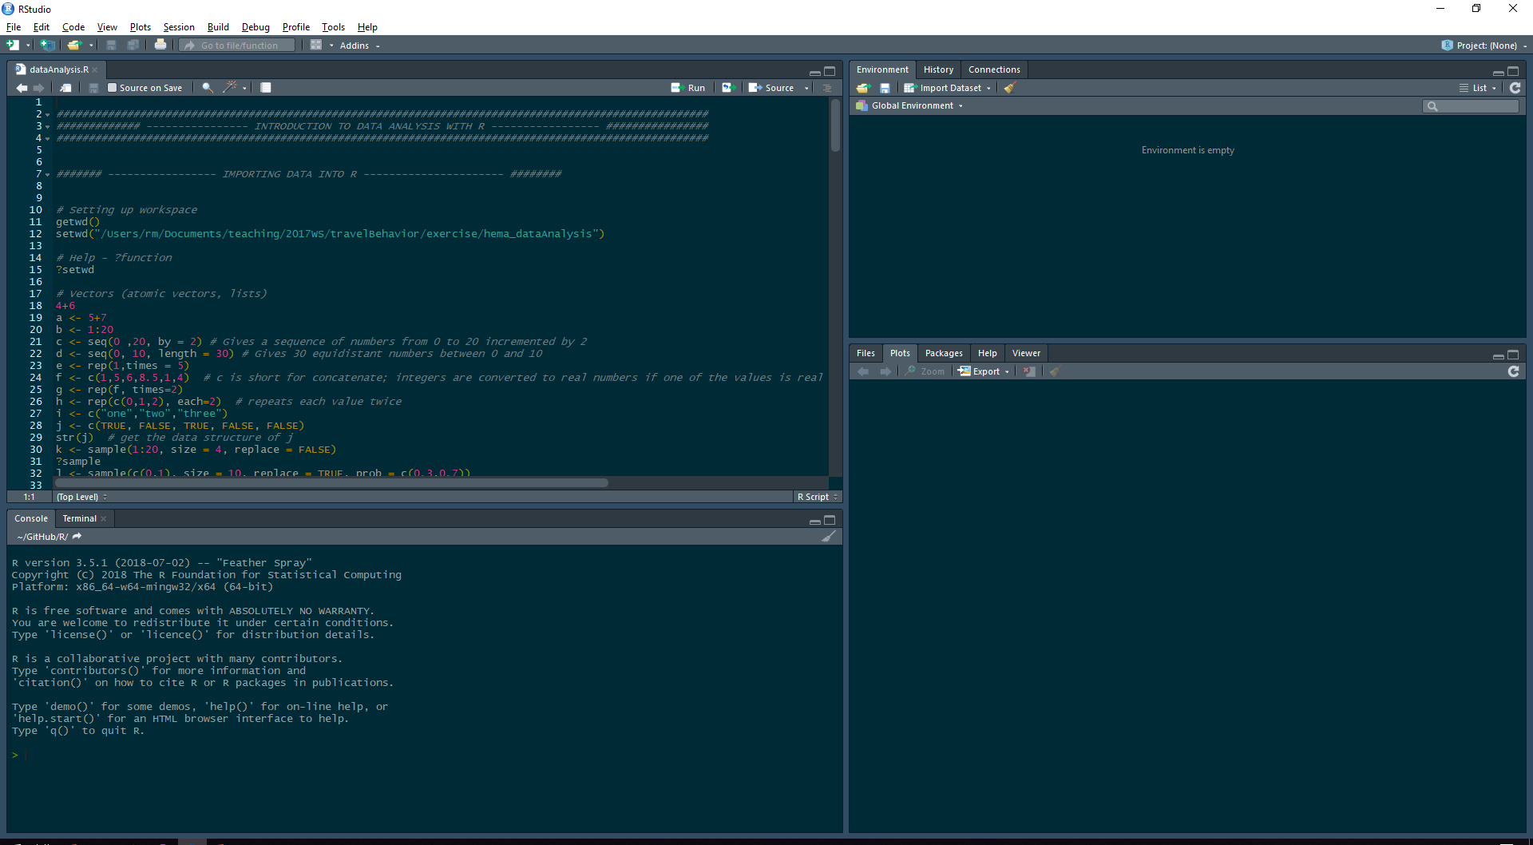
RStudio (IDE for R) Overview
Code Editor
Workspace and History
Plots and Files
R Console

Slide 3
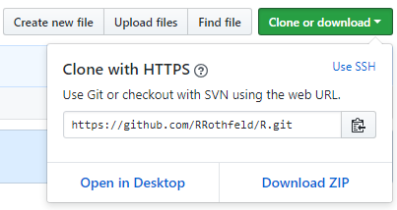
Material for Today’s Class
https://github.com/RRothfeld/R
1
2

Slide 4

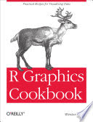
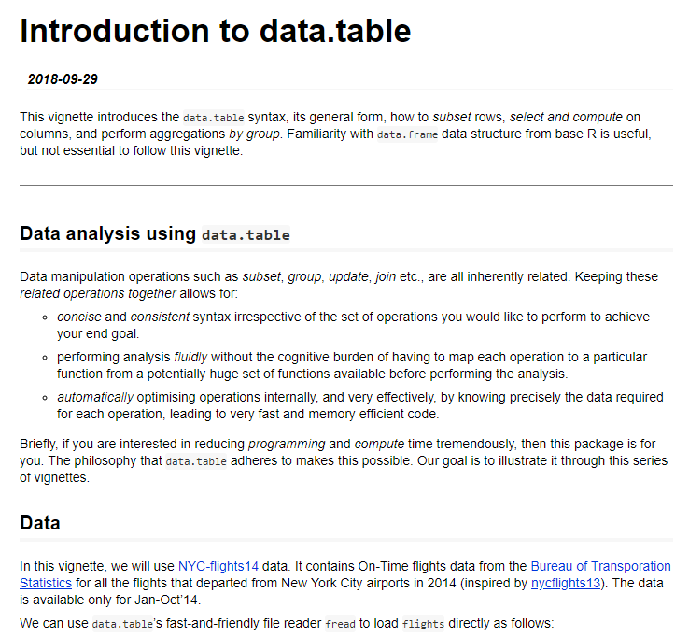
Recommended Reading
Teetor, P. (2011). R cookbook: Proven recipes for data analysis, statistics, and graphics. " O'Reilly Media, Inc.".
Chang, W. (2012). R graphics cookbook: practical recipes for visualizing data. " O'Reilly Media, Inc.".
Introduction to data.table. (2018). https://cran.r-project.org/web/packages/data.table/vignettes/datatable-intro.html

