Slide 1


Instagram Fake, Spammer, and Genuine Accounts Classification
Internship Project Submitted To:
Submitted By:
AKSHAR MISHRA
Data Science Intern

Slide 2
Table of Content
Problem Statement
Data Analysis using Python
Data Cleaning
Model Building and results
Tools, Software and Libraries
References

Slide 3
Problem Statement
Objective: This project aims to classify Instagram accounts into fake/spammer or genuine based on various features extracted from user profiles. Using machine learning techniques, we analyze account metadata like profile picture status, followers, following, username characteristics, etc., to detect anomalies and predict the legitimacy of accounts.

Slide 4
Data Analysis Using Python
Libraries Used: Pandas, NumPy, Seaborn, Matplotlib
Exploratory Data Analysis (EDA):
Distribution of fake vs genuine accounts
Correlation heatmap
Boxplots and countplots for followers, following, profile pics, etc.
Scatter matrix and histograms
Insights:
Fake accounts tend to have fewer profile details, inconsistent follower-following ratios, and often lack profile pictures.

Slide 5
Checked and handled null values (none found)
Feature extraction:
Binary encoding: profile_pic, external_url, private
Numeric transformations: followers, follows, posts
Binned follower counts for visualization
New Features Added:
#followers_bins
Ratios and lengths of username/fullname
Normalization/Scaling: Used StandardScaler for selected features
Data Cleaning and Feature Engineering

Slide 6
Algorithms Used:
Random Forest Classifier (initially)
Decision Tree Classifier (final, best results)
Performance Metrics:
Accuracy (test set): 87.0%
Classification Report:
Precision: 0.86 (Genuine), 0.88 (Fake)
F1-score: ~0.87 average
Confusion Matrix: True positives: 57, True negatives: 44
Feature Importance: Most important features:
#followers, profile_pic, description length, #posts
Model Building and Results
.

Slide 7
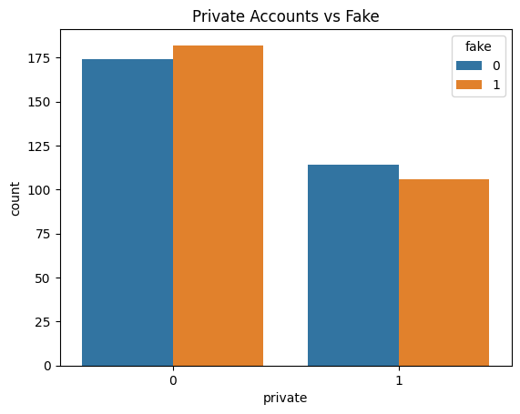
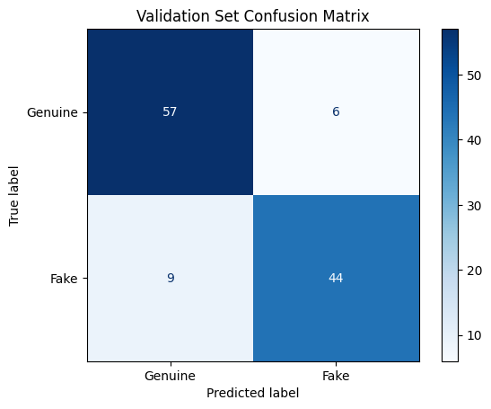
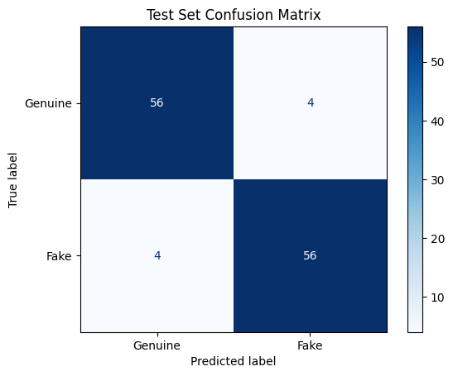
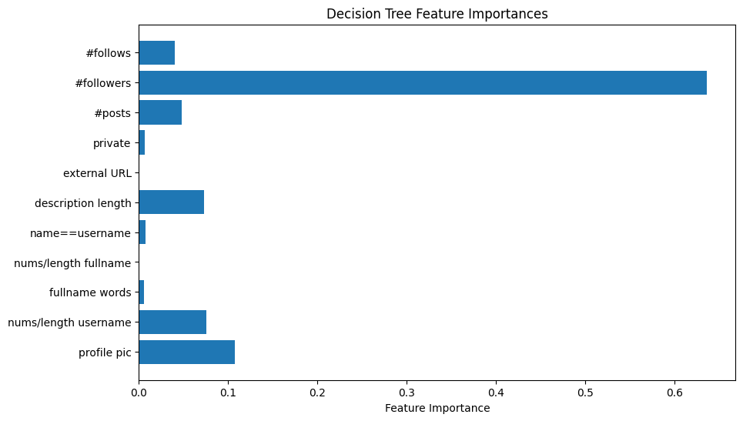
Output and results

Slide 8
Tools, Software and Libraries
Languages & IDEs:
Python (Jupyter Notebook, VS Code)
Libraries:
Pandas, NumPy: Data manipulation
Seaborn, Matplotlib: Visualization
Scikit-learn: Model building and evaluation
SQL: Structured analysis
Others:
Tableau (recommended for business visuals)

Slide 9
References and Bibliography
Instagram Fake accounts dataset
Scikit-learn
SQL analysis best practices
Unified mentor documentation

