Slide 1


Iris Classification
Internship Project Submitted To:
Submitted By:
Ravi Ranjan Sinha
Data Science Intern

Slide 2
Table of Content
Problem Statement
Data Analysis using Python
Data Cleaning
Model Building and results
Tools, Software and Libraries
References

Slide 3
Problem Statement
Objective: The Iris Classification project aims to classify iris flowers into three distinct species—Setosa, Versicolour, and Virginica—based on sepal length, sepal width, petal length, and petal width. This classification task is one of the most popular beginner problems in machine learning and demonstrates supervised learning for multi-class classification.

Slide 4
Data Analysis using Python
The project utilized Python and essential libraries such as Pandas, NumPy, Matplotlib, Seaborn, and Scikit-learn.
Initial exploration included summary statistics, distribution plots, scatterplots, pair plots, and correlation heatmaps to understand the relationship between features.
Libraries like Seaborn were used to visualize species distribution across features.

Slide 5
.
Data Cleaning
The dataset contained 150 rows and 5 columns, with no missing values.
Duplicates based on the Species column were analyzed to identify unique class representatives.
Outliers in features like SepalWidthCm were removed using Interquartile Range (IQR) technique, improving model consistency.

Slide 6
Model Building and Results
Multiple models were trained, including:
K-Nearest Neighbors (KNN)
Random Forest Classifier
Support Vector Machine (SVM)
Logistic Regression
Data was split into 80% training and 20% testing using train_test_split.
Models were evaluated using:
Confusion Matrix
Accuracy
Precision, Recall, F1-score
The final model provided a high classification accuracy (>95%), with the best results from KNN and Random Forest.
Decision boundaries and error plots were generated to visualize performance.

Slide 7
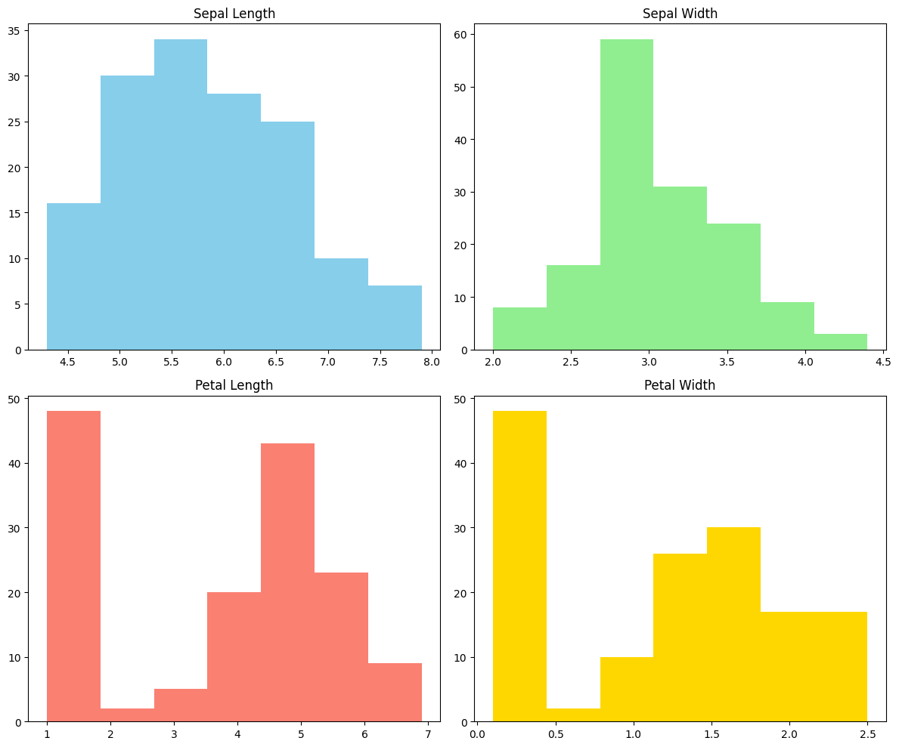
Outputs and Results

Slide 8
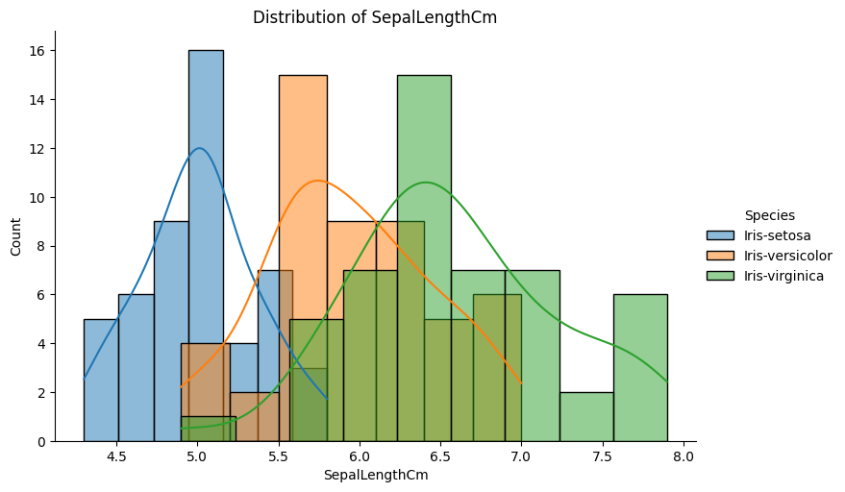
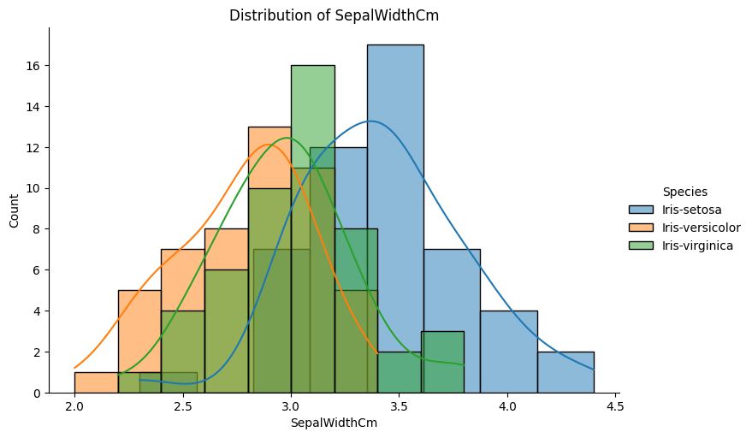
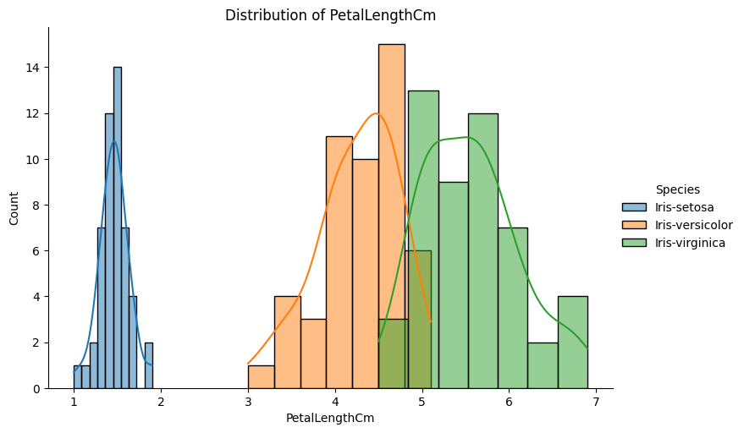
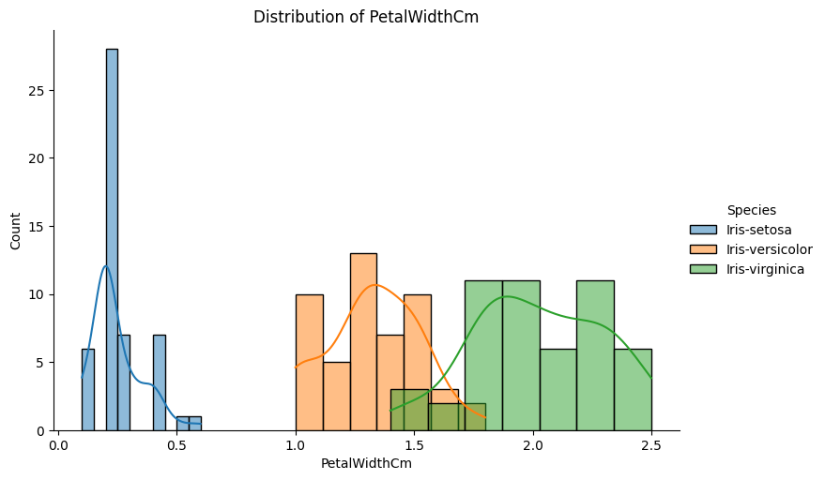

Slide 9
Tools, Software, and Libraries
Tool / Library | Purpose
Python | Primary programming language
Pandas | Data manipulation and analysis
NumPy | Numerical operations
Matplotlib/Seaborn | Visualization of distributions, correlations, etc.
Scikit-learn | Model training, splitting data, evaluation metrics
Jupyter Notebook | Interactive coding and report documentation

Slide 10
References and Bibliography
UCI Machine Learning Repository: Iris Dataset
Official Scikit-learn documentation
GitHub repository: Apaulgithub/oibsip_taskno1
Unified Mentor Documentation

