Slide 1
Julien
Who is he ?

Slide 2

Let me introduce him

Slide 3

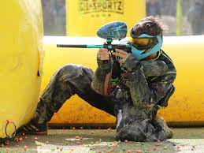
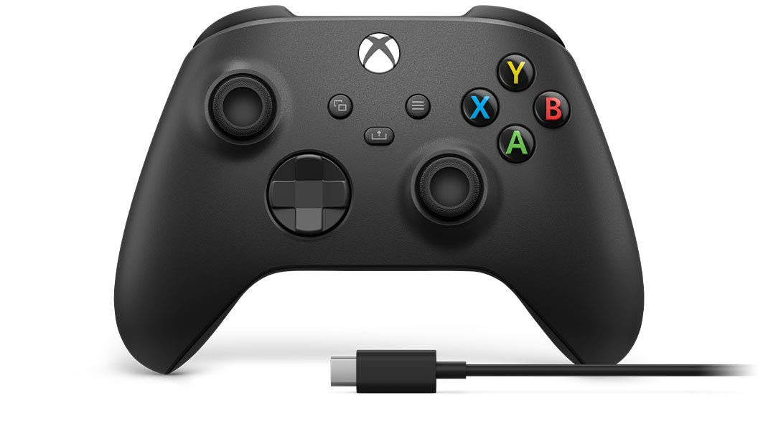
BAckground
Mechanic
Paintball
Video Game

Slide 4


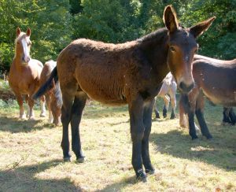
Strenght and flaws
Enthusiatic
Good teammate
Blinkered

Slide 5

IT
Stages

Slide 6

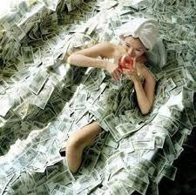

Futur
Professional Title
Make a lot of money
Research Company

