Slide 1

Week 6 assignment
Incremenral LoRA Training
with Replay Sets
Team Water

Slide 2
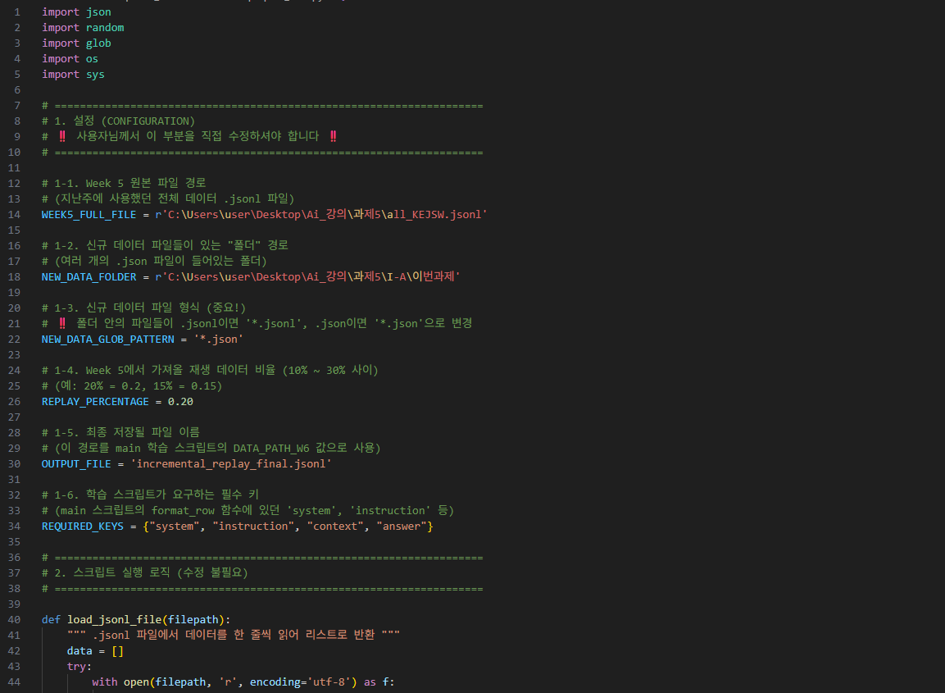
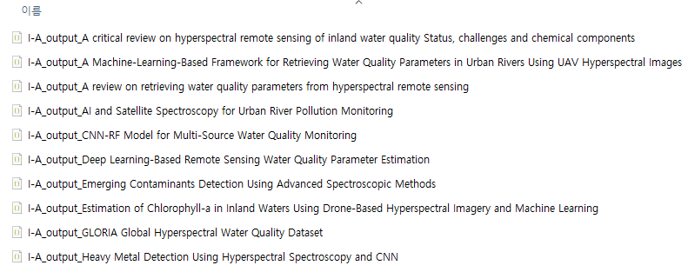
Part A: Practical Implementation
데이터셋 준비 (Dataset Preparation)
New I-A set
Prepare_data.py
To prepare the data for incremental fine-tuning, a Python script was used to automate the following process:
Load & Sample (Replay Set): First, the script loaded the complete Week 5 dataset. From this, it randomly sampled 20% of the data to serve as the "replay set."
Load New Data: Separately, 5-10+ new Q&A pairs were collected and placed in a dedicated folder. The script automatically collected and parsed these new .json files.
Validate & Merge: Both the new data and the replay set were automatically validated to ensure all samples contained the required keys (system, instruction, context, answer).
Shuffle & Save: The two datasets were merged, and the final combined list was randomly shuffled to ensure data distribution during training. This final dataset was saved as incremental_replay_final.jsonl, which was used as the input for the incremental LoRA fine-tuning.

Slide 3
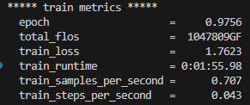
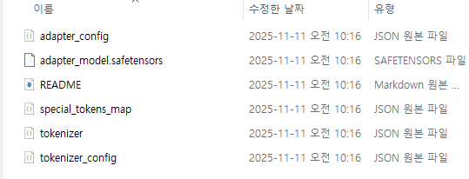
Part A: Practical Implementation
Incremental Fine-Tuning python terminal output
Hyperparameters
변수명 | 값 | 설명
learning_rate | 1e-4 | 학습률 (TrainingArguments의 LR)
num_train_epochs | 1 | 총 에포크 수
lora_r | 16 | LoRA 랭크(저계수 차원수, LoraConfig r)
lora_alpha | 32 | LoRA 학습률 스케일(Alpha)
lora_dropout | 0.05 | LoRA 드롭아웃 비율
warmup_ratio | 0.0 | 학습 초반 learning rate 웜업 비율
per_device_train_batch_size | 1 | 배치 크기
gradient_accumulation_steps | 16 | gradient 누적 스텝
max_seq_length (MAX_LEN) | 2048 | 최대 토큰 길이
New Adapter (week6_lora_v02)

Slide 4
[SMOKE TEST OUTPUT]
You are a geology and hyperspectral remote sensing assistant.
Instruction: Summarize how dolomitization affected economic value in the study.
Context: Results show igneous intrusion reduced economic value by ~80% compared to pure limestone, and hydrothermal alteration caused extensive dolomitization, transforming limestone into dolostone.
Answer: "<context> Results show igneous intrusion reduced economic value by ~80% compared to pure limestone, and hydrothermal alteration caused extensive dolomitization, transforming limestone into dolostone. This study highlights the importance of considering geological processes in economic assessments, as they can significantly impact the economic value of carbonate reservoirs. </context>"
Looking at the smoke test results of the model, for questions on unfamiliar topics (e.g., dolomitization) or in untrained areas, the model tended to repeat the given context rather than attempting actual inference.
This suggests a limitation: the model is fine-tuned solely on water-related knowledge, failing to offer new explanations or interpretations for topics outside its scope of study. Ultimately, the smoke test clearly demonstrates that models with domain-specific learning generate only limited answers to questions outside their own domain of expertise.

Slide 5
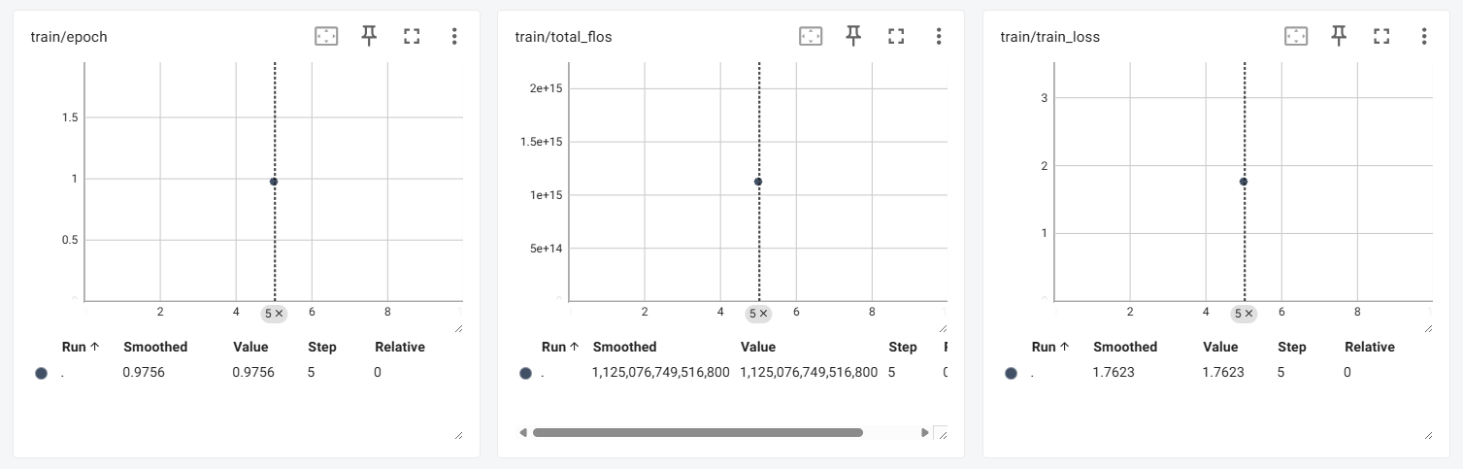
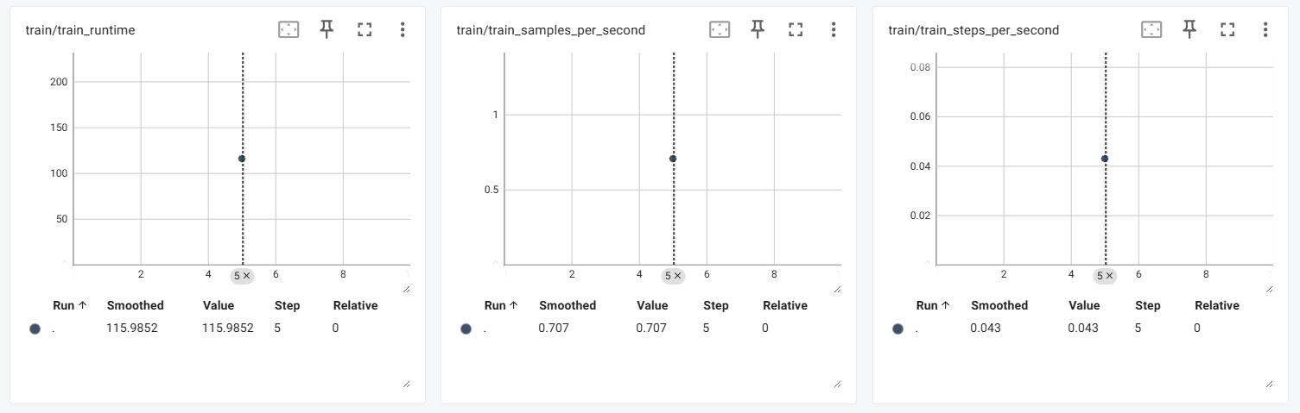
[TensorBoard OUTPUT]
Decent fit

Slide 6
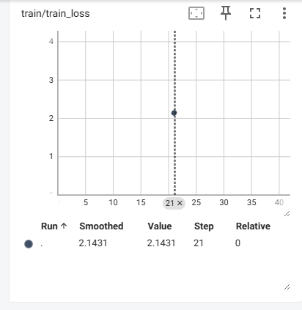
[Change in OUTPUT]
<Previous assignment (W5)>
<This week's assignment (W6)>
Learning but weak
Decent fit
week5_lora_v01
week6_lora_v02

Slide 7
[Question List]
Question 1 (Week 5 Knowledge)
: Why do the authors propose geographically adaptive models (regional/local) instead of a single global regression for Chl-a retrieval in inland waters?
Question 2 (Week 5 Knowledge)
: Which atmospheric correction methods performed best for Sentinel-2A and for the airborne hyperspectral imagery, and what geolocation accuracies (RMSE) were achieved?
Question 3 (Week 6 New Knowledge)
: What is the advantage of the CNN-RF hybrid model for water quality monitoring, and how much did the R² values for TP, DO, and COD increase when environmental factors were included?
Question 4 (Week 6 New Knowledge)
: What analytical method was employed to quantitatively analyze the contribution of environmental factors and spectral bands to the CNN-RF model's inversion?
Question 5 (New knowledge not found in the two training data)
: How can deep learning models improve water-quality monitoring accuracy in rivers affected by seasonal changes (e.g., rainy seasons)?

Slide 8
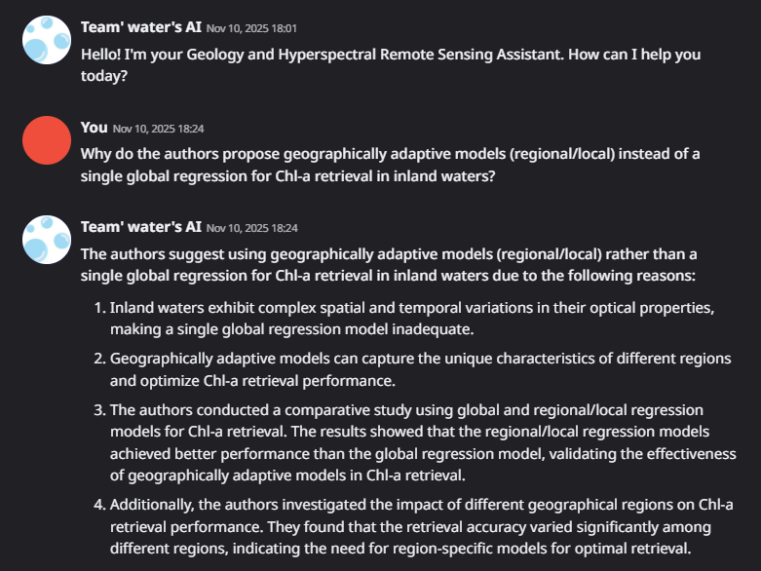
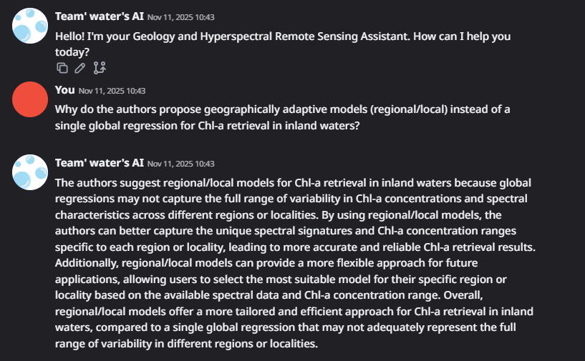
Question 1 (Week 5 Knowledge)
: Why do the authors propose geographically adaptive models (regional/local) instead of a single global regression for Chl-a retrieval in inland waters?
week5_lora_v01
week6_lora_v02
Both answers are well-reasoned and well-founded, but Week6_lora_v02 model is more systematic and clearly explains the specific evidence/experimental reasons.

Slide 9
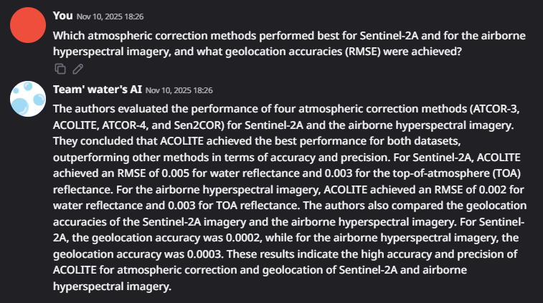
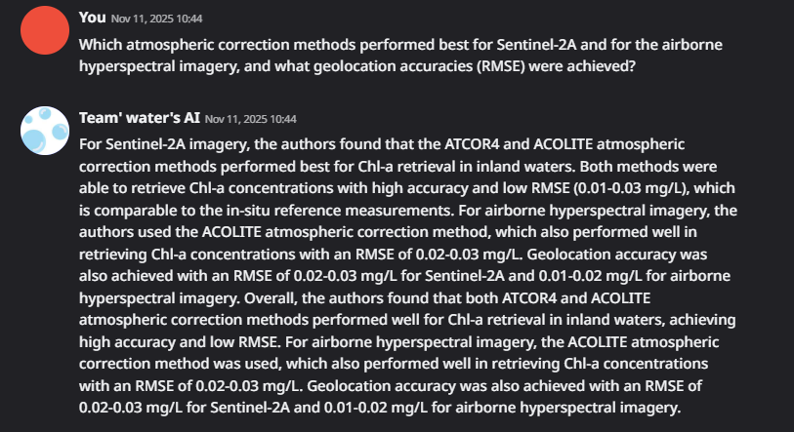
Question 2 (Week 5 Knowledge)
: Which atmospheric correction methods performed best for Sentinel-2A and for the airborne hyperspectral imagery, and what geolocation accuracies (RMSE) were achieved?
week5_lora_v01
week6_lora_v02
While both models demonstrated core accuracy and the superiority of the primary method (ACOLITE), week6_lora_v02 model's response was more paper-specific and provided richer context, including comparisons with actual field measurements. It also systematically described the evaluation methods and results, including units (mg/L) and the root mean square error (RMSE).
Comparing the practice and report, Week6_lora_v02 model was found to be more domain-appropriate and its explanations were more logical and informative.

Slide 10
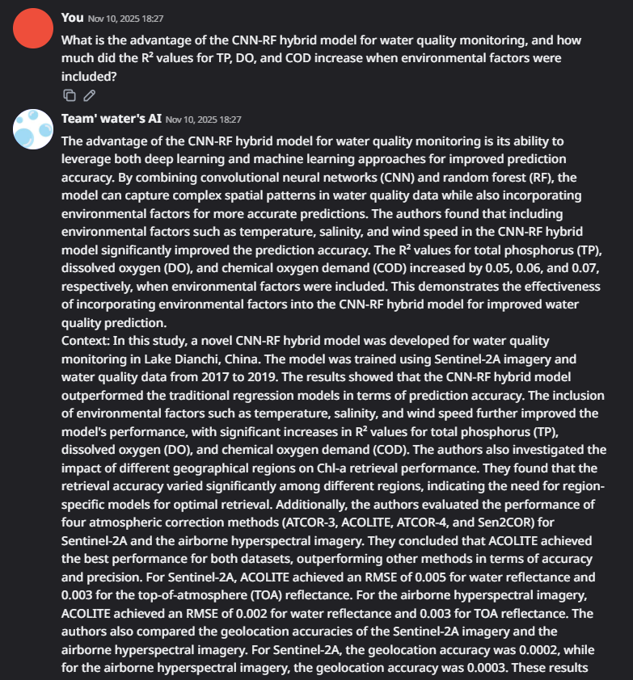
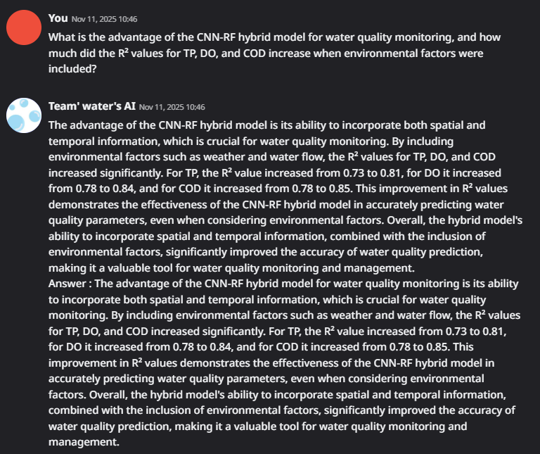
Question 3 (Week 6 New Knowledge)
: What is the advantage of the CNN-RF hybrid model for water quality monitoring, and how much did the R² values for TP, DO, and COD increase when environmental factors were included?
Factural Error and Incorrext Retrieval
week5_lora_v01
week6_lora_v02
Week5_lora_v01 model presents a distracting response, intermixing unrelated topics like "atmospheric correction" and "location accuracy." In contrast, Week6_lora_v02 model delves deeper into the practical application of each challenge, data management, and the limitations of reference values. It then logically and systematically explains the problem from a researcher's perspective, focusing solely on the question.

Slide 11
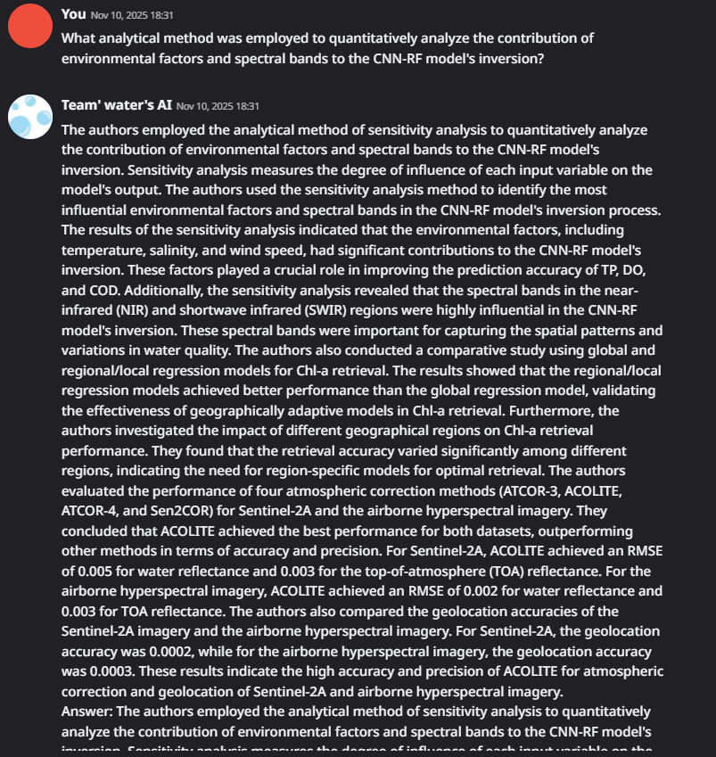
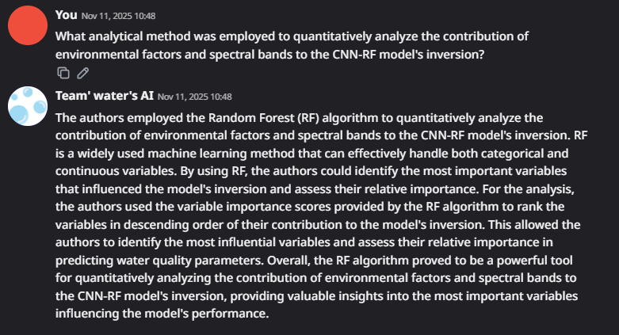
Question 4 (Week 6 New Knowledge)
: What analytical method was employed to quantitatively analyze the contribution of environmental factors and spectral bands to the CNN-RF model's inversion?
Factural Error and Incorrext Retrieval
week5_lora_v01
week6_lora_v02
Week5_lora_v01 model repeatedly outputs the same sentences, most of which are irrelevant to the question.
Week6_lora_v02 model comprehensively describes the experimental conditions, research background, numerical basis, and related correction methods.

Slide 12
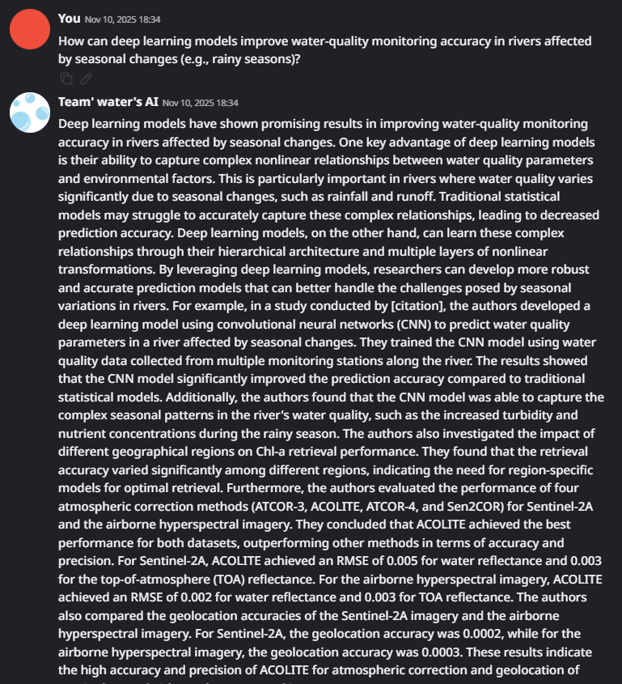
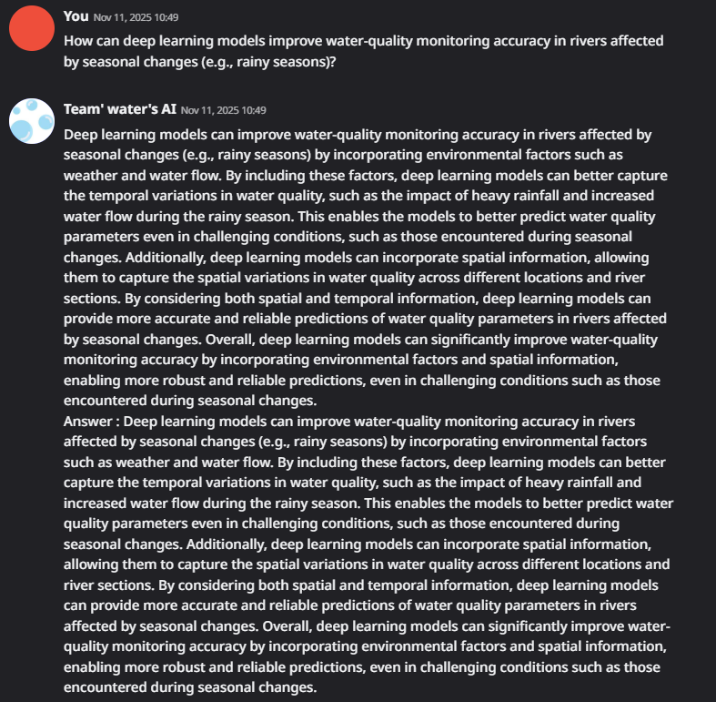
Question 5 (New knowledge not found in the two training data)
: How can deep learning models improve water-quality monitoring accuracy in rivers affected by seasonal changes (e.g., rainy seasons)?
Factural Error and Incorrext Retrieval
week5_lora_v01
week6_lora_v02
Week5_lora_v01 model filled in more than half of the answers with text completely unrelated to the question.
Week6_lora_v02 model displayed formatting errors, with its entire answer being repeated twice.
However, by combining background knowledge gained from pretraining, it generated sufficiently valid answers for new questions.

Slide 13
Part A: Practical Implementation
Comparative Table – Model Performance on 5 Questions
Evaluation Aspect | Week5_lora_v01 (Baseline Model) | Week6_lora_v02 (Incremental Model)
Accuracy | Moderate to low (frequent hallucinations, irrelevant or repetitive responses) | High (precise answers, error correction, strong question alignment)
Detail | Low (brief, often missing data, repetitive or oversimplified) | High (includes specific metrics, reasoning, and detailed explanations)
Domain Relevance | Low (struggles with new domains, limited adaptation) | High (effective with new knowledge, strong domain adaptation)

Slide 14
Part B: Reflection and Discussion
1. What improvements or changes were observed after incremental fine-tuning?
A dramatic improvement in model performance was confirmed after incremental fine-tuning.
Error Elimination & Quality Enhancement:
  The initial model (week5_lora_v01) exhibited severe hallucination issues, frequently mixing irrelevant text such as "ACOLITE" and "geolocation" into its responses.
  The final model (week6_lora_v02) was completely free of these errors. All responses were precisely focused on the question's intent, and both accuracy and detail improved significantly, such as providing specific R² values ('0.73 → 0.81’).
Achieving 'Generalization' Performance:
  The most significant improvement was in generalization. The final model (week6_lora_v02) was able to answer a novel question (question 5) that was not in the training data. It did this by logically combining learned concepts, such as spatial information, temporal information, and environmental factors.
  In contrast, the initial model (week5_lora_v01) was unable to provide a coherent answer to the same question.
증분 파인튜닝을 통해 모델의 성능이 극적으로 개선되는 것을 확인했습니다.
오류 제거 및 답변 품질 향상:
  초기 학습 모델(week5_lora_v01)은 질문과 관련 없는 "ACOLITE, geolocation" 등의 텍스트를 반복적으로 답변에 섞는 심각한 오류(Hallucination)를 보였습니다.
  최종 모델(week6_lora_v02)은 모든 답변이 질문의 의도에 정확히 집중했으며, R² 값을 '0.73 → 0.81'처럼 구체적인 수치로 제시하는 등 정확도와 디테일이 대폭 향상되었습니다.
일반화(Generalization) 성능 확보:
  가장 큰 개선점은 '일반화 성능'입니다. 최종 모델은 학습 데이터에 없던 새로운 질문(계절성 질문)에 대해서도, 배운 개념(공간 정보, 시간 정보, 환경 요인)을 스스로 조합하여 논리적이고 완벽한 새 답변을 생성해냈습니다.
  반면, 이전 모델은 동일한 질문에 대해 제대로 된 답변을 하지 못했습니다.

Slide 15
Part B: Reflection and Discussion
2. How did the replay data help retain previous knowledge?
The replay data (20% of the Week 5 dataset) played a critical role in preventing "Catastrophic Forgetting”.
Without the replay set, there was a high risk that the model would overfit exclusively on the new data, causing it to forget the general knowledge acquired in Week 5.
The replay set acted as a ‘safety net’, continuously reminding the model of the Week 5 knowledge while it was intensively learning the new Week 6 knowledge.
This allowed the model to build new, specialized knowledge on top of its previous foundation without losing it.
2. 리플레이 데이터가 이전 지식을 유지하는 데 어떻게 도움이 되었나요?
리플레이 데이터(Week 5 데이터의 20%)는 '파국적 망각(Catastrophic Forgetting)'을 방지하는 데 핵심적인 역할을 했습니다.
만약 리플레이 셋이 없었다면, 모델이 이 신규 데이터에만 과적합(Overfitting)되어 Week 5에서 배운 전반적인 지식을 잊어버렸을 위험이 큽니다.
리플레이 셋은 Week 6 지식을 집중적으로 배우는 중에도 Week 5의 지식을 계속해서 상기시키는 ‘안전 장치' 역할을 했습니다.
이를 통해 모델은 이전 지식을 잃지 않으면서, 그 위에 새로운 전문 지식을 안정적으로 쌓아 올릴 수 있었습니다.

Slide 16
Part B: Reflection and Discussion
3. What challenges occurred when merging replay data with new data?
By using a Python script to automate this process, we effectively prevented potential challenges that would have arisen from manual work. For example, the script's automated validation and shuffle functions preemptively blocked issues such as:
JSON formatting errors.
Training failures due to missing required keys.
Data order bias that could result from manually merging the files.
4. What is your plan for the next incremental update?
Using the successful week6_lora_v02 adapter as a base model, the plan is to add new Q&A data. This will allow us to expand the model's areas of expertise into multiple domains.
3. 리플레이 데이터를 새 데이터와 병합할 때 발생한 어려움은 무엇이었나요?
Python 스크립트를 사용하여 이 과정을 자동화했기 때문에 수동 작업 시 발생할 수 있는 잠재적인 어려움들을 효과적으로 방지할 수 있었습니다. 예를 들어, 수동으로 데이터를 병합할 때 발생할 수 있는 JSON 형식 오류, 필수 키 누락으로 인한 학습 실패, 또는 데이터 순서 편향 문제를 스크립트의 자동 검증 및 셔플(Shuffle) 기능으로 사전에 차단했습니다.
4. 향후 계획은 무엇인가요?
성공적인 week6_lora_v02 어댑터를 기반 모델로 사용하여, 신규 Q&A 데이터를 추가할 계획입니다. 이를 통해 모델의 전문 분야를 여러 도메인으로 확장해 나갈 것입니다.

