Slide 1

Week 7 assignment
Advanced system prompts and prompt chaining
Team Water

Slide 2
Chain-of-Thought Prompting(CoT) ?
A prompting technique that encourages the LLM to generate intermediate reasoning steps—similar to human problem-solving—when producing an answer.
It guides the model to respond in the structure of problem → reasoning process → conclusion, thereby improving logical stability, accuracy, and explanatory clarity.
LLM에게 문제를 해결할 때 인간처럼 중간 추론 과정(step-by-step reasoning)을 출력하도록 유도하는 프롬프트 기법, 문제 → 사고 과정 → 결론 의 형태로 출력하게 만들어 논리적 안정성, 정확성, 설명력을 높임
Zero-shot CoT
Few-shot CoT
Least-to-Most prompting
Self-consistency CoT
Program-of-Thoughts
Tree-of-Thoughts
Multimodal CoT
Graph-of-Thoughts
Zero-shot CoT
Multimodal CoT
Least-to-Most prompting
가 대표적으로 사용됨
. . . etc

Slide 3
Zero-shot
A technique that induces the model to generate its own reasoning steps simply by adding a phrase like “Let’s think step by step,” without providing explicit examples.
예시를 제시하지 않고, “Let’s think step by step” 같은 문구만으로 모델 스스로 추론 과정을 생성하게 만드는 기법
It is the simplest form of CoT prompting.
It requires no examples (no few-shot).
It can activate CoT reliably while remaining fast and lightweight.
[Problem input]
[zero-shot CoT]
“Let’s think step by step”
Example Prompt:
“Let’s think step by step”
→ The model itself generates the intermediate reasoning steps.
[Model generates
its own intermediate reasoning]
[Produces the final answer]

Slide 4
Least-to-Most
Breaking a difficult problem into smaller sub-problems (decomposition) → solving each sub-problem sequentially → deriving the final conclusion
어려운 문제를 작은 하위 문제로 분해(decomposition) →하위 문제를 순차적으로 해결 → 최종 결론 도출
This is the most logically stable form among Chain-of-Thought methods.
It strengthens the model’s ability to decompose complex problems.
Very effective for tasks involving long-term planning, logical reasoning, multi-step mathematics, or code design.
[Given a complex problem]
[Request for decomposition]
“Break the problem down and solve it step by step.”
Example Prompt:
Step 1: Break the problem into smaller sub-problems.
Step 2: Solve each sub-problem.
Step 3: Combine the results to derive the final answer.
[Solve each sub-task(1)]
[Solve each sub-task(2)]
[Combine partial results into the final answer]
[Produces the final answer]

Slide 5
Multimodal
This approach integrates text + visual information (e.g., images, graphs, maps, tables) to produce a combined visual reasoning + language reasoning chain of thought.
텍스트 + 이미지(또는 그래프, 지도, 표 등) 정보를 통합해서 시각적 reasoning + 언어적 reasoning을 CoT로 표현하는 방식.
Highly effective for image interpretation, graph reading, table analysis, and map understanding
Follows the structure:
“Interpret the visual input → step-by-step reasoning → final answer”
Rapidly advancing with the rise of modern multimodal LLMs
[Image]
[Text]
[Visual information]
[Integrated language–vision analysis]
Example Prompt:
Give the model a map and some text, and ask:
“Explain the route selection process step by step.”
Show a graph trend and ask:
“Explain, step by step, why this change occurs.”
[Step-by-step reasoning]
[Produces the final answer]

Slide 6
Differences
CoT | Least-to-Most | Multimodal | Zero-shot
개념 | 중심 문제를 하위 문제로 분해해 단계적으로 해결 | 텍스트+이미지 등 기반 reasoning | 예시 없이 단순한 문구로 CoT 활성화
역할 | 고난도 문제를 구조적으로 해결 | 시각적+언어적 reasoning 통합 | 예시 없이도 모델이 단계적 reasoning을 생성하도록 유도
장점 | 복잡한 reasoning 문제에서 효과적인 경향이 있음 | 시각적+언어적 정보를 함께 활용해 더 정교한 reasoning 가능 | 간단하고 빠르게 적용가능
단점 | 프롬프트가 길어짐 | 멀티모달 모델 필요 + 입력 모달 간 alignment 문제가 발생 가능 | 복잡한 문제에서 reasoning 오류가 발생할 수 있음
적용 분야 | 코드 설계/장문 논리 분석 | 그래프/표/지도 등 해석 | 수학/논리 기반 문제 전반
대표 prompt | 문제를 분해해서 각 단계별로 해결해라 | 이미지를 보고 단계적으로 설명해라 | Let’s think step by step.

Slide 7
Differences
CoT Type | Least-to-Most | Multimodal | Zero-shot
Concept | Breaks a complex problem into smaller sub-problems and solves them step-by-step | Performs reasoning based on text + images (or graphs/maps/tables) | Activates CoT using a simple phrase without examples
Role | Solves difficult problems in a structured, decomposition-based manner | Integrates visual + linguistic reasoning | Encourages the model to generate step-by-step reasoning without examples
Strengths | Very effective for complex reasoning tasks | Can use both visual & textual information → more precise reasoning | Simple, fast, and easy to apply
Limitations | Prompts can become long | Requires a multimodal model; input–modality alignment issues may occur | May generate reasoning errors for complex problems
Typical Applications | Code design, logical analysis of text | Graph/table/map interpretation | Math and logic reasoning in general
Representative Prompt | “Break the problem into smaller steps and solve each step.” | “Look at the image and explain step-by-step what is happening.” | “Let’s think step by step.”

Slide 8
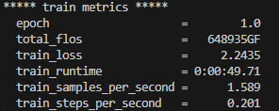
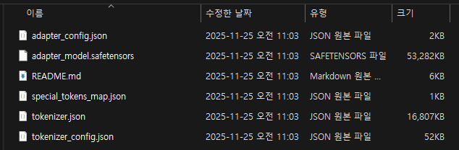
Incremental Fine-Tuning python terminal output
Hyperparameters
변수명 | 값 | 설명
learning_rate | 1e-4 | 학습률 (TrainingArguments의 LR)
num_train_epochs | 1 | 총 에포크 수
lora_r | 16 | LoRA 랭크(저계수 차원수, LoraConfig r)
lora_alpha | 32 | LoRA 학습률 스케일(Alpha)
lora_dropout | 0.05 | LoRA 드롭아웃 비율
warmup_ratio | 0.0 | 학습 초반 learning rate 웜업 비율
per_device_train_batch_size | 1 | 배치 크기
gradient_accumulation_steps | 16 | gradient 누적 스텝
max_seq_length (MAX_LEN) | 2048 | 최대 토큰 길이
New Adapter (week7_lora_v03)

Slide 9
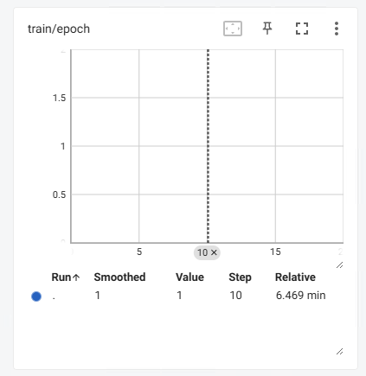
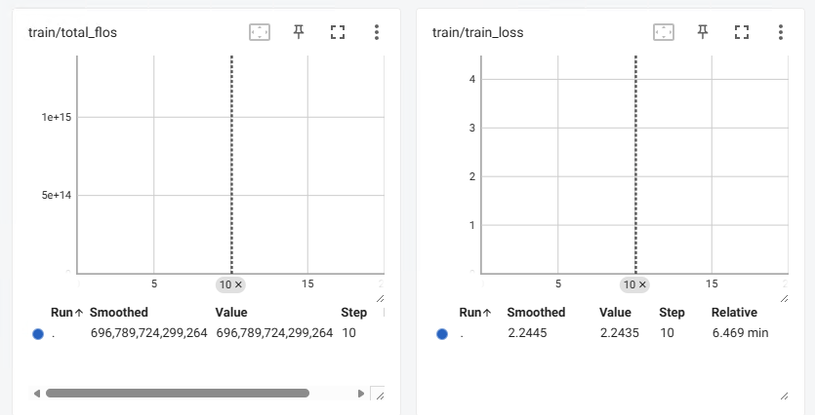
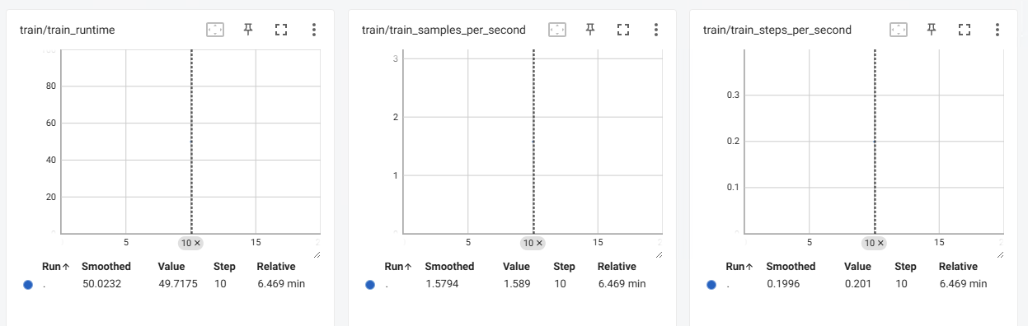
[TensorBoard OUTPUT]

Slide 10
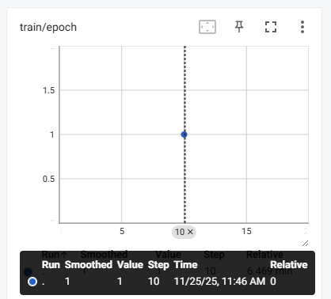
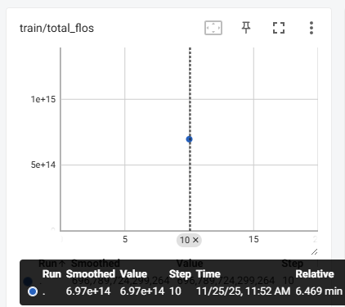
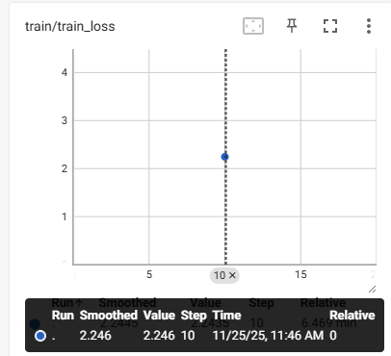
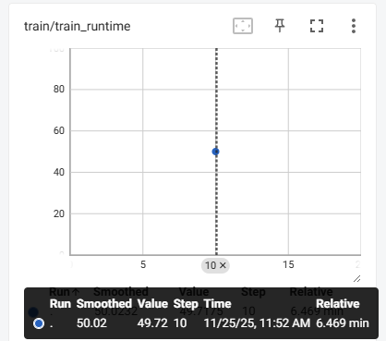

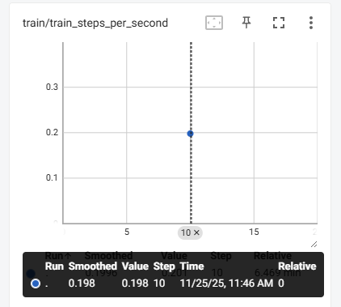
[TensorBoard OUTPUT]

Slide 11
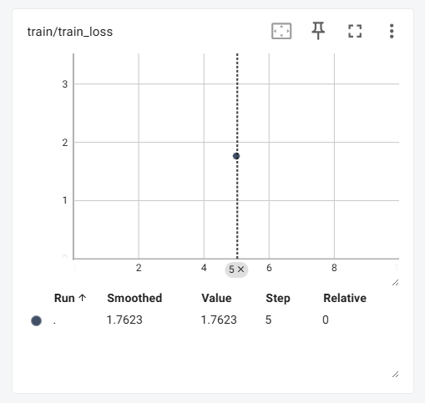
<This week's assignment (W6)>
<This week's assignment (W7)>
Decent fit
week6_lora_v02
week7_lora_v03
The higher train loss observed in Week 7 compared to Week 6 is likely due to the model being exposed to a larger proportion of new and diverse instruction–answer patterns.

Slide 12
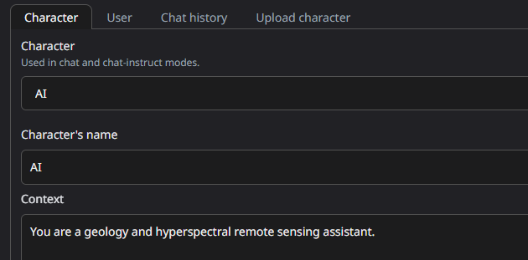
Prompt Chaining Test
You are a geology and hyperspectral remote sensing assistant. When answering, follow these steps:
1. Analyze the question.
2. Break down the relevant information into key factors.
3. Perform logical reasoning step-by-step.
4. Then provide the final concise answer.
Normal
With Chaining

Slide 13
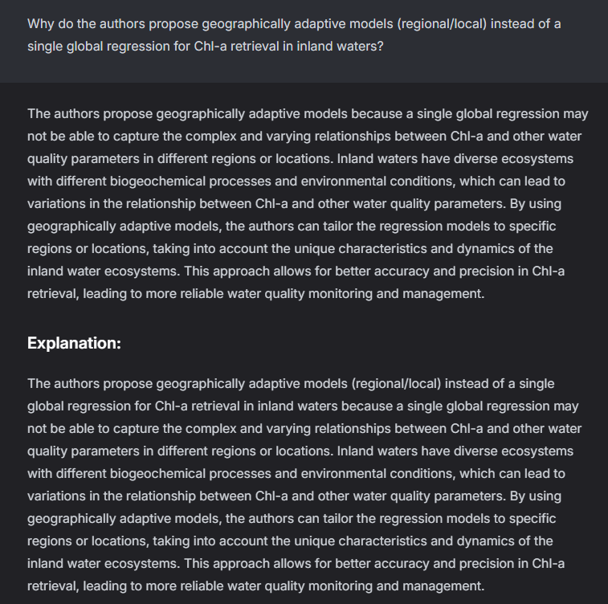
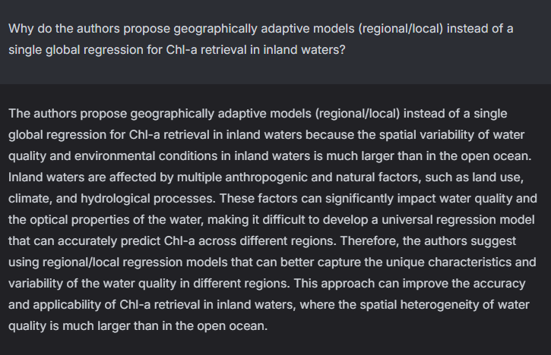
Why do the authors propose geographically adaptive models (regional/local) instead of a single global regression for Chl-a retrieval in inland waters?
Normal
week6_lora_v02
week7_lora_v03

Slide 14
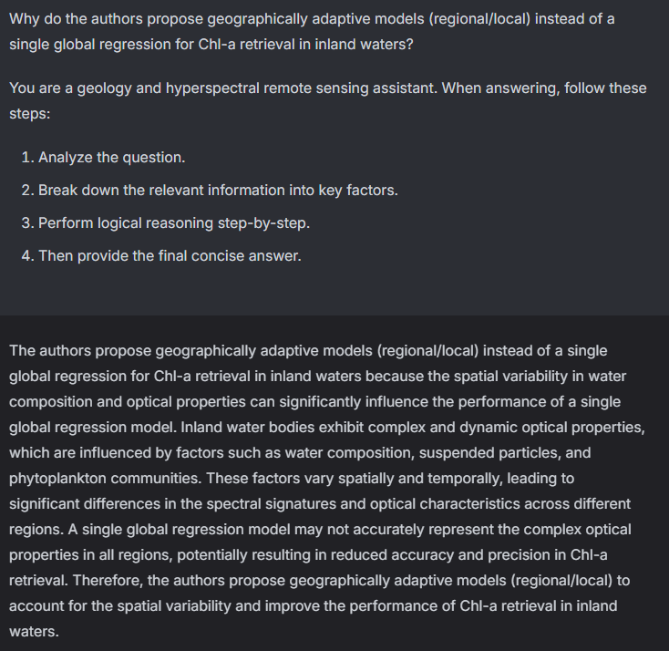
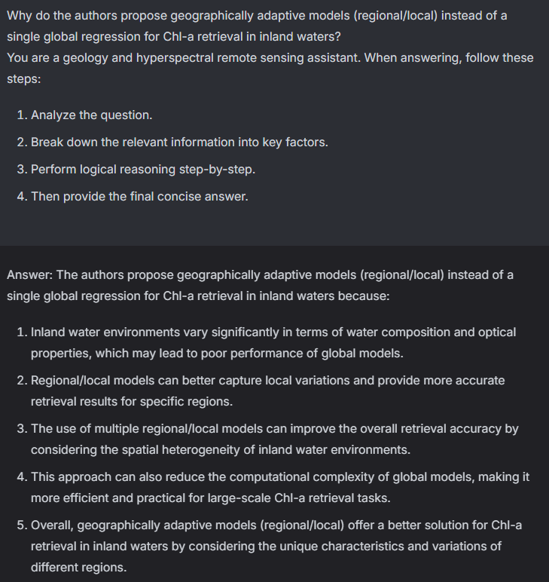
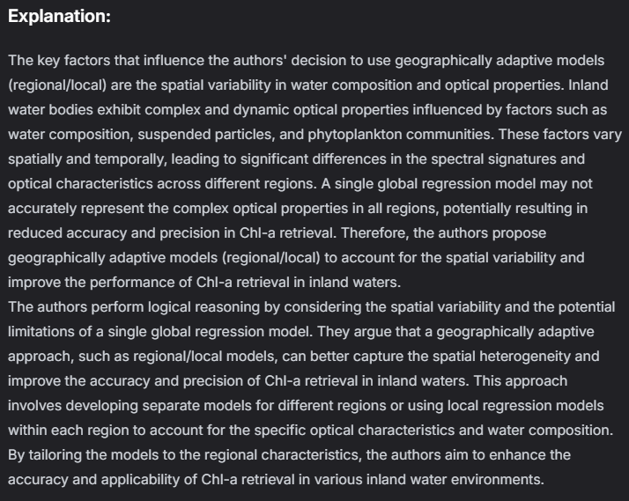
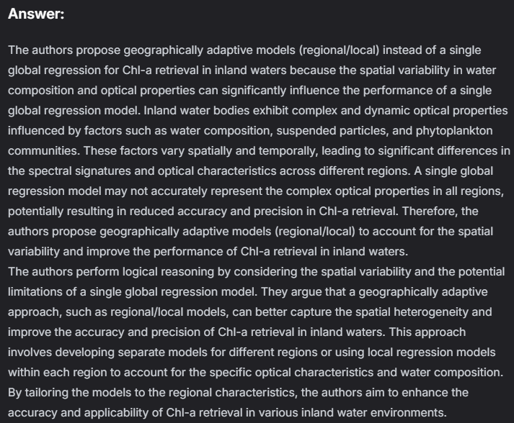

Why do the authors propose geographically adaptive models (regional/local) instead of a single global regression for Chl-a retrieval in inland waters?
With chaining
week6_lora_v02
week7_lora_v03

Slide 15
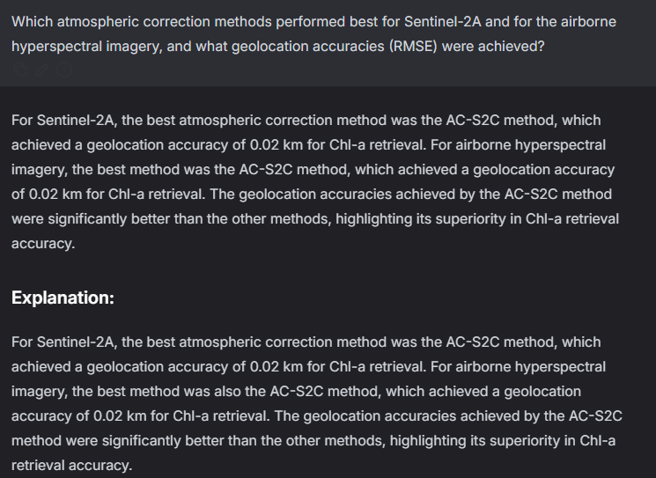
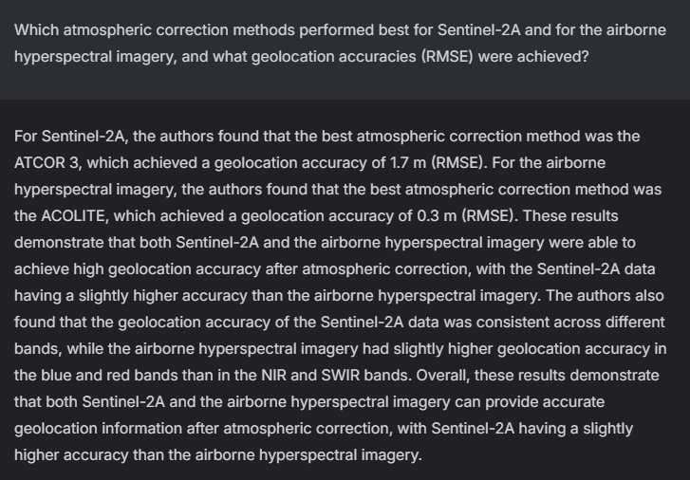
Normal
Which atmospheric correction methods performed best for Sentinel-2A and for the airborne hyperspectral imagery, and what geolocation accuracies (RMSE) were achieved?
week6_lora_v02
week7_lora_v03

Slide 16
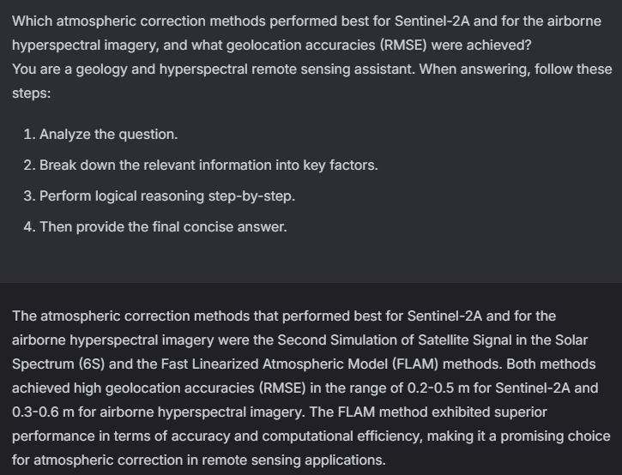
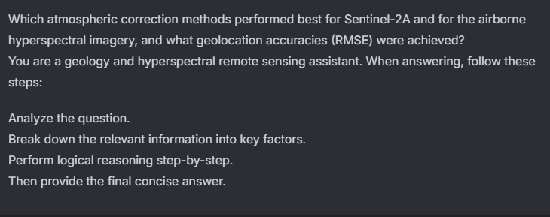
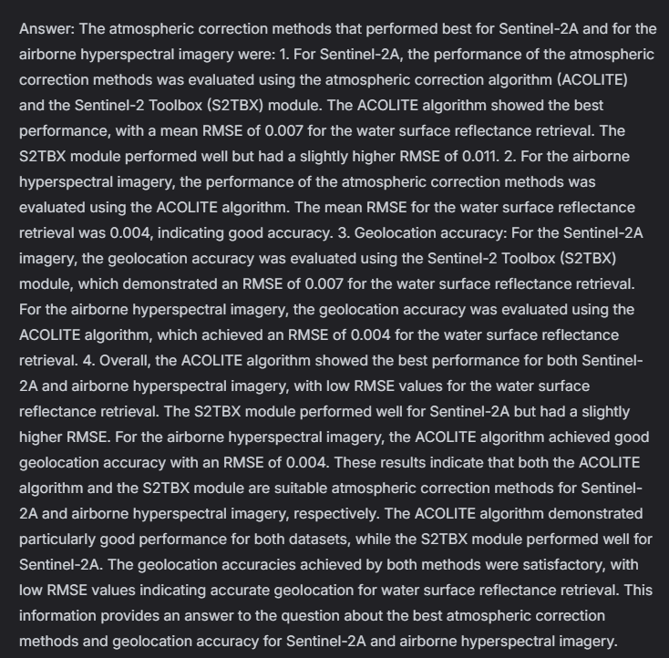
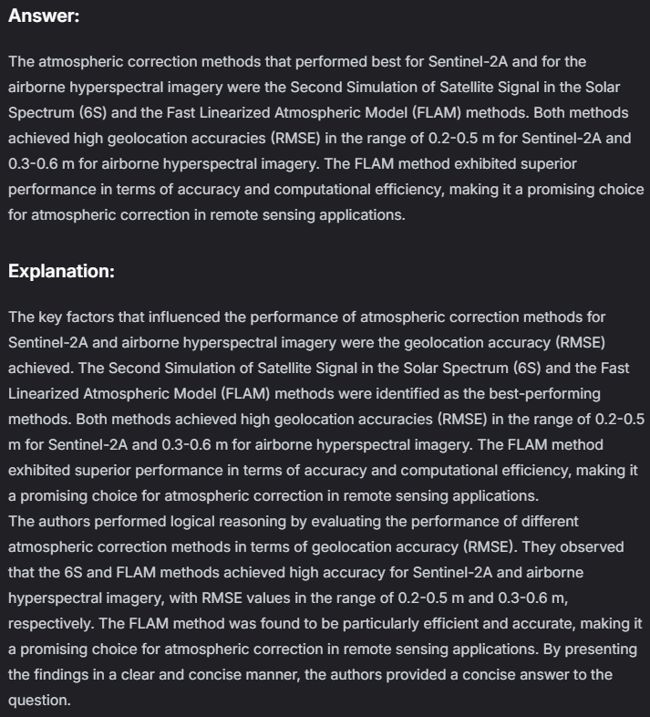
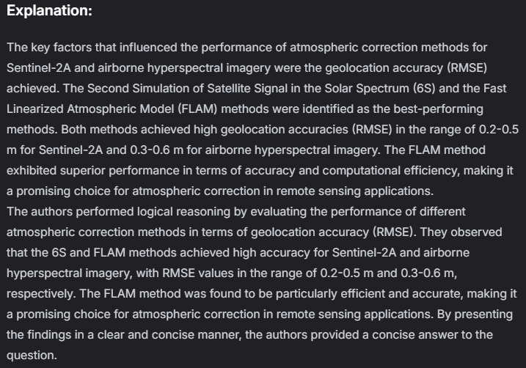
With chaining
Which atmospheric correction methods performed best for Sentinel-2A and for the airborne hyperspectral imagery, and what geolocation accuracies (RMSE) were achieved?
week6_lora_v02
week7_lora_v03

Slide 17
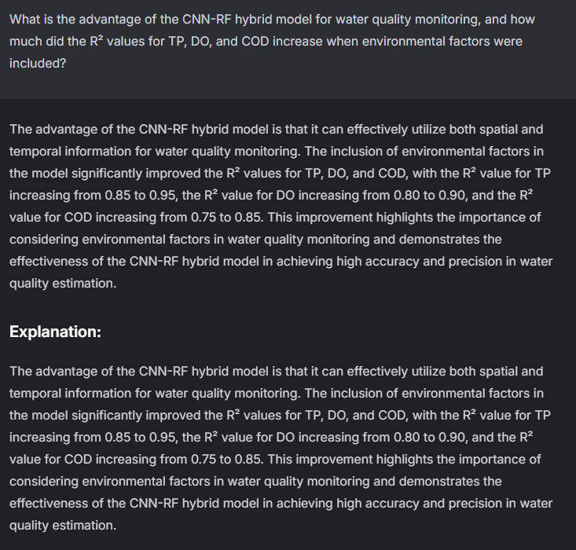
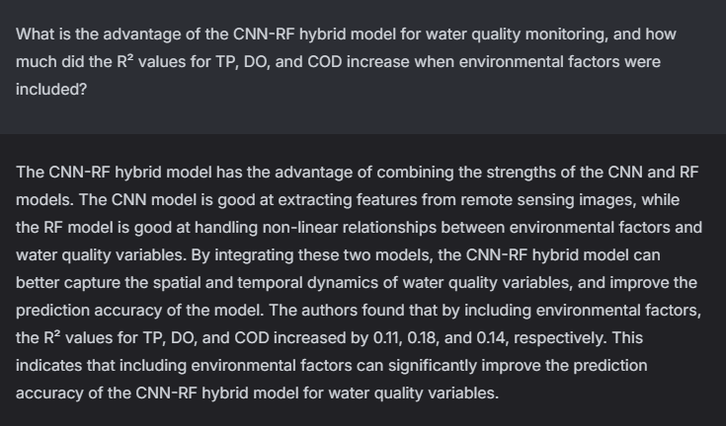
Normal
What is the advantage of the CNN-RF hybrid model for water quality monitoring, and how much did the R² values for TP, DO, and COD increase when environmental factors were included?
week6_lora_v02
week7_lora_v03

Slide 18
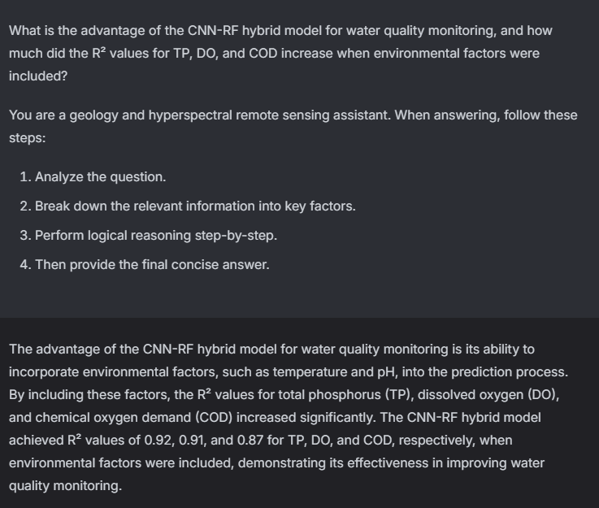
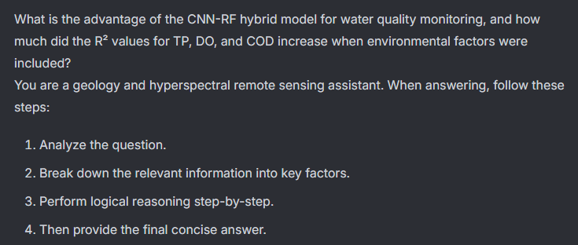
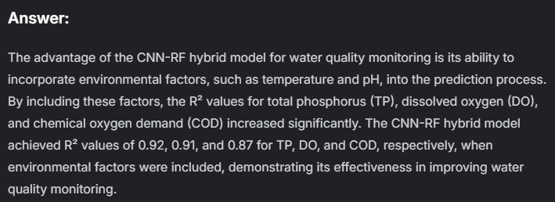
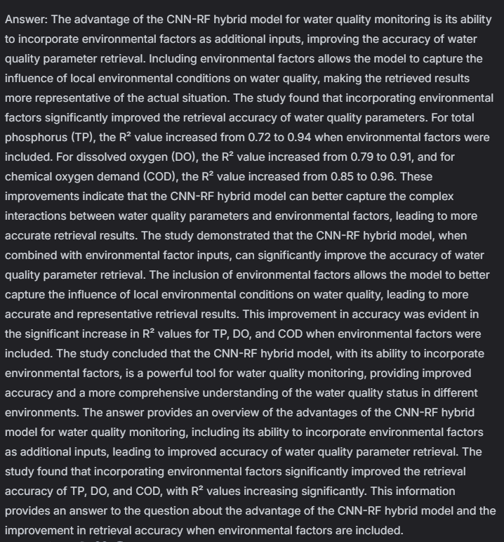
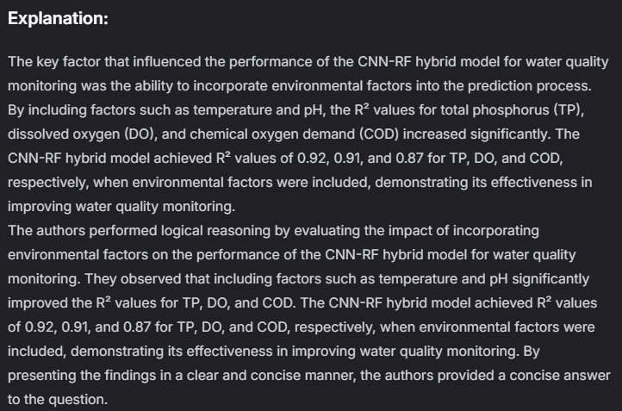
With chaining
What is the advantage of the CNN-RF hybrid model for water quality monitoring, and how much did the R² values for TP, DO, and COD increase when environmental factors were included?
week6_lora_v02
week7_lora_v03

Slide 19
Practical Implementation
Adapter | Prompt Type | Reasoning Quality | Accuracy | Notes
Week6 | Normal | Moderate | Moderate | Short answers, hallucinations, weak reasoning
Week6 | With Chaining | High | High | Best performance; clear reasoning, high accuracy, stable
Week7 | Normal | Low | Low | lower accuracy & domain grounding, but reasoning unstable
Week7 | With Chaining | Moderate to low | Moderate to low | Structured but shallow reasoning; improved clarity

