Slide 1
Assignment 1
leekyoungeun

Slide 2
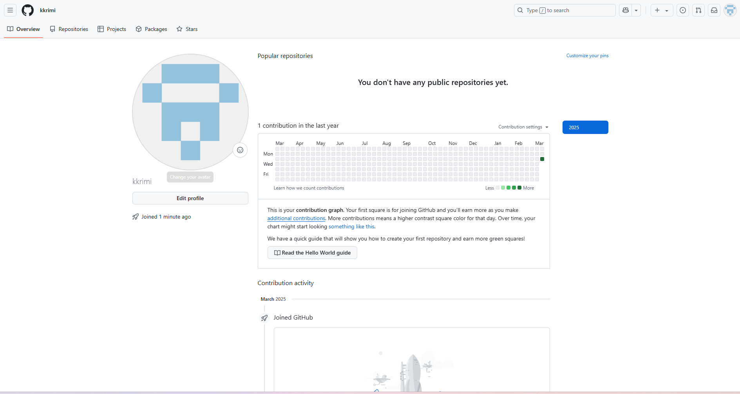
A

Slide 3
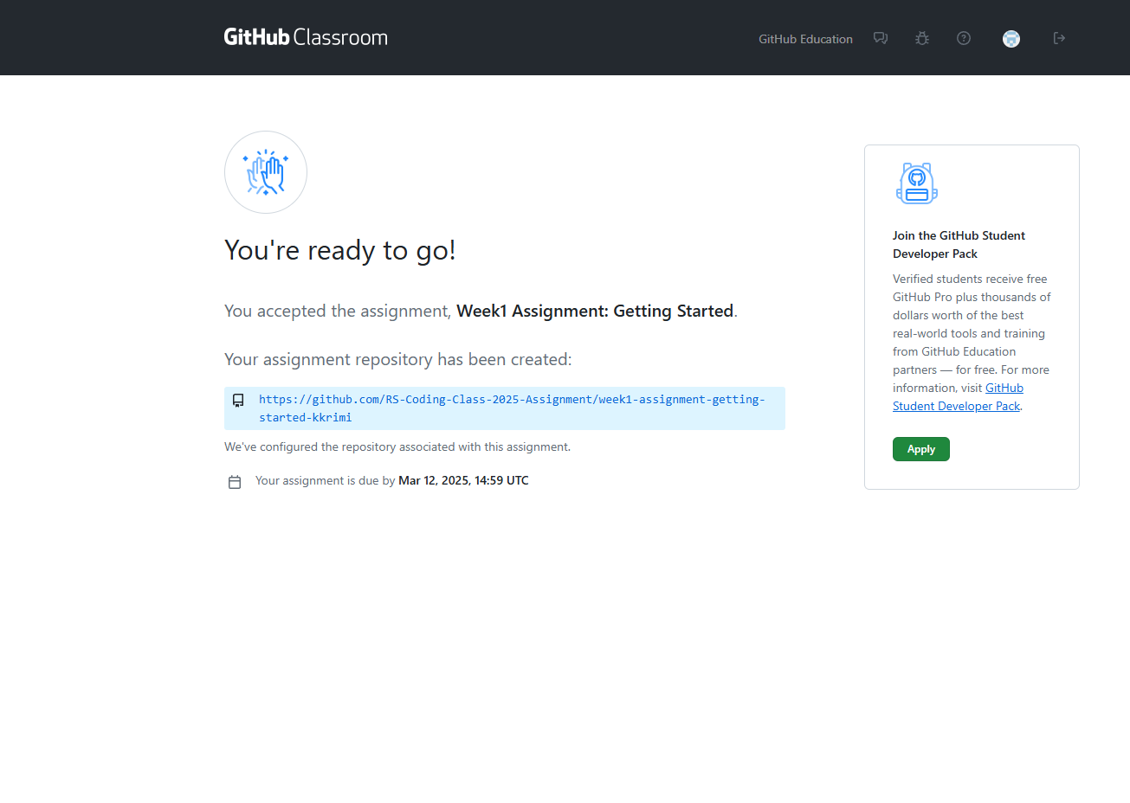
B

