Slide 1
Python Programming for Remote Sensing and Image processing 2
THE NEXT STEP

Slide 2
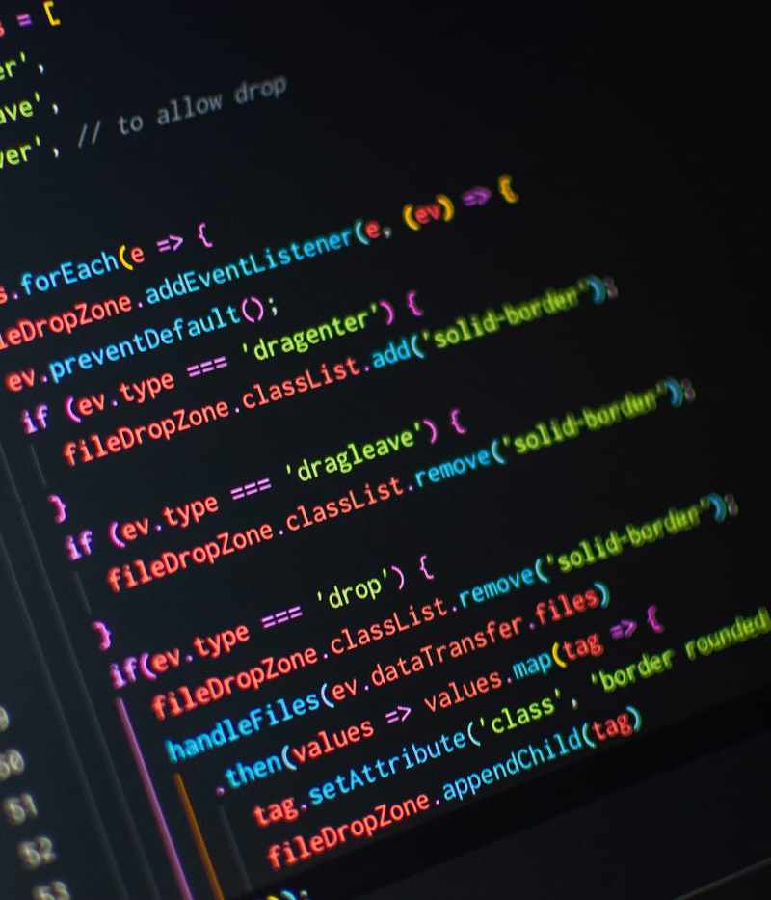
Course description
Recap key Python and hyperspectral concepts from the previous course.
Emphasize the transition from data analysis scripts to standalone software tools.
Overview of creating specialized software for specific image processing tasks.
Introduction to Pyinstaller and the software distribution process.
Weekly topics and progression (building features, packaging, testing and final presentation).

Slide 3
LEARNING OBJECTIVE
Apply advanced Python techniques to build well-structured application.
Leverage last semester’s hyperspectral processing methods.
Design User-Friendly Interfaces (CLI or GUI).
Perform basic and advanced spatial analyses and image classification techniques.
5. Design and implement machine learning models for image processing tasks.
6. Implement Robust Testing and Debugging Practices.
7. Optimize Performance and Document Software.

Slide 4





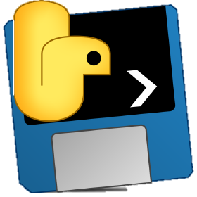
SOFTWARE AND TOOLS
Python: The primary programming language used in this course. Python is a versatile language widely used in scientific computing.
Integrated development environment (IDE): Visual Studio Code, Jupyter notebook, etc.
Hyperspectral and Data Analysis libraries.
Python libraries: TensorFlow, NumPy, Pandas, OpenCV, Geopandas, Matplotlib, etc.
Packaging and Distribution Tools: Pyinstaller, Inno Setup or NSIS.
Testing and documentation tools.
Cloud Services, Github, Overstakingflow, etc,….

Slide 5
evaluation
Weekly Assignment (20%)
Short coding tasks or mini–projects that reinforce weekly lectures.
Could include exercises on optimizing hyperspectral scripts, creating basic GUI, etc…
2. Attendance and Participation (10%)
Active involvement in class discussions, Q&A, and peer-review sessions.
3. Midterm Exam (30%)
Around Weeks 5-6, students will make a presentation about working prototype of their image processing software.
This might include a basic GUI that demonstrates partial functionality.
4. Final Exam (40%)
Making Standard alone Software Tool with Presentation and Demonstration.

Slide 6
10 weeks course
W1: Course Overview and Project Ideal.
W2: Software Design Fundamentals.
W3: Setting Up the Development Environment. (LT)
W4: Core Data Integration and Preprocessing. (LT)
W5: User Interface and Experience (GUI). (LT)
W6: Advanced Data Manipulation and Integration. (LT)
W7: Deep Learning Integration. (LT)
W8: GUI Testing, Packaging and Deployment (LT)
W9: Final Polishing and Mock Presentations. (LT)
W10: Final Presentations and Course Wrap-Up. (LT)
LT: Bring your laptop

