Slide 1
Setting up the development environment
Lab 1

Slide 2
1. Lecture overview
This week, we'll focus on practical coding with Tkinter, emphasizing how to set up a fully functional development environment. We'll cover:
Installing Python and Necessary Packages
Working with Virtual Environments
Introduction to Tkinter Basics
Creating Simple Functions (def) and Integrating Them into a GUI
By the end of this lecture, you will be able to:
Properly set up a Python development environment.
Manage project dependencies using virtual environments.
Create simple graphical user interfaces (GUIs) with Tkinter.
Write basic Python functions and connect them to GUI elements.

Slide 3
2. Introduction to tkinter basics
import tkinter as tk
root = tk.Tk()
root.title("My First Tkinter Window")
root.geometry("300x200")
root.mainloop()
Main Structure:
root = tk.Tk()
root.title(“….”)
root.geometry(“AxB”)
root.mainloop()
tk.Tk() initializes the main application window.
title() sets the window title.
geometry() sets window size (width x height).
mainloop() starts the event loop.

Slide 4
3. Adding widgets
import tkinter as tk
root = tk.Tk()
root.title("Widget Demo")
label = tk.Label(root, text="Hello, Tkinter!")
label.pack()
button = tk.Button(root, text="Click Me")
button.pack()
root.mainloop()
Create a GUI with:
Title: “Widget Demo“
Label: “Hello, Tkinter!”
Button with an inside text "Click Me"
Label: Displays text.
Button: A clickable button.
.pack(): A layout manager that automatically places widgets.
Body Structure:
Variable = tk.function(root, text=“….”)
Extra Task
Put the Label and Button on the same line using a different geometry manager (e.g., grid).
Change the window title to "My Widget Demo".
Set the window size to 400x500.

Slide 5
3. Adding widgets
import tkinter as tk
root = tk.Tk()
root.title("My Widget Demo") # Changed title
root.geometry("400x500") # Set window size
# Using grid layout
label = tk.Label(root, text="Hello, Tkinter!")
label.grid(row=0, column=0, padx=5, pady=5)
button = tk.Button(root, text="Click Me")
button.grid(row=0, column=1, padx=5, pady=5)
root.mainloop()
Extra Task
Put the Label and Button on the same line using a different geometry manager (e.g., grid).
Change the window title to "My Widget Demo".
Set the window size to 400x500.

Slide 6
FORMATTED STRING LITERAL, “F” STRING
user_input = "Alice"
print(f"You typed: {user_input}")
print(f“.... {Variable}”)
How f-strings work
f"..." prefix: When you put an f before your string (for example, f"Hello, {name}!"), Python knows it needs to evaluate any code within the {...} braces.
Variable/Expression Insertion: Anything inside {...} gets replaced by its value at runtime. In the example above, user_input inside {user_input} is replaced with the string "Alice".
String Construction: Python then constructs the entire string on the fly, inserting each variable or expression’s result wherever you place the braces.

Slide 7
FORMATTED STRING LITERAL, “F” STRING
number = 42
print(f"Double of 42 is {number * 2}")
Extra Task
Using f-string to print your name and your age with the format below:
Name: Yourname
Age: Yourage
Name = "Huy Hoa"
Age = "27"
print(f"Name: {Name}, Age: {Age}")

Slide 8
FUNCTION WITH NO RETURN VALUE
def function_name(arguments):
function body
def display_message():
# Step 1: Simply print a statement
print("This is a message")
# Usage Example:
display_message()
def display_message():
user_input = input("Type a message:")
print(f"You typed: {user_input}")
display_message()
Extra Task
Modify display_message() to ask for user input inside the function and then print that input.

Slide 9
ENTRY WIDGET, message box
entry.get()
Retrieves (gets) the current text from the entry field as a string.
name = entry.get()
print(name) # Prints whatever text the user typed
entry.delete(start, end)
Deletes text from the entry field between the specified indices.
Using entry.delete(0, "end") removes all text in the widget:
entry.delete(0, "end") # Clears the entire field

Slide 10
ENTRY WIDGET, message box
messagebox.showinfo is a function from Python’s tkinter.messagebox module that displays a pop-up dialog with an “Info” icon and an OK button. Its signature looks like this:
messagebox.showinfo(title, message)
title: The text that appears in the dialog’s title bar.
message: The content displayed inside the dialog.

Slide 11
5. Integrating a function into tkinter
Problem: I want to make a GUI function to calculate sum of 2 value
Example A: Defining the function to add two numbers.
Example B: Defining the function that uses the first function.
Example C: Creating the Tkinter GUI and wiring everything together.

Slide 12
5. Integrating a function into tkinter
Defining the function to add 2 numbers (add_numbers, num1, num2)
# Modified function to subtract instead of add
def add_numbers(num1, num2):
num1 = float(num1)
num2 = float(num2)
return num1 + num2
Defining the function to use the first funtion (calculate_sum)
def calculate_sum():
a = entry_a.get()
b = entry_b.get()
result = add_numbers(a, b)
messagebox.showinfo("Result", f"Sum Result: {result}")

Slide 13
5. Integrating a function into tkinter
Defining the reset funtion
def reset_fields():
entry_a.delete(0, "end")
entry_b.delete(0, "end")

Slide 14
5. Integrating a function into tkinter
Building GUI
root = tk.Tk()
root.title("Subtraction App")
root.geometry("400x400") # Changed window size
label_a = tk.Label(root, text="Enter A:")
label_a.pack(pady=5)
entry_a = tk.Entry(root)
entry_a.pack(pady=5)
label_b = tk.Label(root, text="Enter B:")
label_b.pack(pady=5)
entry_b = tk.Entry(root)
entry_b.pack(pady=5)
calculate_button = tk.Button(root, text="Calculate", command=calculate_sum)
calculate_button.pack(pady=5)
reset_button = tk.Button(root, text="Reset", command=reset_fields)
reset_button.pack(pady=5)
root.mainloop()

Slide 15
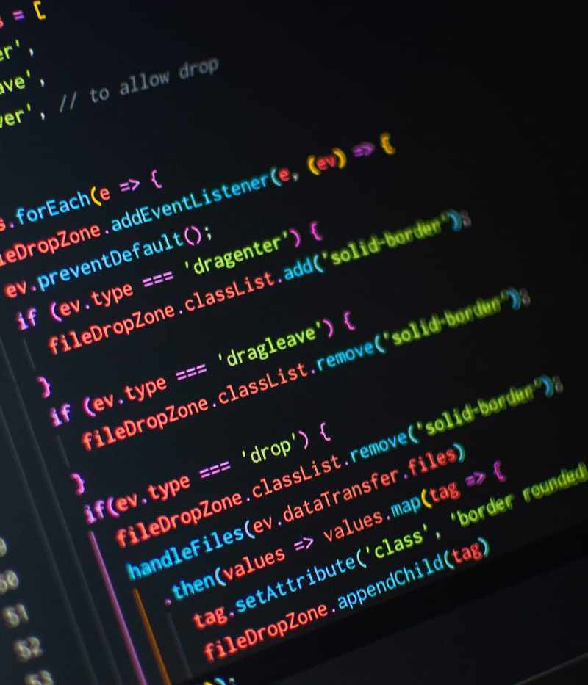
ASSIGNMENT 1: Mini address book
Goal: Create a Tkinter application that stores and displays names and phone numbers.
Create two Entry widgets, one for the Name and another for the Phone Number.
Add a button labeled "Add Contact" that, when clicked, appends the entered data to a Listbox.
Add another button labeled "Clear Fields" that clears both Entry widgets.
Use a Label at the top titled "Address Book".
(Optional) Add a Delete button that removes the selected contact from the Listbox.

Slide 16
ASSIGNMENT 2: simple temperature converter
Goal: Build a Tkinter app that converts temperatures from Celsius to Fahrenheit.
Create an Entry widget for the user to input Celsius.
Add a "Convert" button that calculates Fahrenheit using the formula F = (C * 9/5) + 32.
Show the result in a Label below the button.
Change the window title to "Temperature Converter".
(Optional) Add another button or function to convert Fahrenheit back to Celsius.

