Slide 1
CORE DATA INTEGRATION AND PRE-PROCESSING
Lab 2

Slide 2
1. Lecture overview
In Week 4, we will continue building on our Tkinter knowledge by learning how to integrate external data, models, and scripts into our GUI. We will cover:
Progress Bars: Creating a progress bar with live updates.
Threading: Running tasks in the background without freezing the GUI.
Importing External Data: Loading .h5 models or other data files.
Building on an Existing Script: Combining existing Python code with a Tkinter interface.
By the end of this lecture, you will be able to:
Create a progress bar that updates in real time.
Use threading to keep your GUI responsive during heavy tasks.
Import and integrate data files (e.g., .h5 models) in your Tkinter application.
Add a GUI front-end to an existing script.

Slide 3
WHAT IS THREADING? Why do we use it?
Threading (or multi-threading) is an execution model that enables programmers to implement concurrency or parallelism. A thread is a lightweight unit of a program that can run independently. All threads share the same memory space and resources of the main program.
Benefits:
Improved performance: Threads allow you to do more work in less time.
Responsiveness: Threading boosts program responsiveness by allowing it to handle multiple requests simultaneously.
Increased scalability: Threading can also improve the scalability of your program by allowing it to be adapted to run on multiple cores or machines.
Simplified communication: Threads share the same memory space, which makes communication between them more straightforward than with multiple processes.

Slide 4
WHAT IS THREADING? Why do we use it?
Definition: Multiple “threads” (lightweight processes) run within the same process.
Shared Memory Space: All threads access the same memory, making it easy to share data but requiring careful synchronization to avoid conflicts (e.g., using locks or queues).
GIL (Global Interpreter Lock) in CPython:
Only one thread can execute Python code at a time: This means CPU-bound tasks might not get a massive speed boost from threading in Python.
Ideal Use Cases:
I/O-bound tasks (e.g., network requests, file I/O).
GUI applications where you want background tasks without freezing the interface.

Slide 5
WHAT IS multiprocessing
Definition: Spawns multiple separate processes, each with its own Python interpreter and memory space.
Independent Memory: Since each process has its own memory, data sharing requires IPC (Inter-Process Communication) methods such as pipes, queues, or shared memory.
No GIL Limitation: Each process has its own GIL, effectively bypassing the single-thread restriction.
Ideal Use Cases:
CPU-bound tasks where you want to fully utilize multiple CPU cores.
Parallel data crunching, machine learning model training, etc.

Slide 6
Multithreading vs multiprocessing
Aspect | MultiThreading | MultiProcessing
Memory Sharing | Threads share the same memory (easy data sharing) | Separate memory spaces (requires explicit IPC)
GIL Impact | A single GIL may limit true parallelism for CPU-bound work | Each process has its own GIL (full parallelism)
Overhead | Lower overhead (lightweight) | Higher overhead (new processes, separate memory)
Best For | I/O-bound tasks, GUI responsiveness, background tasks | CPU-bound tasks, heavy computations
Communication Complexity | Easier (shared variables, locks, queues) | Harder (queues, pipes, or shared memory)

Slide 7
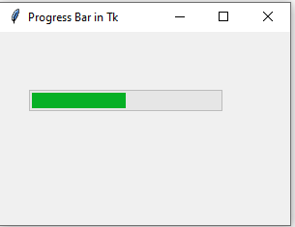
PROGRESS BAR
A progress bar is useful to display the status of an operation or task. The ttk.Progressbar widget can indicate the evolution of a certain process (for example, downloading a file from the Internet) or simply represent that an operation is being executed, in those cases in which the remaining time is unknown.
import tkinter as tk
from tkinter import ttk
root = tk.Tk()
root.title("Progress Bar with Grid")
progressbar = ttk.Progressbar(root, orient="horizontal", length=200, mode="determinate")
progressbar.grid(row=0, column=0, pady=10)
root.geometry("300x200")
root.mainloop()

Slide 8
PROGRESS BAR
A progress bar is useful to display the status of an operation or task. The ttk.Progressbar widget can indicate the evolution of a certain process (for example, downloading a file from the Internet) or simply represent that an operation is being executed, in those cases in which the remaining time is unknown.
import tkinter as tk
from tkinter import ttk
root = tk.Tk()
root.title("Progress Bar with Grid")
progressbar = ttk.Progressbar(root, orient="horizontal", length=200, mode=“indeterminate")
progressbar.grid(row=0, column=0, pady=10)
root.geometry("300x200")
root.mainloop()

Slide 9
When do we need padx, pady?
Padx: adds space on the left and right sides of a widget.
Pady: adds space above and below a widget.
When might you use only pady?
If you have widgets arranged top-to-bottom (like in pack or in grid rows) and you only need vertical spacing between them (no crowding left or right).
When to use both?
If your widgets are too cramped both vertically and horizontally, you would add both padx and pady to create comfortable spacing in all directions.

Slide 10
what is columnspan?
columnspan=z: The widget spans (or stretches across) z columns in the same row.
This is useful if you have an element (like a wide label or progress bar) that needs to be wider than a single grid cell.
widget.grid(row=1, column=0, columnspan=2)
Places the widget starting at row 1, column 0, but it extends across 2 columns (column 0 and column 1).

Slide 11
1. Progress bar (simple)
1.1 Example 1: The Simplest Progress Bar
import tkinter as tk
from tkinter import ttk
root = tk.Tk()
root.title("Simple Progress Bar")
progress = ttk.Progressbar(root, orient="horizontal", length=300, mode="determinate")
progress.pack(pady=20)
# Manually set progress to 50 (just for demonstration)
progress["value"] = 50
root.mainloop()

Slide 12
1. Progress bar (simple)
Change the length to 200 and place the progress bar using grid.
Add a button labeled "Fill 85%" that sets the bar to value=85.
1.1 Extra task:
import tkinter as tk
from tkinter import ttk
root = tk.Tk()
root.title("Simple Progress Bar")
progress = ttk.Progressbar(root, orient="horizontal", length=200, mode="determinate")
progress.grid(row=0, column=0, pady=10)
button = tk.Button(root, text=“Fill 85%”)
button.grid(row=1, column=0)
root.mainloop()
, command=lambda: progress.config(value=85))

Slide 13
1. Progress bar (simple)
1.2 Example 2: Progress bar from 0 to 100% with Label (percent_label as variable for Label) + make a button to click
import tkinter as tk
from tkinter import ttk
import time
root = tk.Tk()
root.title("Progress Bar + Percentage")
progress = ttk.Progressbar(root, orient="horizontal", length=300, mode="determinate")
progress.pack(pady=20)
percent_label = tk.Label(root, text="0%")
percent_label.pack()

Slide 14
1. Progress bar (simple)
1.2 Example 2: Progress bar from 0 to 100% with Label
def start_progress():
for i in range(101):
progress["value"] = i
percent_label.config(text=f"{i}%")
# Force the GUI to update
root.update()
# Simulate work time
time.sleep(0.02)
start_button = tk.Button(root, text="Start", command=start_progress)
start_button.pack(pady=10)
root.mainloop()

Slide 15
1. Progress bar (simple)
1.2 Extra Task: Add a “reset” button that sets the bar value back to 0; change to vertical, use grid() instead of pack()
root = tk.Tk()
root.title("Example2")
root.geometry("600x700")
progress_bar = ttk.Progressbar(root, orient="vertical", length=200, mode="determinate")
progress_bar.grid(row=0, column=0, padx=5, pady=5)
percent_label = tk.Label(root, text="Label: 0%")
percent_label.grid(row=0, column=1, padx=5, pady=5)
def start_progress():
for i in range(101):
progress_bar["value"] = i
percent_label.config(text=f"{i}%")
root.update()
time.sleep(0.5)

Slide 16
1. Progress bar (simple)
1.2 Extra Task: Add a “reset” button that sets the bar value back to 0; change to vertical, use grid() instead of pack()
def reset_progress():
# Reset both the bar and the label
progress_bar.config(value=0)
percent_label.config(text="0%")
# Force the GUI to update if you want an immediate visual reset
root.update()
# Place Start in (row=1, column=0)
Start_button = tk.Button(root, text="Start", command=start_progress)
Start_button.grid(row=1, column=0, padx=5, pady=5)
# Place Reset in (row=1, column=1)
Reset_button = tk.Button(root, text="Reset", command=reset_progress)
Reset_button.grid(row=1, column=1, padx=5, pady=5)
root.mainloop()

Slide 17
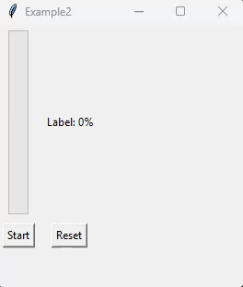
1. Progress bar (simple)
WHAT ARE THE PROBLEMS?
Active Loop Still Running
If you have a for i in range(101) loop still in progress, each iteration sets the progress bar’s value to i. Calling reset_progress() sets it back to 0, but then the next line in the loop sets it again to, say, 50.
Solution: Stop or break out of the loop before resetting, or ensure the loop finishes first.
Thread Not Stopped
If you’re using threading, the background thread might be continuing to update the progress bar while you try to reset it.
Solution: If you want to completely reset, signal the thread to stop first (e.g., set stop_thread = True), wait for it to end, then do reset_progress().
One Function Overwrites the Other
If your start_progress() function is in the same event loop call, you might set .config(value=0) (reset), but then have more code in the function that runs afterward.
Solution: Restructure your code so that once you reset, the bar doesn’t get overwritten again.

Slide 18
1. Progress bar (simple)
1.3 Example 3: Step-Based Progress
import tkinter as tk
from tkinter import ttk
import time
root = tk.Tk()
root.title("Step-Based Progress")
# We'll simulate 5 steps
steps = ["Loading", "Processing", "Analyzing", "Finalizing", "Done"]
progress = ttk.Progressbar(root, orient="horizontal", length=300, mode="determinate")
progress.pack(pady=20)
status_label = tk.Label(root, text="Waiting...")
status_label.pack()
progress["maximum"] = len(steps)

Slide 19
1. Progress bar (simple)
1.3 Example 3: Step-Based Progress
def run_steps():
for step in steps:
status_label.config(text=step)
progress.step(1)
root.update()
time.sleep(1)
start_button = tk.Button(root, text="Start", command=run_steps)
start_button.pack(pady=10)
root.mainloop()

Slide 20
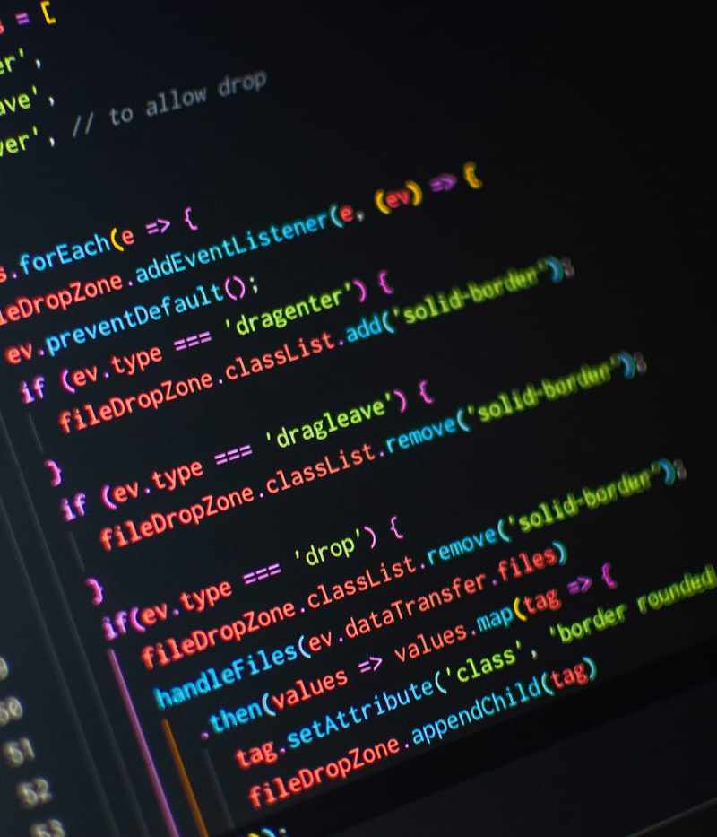
ASSIGNMENT 3
Goal: Build a Tkinter app that show each steps of processing with progress bar (%) and tracking.
Change the number of steps to 10.
Print each step in the console and label.
Add a second label to track how many steps are done (Step 3/5).

