Slide 1
User Interface and Experience
LAB 3

Slide 2
1. Lecture overview
In Week 5, we continue our journey with Tkinter by focusing on creating a more responsive and user-friendly interface. We’ll build on our threading knowledge to keep the GUI from freezing, ensuring the best user experience (UX). Our goals:
Why Threading Matters: Understanding the Benefits of the User Experience.
Basic Thread Example: A minimal approach to show concurrency.
Enhanced Thread Example: Handling multiple tasks and updating labels.
Extra Tasks: Practice-based assignments to reinforce learning.
By the end of this lecture, you will be able to:
Implement threading in a Tkinter application without freezing.
Provide clear feedback to users with regular progress updates.
Build a more polished and user-friendly interface.

Slide 3
WHy THREADING MATTERS?
1.1. Freezing Problems
In a single-threaded Tkinter application, a long-running process (e.g., heavy computation, file I/O) blocks the main thread, causing the GUI to become unresponsive (frozen) until the task is completed. A frozen GUI leads to poor user experience, as users may think the app has crashed.
1.2. Threading benefits
Keeps UI Responsive: The main thread handles rendering, while a worker thread performs the heavy task.
Progress or Status Updates: Display the user what’s happening in real-time.
Better Overall UX: Users can interact with other parts of the interface while tasks run in the back

Slide 4
Example 1: A Simple Tkinter App (No Threading)
import tkinter as tk
import time
root = tk.Tk()
root.title("Example 1: No Threading")
label = tk.Label(root, text="Hello!")
label.pack(pady=20)
def block_gui():
for i in range(5):
label.config(text=f"Count: {i}")
time.sleep(1)
block_button = tk.Button(root, text=“Run for 5s", command=block_gui)
block_button.pack(pady=10)
root.mainloop()
Extra Tasks
Change 5 to 10 in the loop. Observe how the GUI stays blocked even longer.
Remove time.sleep(1) and see how quickly the text updates.

Slide 5
Ex2: intro to threading (non-blocking)
import tkinter as tk
import time
import threading
root = tk.Tk()
root.title("Example 2: Basic Threading")
label = tk.Label(root, text="Ready")
label.pack(pady=20)
def run_in_thread():
for i in range(10):
label.config(text=f"Count: {i}")
time.sleep(1)
Variable = threading.Thread(target=def of the variable above)
t.start()
def start_thread():
t = threading.Thread(target=run_in_thread)
t.start()
start_button = tk.Button(root, text="Start", command=start_thread)
start_button.pack(pady=10)
root.mainloop()

Slide 6
Ex2: intro to threading (non-blocking)
import tkinter as tk
import time
import threading
root = tk.Tk()
root.title("Example 2: Basic Threading")
label = tk.Label(root, text="Ready")
label.pack(pady=20)
def run_in_thread():
for i in range(10):
print("Iteration:", i)
label.config(text=f"Count: {i}")
time.sleep(1)
Extra Tasks
Try adding root.update() inside run_in_thread() and see smoother text changes.
Insert a print statement in the loop to see the console output.
Increase the loop to 10 or 20 to see a longer demonstration.
def start_thread():
t = threading.Thread(target=run_in_thread)
t.start()
start_button = tk.Button(root, text="Start", command=start_thread)
start_button.pack(pady=10)
root.mainloop()

Slide 7
Ex3: progress bar + threading
1. Create a progress bar and a button that run on a separate thread. When you click the button, the progress bar will progress from 0% to 100%, with 1% = 2 seconds.
import tkinter as tk
from tkinter import ttk
import time
import threading
root = tk.Tk()
root.title("Example 3: Progress Bar + Thread")
progress_bar = ttk.Progressbar(root, orient="horizontal", length=300, mode="determinate")
progress_bar.pack(pady=20)
percent_label = tk.Label(root, text="0%")
percent_label.pack()
def update_progress():
for i in range(101):
progress_bar["value"] = i
percent_label.config(text=f"{i}%")
time.sleep(2)
root.update()
def start_progress():
t = threading.Thread(target=update_progress)
t.start()
start_button = tk.Button(root, text="Start", command=start_progress)
start_button.pack(pady=10)
root.mainloop()
Extra Tasks
1. Change the orientation to vertical.
2. Add reset button sets the progress bar to – and label to 0%

Slide 8
Ex4: ADDING A STOP BUTTON
global stop_thread
stop_thread = True/ False
if stop_thread:
break
import tkinter as tk
from tkinter import ttk
import time
import threading
root = tk.Tk()
root.title("Simple Progress with Thread")
progress = ttk.Progressbar(root, length=300, mode="determinate")
progress.pack(pady=10)
label = tk.Label(root, text="0%")
label.pack()
stop_thread = False # True if the user wants to stop early
def run_progress():
global stop_thread
# Loop from 0 to 100 to fill the bar
for i in range(101):
if stop_thread: # If stop was requested, break
break
progress["value"] = i
label.config(text=f"{i}%")
time.sleep(0.02) # Simulate work
root.update() # Refresh the bar & label
Add “stop” button that sets the progress bar to 0% and label to 0% during the loop.
def start():
global stop_thread
stop_thread = False # Reset the stop flag
progress["value"] = 0 # Reset the bar
label.config(text="0%") # Reset the label
# Run the progress in a background thread
t = threading.Thread(target=run_progress)
t.start()
def stop():
global stop_thread
stop_thread = True
# Optionally reset the bar & label immediately
progress["value"] = 0
label.config(text="0%")
start_button = tk.Button(root, text="Start", command=start)
start_button.pack(side=tk.LEFT, padx=5)
stop_button = tk.Button(root, text="Stop", command=stop)
stop_button.pack(side=tk.LEFT, padx=5)
root.mainloop()

Slide 9
Ex5: BUTTON STAGE
start_button.config(state=tk.NORMAL): start_button.config(state=tk.DISABLED):
You have a long-running task that runs in a thread. Create two buttons in Tkinter:
Start (initially enabled):
When clicked, disable Start and enable Stop.
Launch the background task.
Stop (initially disabled):
When clicked, signal the thread to stop the background task.
Disable Stop again and re-enable Start.

Slide 10
def start():
global stop_thread
stop_thread = False # Reset the stop flag
progress["value"] = 0 # Reset the bar
label.config(text="0%") # Reset the label
# Run the progress in a background thread
t = threading.Thread(target=run_progress)
t.start()
start_button.config(state=tk.DISABLED)
stop_button.config(state=tk.NORMAL)
def stop():
global stop_thread
stop_thread = True
# Optionally reset the bar & label immediately
progress["value"] = 0
label.config(text="0%")
start_button.config(state=tk.NORMAL)
stop_button.config(state=tk.DISABLED)
start_button = tk.Button(root, text="Start", command=start)
start_button.pack(side=tk.LEFT, padx=5)
stop_button = tk.Button(root, text="Stop", command=stop)
stop_button.pack(side=tk.LEFT, padx=5)
stop_button.config(state=tk.DISABLED)
root.mainloop()
import tkinter as tk
from tkinter import ttk
import time
import threading
root = tk.Tk()
root.title("Simple Progress with Thread")
progress = ttk.Progressbar(root, length=300, mode="determinate")
progress.pack(pady=10)
label = tk.Label(root, text="0%")
label.pack()
stop_thread = False # True if the user wants to stop early
def run_progress():
global stop_thread
# Loop from 0 to 100 to fill the bar
for i in range(101):
if stop_thread: # If stop was requested, break
break
progress["value"] = i
label.config(text=f"{i}%")
time.sleep(0.02) # Simulate work
root.update() # Refresh the bar & label

Slide 11
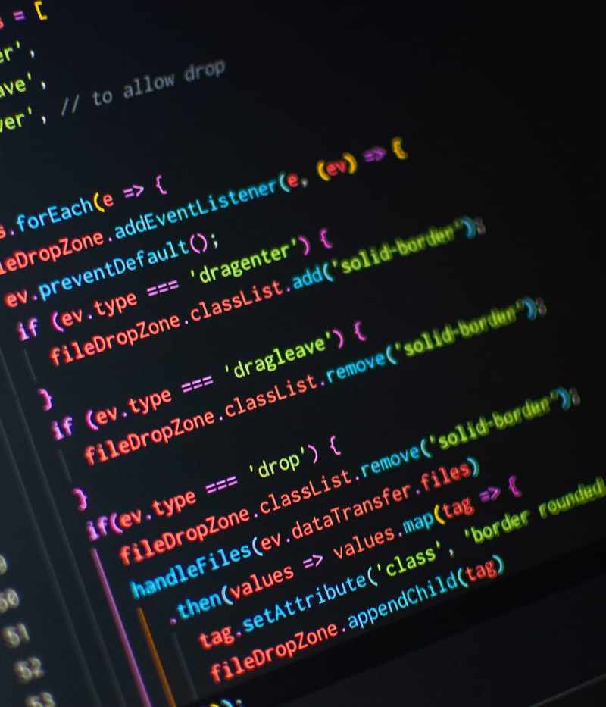
ASSIGNMENT
Goal: In addition to Start and Stop buttons, add two more buttons: Pause and Resume
Pause:
Temporarily halts the task but keeps the thread alive.
Disables itself and enables Resume.
Resume:
Continues the task from where it paused.
Disables itself and re-enables Pause.
Use pause flags (e.g., pause_thread = True/False) inside your task loop so that when Pause is clicked, the thread waits until Resume is clicked. Remember to update button states with button.config(state=tk.DISABLED) or tk.NORMAL appropriately.
while pause_thread and not stop_thread:
time.sleep(0.1)

Slide 12
Review: key points for mid-term
1.1 Tkinter Essentials
label = tk.Label(root, text="Hello, Tkinter!")
label.pack()
Label
def say_hello():
print("Hello!")
button = tk.Button(root, text="Click Me", command=say_hello)
button.pack()
Button
entry = tk.Entry(root)
entry.pack()
text = entry.get() # Retrieve contents
entry.delete(0, tk.END) # Clear
Entry

Slide 13
Review: key points for mid-term
1.2 Tkinter Essentials
pack()
Stacks widgets top-to-bottom or left-to-right.
grid()
Places widgets in a row/column layout.
row, column, columnspan, rowspan, padx, pady.
place()
Positions widgets by explicit x, y coordinates (rarely used for large apps).

Slide 14
Review: key points for mid-term
2. Progress Bars
ttk.Progressbar
mode="determinate": You manually set .value or call .step(...).
mode="indeterminate": The bar moves continuously (unknown duration)..
progress = ttk.Progressbar(root, orient="horizontal", length=300, mode="determinate")
progress["value"] = 50 # sets 50% if max=100
progress["maximum"] = 100 # sets the upper bound
progress.step(10) # increments by 10
If you do a loop (for i in range(101)) and want the bar to move each iteration, call:
root.update() # forces the progressbar & GUI to refresh

Slide 15
Review: key points for mid-term
t = threading.Thread(target=long_task)
t.start()
3. Threading
import threading
def long_task():
# e.g., a loop from 0 to 100 with sleeps
def start_task():
# create a background thread so we don't freeze
t = threading.Thread(target=long_task)
t.start()
Maintain a global flag (e.g., stop_thread = False).
if stop_thread:
break
For pause, add a pause_thread = True and a while pause_thread: time.sleep(0.1) check.

Slide 16
Review: key points for mid-term
4. UI States
button.config(state=tk.NORMAL): button.config(state=tk.DISABLED):
5. Concluding Notes
Practice: The best way to prepare is to code small examples.
Focus: Understand why we use threads, how to update progress bars, and how to handle user input with Entry/Label.
UX Matters: Even simple changes like disabling Start once it’s clicked can significantly improve user experience.
Good luck studying, and remember: short, hands-on exercises are key to mastering these concepts for your mid-term exam!

