Slide 1
CSN - 371 [Artificial Intelligence]
Part of Speech Tagging
Group Members :
Aditya Kumar Singh [18116003]
Anmol Agarwal [18116013]
Saksham Sharma [18116067]
Project Github Link : Part_Of_Speech_Training
Instructor :
Raksha Sharma

Slide 2
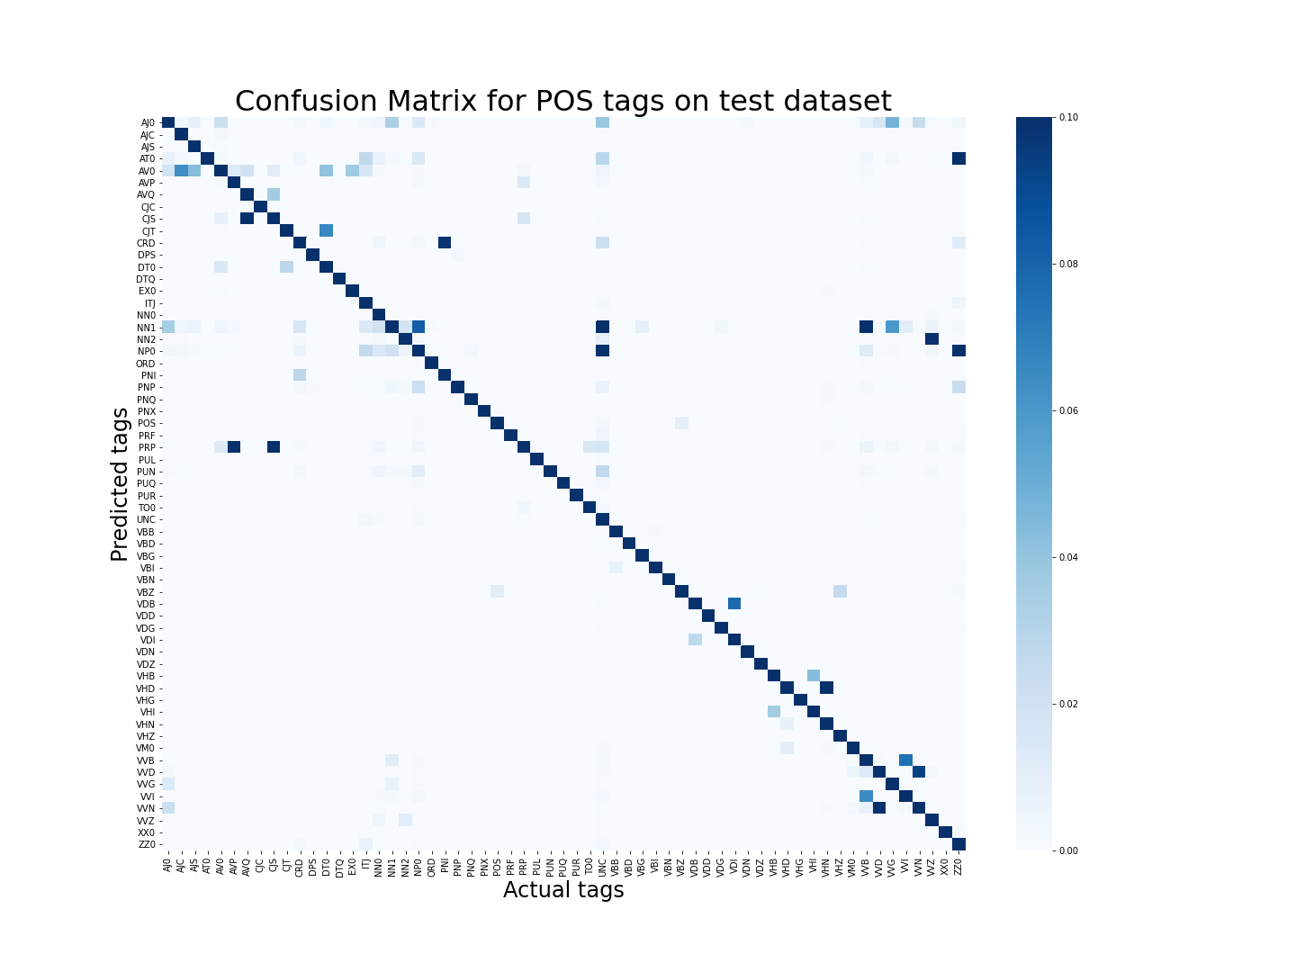
Confusion Matrix on Test Dataset [ 96.97% Accuracy ]
The values in confusion matrix are column-wise normalised from 0 to 0.1 for better representation
Any cell in confusion matrix shows the number of occurrences (normalised) on which the predicted tag is the Y-axis tag and the correct tag is the X-axis tag.

Slide 3
Analysis of Model
The model gave an accuracy of 96.976% on the BNC dataset using HMM with Viterbi. As expected, the model performs significantly better than the Bayesian model, which had an accuracy of 91.7%.
By comparing the confusion matrix of Bayesian model and HMM model we observe that the HMM model is also able to predict less frequent tags like VDI correctly. Also, the confusion between tags like VVI and NN1 is significantly reduce.
Although we didn't experiment much, but by implementing our model with a transition probability of 0.0059 for new tag-to-tag associations and an emission probability of 8*10⁻¹⁰ for new tag-to-word associations, we were able to achieve the above results.
We were also able to build a sub-optimal model with an accuracy of ~96.5%, which was upto 25 times faster than the current model. We used only existing tag-to-tag transmission and assumed uniform emission for new words. Hence, we can infer that seldom do we encounter a new tag-to-tag association.

Slide 4
Analysis of Model
The probabilities of new tag-tag and tag-word associations were calculated using smoothing techniques. When the probabilities were taken different for each tag based on its known associations and occurrences, an accuracy of 94% was found. Whereas when the transition and emission probabilities were assumed as constant irrespective of tags, the accuracy increased to ~96.8%. We think we were unable to make more optimal assumptions.
When moving from a current word to next word , if the number of tag nodes related to current word was restricted to 10⁻³ of maximum probability in the current word layer , the accuracy reduced from 96.97% to 96.88%. Such small decrease points out that the probability of probable tags for a word is greater than non-probable tags by almost a factor of 1000.
Altogether, the model did beyond our expectation, and we are sure that had we implemented backward-forward algorithm and/or n-gram tagger and/or regex matching, we would have been able to cross 97.5% accuracy, but due to limited time, we decided to stick with a simpler implementation and make the best out of it.

Slide 5
Improvements
The HMM model with Viterbi runs in N²*T , where N is the number of tags and T is no of words in a sentence. The HMM model we implemented for 61 tags had a runtime of ~2 hours on test dataset. We also tried to reduce the number of tag nodes corresponding to a word by selecting only a those tag nodes whose probability is greater than 0.001 times maximum probability in that word layer. This reduced the runtime to ~15 minutes , i.e. reduction by a factor of 8. The accuracy drop was only 0.1% , which makes our model suitable for real-time applications.
We also tried to optimize further without disturbing the accuracy much, and were able to achieve an accuracy 96.6% with a runtime of ~7 minutes. Which is suitable for faster results.
We used smoothing techniques like Lidstone’s Law for improving accuracy by choosing constants assuming on a uniform distribution , and found highest accuracy of 96.976% after scaling these constants.
The use of dynamic programming (using Viterbi) to optimize the process of selecting most probable path in the HMM algorithm was the biggest improvement of all.

