Slide 1
CSN - 371 [Artificial Intelligence]
Part of Speech Tagging
Group Members :
Aditya Kumar Singh [18116003]
Anmol Agarwal [18116013]
Saksham Sharma [18116067]
Project Github Link : Part_Of_Speech_Training
Instructor :
Raksha Sharma

Slide 2
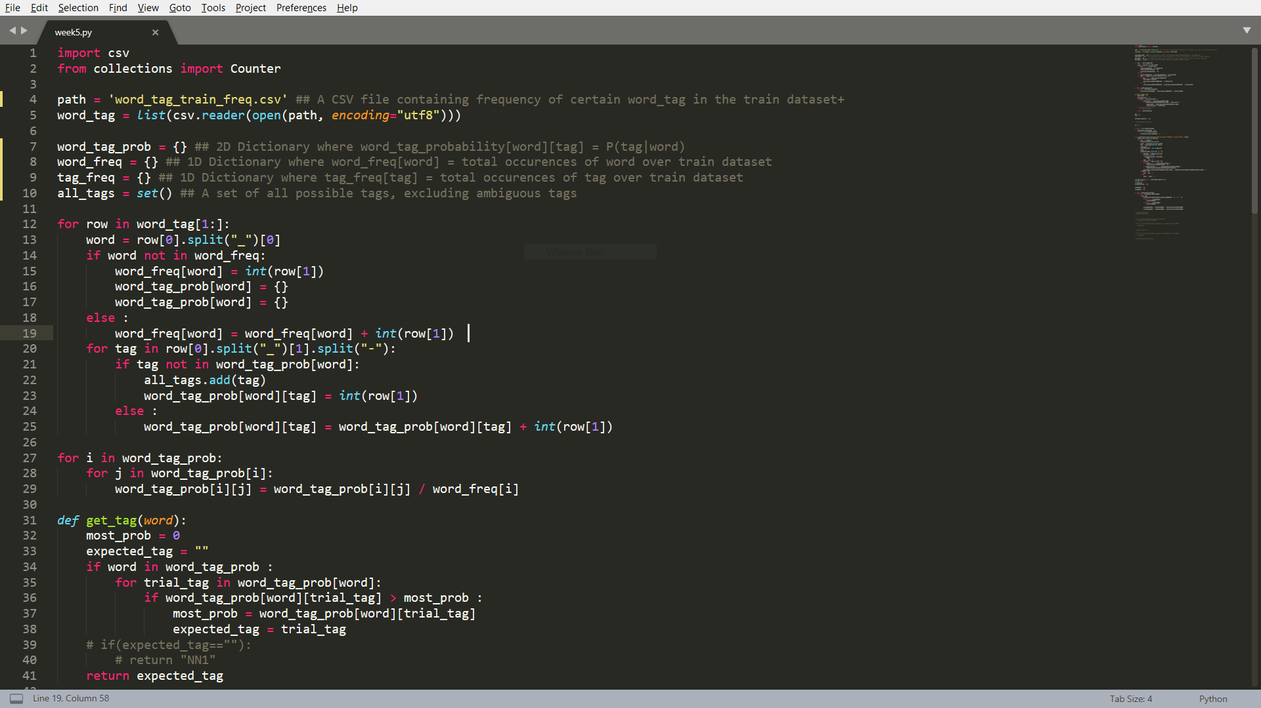
MODEL TO PREDICT THE TAG FOR A NEW WORD BASED ON THE TRAIN DATASET

Slide 3
PERFORMANCE OF THE MODEL ON TEST DATASET
The above model, which predicts the most probable tag for a given word, was able to achieve an accuracy of 91.71% with a total of 342172 wrongly assigned tags.
Even the slight modification of predicting the tag "NN1" (overall most frequent tag) to words which do not have any past record, the accuracy increased to 92.31% with a total of 317427 wrongly assigned tags.
We will stick to the first model, which doesn't predict "NN1" for unknown words for our further analysis.

Slide 4
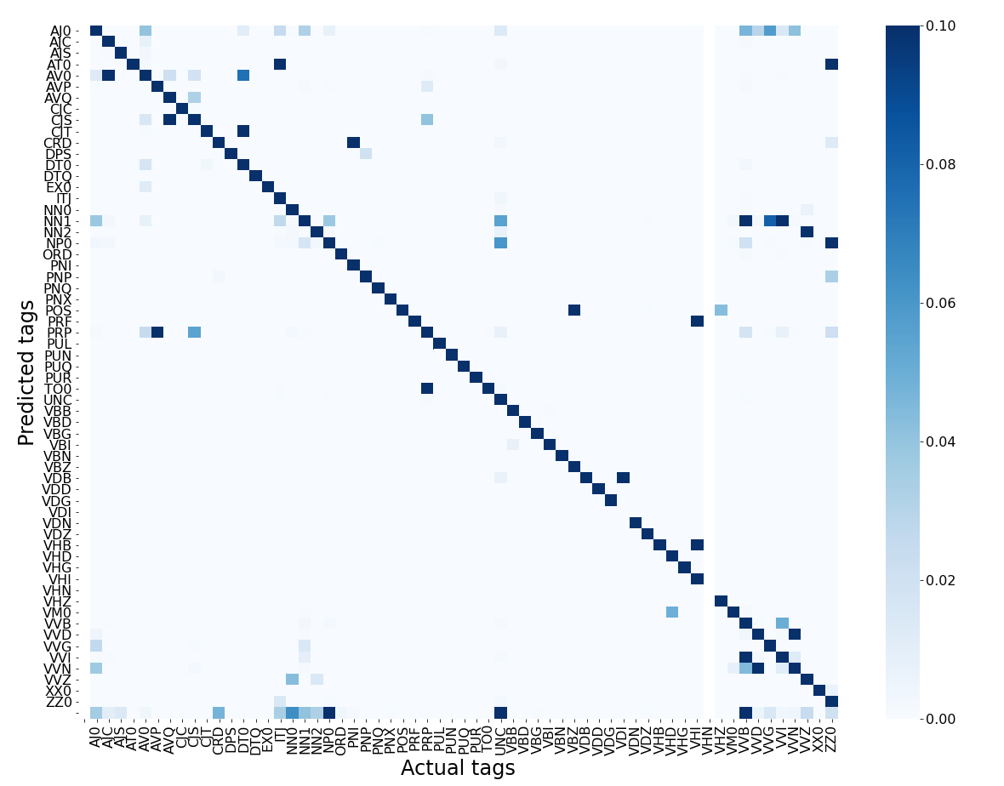
CONFUSION MATRIX FOR THE MODEL OVER TEST DATASET
The values in confusion matrix are column-wise normalised from 0 to 0.1 for better representation
Any cell in confusion matrix shows the number of occurrences (normalised) on which the predicted tag is the Y-axis tag and the correct tag is the X-axis tag.

Slide 5
ANALYSIS OF THE MODEL
Although the model was able to surpass our expectation of 85% accuracy, but it still lags behind the state-of-the-art accuracy.
The tag PRP was most often confused for the tag TO0, for a total of 38693 times, which makes sense because all the occurrence of "to" were tagged as TO0 even if they were actually a PRP. This accounts for more than 10% mistakes made.
The tag VVN was confused for VVD owing to some words being common to both these tags.
34282 words (occurring 79984 times) were new to the test dataset were not there in train dataset.
The tag NN1 (followed by PRP) was wrongly assigned some other tag the most number of times. The tag NN1 (followed by VVN) was also assigned to some other tag the most number of times.
The confusion matrix shows high intensity diagonal owing to high accuracy of model.
Overall, the model performs well in predicting the tags for a given word, but its inability to predict tags for new words is one major flaw, followed by its inability to understand a word which is not in its most frequently used form.

