Slide 1



Zero-Effort Image-to-Music Generation:
An Interpretable RAG-based VLM Approach
Zijian Zhao*, Dian Jin, Zijing Zhou
Presenter: Zijian Zhao
The Hong Kong University of Science and Technology
16th ACM International Conference on Multimedia Retrieval (ICMR), 2026

Slide 2

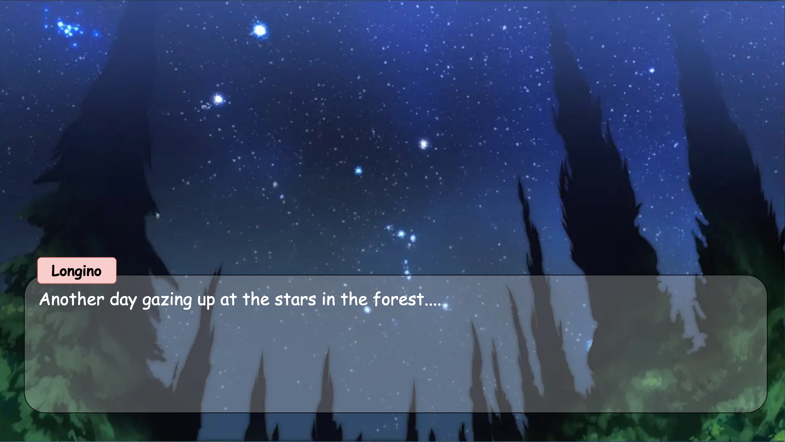
Background
Image-to-Music Generation
Music Photo Album
Game Music
Advertising Music
Multi-Modal Art
...

Slide 3
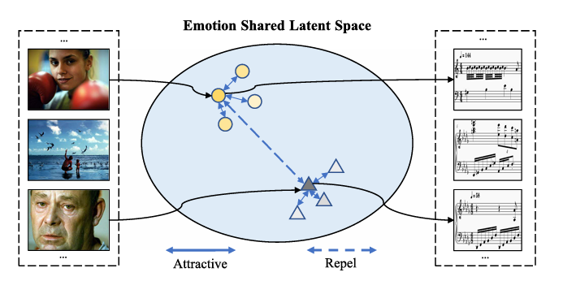
Previous Works
Training-Based Methods
Large Computation Resource Requirement
Dataset Limitations
Mapping-Based Methods
Lack of Rationality
Low Interpretability
Our Method
High Interpretability
Attention Map
Creation Motivation
Low Cost
No Need for Training
High Quality
RAG-Based Generation
Self-Refinement Mechanism
Wang Y, Chen M, Li X. Continuous emotion-based image-to-music generation[J]. IEEE Transactions on Multimedia, 2023, 26: 5670-5679.

Slide 4
Previous Works
Training-Based Methods
Large Computation Resource Requirement
Dataset Limitations
Mapping-Based Methods
Lack of Rationality
Low Interpretability
Wang Y, Chen M, Li X. Continuous emotion-based image-to-music generation[J]. IEEE Transactions on Multimedia, 2023, 26: 5670-5679.

Slide 5
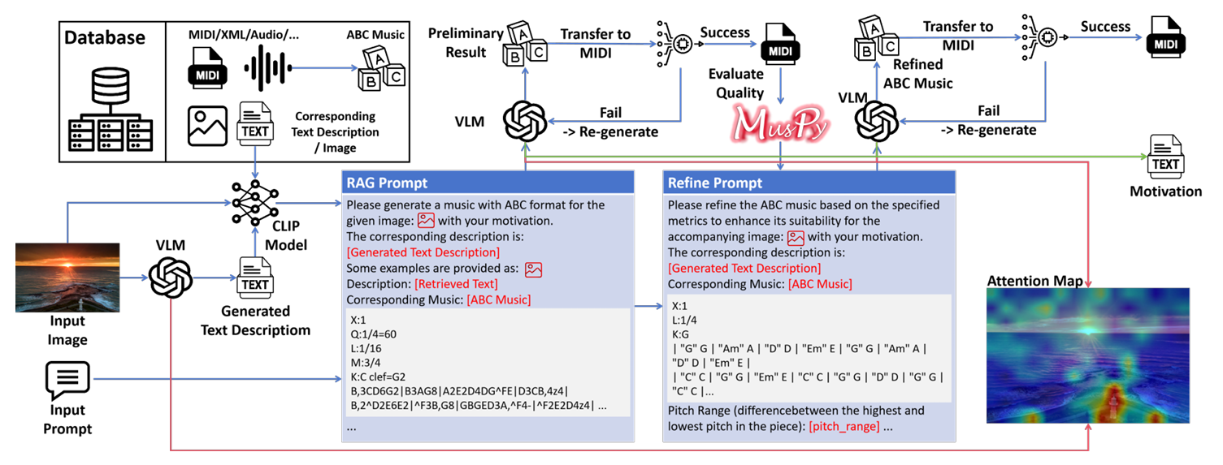
Workflow
Primary Music Generation
Generate Image Description
Generate ABC Music via Multi-Modal RAG
Music Refinement Using a Model-Based Evaluator
Self-Refine According to Music Quality Metrics
Explanation Generation with Text Output and Image Attention Map

Slide 6
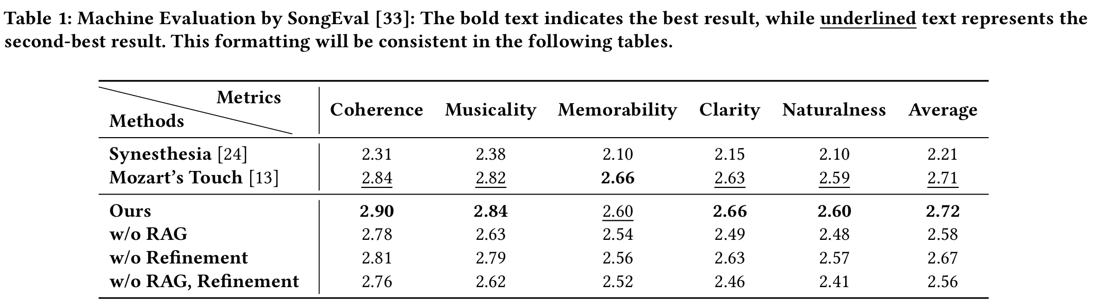
Machine Evaluation
Music Quality Evaluation
SongEval

Slide 7
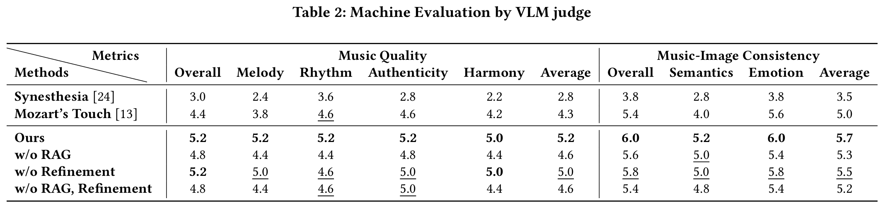
Machine Evaluation
LM as Judger
Generation VLM: Keye-VL-8B
Evaluation VLM: Grok4 (web version)

Slide 8
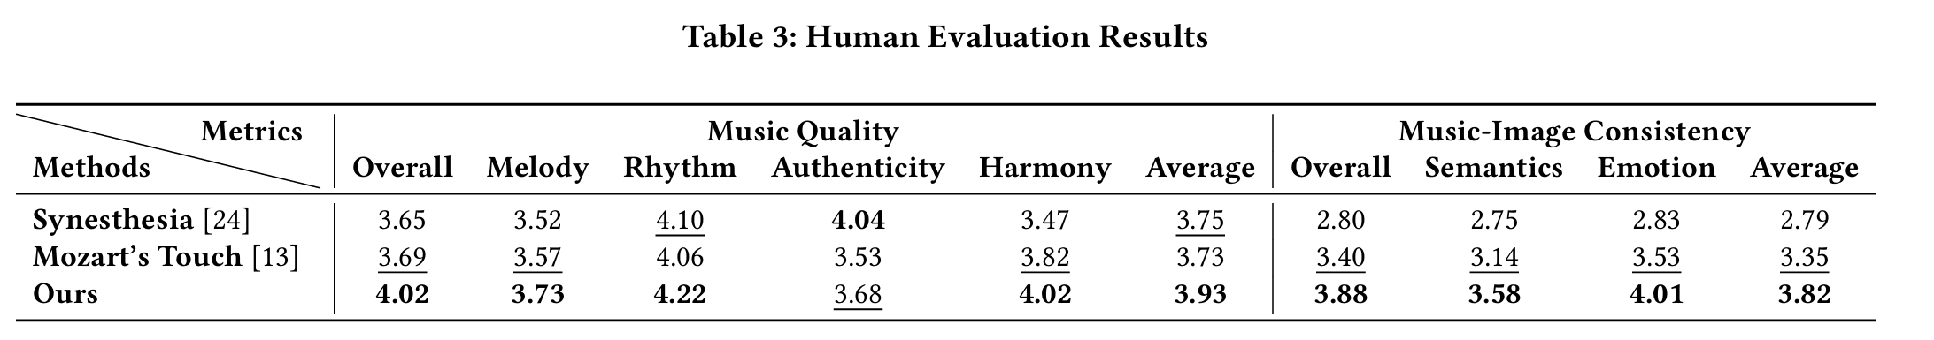
Human Evaluation
Study Steup
31 repondents
13 males and 18 females aged 18–55
13 participants reported no relevant experience about music or visualarts

Slide 9
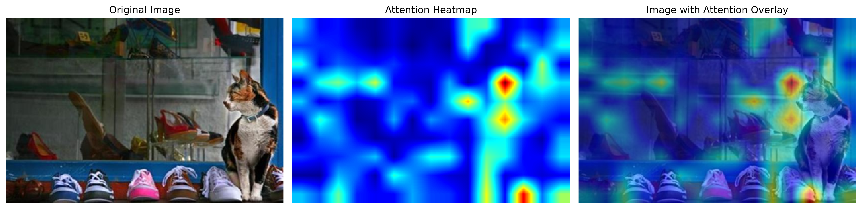
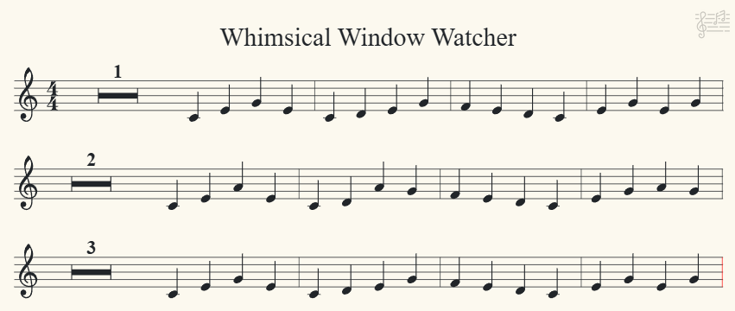
Generation Result
The music for "Whimsical Window Watcher" aims to evoke the serene curiosity of a calico cat observing a vibrant shoe display. The gentle 4/4 meter and C major key establish a calm, playful foundation, while the flowing melody (inspired by the cat’s graceful movements) weaves through the scene. Light dynamics (mf to crescendo) mirror the cat’s growing fascination, and simple ornaments (trills) add a whimsical touch, reflecting the vibrant yet peaceful atmosphere of the shop. The repeated motifs and soft resolution capture the cat’s lingering gaze, blending the tranquil interior with the lively colors of the shoes.

Slide 10
Thanks for your attention!
Presented by Zijian Zhao
Email: zzhaock@connect.ust.hk

