Slide 1



LoFi: Vision-Aided Label Generator for
Wi-Fi Localization and Tracking
Zijian Zhao, Tingwei Chen, Fanyi Meng, Zhijie Cai, Hang Li, Xiaoyang Li, Guangxu Zhu*
Shenzhen Research Institute of Big Data (SRIBD)
Sun Yat-sen
University
(SYSU)
The Chinese University
of Hong Kong, Shenzhen
(CUHK-SZ)
Presentation at IEEE GLOBECOM Workshop, December 11, 2025

Slide 2
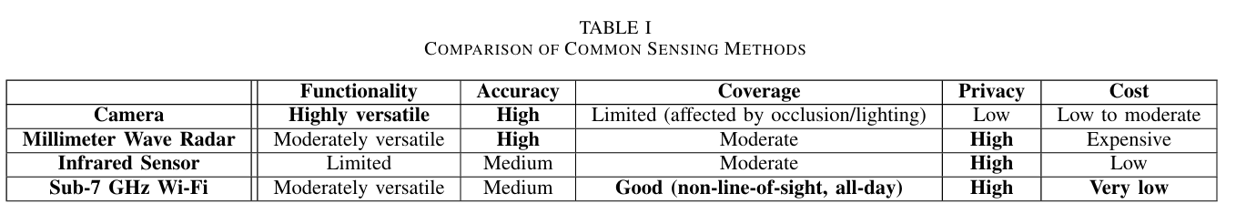
Background: Wi-Fi Sensing
Wi-Fi Sensing
  Advantages: high privacy, high penetration, extensive coverage, and low cost
  Application scenarios: smart elderly care, smart home, smart transportation...
  Specific tasks: indoor localization, tracking, fall detection, action recognition ...

Slide 3
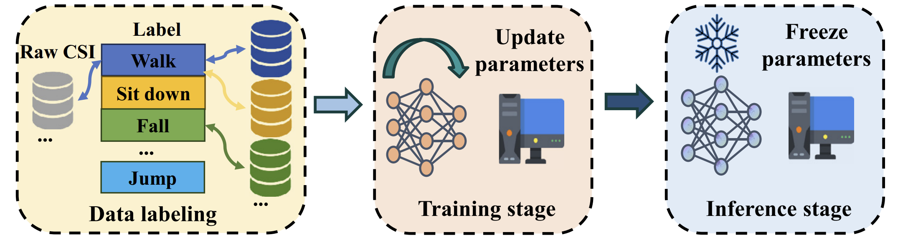
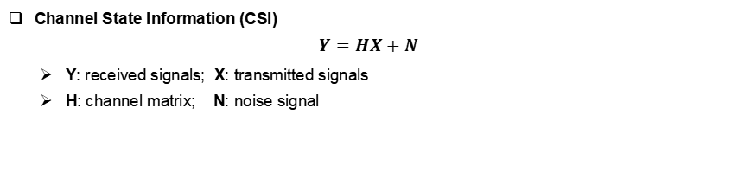
Background: Wi-Fi Sensing
Channel State Information (CSI)
$$Y=HX+N$$
  Y: received signals; X: transmitted signals
  H: channel matrix; N: noise signal

Slide 4
Background: Data Scarcity
Limited Public Dataset
  Data Heterogeneity
    RX-TX pair amount
    antenna amount
    subcarrier configurations
    sampling rate
    frequency
    ...
[1] Wang F, Zhang T, Zhao B, et al. A survey on wi-fi sensing generalizability: Taxonomy, techniques, datasets, and future research prospects[J]. arXiv preprint arXiv:2503.08008, 2025.

Slide 5
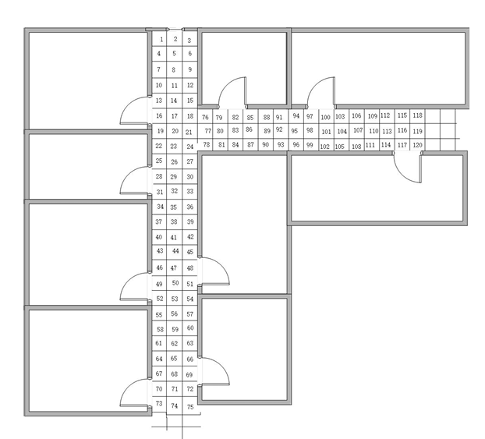
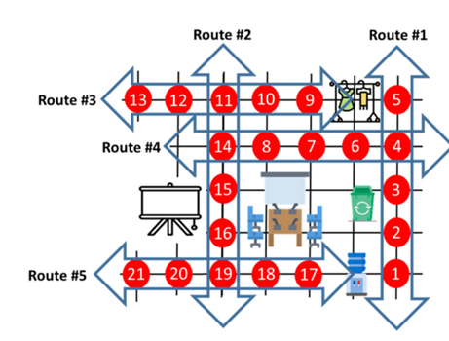
Background: Data Collection Method for Wi-Fi Localization & Tracking
Pre-assigned Position & Trajectory
  Corse-grained
  Time-costly
[2] Liu W, Chen Y, Zhang H. Sifi: Siamese networks based csi fingerprint indoor localization with wifi[C]//2024 IEEE Wireless Communications and Networking Conference (WCNC). IEEE, 2024: 01-06.
[3] Zhang Z, Lee M, Choi S. Deep-learning-based Wi-Fi indoor positioning system using continuous CSI of trajectories[J]. Sensors, 2021, 21(17): 5776.

Slide 6
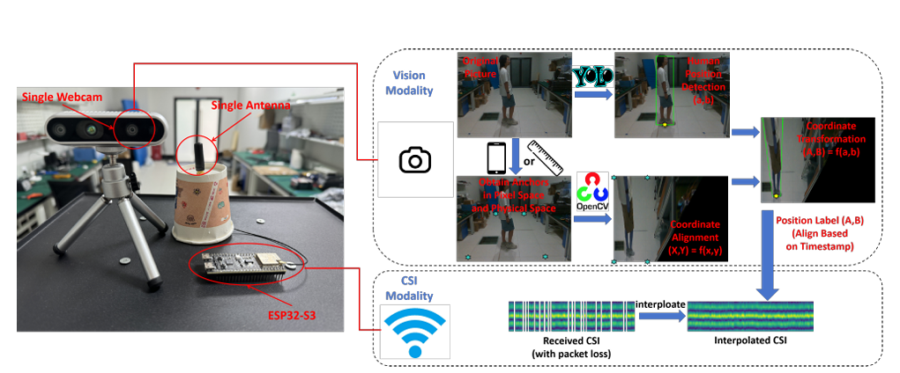
Our Solution: LoFi
Workflow
  Data Collection: vision & CSI
  Data Process: modality alignment & missing data interpolation
  Label Generation: human detection in images & coordination transformation
  Dataset Creation: pairing label with CSI

Slide 7
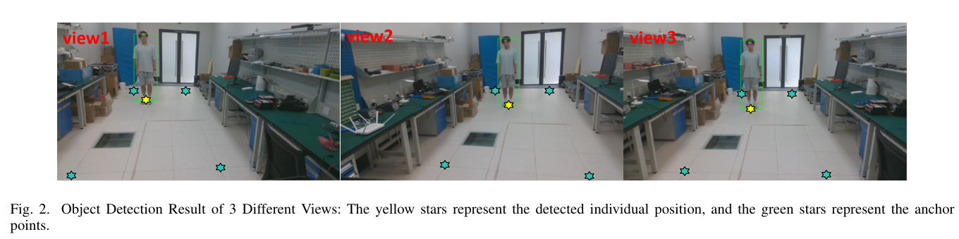
Experiment
Dataset Collection
  RX-TX: single pair ESP32-S3 with single antenna
  Camera: Intel D435 (utilzing the RGB image only)
  Object Detection Algorithm: YOLOv3
  Error in Three Views: 17.44cm, 12.13cm, and 11.82cm

Slide 8
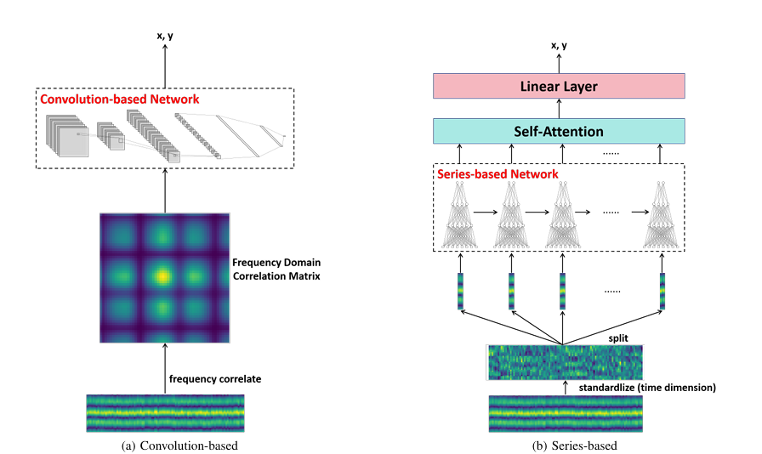
Experiment
Benchmark Methods
  Convolutional Network
    frequency correlation -> CNN -> output linear layer
  Time-series Netwrok
    time-dimension normalization -> seires network -> self-attention -> output linear layer

Slide 9
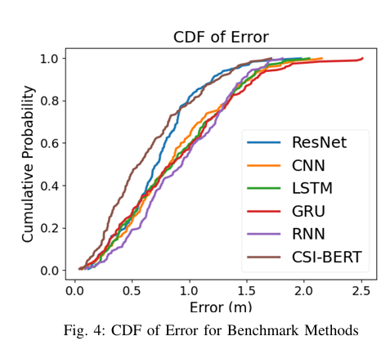
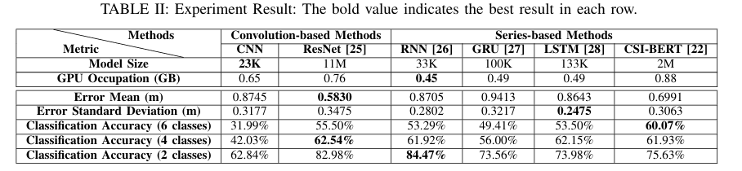
Experiment
Benchmark Results
  ResNet and CSI-BERT show superior performance.
  Average localization error is less than 1m across all methods.
  Deep learning methods demonstrate effectiveness in Wi-Fi localization with a single RX-TX pair and single antenna.

Slide 10
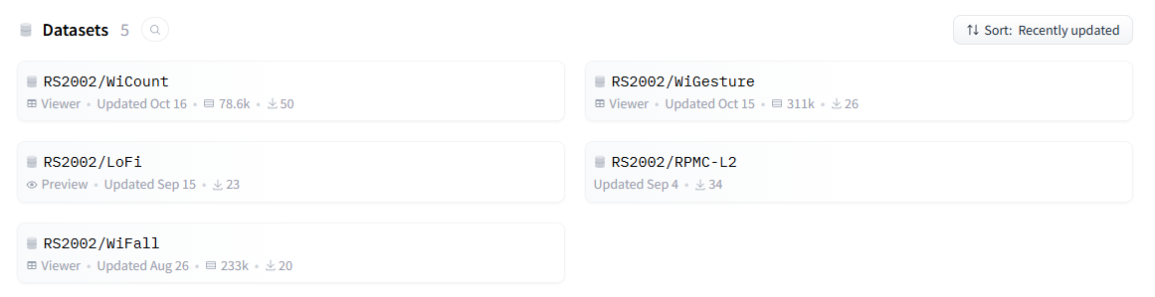

Thanks for your attention!
Presented by Zijian Zhao

