Slide 1





Does MMD Really Align? A Cross Domain Wireless Sensing Method via Local Distribution
Presenter: Zijian Zhao
Joint Work With: Zhijie Cai, Tingwei Chen, Xiaoyang Li, Hang Li, Qimei Chen, Guangxu Zhu*
Shenzhen Research Institute of Big Data (SRIBD)
Sun Yat-sen
University
(SYSU)
The Chinese University
of Hong Kong, Shenzhen
(CUHK-SZ)
Wuhan
University
(WHU)
The Hong Kong University
of Science and Technology
(HKUST)
Presentation at 14th IEEE/CIC ICCC, August 11, 2025

Slide 2
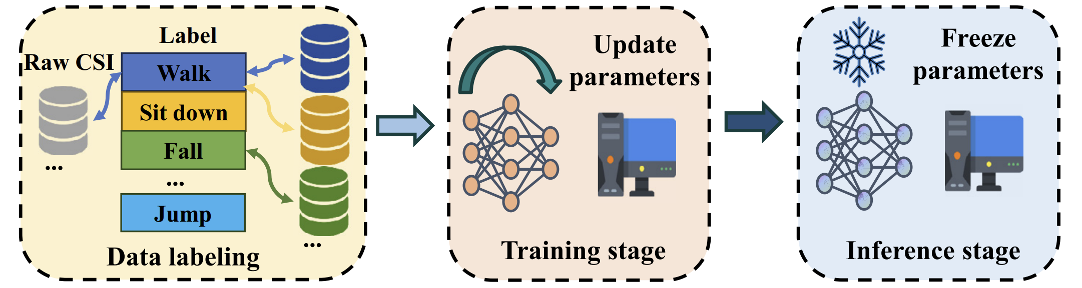
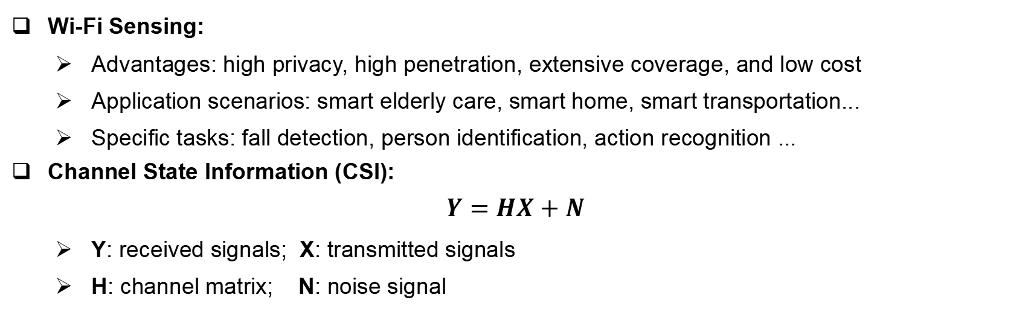
Background: Wireless Sensing
Wi-Fi Sensing:
Advantages: high privacy, high penetration, extensive coverage, and low cost
Application scenarios: smart elderly care, smart home, smart transportation...
Specific tasks: fall detection, person identification, action recognition ...
Channel State Information (CSI):
$$Y=HX+N$$
Y: received signals; X: transmitted signals
H: channel matrix; N: noise signal
Notes:
With the development of IEEE Wi-Fi protocol, the Wi-Fi sensing gets better support and CSI has become the most popular feature in Wi-Fi sensing.

Slide 3
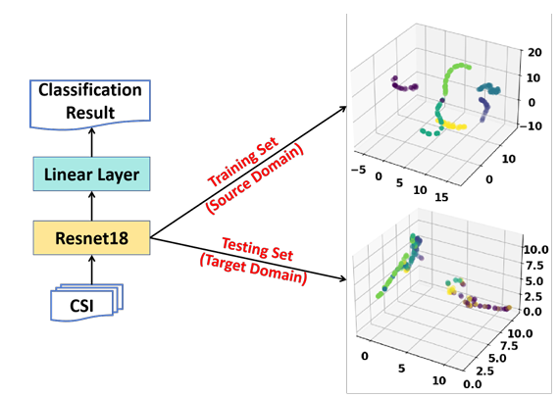
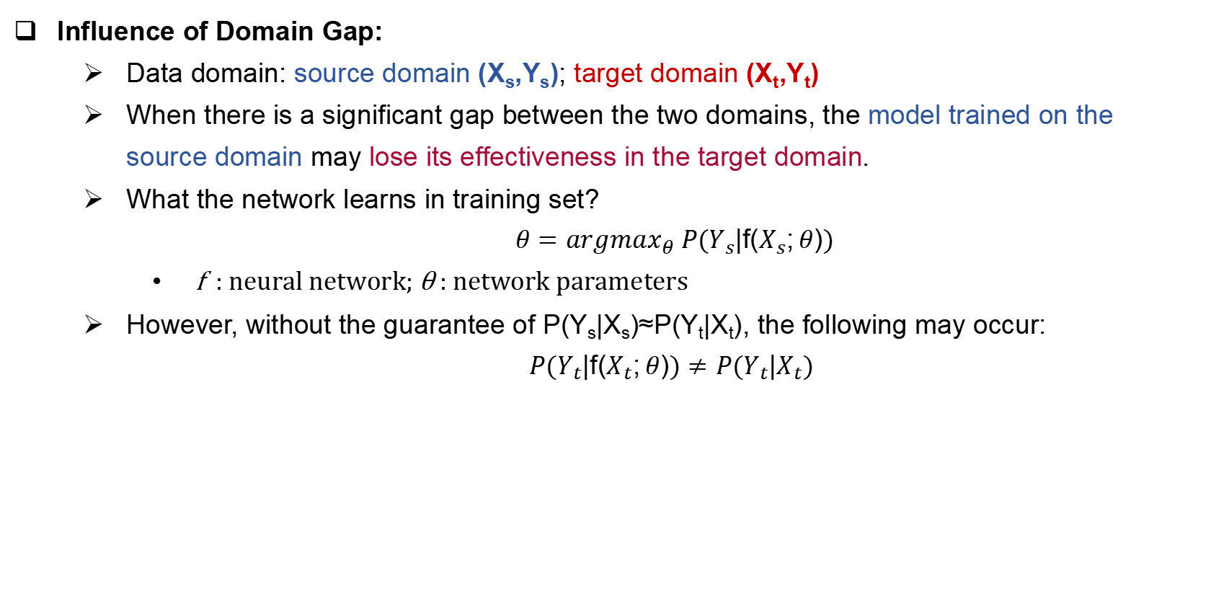
Background: Cross Domain Challenge
Influence of Domain Gap:
Data domain: source domain (X_{s},Y_{s}); target domain (X_{t},Y_{t})
When there is a significant gap between the two domains, the model trained on the source domain may lose its effectiveness in the target domain.
What the network learns in training set?
$$θ={argmax}_{θ} P(Y_{s}|f(X_{s};θ))$$
f : neural network; θ : network parameters
However, without the guarantee of P(Y_{s}|X_{s})≈P(Y_{t}|X_{t}), the following may occur:
$$P(Y_{t}|f(X_{t};θ))≠P(Y_{t}|X_{t})$$

Slide 4
Background: Cross Domain Challenge
Few-Shot Scenaio:
Practical factors:
Labeling data can be costly.
Collecting data is relative easy.
Available data during training:
 | Domain | Amount | Label
Training Set | source | suffieicnt | √
Support Set | target | limited | √
Testing Set | target | sufficient | ×

Slide 5
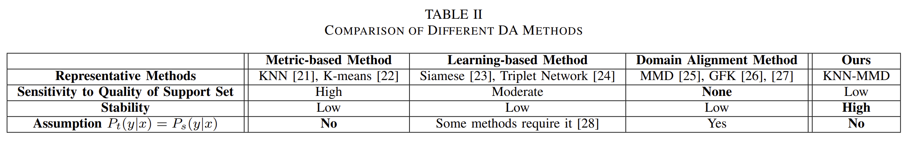
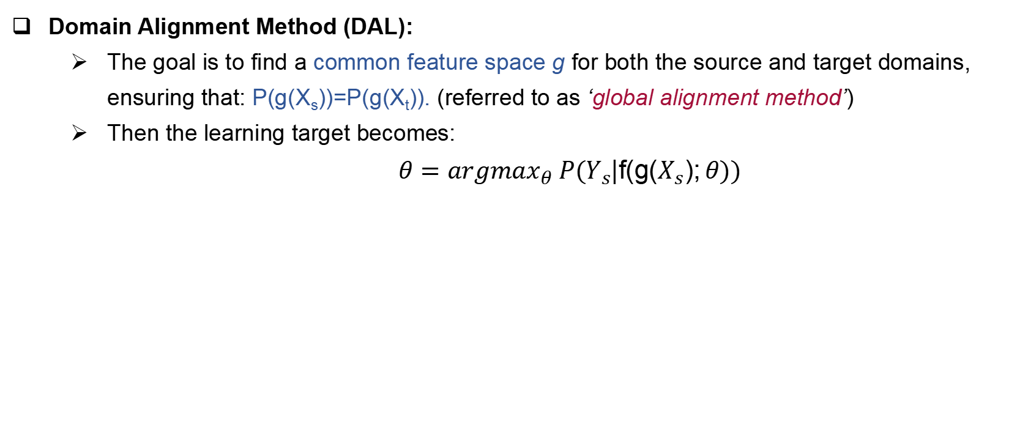
Background: Previous Domain Adaptation (DA) Methods
Domain Alignment Method (DAL):
The goal is to find a common feature space g for both the source and target domains, ensuring that: P(g(X_{s}))=P(g(X_{t})). (referred to as ‘global alignment method’)
Then the learning target becomes:
$$θ={argmax}_{θ} P(Y_{s}|f(g(X_{s});θ))$$

Slide 6
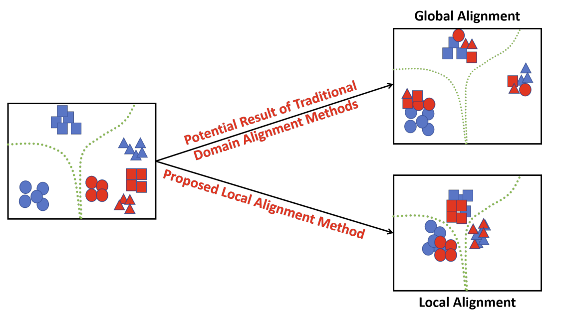
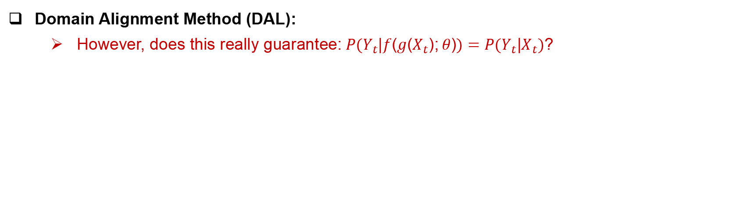
Background: Previous Domain Adaptation (DA) Methods
Domain Alignment Method (DAL):
However, does this really guarantee:$P(Y_{t}|f(g(X_{t});θ))=P(Y_{t}|X_{t})$?

Slide 7
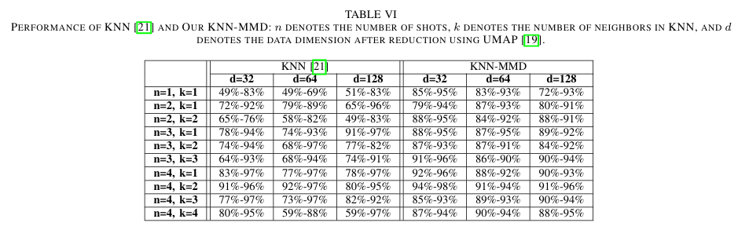
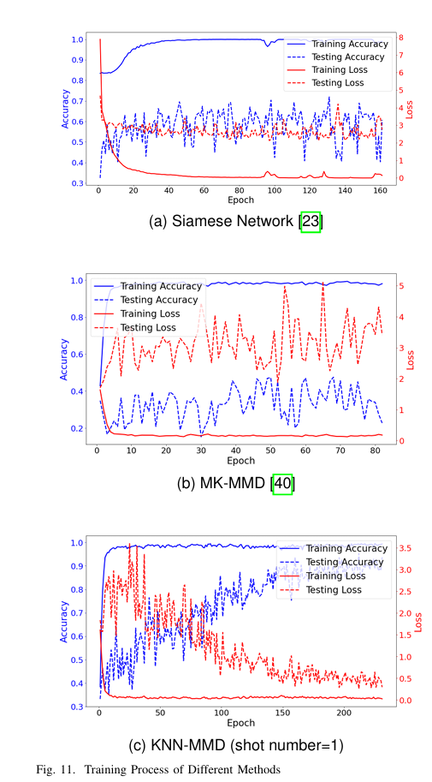
Background: Previous Domain Adaptation (DA) Methods
Metric-based Methods: rely on the quality of the support set
Learning-based Methods: experience an unstable training process.

Slide 8
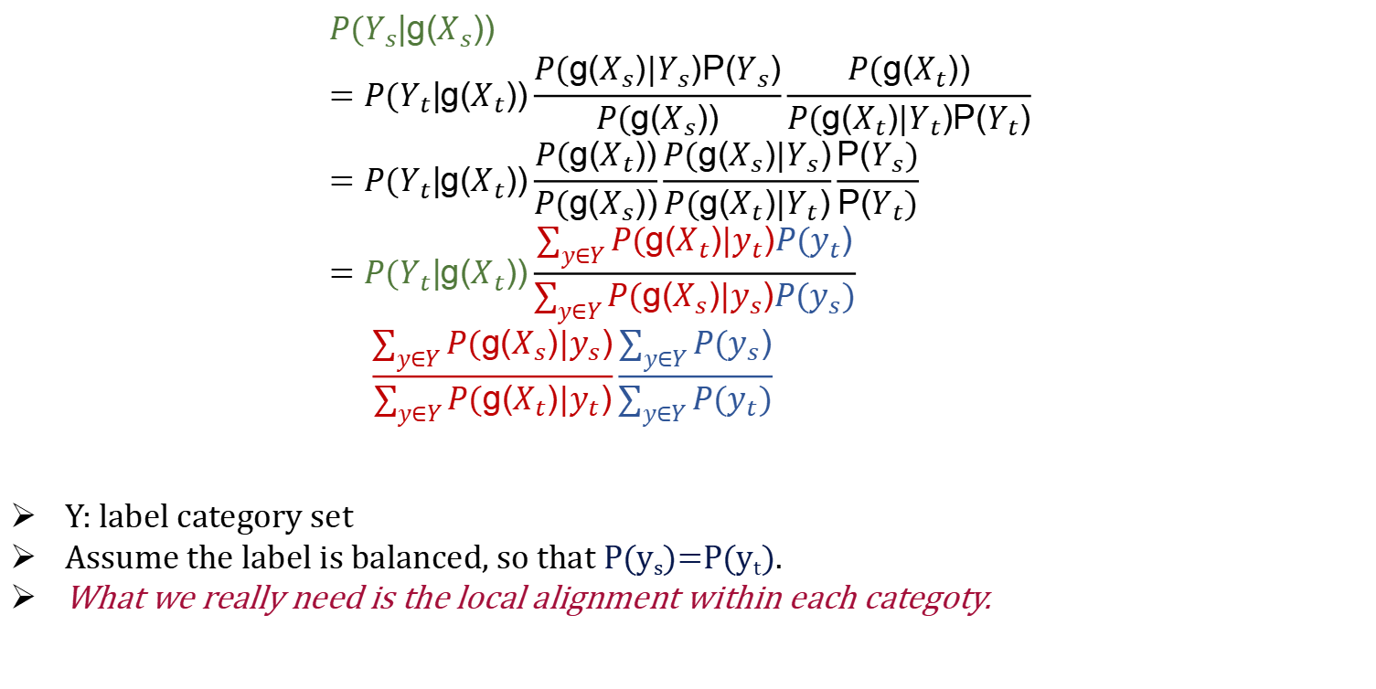
Principle of Local Alignment: From Bayes’ Rules
$$P(Y_{s}|g(X_{s})) \\ =P(Y_{t}|g(X_{t}))\frac{P(g(X_{s}){|Y}_{s})P(Y_{s})}{P(g(X_{s}))}\frac{P(g(X_{t}))}{P(g(X_{t}){|Y}_{t})P(Y_{t})} \\ =P(Y_{t}|g(X_{t}))\frac{P(g(X_{t}))}{P(g(X_{s}))}\frac{P(g(X_{s}){|Y}_{s})}{P(g(X_{t}){|Y}_{t})}\frac{P(Y_{s})}{P(Y_{t})} \\ =P(Y_{t}|g(X_{t}))\frac{\sum_{y∈Y}{P(g(X_{t}){|y}_{t})P(y_{t})}}{\sum_{y∈Y}{P(g(X_{s}){|y}_{s})P(y_{s})}} \\ \frac{\sum_{y∈Y}{P(g(X_{s}){|y}_{s})}}{\sum_{y∈Y}{P(g(X_{t}){|y}_{t})}}\frac{\sum_{y∈Y}{P(y_{s})}}{\sum_{y∈Y}{P(y_{t})}}$$
Y: label category set
Assume the label is balanced, so that P(y_{s})=P(y_{t}).
What we really need is the local alignment within each categoty.

Slide 9
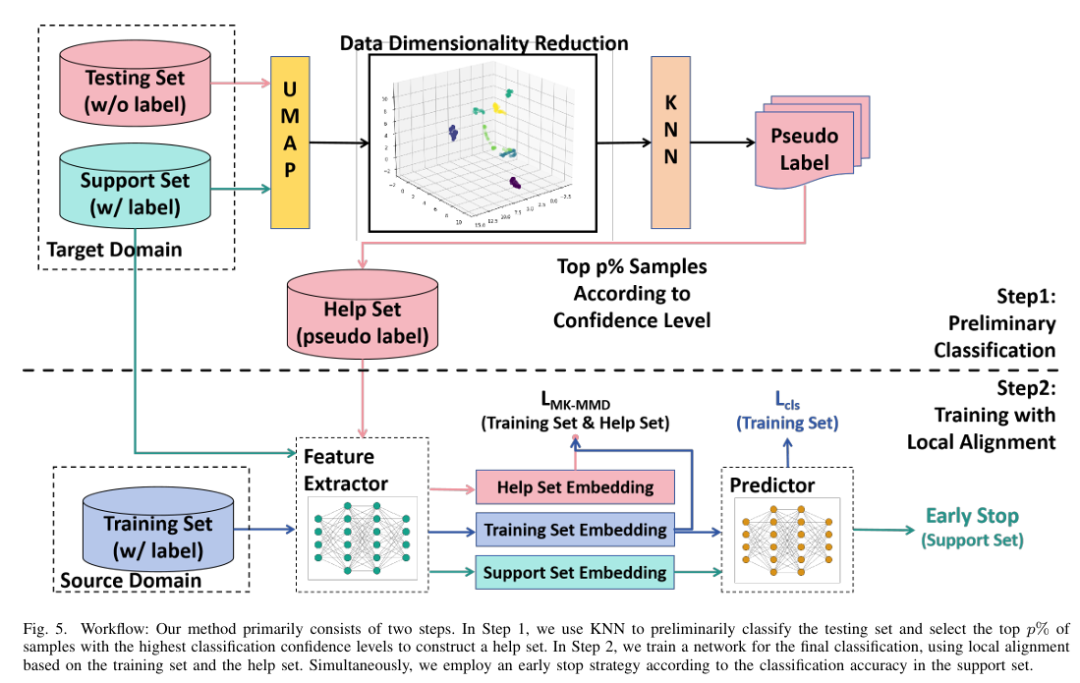
Workflow
How to Achieve Local Alignment:
generate pseudo labels for the testing set
align training set and testing set within each category using MK-MMD
How to Overcome the High Dependence to Support Set Quality:
construct the help set according to confidence levels
How to Identify When to Stop the Training:
exclude the support set during training and use it as valid set

Slide 10
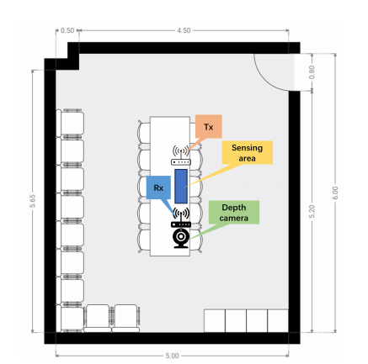
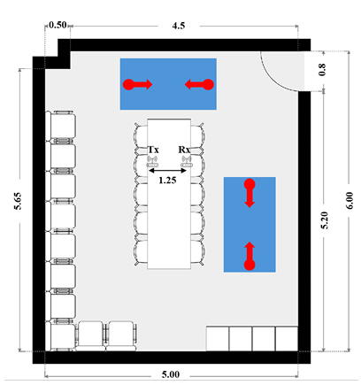
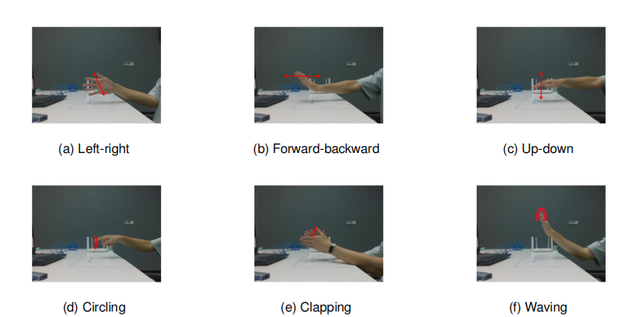
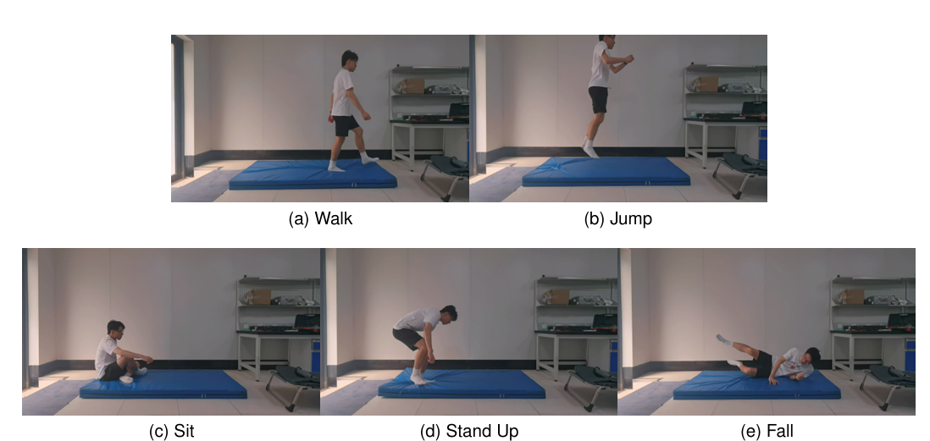
Experiment Datasets
WiGesture
WiFall
6 gestures
8 volunteers
task:
gesture recognition
person identification
5 actions
10 volunteers
task:
action recognition
fall detection

Slide 11
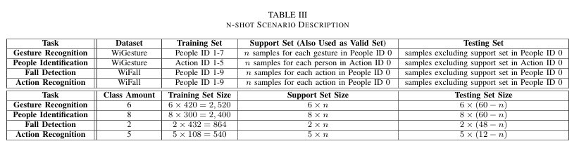
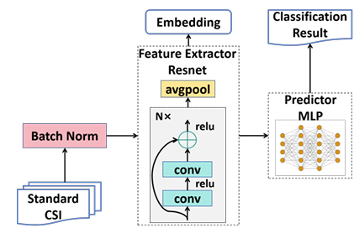
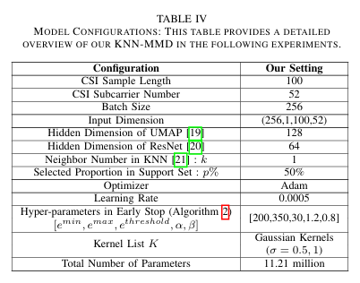
Experiment Setup
Dataset Split Method:
Configurations Setup:

Slide 12
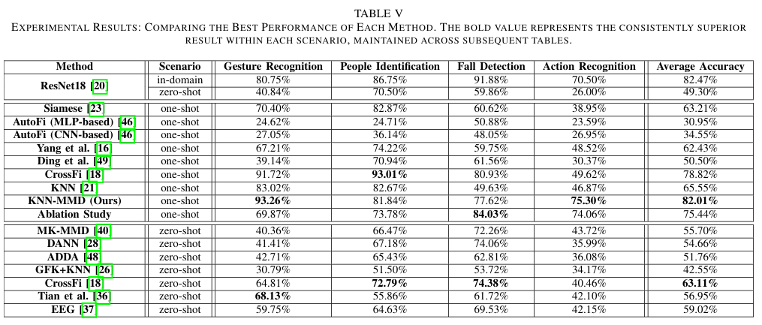
Experiment Results
One-Shot Scenario:

Slide 13
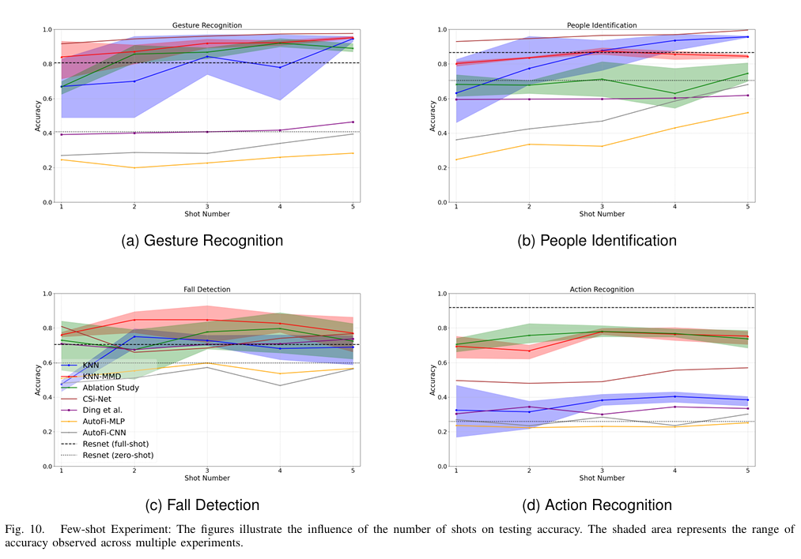
Experiment Results
Few-Shot Scenario:

Slide 14
Thanks for your attention!
Presented by Zijian Zhao

Slide 15
References
WiGesture Dataset:
Zhao Z, Chen T, Meng F, et al. Finding the missing data: A bert-inspired approach against package loss in wireless sensing[C]//IEEE INFOCOM 2024-IEEE Conference on Computer Communications Workshops (INFOCOM WKSHPS). IEEE, 2024: 1-6.
WiFall Dataset (Expanded Version):
Zhao Z, Cai Z, Chen T, et al. KNN-MMD: Cross Domain Wireless Sensing via Local Distribution Alignment[J]. arXiv preprint arXiv:2412.04783, 2024.
CrossFi:
Zhao Z, Chen T, Cai Z, et al. Crossfi: A cross domain wi-fi sensing framework based on siamese network[J]. IEEE Internet of Things Journal, 2025.

