Slide 1
Let Network Decide What to Learn: Symbolic Music Understanding Model Based on Large-scale Adversarial Pre-training
Notes:
Good morning. My name is Zijian Zhao and I’m a undergraduate student from Shenzhen Research Institute of Big Data, and Sun Yat-sen University. I am honored to be able to talk about one of our recent works, titled Finding the Missing Data: A BERT-inspired Approach Against Package Loss in Wireless Sensing. I’d like to begin with the background of wireless sensing.

Slide 2
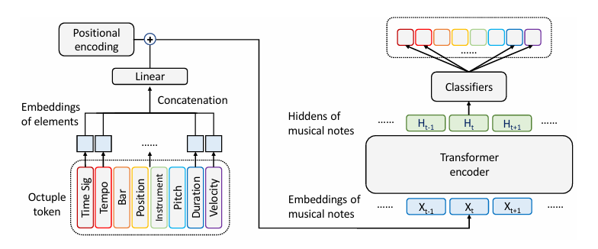
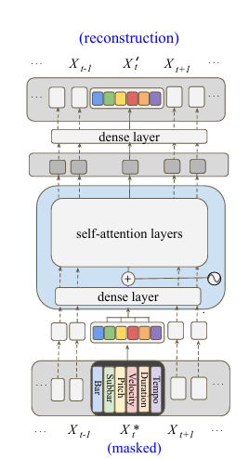
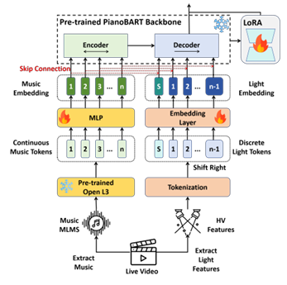
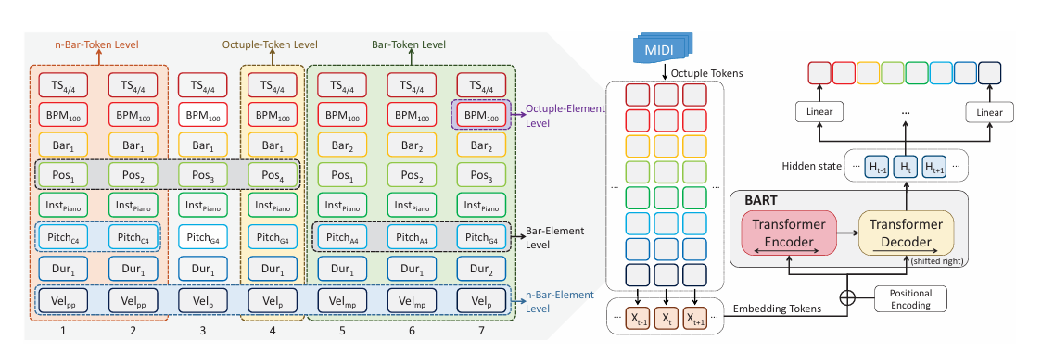
Backgrounds
Mask Language Model (MLM) in
Music Information Retrieval (MIR)
MusicBERT
MidiBERT
Skip-BART
PianoBART
Adversarial Midi-BERT
Zijian Zhao, SYSU, HKUST
Notes:
As a significant technology in ISAC, wireless sensing has gained widespread application in various settings such as homes, offices, and public spaces. Its potential applications include fall detection, indoor location tracking, and gesture recognition, among others. While this technology may not be as mature as other modalities like vision, it possesses its own set of advantages, including wide coverage, affordability, penetration ability, immunity to lighting conditions, and privacy protection. For instance, in the context of elderly care, cameras pose risks of privacy breaches and may struggle to operate in low-light environments. However, wireless sensing can address these issues effectively. Furthermore, it only requires a home Wi-Fi network without the need for additional devices.

Slide 3
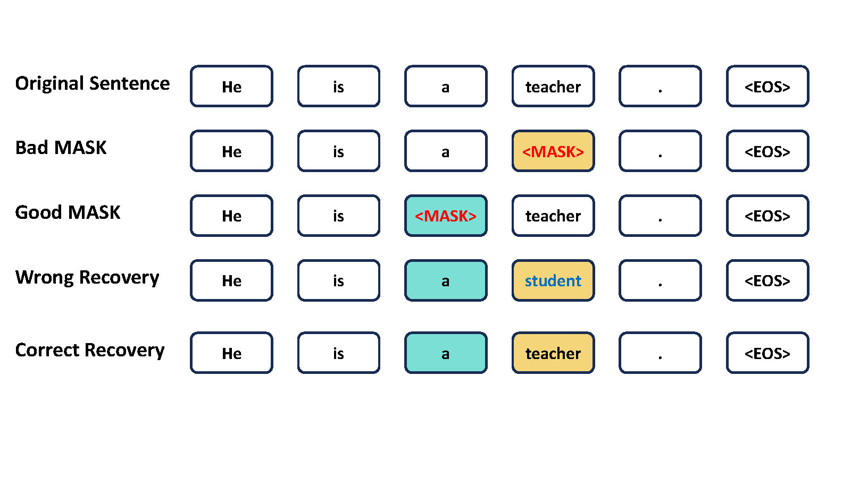
Backgrounds
Bias in Mask Language Model (MLM)
Take Natural Language as an Example
In music, we aim for the model to learn common musical structures, relationships, and regularities—such as basic modes, riff patterns, and modulation techniques—rather than developing habits specific to particular composers.
Not all tokens can be recovered from context!
Adversarial Midi-BERT
Zijian Zhao, SYSU, HKUST
Notes:
As a significant technology in ISAC, wireless sensing has gained widespread application in various settings such as homes, offices, and public spaces. Its potential applications include fall detection, indoor location tracking, and gesture recognition, among others. While this technology may not be as mature as other modalities like vision, it possesses its own set of advantages, including wide coverage, affordability, penetration ability, immunity to lighting conditions, and privacy protection. For instance, in the context of elderly care, cameras pose risks of privacy breaches and may struggle to operate in low-light environments. However, wireless sensing can address these issues effectively. Furthermore, it only requires a home Wi-Fi network without the need for additional devices.

Slide 4
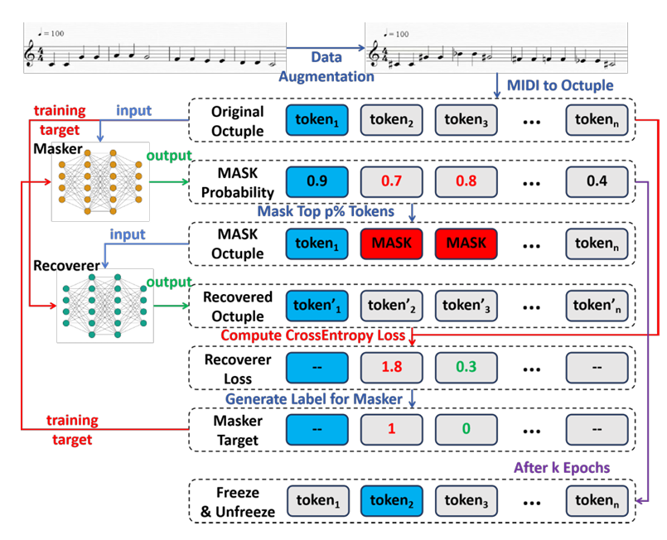
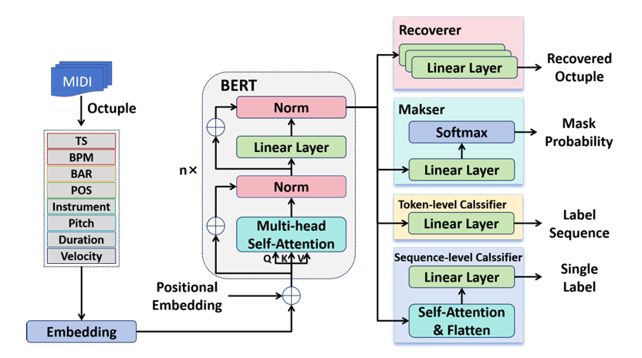
Proposed Method
Workflow
Network Architecture
Take Natural Language as an Example
Adversarial Midi-BERT
Zijian Zhao, SYSU, HKUST
Notes:
As a significant technology in ISAC, wireless sensing has gained widespread application in various settings such as homes, offices, and public spaces. Its potential applications include fall detection, indoor location tracking, and gesture recognition, among others. While this technology may not be as mature as other modalities like vision, it possesses its own set of advantages, including wide coverage, affordability, penetration ability, immunity to lighting conditions, and privacy protection. For instance, in the context of elderly care, cameras pose risks of privacy breaches and may struggle to operate in low-light environments. However, wireless sensing can address these issues effectively. Furthermore, it only requires a home Wi-Fi network without the need for additional devices.

Slide 5
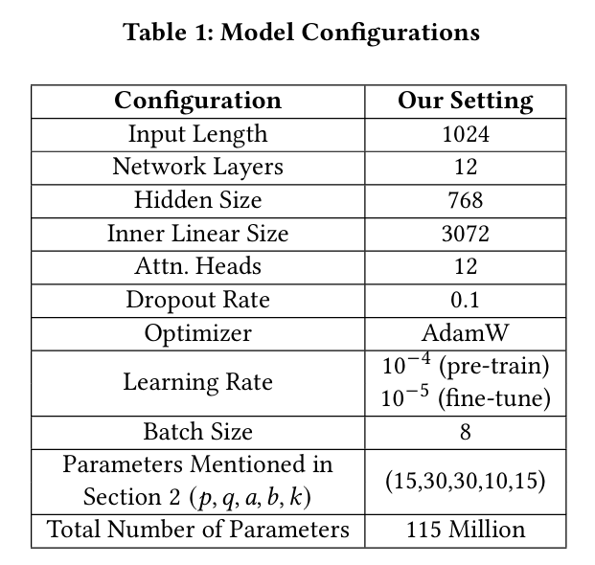
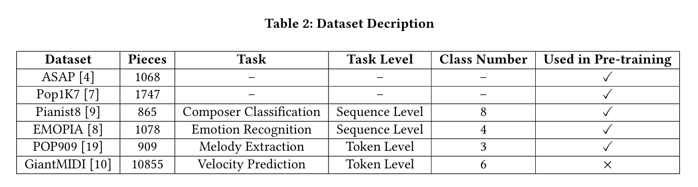
Experiment
Experiment Steup
Adversarial Midi-BERT
Zijian Zhao, SYSU, HKUST
Notes:
As a significant technology in ISAC, wireless sensing has gained widespread application in various settings such as homes, offices, and public spaces. Its potential applications include fall detection, indoor location tracking, and gesture recognition, among others. While this technology may not be as mature as other modalities like vision, it possesses its own set of advantages, including wide coverage, affordability, penetration ability, immunity to lighting conditions, and privacy protection. For instance, in the context of elderly care, cameras pose risks of privacy breaches and may struggle to operate in low-light environments. However, wireless sensing can address these issues effectively. Furthermore, it only requires a home Wi-Fi network without the need for additional devices.

Slide 6
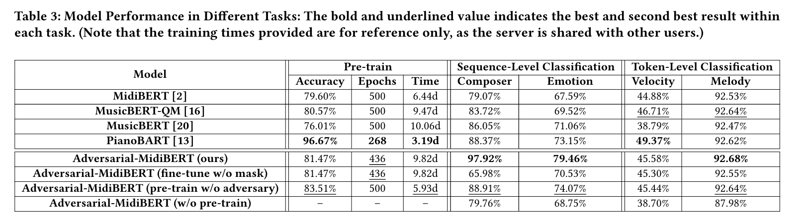
Experiment
Experiment Result
Adversarial Midi-BERT
Zijian Zhao, SYSU, HKUST
Notes:
As a significant technology in ISAC, wireless sensing has gained widespread application in various settings such as homes, offices, and public spaces. Its potential applications include fall detection, indoor location tracking, and gesture recognition, among others. While this technology may not be as mature as other modalities like vision, it possesses its own set of advantages, including wide coverage, affordability, penetration ability, immunity to lighting conditions, and privacy protection. For instance, in the context of elderly care, cameras pose risks of privacy breaches and may struggle to operate in low-light environments. However, wireless sensing can address these issues effectively. Furthermore, it only requires a home Wi-Fi network without the need for additional devices.

Slide 7
Thanks!
zhaozj28@mail2.sysu.edu.cn
Adversarial Midi-BERT
Zijian Zhao, SYSU, HKUST
Notes:
I would like to give a summary of our work here. Our work focuses on the problem of package loss in Wi-Fi sensing. We introduced CSI-BERT, which is the first model specifically designed for CSI recovery. Our model also proposes a novel approach that incorporates NLP methods into signal processing. Through extensive experimentation, we have observed that CSI-BERT achieves exceptional performance in CSI recovery. The data recovered by CSI significantly enhances the performance of other CSI sensing models. Furthermore, its self-supervised training method and fast recovery speed make it well-suited for real-time systems.
That concludes my presentation. Thank you for your attention. Do you have any questions?

