Slide 1
K-Means Clustering

Slide 2

Unsupervised Learning
Many times we want to group data points together that are similar looking/behaving
Customer behavior
Music listening/movie watching behavior
Unsupervised learning is used when you don’t have a training set of labeled outputs (i.e., you don’t know which group each member falls into)
Need to look for grouping or patterns in the data

Slide 3
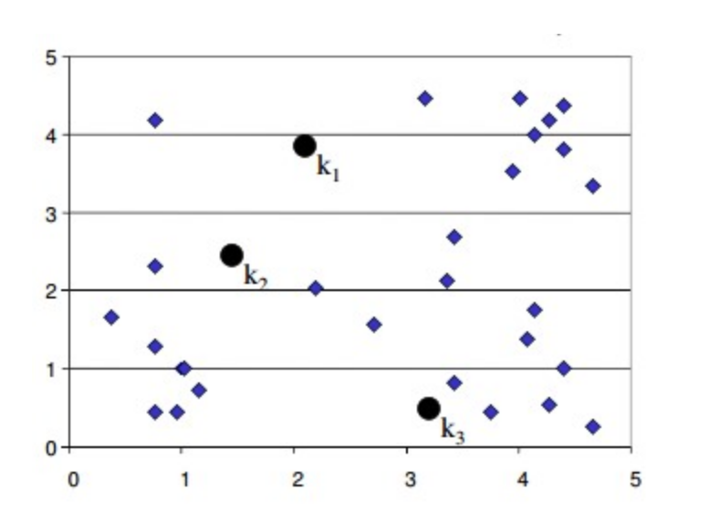
K-Means Clustering: Step 1
First, you guess how many clusters there are in the data
Then you guess the first set of cluster centers (k₁, k₂, k₃)

Slide 4
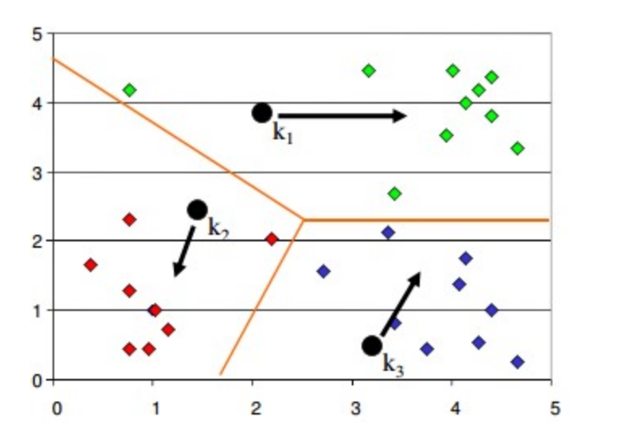
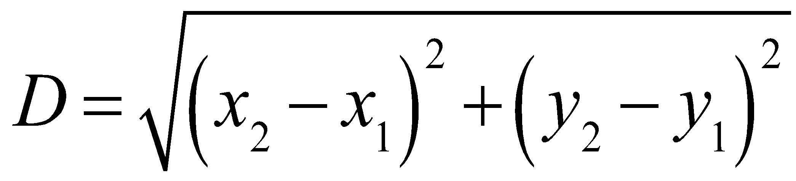
K-Means Clustering: Step 2
Group the data points by which cluster center is closest
Usually use Euclidean distance
Shift the cluster center to the mean location of the group of data points in each cluster

Slide 5
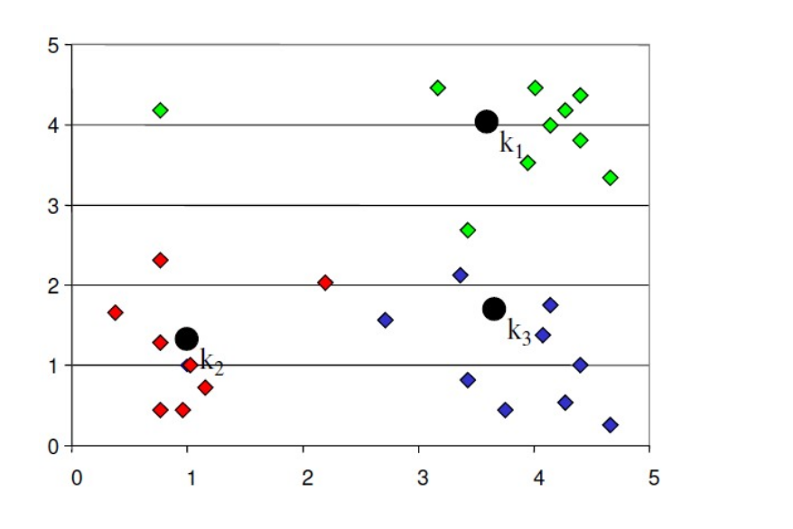
K-Means Clustering: Step 3
New cluster centers are shown to the right after shift to mean location
Process is repeated back to Step 2
Clustering process stops when there is no change in membership of each cluster

Slide 6
Example
https://www.naftaliharris.com/blog/visualizing-k-means-clustering/

Slide 7
Initial Cluster Centers
The k-means algorithm can be sensitive to the initial cluster center values. Therefore, k-means is often run multiple times with different initial cluster values and the best result is kept.
In the sklearn implementation of k-means, the n_init parameter controls the number of times the k-means algorithm will be run with different centroid seeds. By default, this value is set to 10.

Slide 8
Pros & Cons
Pros
Cons
Easy to implement and understand
Scales easily to large data sets
Works well with spherical clusters
Efficient
Have to choose k manually. Results sensitive to k.
Dependent on initial centroid values.
Doesn’t work well with clusters of varying sizes
Doesn’t work well with clusters of unusual shapes

Slide 9
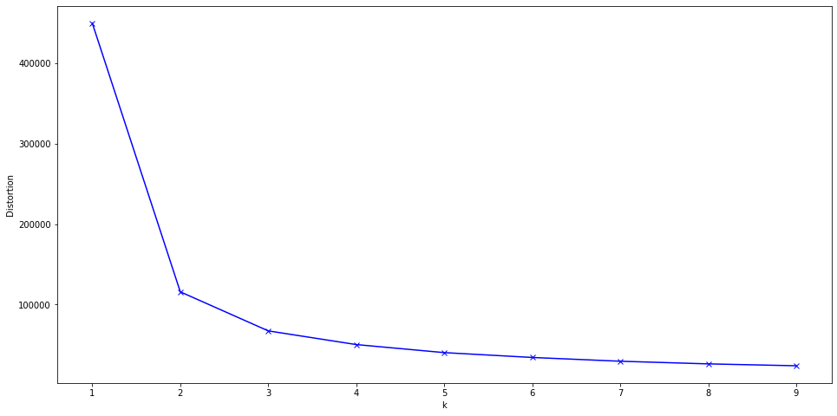
Choosing K
When k is small, all points will belong to the same cluster. When k is large, all points will belong to their own clusters. Therefore, there is a “sweet spot” value of k.
The most common way of choosing k is using the elbow method. Run k-means for a range of k values and calculate the distortion. Choose the value of k that falls in the “elbow”.
Elbow

Slide 10
What is Distortion?
Distortion is simply the within-cluster sum of squared error:
For each cluster, find the distance between each point and the centroid.
Square the distance and sum it.
Then sum the squared error across all clusters.

