Slide 1
DBSCAN Clustering

Slide 2
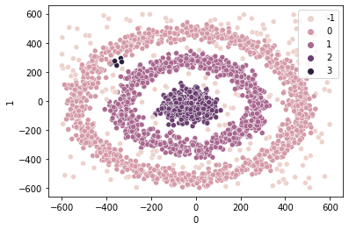
DBSCAN Overview
DBSCAN ( Density-Based Spatial Clustering of Applications with Noise) is a clustering algorithm that works by looking for densely grouped data.
It assumes that clusters are dense regions separated by regions of lower density.
DBSCAN is very efficient in finding non-spherical shapes.

Slide 3
DBSCAN Parameters
The DBSCAN algorithm uses two parameters:
minPts: The minimum number of points clustered together for a region to be considered dense.
eps (ε): A distance measure used to locate the points in the neighborhood of any point.
eps
If minPts = 4, this region would be considered dense

Slide 4
DBSCAN Process
User specifies minPts and eps.
An initial point is selected at random and it is determined whether the point is a core point, border point or noise point.
If it is a core point, all points within the neighborhood of that point become a part of its cluster. If the new points are also core points, their neighbors also join the cluster.
A next point that hasn’t been visited yet is randomly chosen and the same process takes place.
The algorithm is finished when all points have been visited.
Core Point - a point that has at least minPts number of points in neighborhood
Border Point - a point that has >0 but <minPts in neighborhood
Noise Point - a point that has no points in neighborhood

Slide 5
Example
https://www.naftaliharris.com/blog/visualizing-dbscan-clustering/

Slide 6
DBSCAN vs K-Means
DBSCAN does not require that you specify the number of clusters beforehand.
DBSCAN is sensitive to its two parameters.
K-means works well for spherical clusters. DBSCAN works well for non-spherical clusters.
K-means requires that all points be assigned to a cluster. DBSCAN will assign some points as being “noise”.

